Slide 1
Color Palettes 101
How to import DIV’s suggested color palettes for Microsoft Office (currently not applicable for Macs)

Slide 2
What to Avoid

Slide 3
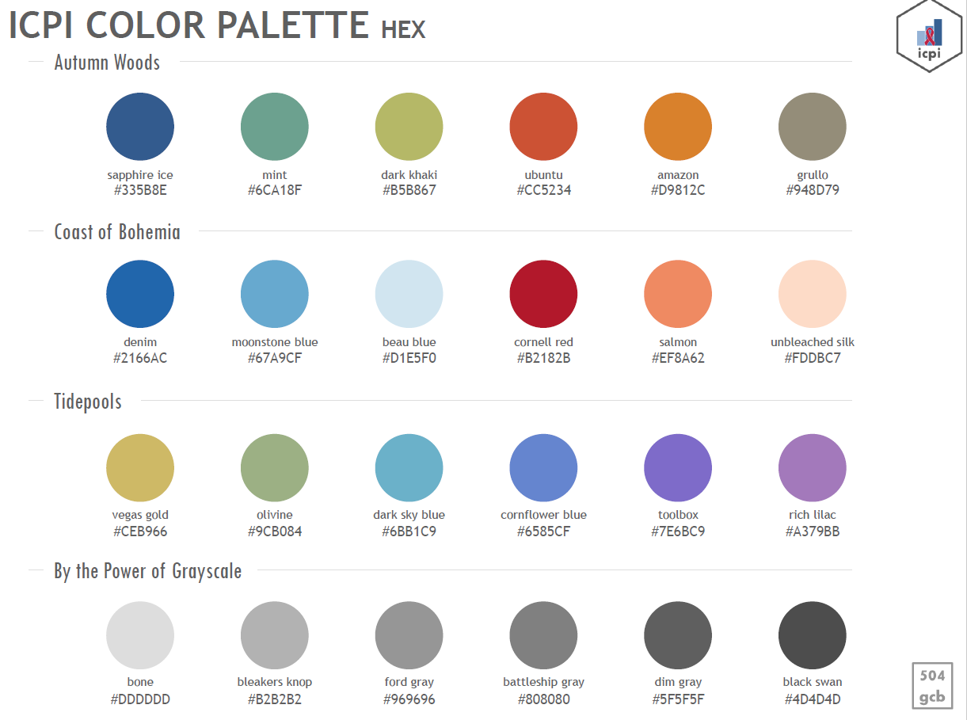

Slide 4
How Do I Import the Palettes?!
Instructions only for PC at the moment, not Mac
Files are in two locations:
Sharepoint: https://www.pepfar.net/OGAC-HQ/icpi/_layouts/15/listform.aspx?PageType=4&ListId=%7BA9595CFC%2D8102%2D4871%2DAD9E%2DDF2D795F554E%7D&ID=6&ContentTypeID=0x01040008DDF174B4574743B59747755D6ABA13
GitHub: https://github.com/ICPI/DIV/tree/master/Color_Palettes

Slide 5
1) Navigate to site page
2) Click zip file

Slide 6
3) Click “View Raw”
to download file

Slide 7
4) Right click “Extract All”
5) Choose destination for extracted files

Slide 8
Extracted files
6) Right click on left directory and open a new window
7) Paste & go to this address into Microsoft Explorer bar (replace “[yourusername]” with your username)

Slide 9
7) Go back to window with extracted palettes and select all files in folder
8) Right click
9) Select “Copy”

Slide 10
10) Paste palettes into the “Theme Colors” folder
11) Close out of Excel/Word/PowerPoint and reopen one of the programs to see the color palettes in action!

Slide 11
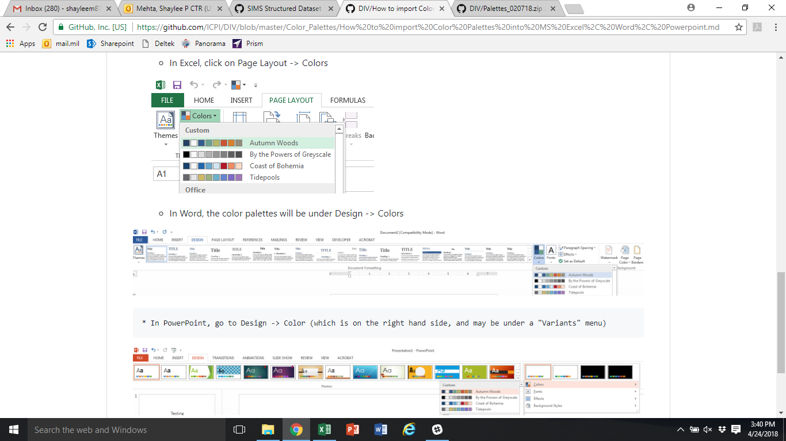
You can find the location of the new custom color palettes located in the different MS products

Slide 12
These slides were powered by the Tidepools color palette.

