Slide 1


Denominators Workgroup
August 12th, 2019
Monthly Meeting

Slide 2
Agenda
Logistics - Github Repo
LEIA model update – Roma and Imram
Population sources model update – Roma
YODA model update

Slide 3
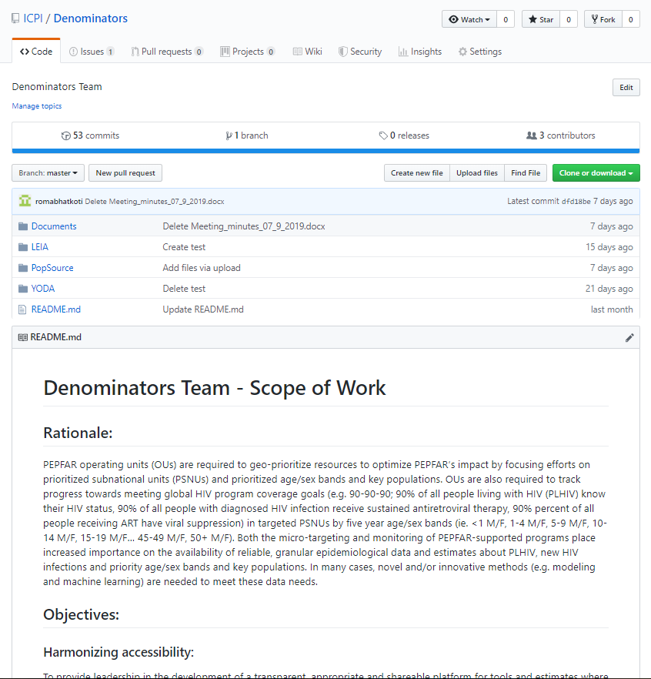
Logistics - Denominators Github Repository
https://github.com/ICPI/Denominators

Slide 4
Linkage Event Identification Algorithm model update (LEIA_1) – Roma and Imram
Roma and Imran

Slide 5
LEIA_2 and LEIA_3
LEIA_2
Running LEIA_1 for age and sex stratification. The heat and spider maps are generated using leaflet.
LEIA_3
Treating each testing site as the home base for each individual rather than assigning each individual to a random point in the SNU2.
Considering distance between each testing site when determining the assignment of new ART initiates.
First pass: using the straight line distance. Later: using openstreetmap data to determine actual driving distance between sites.
Setting the radius, for determining neighbors, based on the density of testing sites. The radius would decrease in areas with many nearby testing sites; whereas, it would increase in sparsely populated areas.
Spatial sampling of individuals, to account for non-populated areas such as lakes and rivers in the sampling process.

Slide 6
Population sources model – Roma
PLHIV estimation (using spreadsheet disaggregation method) requires subnational population numbers
Primary source subnational population – actual census counts published by the various countries
Issues with using census counts for PLHIV estimation
frequency
data gaps
reliability
Solution – provide population alternatives to census counts for countries.

Slide 7
Population sources model – Roma
Potential Population Sources –
WorldPop - https://www.worldpop.org/
landScan - https://landscan.ornl.gov/
Facebook - https://data.humdata.org/organization/facebook
Gridded Population of the World (GPW) - https://sedac.ciesin.columbia.edu/data/collection/gpw-v4
GHS POP - https://ghsl.jrc.ec.europa.eu/ghs_pop2019.php
Global Rural-Urban Mapping Project (GRUMP) - https://sedac.ciesin.columbia.edu/data/collection/grump-v1
ArcGIS Living Atlas of the World - https://livingatlas.arcgis.com/en/browse/#d=2&q=World%20Population%20Estimate
US Census Subnational Population by Sex, Age, and Geographic Area - https://www.census.gov/geographies/mapping-files/time-series/demo/international-programs/subnationalpopulation.html?

Slide 8
Method
Using Rasterized Population Data
Connect to the publically available population database such as WorldPop, a High spatial resolution, contemporary data on human population.
Use publically available R packages to gather iso3 names (identifiers for countries) for PEPFAR countries from WorldPop FTP.
Developed R script to download individual (PEPFAR) countries population raster datasets for the most recent years from WorldPop FTP.
Download PEPFAR subnational shape files from ArcGIS online.
Developed R script to run zonal statistics for PEPFAR subnational units (which means calculating subnational population for PEPFAR countries).
This method is generalizable for all population data available in rasterized form.
Import the subnational populations into PAW.

Slide 9
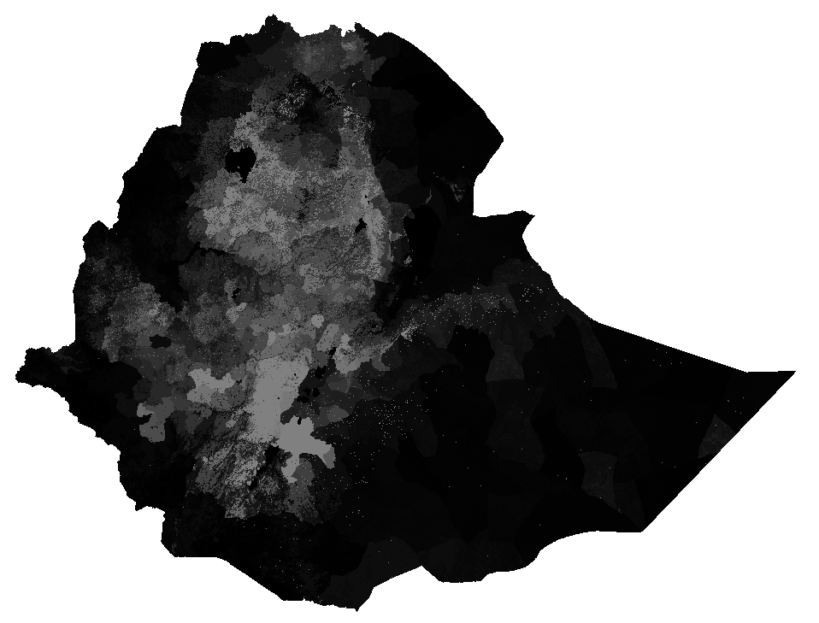
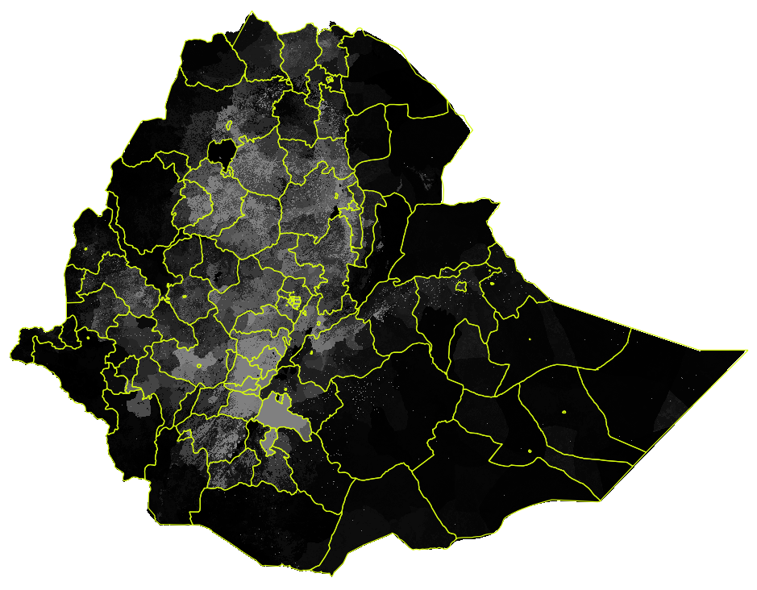
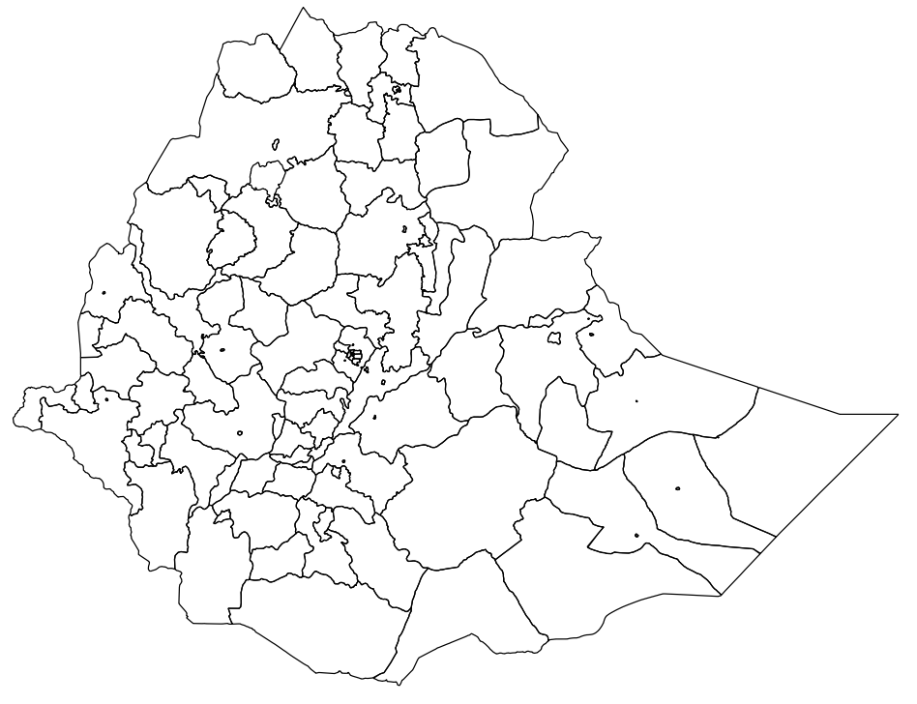
raster
Calculate Zonal Statistics – sum the raster values lying within each polygon
https://www.worldpop.org/
API Connection
+
https://www.cdcarcgis/maps/arcgis.com/
API Connection
polygon

Slide 10
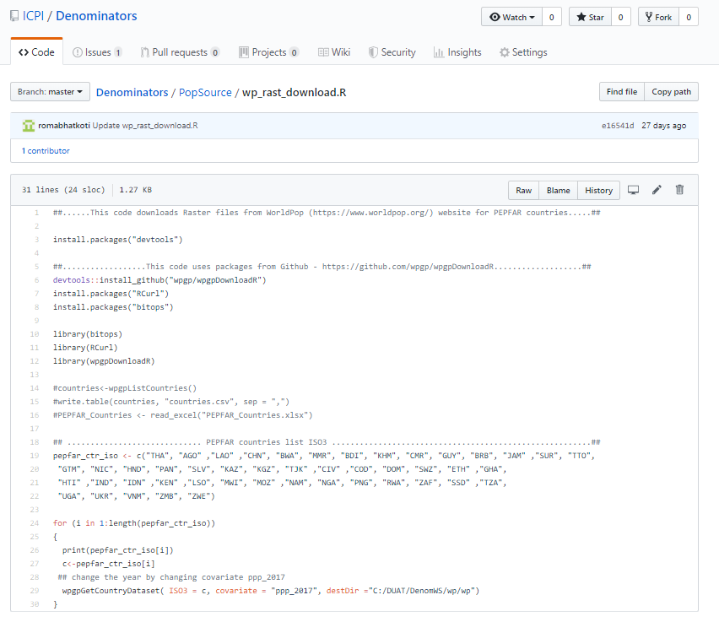
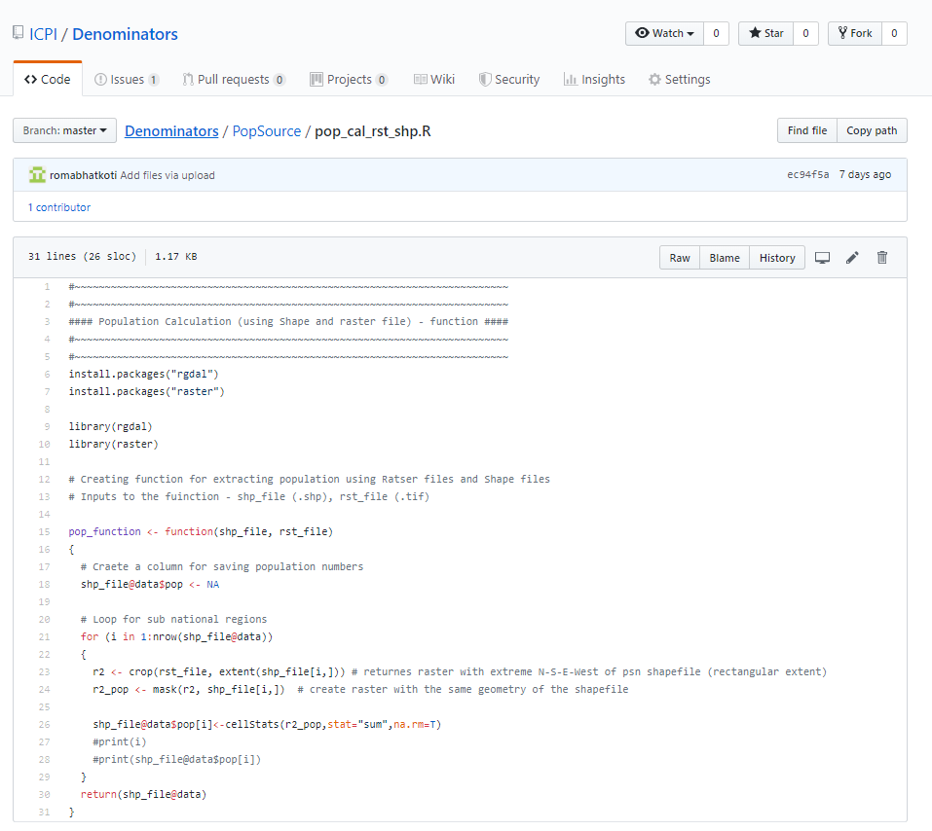
Update
https://github.com/ICPI/Denominators/tree/master/PopSource
Achievements
Code to download Rasters has been uploaded on GitHub - wp_rast_download.R
Code to calculating populations by overlaying PEPFAR shapefiles with Raster has been uploaded on GitHub - pop_cal_rst_shp.R.
Ratser data is already in AWS
PEPFAR files already is AWS (?)
Next Steps
Run the R code on AWS with all PEPFAR shapefiles and Rasters.

Slide 11
Collaboration with UNAIDS Reference Group on Estimates, Modelling and Projections
Review sources to recommend best ‘default’ source for population inputs by SNU2 / age / sex.
Be able to provide countries with documentation for basic methodologies and specific data sources that were used for population inputs (e.g. which censuses, at what level of stratification.)
Record any country-specific challenges or discrepancies that should be considered by country teams when creating their estimates.

Slide 12
YODA model update
The Nigeria program improvement activity is underway in three states.
A total of 18 sites were identified across three main categories of sites, e.g., low yield sites, high yield sites, and sites with upward trending yield sites.
The YODA model was run nationally using MER data.
The 18 sites included in the program improvement activity were provided updated testing allocations by age, sex, and modality based on YODA’s optimization procedure.

