Slide 1
Linkage Event Identification Algorithm (LEIA)
Agent Based Model (ABM) simulating presumed patient movement between PEPFAR supported sites to understand where patients are seeking treatment after being tested positive.

Slide 2
Objectives
Analysis of patient movement across facilities using facility testing and treatment numbers and the simulated spatial location of patients in relation to the treatment facilities within their spatial neighborhood.
To identify where newly identified HIV positive persons (HTS_TST_POS) receive treatment (TX_NEW); to identify sites with the largest treatment gaps (i.e., newly identified HIV positive persons who are not linked to care); and to identify potential bottlenecks to treatment by analyzing patient flow from sites (facilities or commune) with the largest treatment gaps to neighboring sites.
Adjusted ART coverage (and gap) at district level based on surrounding patient flux

Slide 3
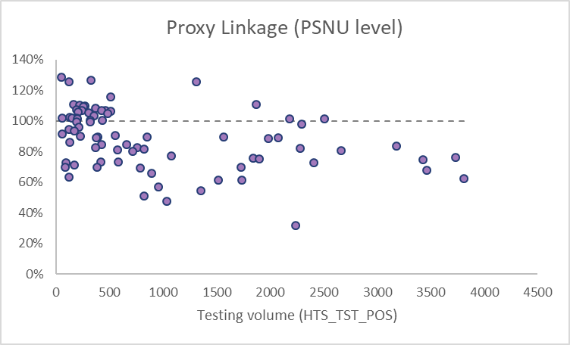
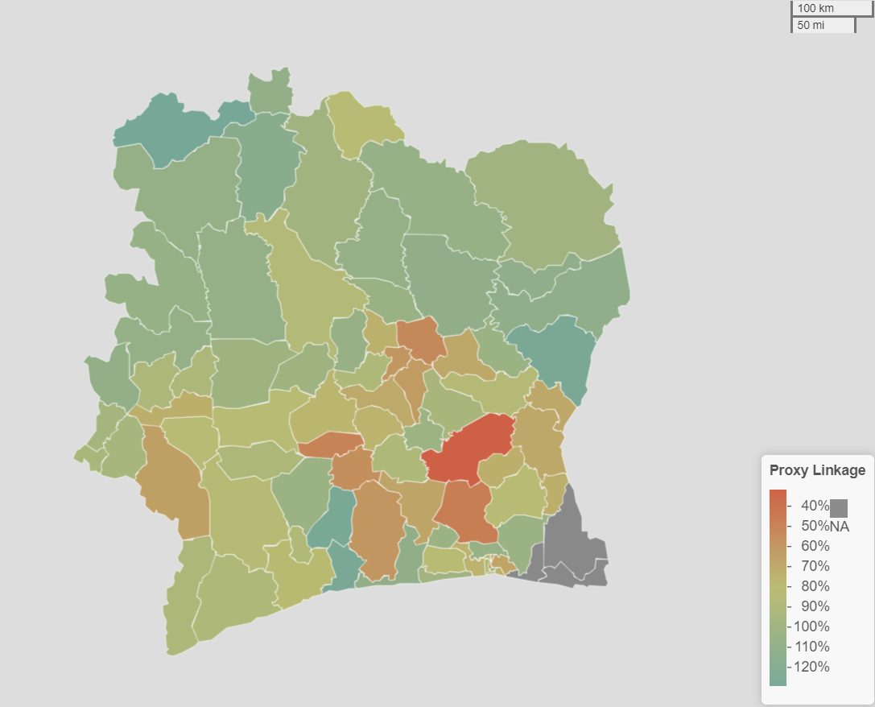
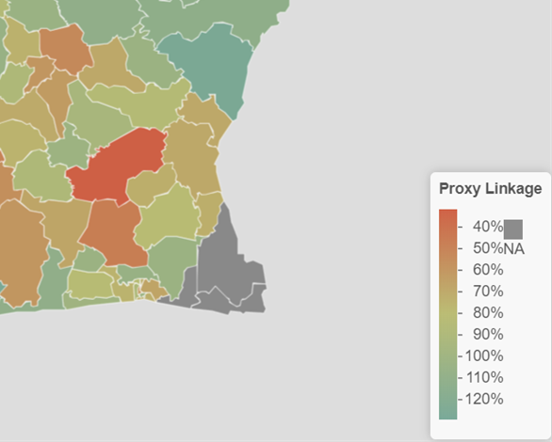
Background
Current proxy linkage estimate (TX_NEW/HTS_TST_POS) doesn’t account for patients testing at one site, and getting treatment at another.
Proxy linkage of greater than 100% seen at large treatment sites, and zero at community sites, and very small for predominantly testing sites.
No way of assessing community linkage, as proxy linkage is always zero!

Slide 4





Background: Treatment Choice
Choice for treatment after testing positive

Slide 5
Methodology: Assumptions
TX_NEW are newly identified HIV positive patients put on treatment.
Assigned: Individuals who tested as HIV positive either at facility or community site (HTS_TST_POS) that linked to treatment at a treatment facility.
Unassigned: Individuals who tested as HIV positive, but did not get linked.
Patients are assumed to be assigned to the sites they were tested as their first choice (except for community sites).
Patients are assumed to be randomly distributed within a predefined radius around the site where they were tested. The splay radius was defined considering that patients may seek treatment far from where they live to escape stigma, but not too far that it’s arduous to travel there.
Patients are assumed to receive treatment services at the nearest site if they don’t get assigned to the site where they were tested. Although the decision on where to receive treatment has many potential determinants such as referrals by hospital personnel, size of the facility, number of HRH workers, but in the absence of any concrete data to model decision making behavior, patients are assumed to choose where to receive treatment based on distance.

Slide 6

Methodology: Agent Based Model
Dynamic agent-based spatial analysis was used to simulate where patients seek treatment after being testing positive at a site.
Agents (simulated patients) were created at each site based on the HTS_TST_POS number. E.g if a site has 20 patients who tested positive, we’d create 20 agents.
Agents have no volition of their own, but their treatment choice is governed by assignment rules.

Slide 7
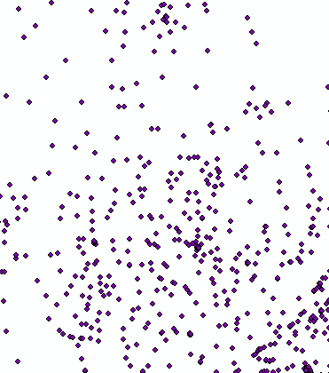
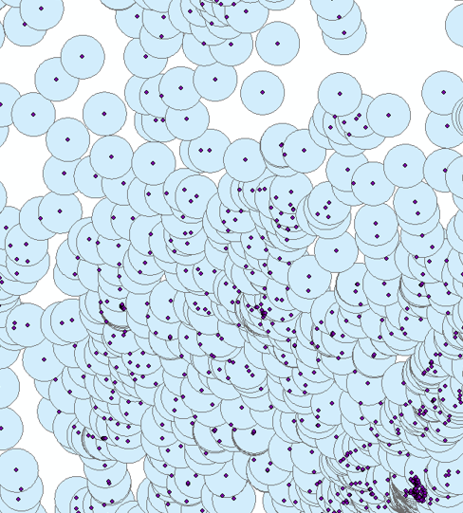
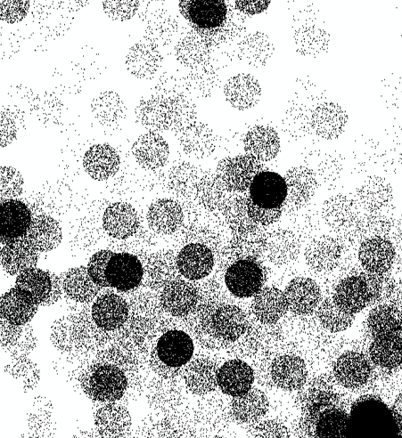
Methodology: Agent Distribution
sites
buffer
Simulated agents

Slide 8
Spatial Buffer Radius and Agent Dispersion
Facilities: Agents are randomly splayed within a predefined radius (20 km)
Community sites: Agents randomly dispersed over entire PSNU polygon.
PSNUs: lowest available geographical location for community
HTS_TST_POS
7
HTS_TST_POS
13
20 km

Slide 9
Methodology: Parameters
Spatial buffer radius: 20 km.
Search distance radius (around simulated HIV positive person): This is the radius around which a positively tested patient can seek treatment at another facility. We considered 50 km a distance that also accounts for stigma.
Maximum time for assignment: 2 quarters
50 km

Slide 10
Spatial Buffer & Search Distance Radii
50 km
50 km
20 km

Slide 11
Methodology: Assignment Rules
Agents were assumed to be placed on treatment at the sites where they were identified as long as the treatment site had the capacity (TX_NEW) to do so.
If an agent remained unassigned due to capacity constraints at their home site, they would be assigned to the closest site in their choice matrix that had excess capacity and fell within a predefined search radius.
Each agent had two chances to be assigned. The first attempt occurred in the same quarter in which the agent was identified, i.e., tested positive.
If an agent was unable to find a treatment slot in the facility where they were identified or a nearby site, they were carried forward to the next quarter for assignment.
If the same agent still remained unassigned after the second quarter, they would be moved out of the system and were classified as unassigned

Slide 12


Methodology: Choice Matrix
Distance from Agent
Random
Order

Slide 13
Agent/Patient Movement Simulated!
HTS_POS = 6
HTS_POS
TX_NEW
TX_NEW = 3
TX_NEW = 2
TX_NEW = 4
HTS_POS = 6
50 km

Slide 14
Outputs: Dataset and Geospatial Information
Total number of diagnosed HIV positives who were assigned
Where and when they were tested (quarter and site)
Where and when they were treated (quarter and site)
Total number of diagnosed HIV positives who were unassigned
Where and when they were tested (quarter and site)
Analytic dataset that allows you to explore linkage relationships between facilities, and between community sites and facilities.
Provides estimates of internal linkage (testing and treatment ratios at the same facility) and external linkage (treatment at another facility, especially community-facility linkage.
Dataset can be aggregated up to PSNU level to get estimates of cross-district movement.
Estimated location of presumed unassigned agents, indicating potential issues with linkage in those areas.
Networks of community-facility and facility-facility linkages.
Additional views by quarters can also be created, if required.
R script with single workflow, which uses the DATIM Genie output file, along with standard geospatial data to give the above outputs.

Slide 15
Functions in LEIA script
ldpkg: Checks whether each package in a list of packages is installed, and if not installed installs them, before finally loading all the packages.
comsplay: Splays agents based on HTS_POS values, uniformly within a community site's containing polygon. The splay distance can be defined.
qchoice: Creates a choice matrix for both, community and facility sites, for a given quarter, and limits the choice of treatment sites based on specified search distance.
abm_q: ABM movement algorithm implementation, which forms the core of the ABM model, which loops through each quarter of data.
ABM_main_script_loop: Runs the final model, incorporating the aforementioned functions, for each age-sex band separately.
abm_agesex: Runs the final model, incorporating the aforementioned functions, for each age-sex band separately.
Notes:
Key pops movemnet, factoring in decision
Looking at PLHIV data and ART coverge. Adjusting TX numbers for only the PLHIV in the district.

Slide 16
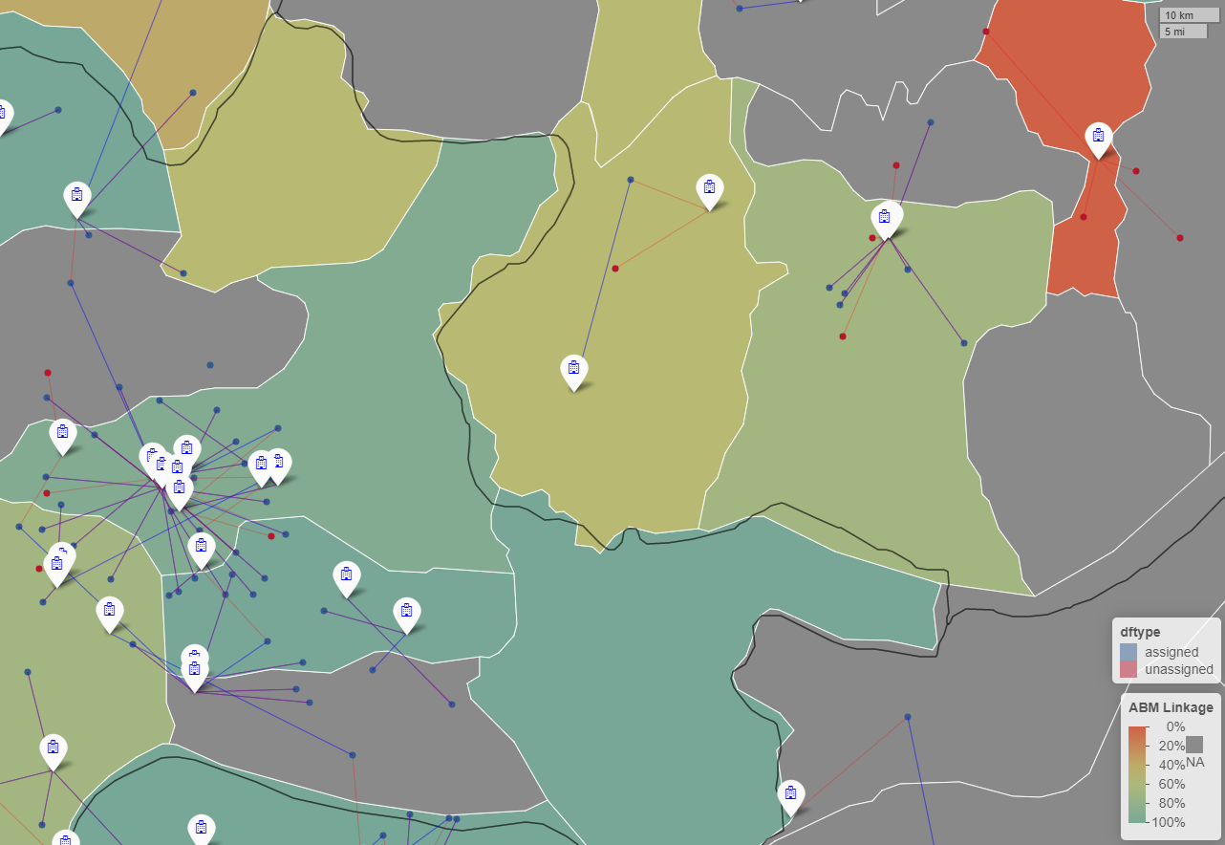
Outputs: Dataset and Geospatial Information
Tested at one and treated at different facility
Tested and treated at same facility

Slide 17
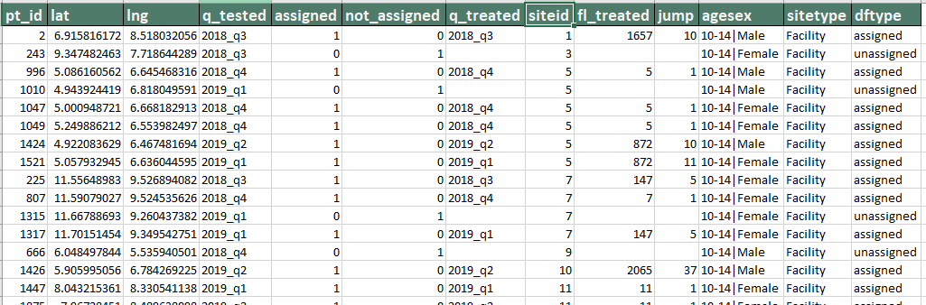
Outputs: Dataset and Geospatial Information
Agent info
Testing site
Treatment site

Slide 18
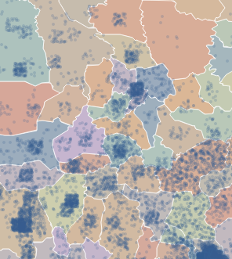
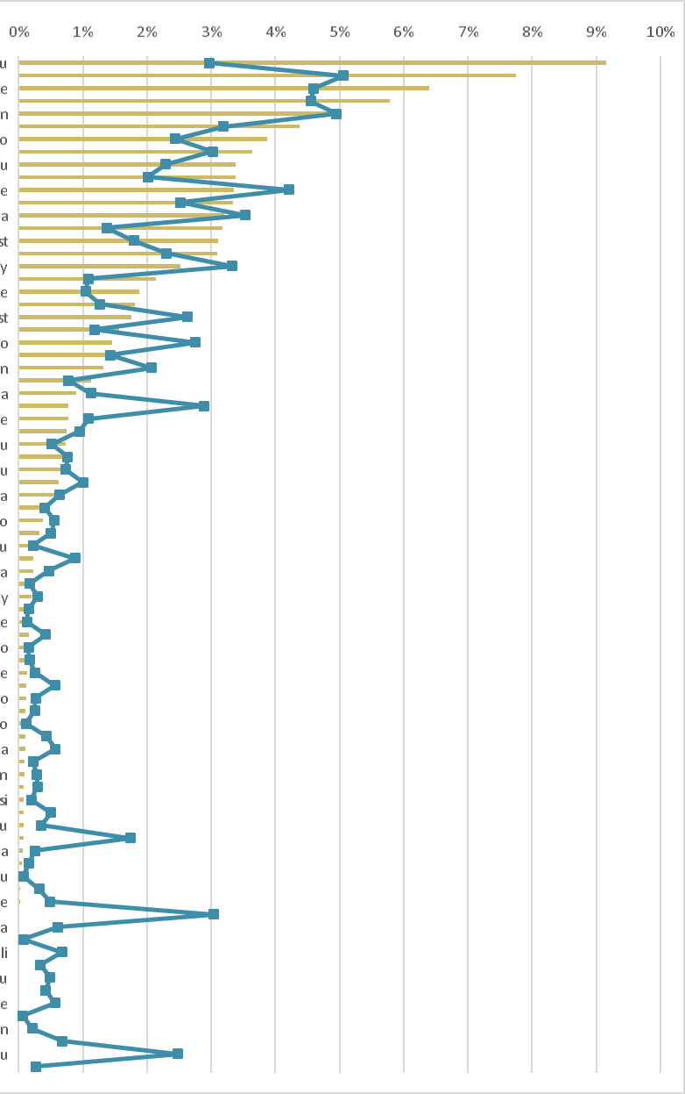

Outputs: Spatial dist. of Unassigned Agents
% unassigned
% HTS volume

Slide 19
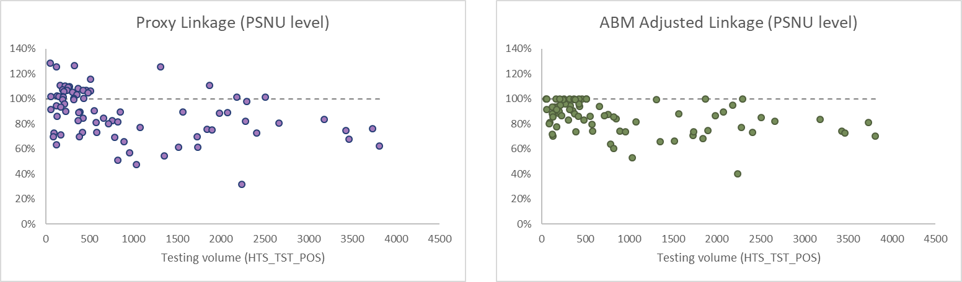
Findings: Optimization of Linkage Estimates
ABM provides a more optimized picture of linkage, with lesser variation between PSNUs.
Community site are also able to get an approximate estimate of their presumed linkage.
Attempts to gain an understanding of how patient flux impacts our indices of Linkage.

Slide 20
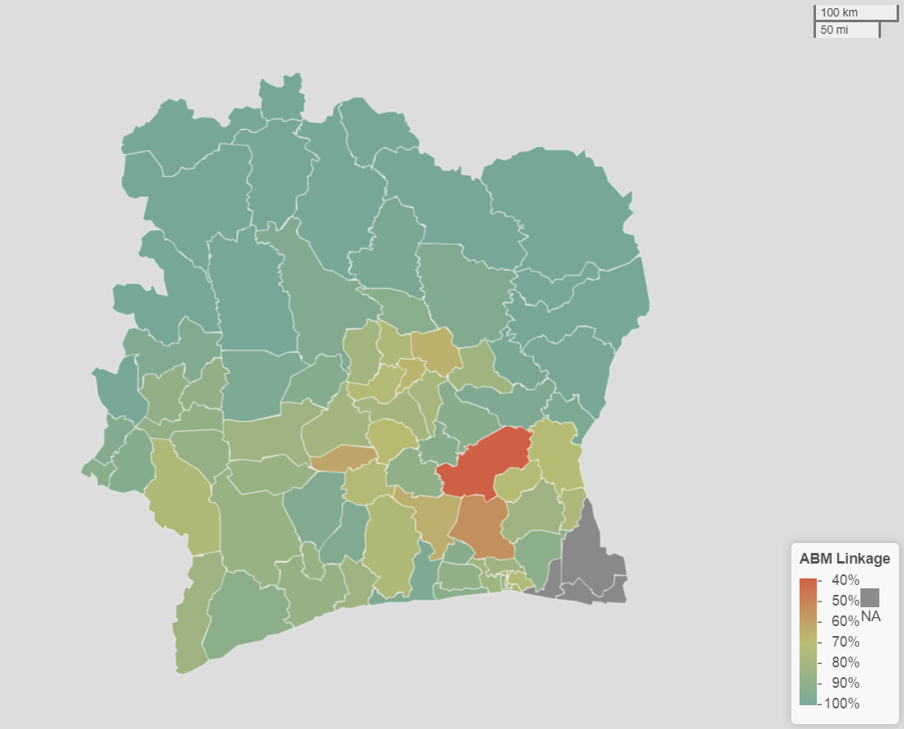
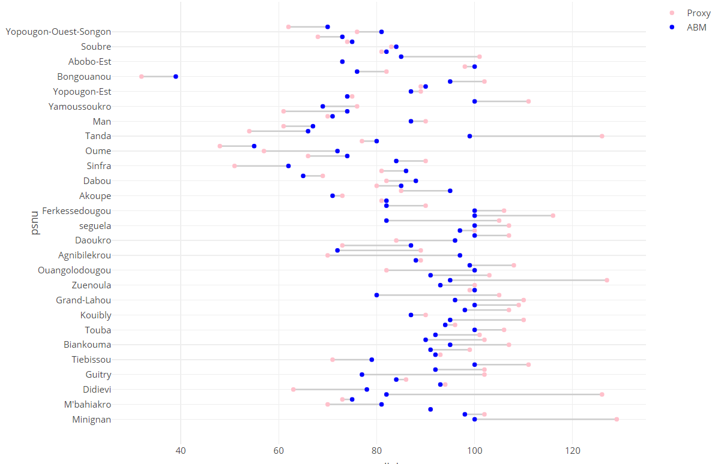
Findings: Optimization of Linkage Estimates
ABM provides a more optimized picture of linkage, with lesser variation between PSNUs.
Community site are also able to get an approximate estimate of their presumed linkage.
Attempts to gain an understanding of how patient flux impacts our indices of Linkage.

Slide 21
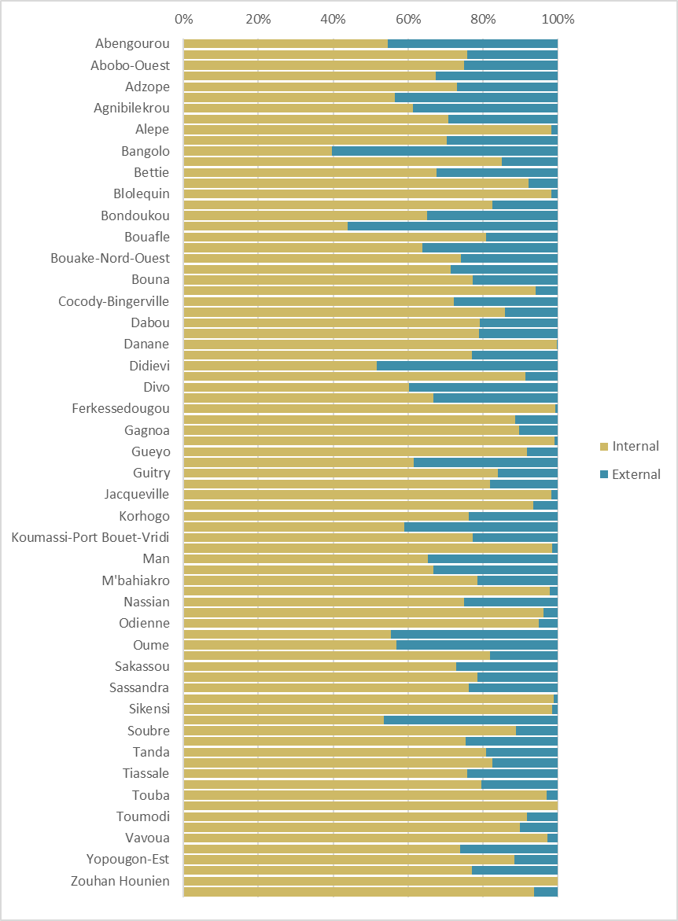
Indices: External and Internal Linkage

Slide 22
Next Steps
Obtain community-level shape files for more accurate dispersion of community agents.
Correct splay of facility agents into the ocean! ☺
Add TX_CURR, HRH indicators to the choice matrix.
Develop uncertainty estimates, using bootstrap confidence intervals?
Explore the option of having customized spatial buffer and search radii.
Calibrate and/or validate simulation with sub-samples of aggregated patient referral data from sites.
Utilize machine learning to fine-tune model when true linkage information becomes available.
R Shiny app with interactive visualization and maps.
Anything else?
Notes:
Key pops movemnet, factoring in decision
Looking at PLHIV data and ART coverge. Adjusting TX numbers for only the PLHIV in the district.

Slide 23

Questions?

