Slide 1
Yield Optimization Data Algorithm (YODA): Granular Targeted HIV Testing Using Machine Learning
Ian E. Fellows and Ray Shiraishi

Slide 2
The Agenda
The Big Picture: Driving Action Using Machine Learning
YODA: An In Depth Look At Yield Optimization
Site Performance Metrics: Making Apples to Apples Comparisons
Final Thoughts
YODA in the Nigeria Surge

Slide 3
The Big Picture

Slide 4
The Big Picture: How To Use Machine Learning for Decision Making
Machine Informed: Analytic models providing useful descriptions of reality that are used by human decision makers.
Using a clustering algorithm to divide a population into different risk groups for which different interventions are designed.
Machine Augmented: Models and algorithms provide recommended decisions based on data, which are combined with human knowledge to determine an action plan.
Pre-screening potential HIV test recipients using a mathematical model combined with clinician judgement.
Fully Autonomous: Models and algorithms make decisions with no human in the loop.
An automated system to set HIV test manufacturing rates and route deliveries.

Slide 5
Yield Optimization: YODA

Slide 6
YODA: Goals
If treatment is prevention and testing leads to treatment, then increasing yield rates is of paramount importance in preventing infections.
Many people are being tested, but are we targeting the right people? How would we know?
Can machine learning help target positive individuals for testing by setting testing targets at a granular level?
Can we identify high performing sites and replicate their methods?
Can we identify low performing sites and stage interventions?

Slide 7
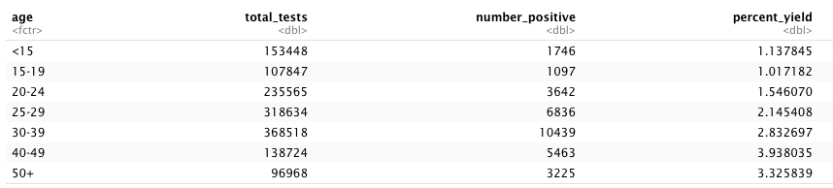
Top Level Opportunities for Improved Test Allocation
More tests were done in the 1-15 age group than the 40-49, even though the yield rate is almost 4 times lower.

Slide 8
Toward a Solution
Construct a machine learning model of yield rate leveraging Spectrum estimates and accounting for things like:
Age
Gender
Population size within age/gender/PSNU
PLHIV within age/gender/PSNU
# on treatment within age/gender/PSNU
# of tests done by the site
Site type
Prioritization
Modality
Partner
Time
Create an optimization algorithm to set targets at the Partner / Modality / Site / Age / Gender disaggregated level.

Slide 9
Yield Model
Outcome: Yield (probability of a test identifying a new HIV case)
Data Sources: MER and Spectrum
Predictors: time, sex, age, site type site, snu prioritization, prime partner, modality, psnu, age, sex, # Tested, PLHIV (Spectrum), Population Size (Spectrum), # Treated (Spectrum)
Model Classes: Gradient Boosted Machines, Elastic Net, Generalized Linear Mixed Model, Model Boosting
Evaluation: A holdout testing set of 20% from the most recent quarter.

Slide 10
Yield Model: Boosting Stage 1
The Generalized Linear Mixed Model (GLMM) performed best due to the hierarchical nature of the data.
Details:
185 fixed effect parameters are used to model the non-hierarchical relationships. These relationships are non-linear and there are many interactions.
35 parameters modeling PSNU
5044 parameters are used to model site level effects.
Evaluation:
Area Under The Curve = 82.3%
What does that mean?
50% = random guess
100% = perfect classification
Country
Psnu1
Site1
2018q1
2018q2
2018q3
2018q4
Site2
2018q1
2018q2
2018q3
2018q4
Psnu2
Site3
2018q1
2018q2
2018q3
2018q4
Site4
2018q1
2018q2
2018q3
2018q4

Slide 11
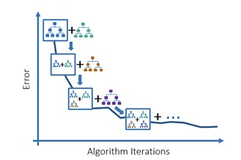
Yield Model: Boosting Stage 2
Gradient Boosted Machine to capture any lingering non-linear interactions
Details:
Bayesian optimization to find optimal hyper-parameters.
94 trees
Evaluation:
Area Under The Curve = 83.1%
What does that mean?
50% = random guess
100% = perfect classification

Slide 12
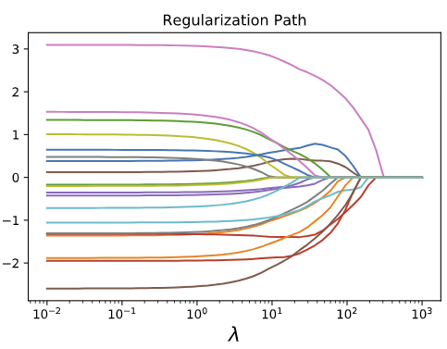
Yield Model: Boosting Stage 3
Elastic Net to ensure maximum consistency with observed data
Details:
One parameter for each quarter/site/age/partner/modality combination
Shrinkage determined by AUC
Evaluation:
Area Under The Curve = 83.2%
What does that mean?
50% = random guess
100% = perfect classification

Slide 13
Optimization Algorithm
Important detail: Yield depends on the number of tests performed, with additional tests leading to lower yield. Thus there is a diminishing return on increasing the testing rate.
Greedy Optimization Algorithm:
Start all active partner / site / age / sex / modality / prioritization observation at 83% of their number of tests in the last quarter (2019q2).
Set any constraints. Current constraints are
Maximum increase in the number of tests for any observation is 120%
Total number of tests in country is fixed at the last quarter.
Find the observation that would cause the largest increase in yield rate if the number of tests were nudged upward that doesn’t violate any constraints.
Repeat step 3 until there are no observations that don’t violate the constraints.

Slide 14
Results
With a maximum increase of 20% for any (non-index) observation, the yield model estimates a 21% increase in yield.
Actionable table of recommended # of tests by site/modality/partner/age/sex

Slide 15
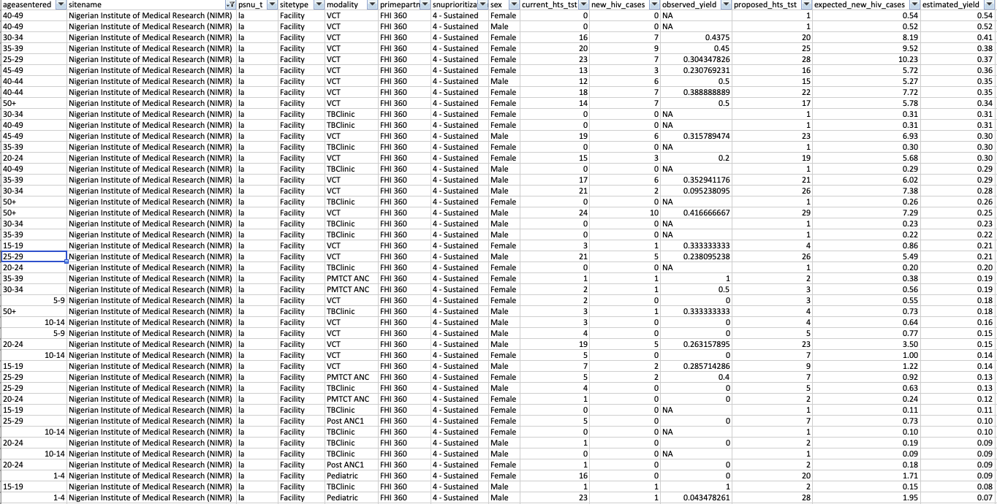

Slide 16
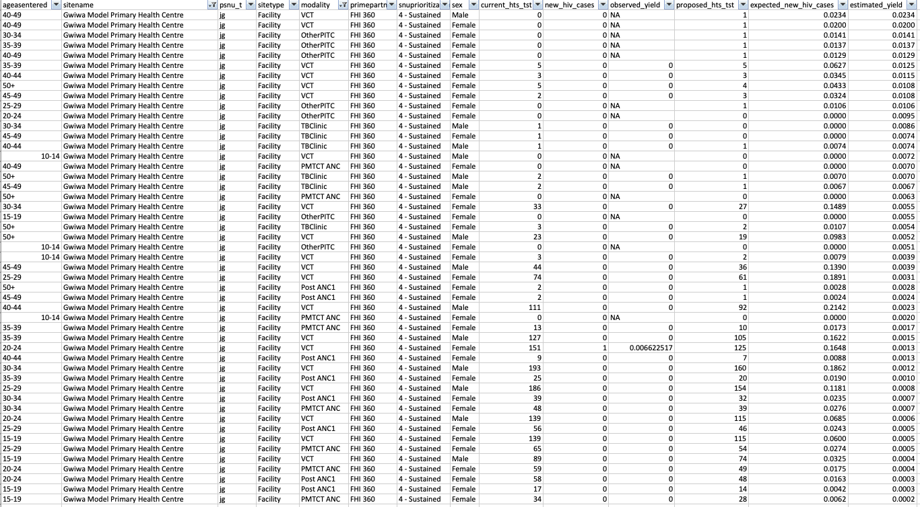

Slide 17
Site Effectiveness

Slide 18
Site Testing Effectiveness
How likely is it for an HIV test at a site to be positive compared to an “average” site with similar characteristics?
The site level random effects in the GLMM model are measures of the effectiveness of each site adjusting for all other covariates.
These are translated into odds ratios for interpretability.

Slide 19
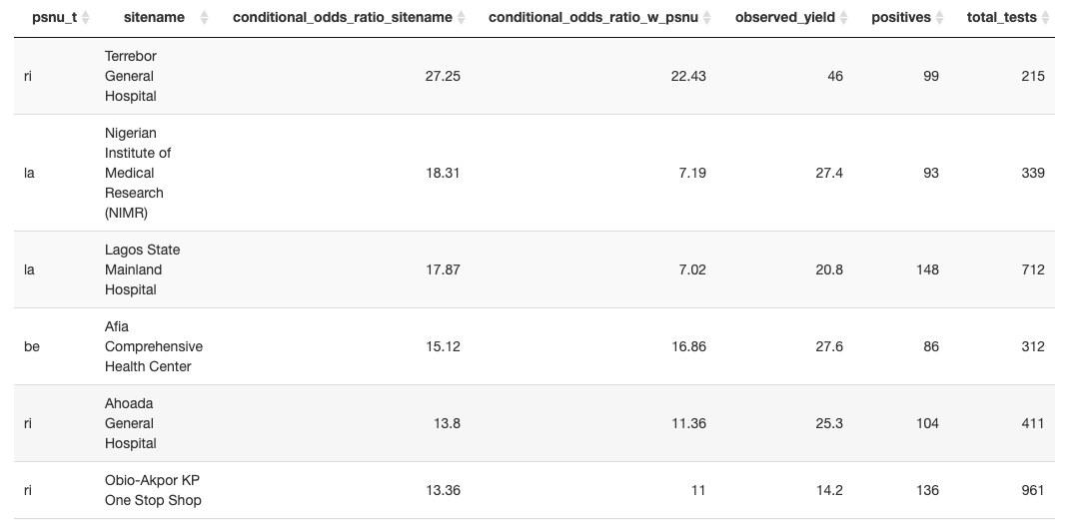
Highly Effective Sites

Slide 20
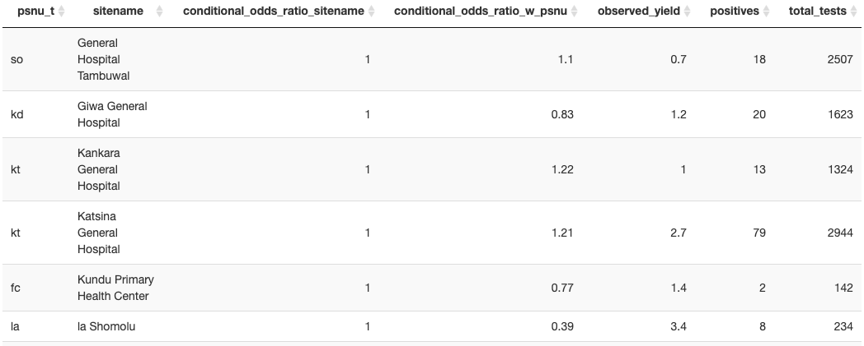
Average Sites

Slide 21
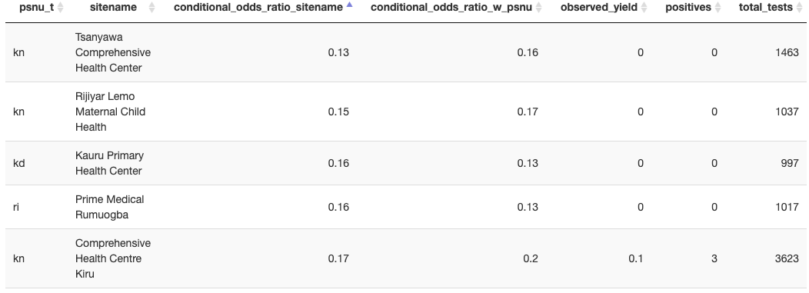
Less Effective Sites

Slide 22
Implementation Progress

Slide 23
Implementation Pipeline
Analysis
Malawi
Stakeholder Review
Lesotho
Cote D’Ivoire
Staged Launch
Nigeria (18 sites in 3 states)
Nationwide Implementation
…
Tanzania

Slide 24
Nigeria Launch

Slide 25
Communicating With Sites
Site Name
Date Modeled
Site-specific proposed testing can be updated based on actual performance
YODA Introduction
Proposed weekly tests
Aligned with Surge testing targets
By modality
Succinct guidance to help site staff understand areas the model proposes to prioritize testing by modality, sex, and age group
By sex
By age group
CDC Nigeria POC Contact Information

Slide 26
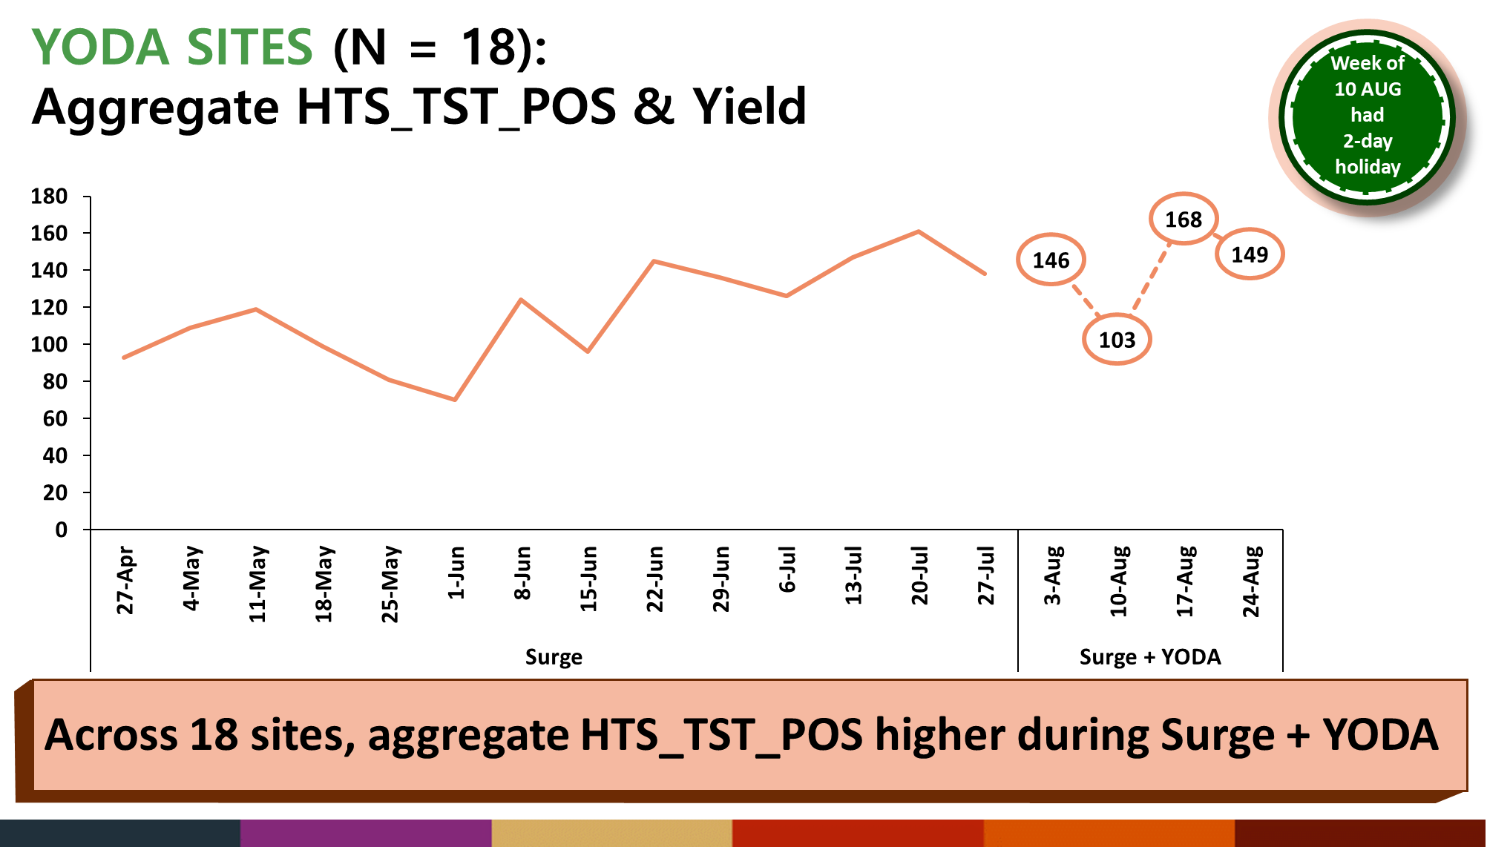
Effect on HTS_TST_POS

Slide 27
Were the recommendations followed?

Slide 28
Final Thoughts

Slide 29
Final Thoughts
Countries seem very excited about optimizing their yields
The model outputs appear informative to those who know the on-the-ground situation.
Lessons have been learned from the Nigeria experience.
Sites are receptive to the program, but need more support to help them adhere to the recommendations.
In countries with highly fluid testing rates, running YODA on up-to-date weekly data will provide more relevant recommendations.

