Slide 1


Denominators Workgroup
July 9th, 2019
Monthly Meeting

Slide 2
Agenda
Logistics - Github page
Yoda model update (Yield Optimization Data Algorithm) – Ian/Ray
Population sources model update – Roma
Discussion on new projects in pipeline – VMMC (tentative)

Slide 3
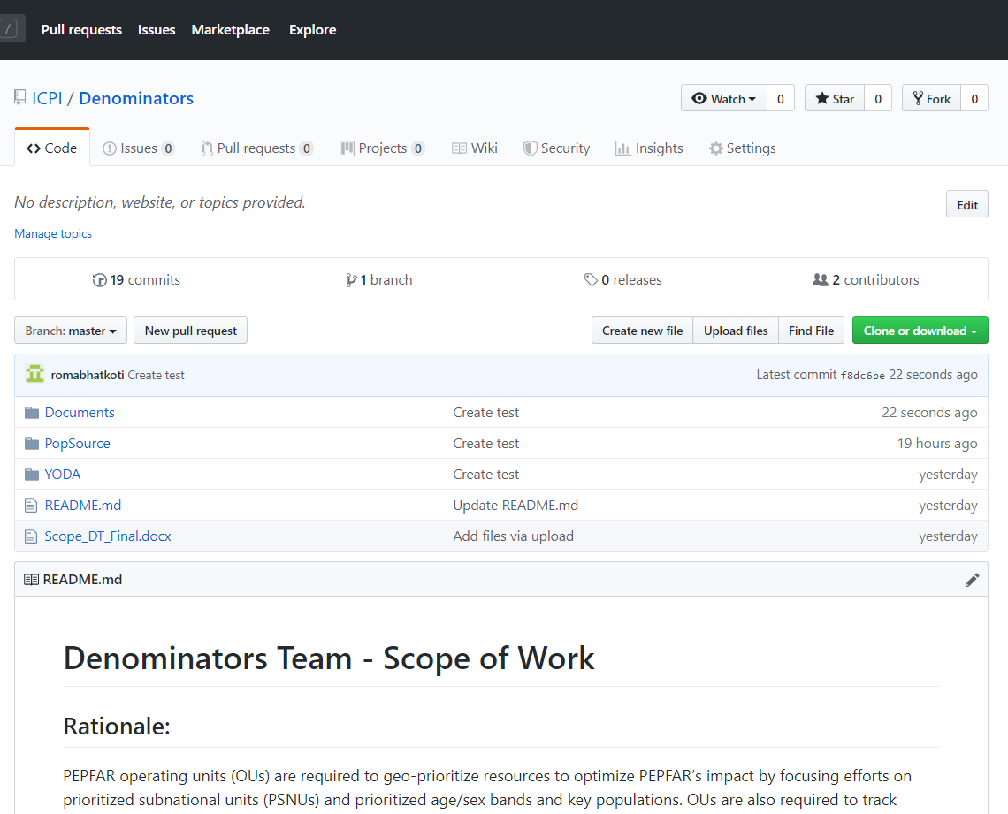
Logistics - Denominators Github Repository
https://github.com/ICPI/Denominators

Slide 4
Yield Optimization Data Algorithm (YODA) – Ian/Ray
Ian’s Presentation

Slide 5
Population sources model – Roma
PLHIV estimation (using spreadsheet disaggregation method) requires subnational population numbers
Primary source subnational population – actual census counts published by the various countries
Issues with using actual census counts for PLHIV estimation
frequency
data gaps
reliability
Solution – provide population alternatives to actual census counts for countries.

Slide 6
Population sources model – Roma
Potential Population Sources –
WorldPop - https://www.worldpop.org/
landScan - https://landscan.ornl.gov/
Facebook - https://data.humdata.org/organization/facebook
Gridded Population of the World (GPW) - https://sedac.ciesin.columbia.edu/data/collection/gpw-v4
GHS POP - https://ghsl.jrc.ec.europa.eu/ghs_pop2019.php
Global Rural-Urban Mapping Project (GRUMP) - https://sedac.ciesin.columbia.edu/data/collection/grump-v1
ArcGIS Living Atlas of the World - https://livingatlas.arcgis.com/en/browse/#d=2&q=World%20Population%20Estimate
US Census Subnational Population by Sex, Age, and Geographic Area - https://www.census.gov/geographies/mapping-files/time-series/demo/international-programs/subnationalpopulation.html?

Slide 7
Method
Using Rasterized Population Data
Connect to the publically available population database such as WorldPop, a High spatial resolution, contemporary data on human population.
Use publically available R packages to gather iso3 names (identifiers for countries) for PEPFAR countries from WorldPop FTP.
Developed R script to download individual (PEPFAR) countries population raster datasets for the most recent years from WorldPop FTP.
Download PEPFAR subnational shape files from ArcGIS online.
Developed R script to run zonal statistics for PEPFAR subnational units (which means calculating subnational population for PEPFAR countries).
This method is generalizable for all population data available in rasterized form.
Import the subnational populations into PAW.

Slide 8
Collaboration with UNAIDS Reference Group on Estimates, Modelling and Projections
Review sources to recommend best ‘default’ source for population inputs by SNU2 / age / sex.
Be able to provide countries with documentation for basic methodologies and specific data sources that were used for population inputs (e.g. which censuses, at what level of stratification.)
Record any country-specific challenges or discrepancies that should be considered by country teams when creating their estimates.

Slide 9
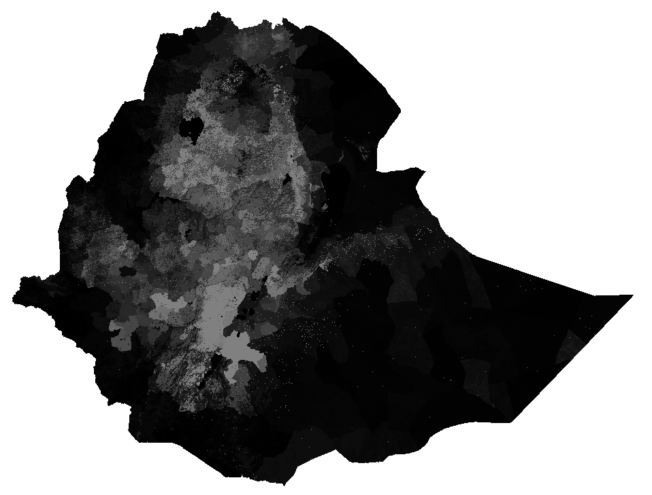
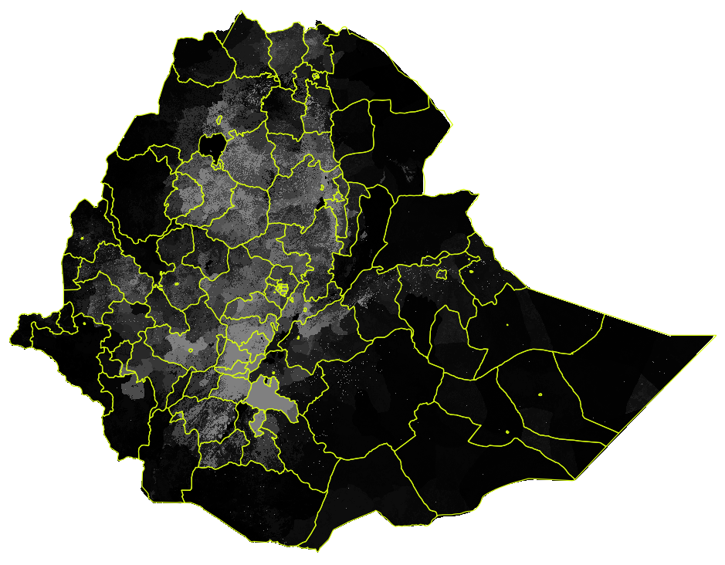
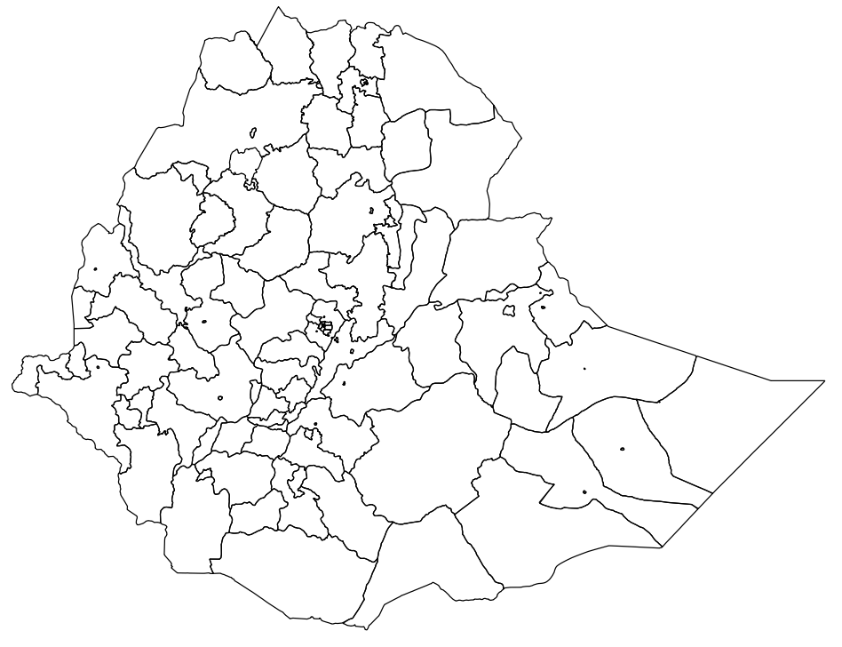
raster
Calculate Zonal Statistics – sum the raster values lying within each polygon
https://www.worldpop.org/
API Connection
+
https://www.cdcarcgis/maps/arcgis.com/
API Connection
polygon

Slide 10
New Projects in Pipeline – VMMC
Problem statement
PEPFAR has supported over 18 million voluntary medical male circumcisions (VMMC) since the program’s inception. However, accurate, reliable estimates of the proportion of men circumcised nationally, or at sub-national levels which are crucial for program planning, are missing. Various estimate sources exist that currently offer that information, however, discrepancies have been noted between sources.
The major goal of this activity is to develop a tool that summarizes national and SNU-level coverage of medical circumcision (e.g., proportion of men medically circumcised) across 15 priority countries for VMMC, triangulated and validated through an agreed-on process that incorporates the full range of available data streams. This will include circumcision coverage estimates in priority age bands (i.e., 15-29) and other age groups. This tool will also aim to assist countries in longer-term planning for VMMC by establishing a way to plan for ongoing circumcision of rising cohorts of males as they age into the eligible population (at least 10 years of age). (from Carlos Toledo’s team)

Slide 11
Next Recurring Meeting

