Slide 1
Yield Optimization Data Algorithm (YODA):
Granular Targeted HIV Testing Using Machine Learning
Ian E. Fellows and Ray Shiraishi

Slide 2
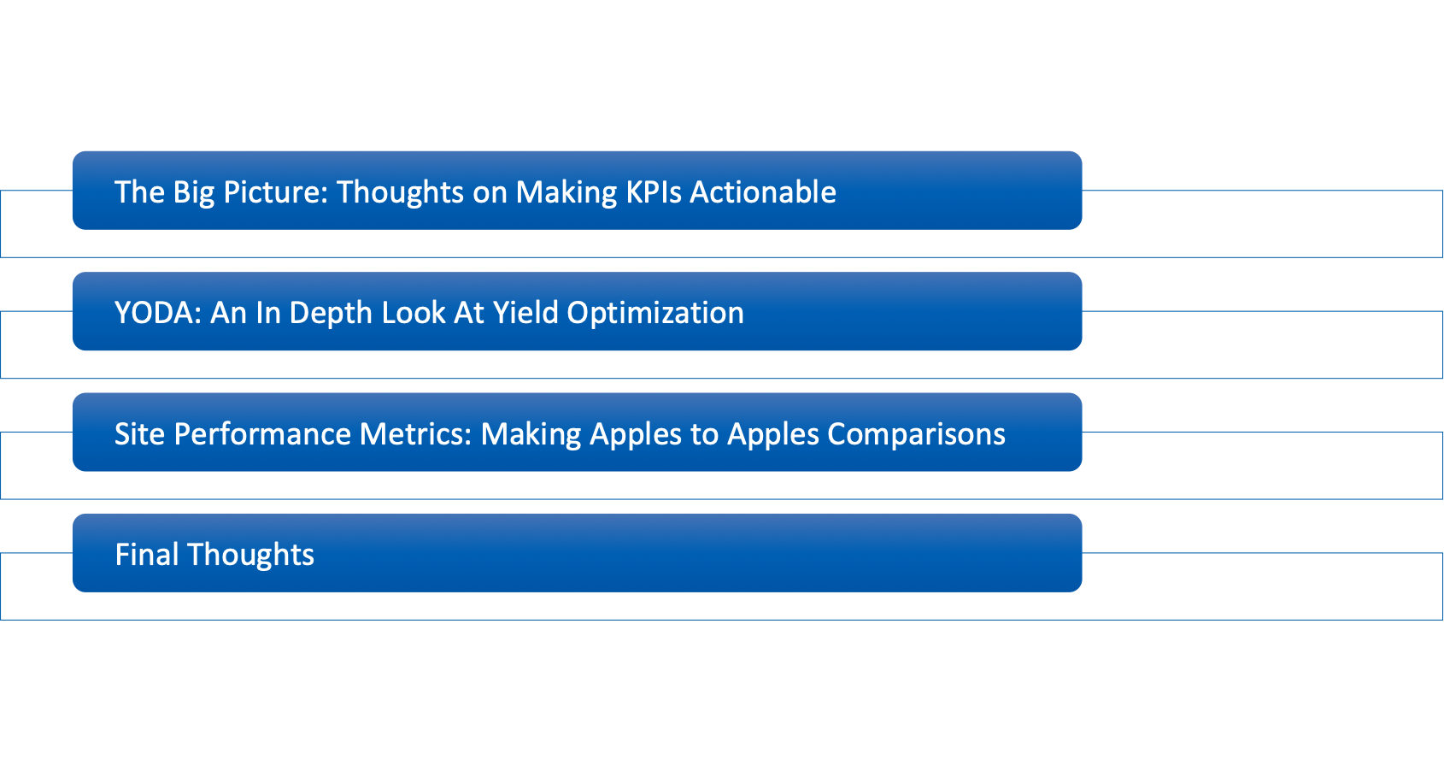
The Agenda

Slide 3
The Big Picture

Slide 4
The Big Picture
Theorem 1: It is hard to optimize what you don’t measure.
Theorem 2: If measurements have high variability, optimization is prone to overreactions.
  e.g. small sample sizes at particular sites
Theorem 3: Be careful what you measure, because you WILL optimize it.
  Raw indicators can lead to apples to oranges comparisons (e.g. comparing the raw HIV test yield of a maternity ward to a KP community site)

Slide 5
Toward Tackling the Big Picture
 | Getting HIV Positive Individuals Diagnosed | Link to Care / Treatment | Treatment Retention
Raw Data | MER, Spectrum, weekly/daily country reports | MER | ???
Theorem 1: Measurements | Good | Not Directly | ???
Theorems 2: Variability | Yes | Yes | ???
Theorem 3: Raw Compares Apples to Oranges | Yes | Yes | ???
Algorithmic Approach | YODA | LEIA | ???

Slide 6
Approaches to Optimization
Top Down
Specified targets
Mandated methodologies
Interventions for poor performance
…
Bottom Up
Timely and easy to understand site dashboards and reports
Comparisons to other sites so they know where they stand
Resources for improvement

Slide 7
Yield Optimization: YODA

Slide 8
YODA: Goals
If treatment is prevention and testing leads to treatment, then increasing yield rates is of paramount importance in preventing infections.
Many people are being tested, but are we targeting the right people? How would we know?
Can machine learning help target positive individuals for testing by setting testing targets at a granular level?
Can we identify high performing sites and replicate their methods? Can we identify low performing sites and stage interventions?

Slide 9
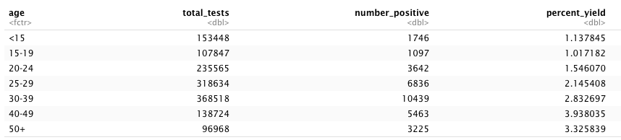
Nigeria: Top Level Opportunities for Improved Test Allocation
More tests were done in the 1-15 age group than the 40-49, even though the yield rate is almost 4 times lower.

Slide 10
Toward a Solution
Construct a machine learning model of yield rate leveraging Spectrum estimates and accounting for things like:
  Age
  Gender
  Population size within age/gender/PSNU
  PLHIV within age/gender/PSNU
  # on treatment within age/gender/PSNU
  # of tests done by the site
  Site type
  Prioritization
  Modality
  Partner
  Time
Create an optimization algorithm to set targets at the Partner / Modality / Site / Age / Gender disaggregated level.

Slide 11
Yield Model
Outcome: Yield (probability of a test identifying a new HIV case)
Data Sources: MER and Spectrum
Predictors: time, sex, age, site type site, snu prioritization, prime partner, modality, psnu, age, sex, # Tested, PLHIV (Spectrum), Population Size (Spectrum), # Treated (Spectrum)
Model Classes: Gradient Boosted Machines, Elastic Net, Generalized Linear Mixed Model, Model Boosting
Evaluation: A holdout testing set of 20% from the most recent quarter.

Slide 12
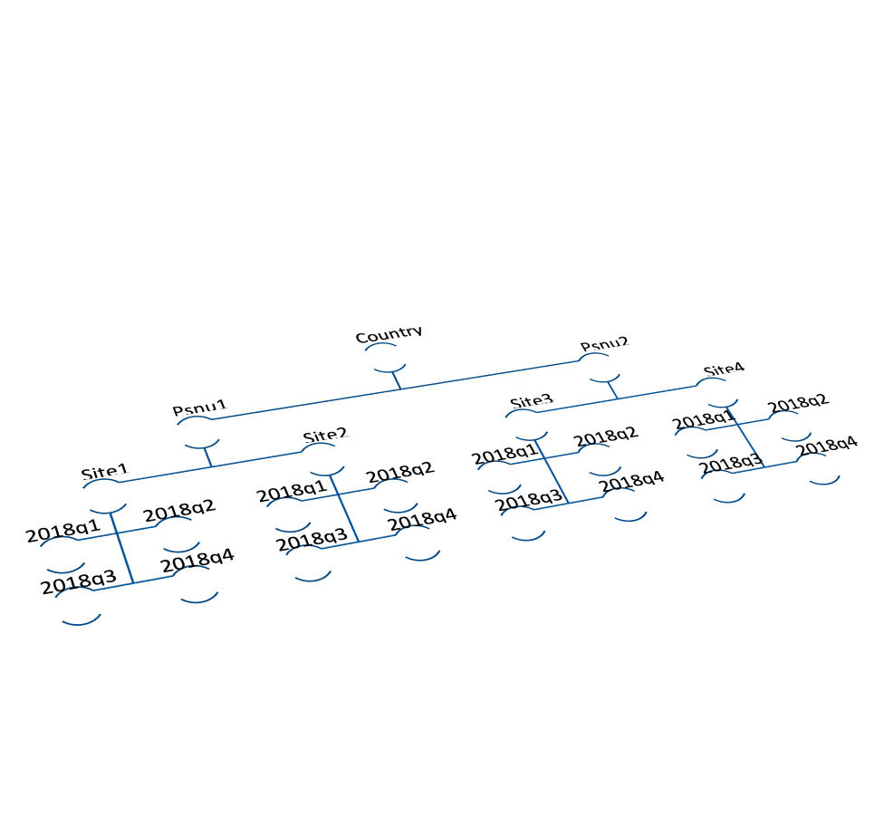
Yield Model: Boosting Stage 1
The Generalized Linear Mixed Model (GLMM) performed best due to the hierarchical nature of the data.
Details:
  185 fixed effect parameters are used to model the non-hierarchical relationships. These relationships are non-linear and there are many interactions.
  35 parameters modeling PSNU
  5044 parameters are used to model site level effects.
Evaluation:
  Area Under The Curve = 82.3%
  What does that mean?
    50% = random guess
    100% = perfect classification

Slide 13
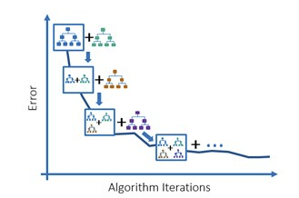
Yield Model: Boosting Stage 2
Gradient Boosted Machine to capture any lingering non-linear interactions
Details:
  Bayesian optimization to find optimal hyper-parameters.
  94 trees
Evaluation:
  Area Under The Curve = 83.1%
  What does that mean?
    50% = random guess
    100% = perfect classification

Slide 14
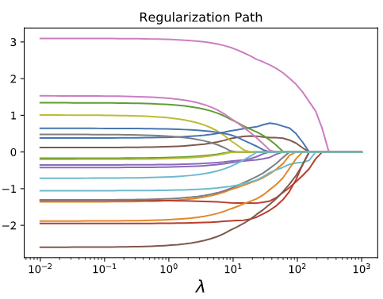
Yield Model: Boosting Stage 3
Elastic Net to ensure maximum consistency with observed data
Details:
  One parameter for each quarter/site/age/partner/modality combination
  Shrinkage determined by AUC
Evaluation:
  Area Under The Curve = 83.2%
  What does that mean?
    50% = random guess
    100% = perfect classification

Slide 15
Optimization Algorithm
Important detail: Yield depends on the number of tests performed, with additional tests leading to lower yield. Thus there is a diminishing return on increasing the testing rate.
Greedy Optimization Algorithm:
Start all active partner / site / age / sex / modality / prioritization observation at 83% of their number of tests in the last quarter (2019q2).
Set any constraints. Current constraints are
  Maximum increase in the number of tests for any observation is 120%
  Total number of tests in country is fixed at the last quarter.
Find the observation that would cause the largest increase in yield rate if the number of tests were nudged upward that doesn’t violate any constraints.
Repeat step 3 until there are no observations that don’t violate the constraints.

Slide 16
Results
With a maximum increase of 20% for any (non-index) observation, the yield model estimates a 21% increase in yield.
Actionable table of recommended # of tests by site/modality/partner/age/sex

Slide 17
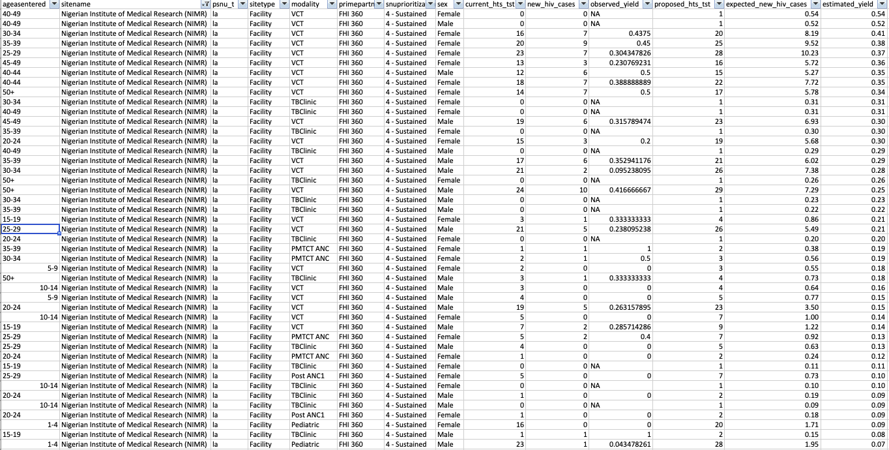

Slide 18
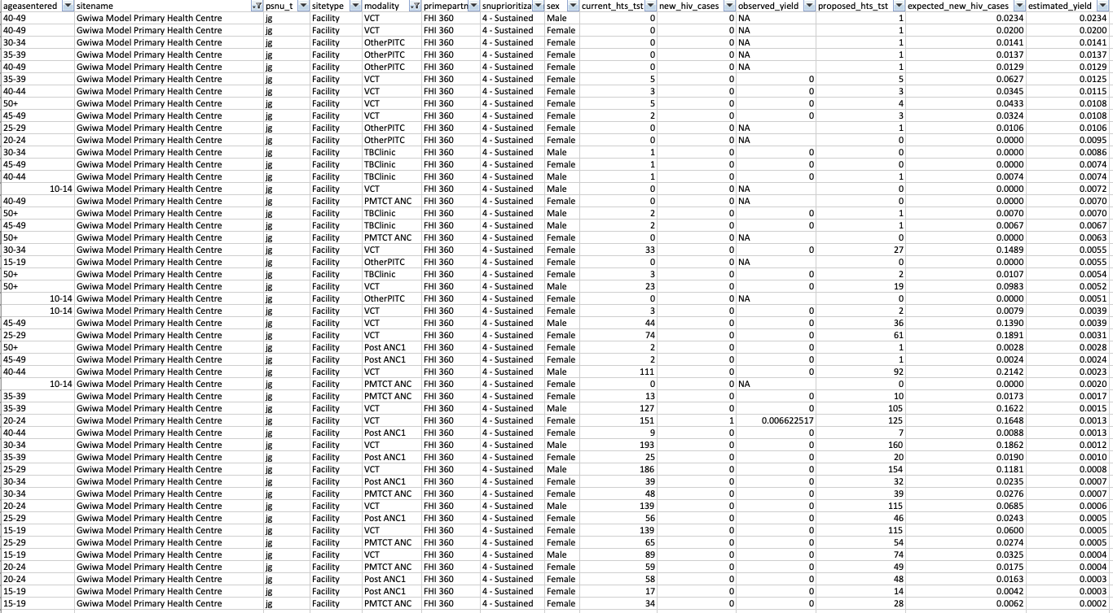

Slide 19
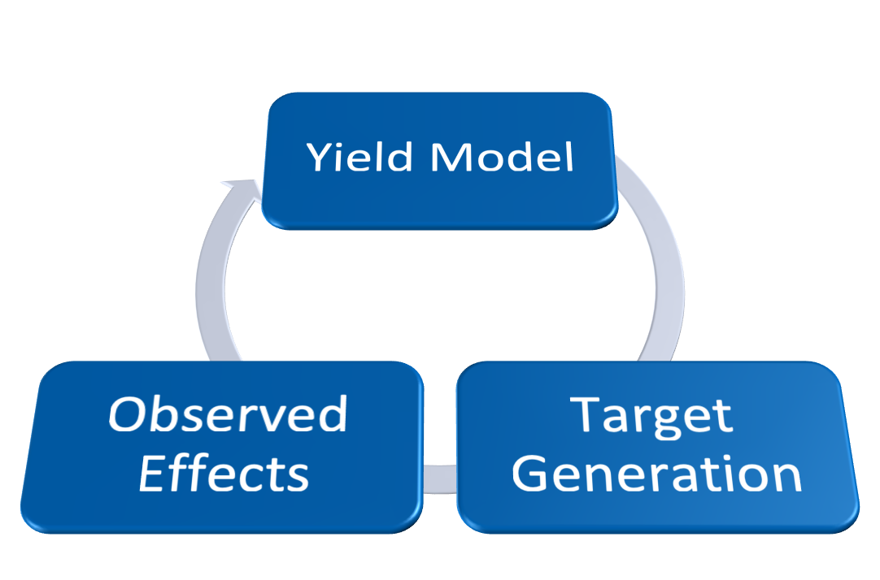
Possible Extensions
Bayesian optimization lets us measure the actual effects of target setting and feed that back into the model.

Slide 20
Site Effectiveness

Slide 21
Site Testing Effectiveness
How likely is it for an HIV test at a site to be positive compared to an “average” site with similar characteristics?
The site level random effects in the GLMM model are measures of the effectiveness of each site adjusting for all other covariates.
These are translated into odds ratios for interpretability.

Slide 22
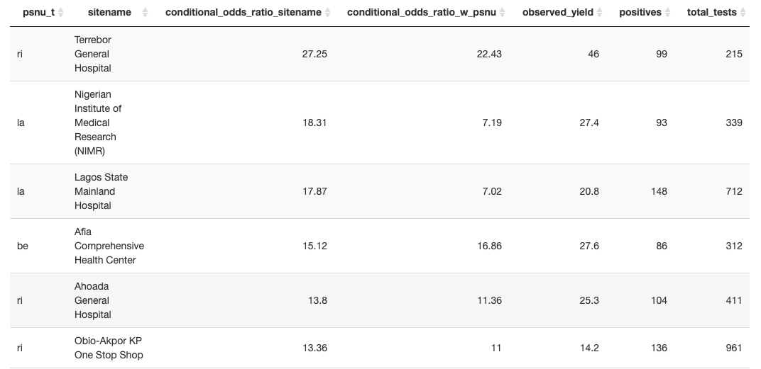
Highly Effective Sites

Slide 23
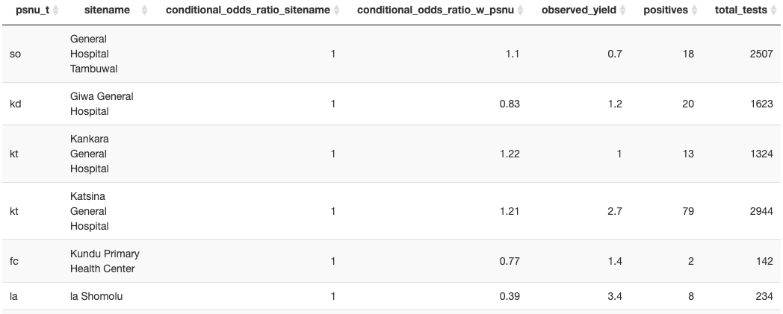
Average Sites

Slide 24
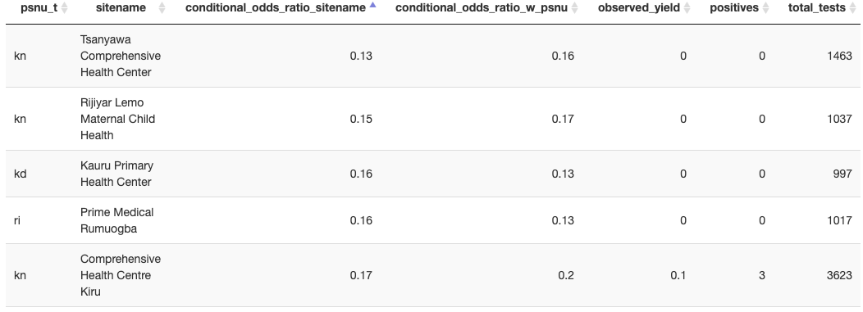
Less Effective Sites

Slide 25
Site Index Testing Effectiveness
Questions
  How good are sites at going out and index testing new positives?
  Given that an index test has occurred at a site, how likely is it to be positive?
Model
  Hierarchical glmm models.
Output
  conditional_ratio_total_index_test : A measure of how effective the site is at tracing contacts and finding individuals to index test
  condiational_odds_total_index_test_is_pos : A measure of how likely an index test is to be positive given the number of index tests and the number of non-index positives.
  conditional_ratio_combined : A combined effectiveness at generating new positives from index testing irrespective of the number of tests, but adjusting for number of non-index positives, etc.

Slide 26
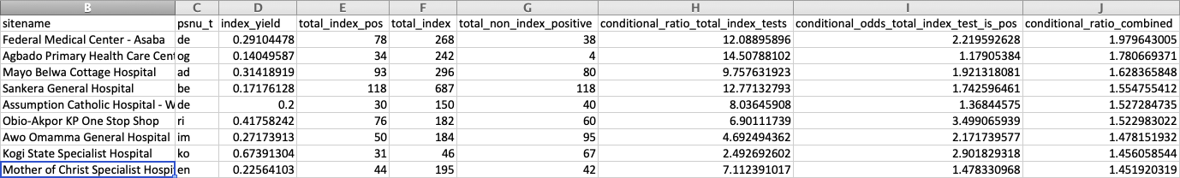

Slide 27
Implementation Progress

Slide 28
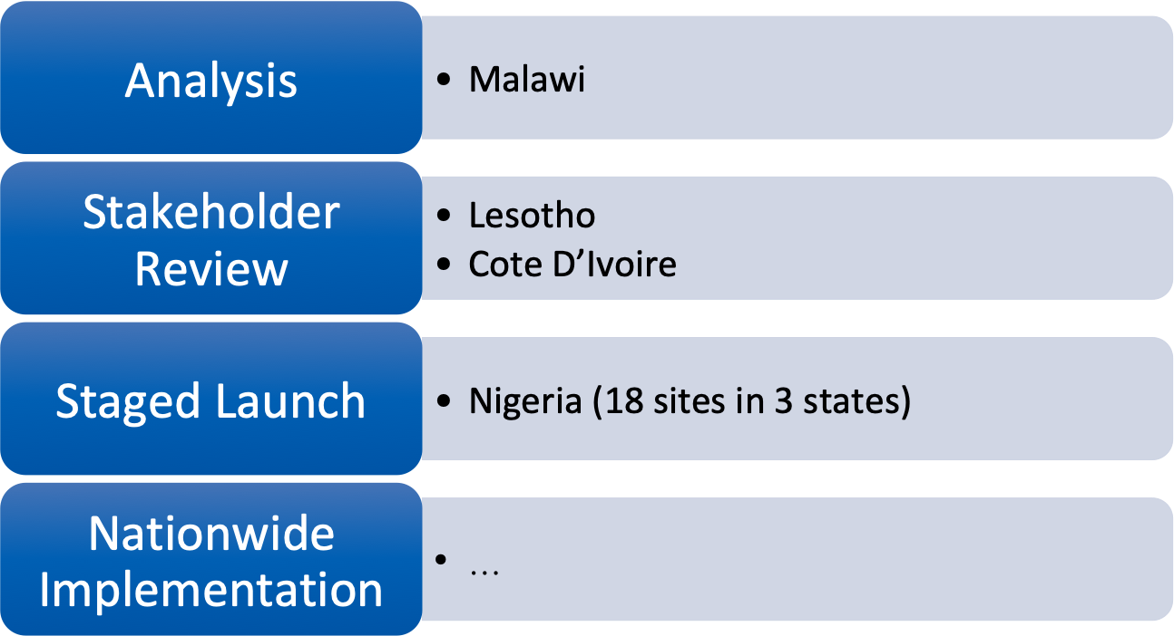
Implementation Pipeline

Slide 29
Final Thoughts

Slide 30
Final Thoughts
Countries seem very excited about optimizing their yields
The model outputs appear informative to those who know the on-the-ground situation.
More generally, how can we use advanced analytics to help decision makers on both the macro (The ambassador) and micro (A site manager) make policy decisions that minimize HIV transmission?

