Slide 1

ICPro OG TECHNOLOGIES PTE. LTD
Create better value for life
through innovation, quality & PROBLEM SOLVING
J3 He SCADA System
AIR LIQUIDE SINGAPORE PRIVATE LIMITED
05 Jan 2022

Slide 2
Agenda
01
Safety Introduction
02
Project Architecture
03
Project Scope
04
Proposed Control BOM
J3 He SCADA SYSTEM
05
Deliverable Documents
06
Project Schedule
07
Project Organization Chart
08
Discussion Points

Slide 3


Safety Moment
J3 He SCADA System

Slide 4
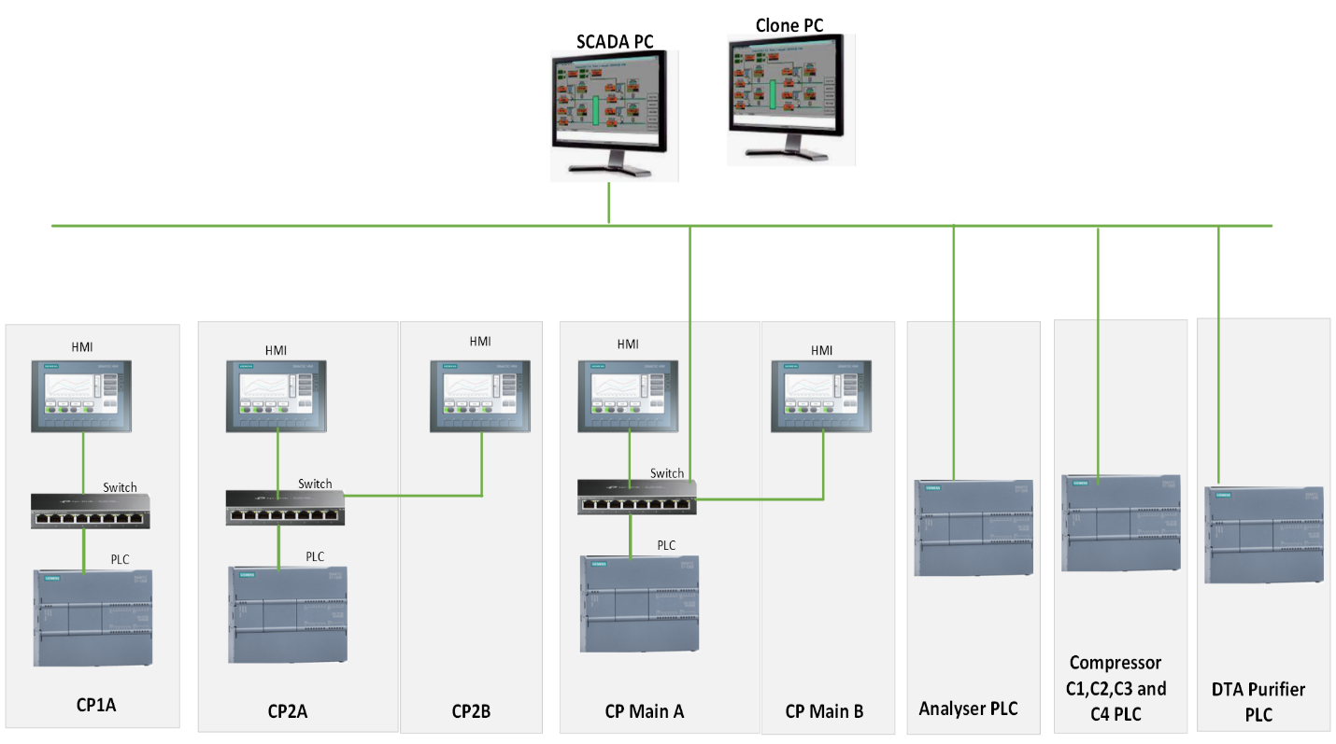
Project Architecture
J3 He SCADA System

Slide 5
Project Scope
Supply & install the SCADA PC with necessary, power supply cable and LAN Cable.
Design & Configure SCADA Graphics to monitor data from existing plant PLC’s IO’s.
Design to communicate with different filling panel PLC, Compressors, DTA Purifiers and Analyzer PLC.
Required SAT and other testing requirements to confirm the quality of the equipment and components.
Documentation and handover of document to ALSg.
Training for ALSg Operations and Maintenance Team.
J3 He SCADA System

Slide 6
Project Scope
Sl. No | DESCRIPTION
1. | FAT / SAT as per IC Pro OG Technologies Standard procedure approved by client. IC Pro OG Technologies shall send their Standard procedure to customer during detailed engineering.
2. | Storage at site, including watch & ward has not been considered.
3. | No Mechanical Installation is considered as part of this Scope.
4. | SCADA PC Spec suitable for the application is selected. ALSg to review and revert if any changes required in the Spec.
5. | Existing As-built PLC, HMI program back-ups shall be provided by Alsg which will be used for configuring new SCADA PC
6. | Power Outlet/Socket for the connection of the new SCADA PC within the same room is provided by Alsg. We will install the PC and connect the power cable from SCADA PC.
7. | Clone PC with same configuration as the operating SCADA PC is provided as per Alsg RFQ. This PC is not connected to the network during normal operation; licenses from existing SCADA PC shall be transferred to this Clone PC before use as replacement.
8. | Only Runtime License considered under this scope. No Development license for SCADA is considered under this scope of proposal.
9. | As per clarification meeting on 25-Oct-21, Alsg confirmed that the existing PLC has sufficient capacity, performance capability to meet the additional communication to the new SCADA. There is no additional programming or hardware, or software modification required connect to the new SCADA; any such changes shall be performed by existing PLC/HMI supplier or performed at additional cost.
10. | As per clarification meeting on 25-Oct-21, Alsg confirmed that there is no requirement for Historian as the SCADA will be used for more of real-time monitoring and reporting.
11. | Assumes that Cable tray is available from all PLC and only Unarmored CAT6 Ethernet cables needs to lay between the PLCs and SCADA. Following cables considered for Installation. Installation of 70m CAT6 unarmored cable from C3 and C4. Installation of 30m CAT6 unarmored cable from Compressor DTA Purifier, C1 and C2. Installation of SCADA PC and Ethernet Cable Laying from CP Main PLC approximately 30Mtrs

Slide 7
Proposed Control BOM
S.No | Particulars | Qty
1 | Intouch SCADA Runtime License 60K with IO | 1 | No
2 | SCADA PC with Below Configurations: Advantech PC-510MB Industrial PC. FSP-400W – Industrial SMPS ASMB-786G4 Server Class 9th Gen. Mother Board. Intel® Core™ i7-8700 8th Gen. @ 3.0 GHz OEM CPU Cooler 32GB DDR4 RAM 2TB 3.5 Hard Disk 2 x Ethernet Port 2 X PCIe x4, 2 X PCIe x16 3 X PCIe x1 2 x RS232 Card 4 X USB 3.0 2 X USB 2.0 1 x VGA 1 x DVI-D 1 x HDMI DVD ROM Drive Logitech KB/MS Windows 10 Pro. 64bit Original OEM. | 2 | Nos
3 | Antivirus | 2 | No
4 | MS Office | 2 | No
5 | Dell Monitor 27" | 1 | No
6 | CAT6 unarmored cable | 130 | mtr
J3 He SCADA System

Slide 8
Deliverable Documents
Pre-Engineering Documents
Key Engineering Documents
Bill of Materials
System Architecture
Software Functional Design Specification
Document (FDS)
Test Procedures
Manuals & Maintenance Documents
Factory Acceptance Test Procedure (FAT)
Site Acceptance Test Procedure (SAT)
Operational and Maintenance Manual
J3 He SCADA System

Slide 9

Project Schedule
05-Jan-2022
12-Jan-2022
12-Jan-2022
22-Jan-2022
12-Jan-2022
28-Feb-2022
12-Jan-2022
28-Feb-2022
28-Feb-2022
01-Mar-2022
05-Jan-2022
* Based on site availability ALSG to confirm the date
Data Collection
Ordering and receiving of Materials
FAT with ALSG
Installation of new J3 He SCADA PC
(ALSG Scope)
Kick of Meeting
Document Submission and Approvals
Development of Software/ Internal Testing
Packing &
Delivery
Integration & Commissioning of SCADA System
1. Data Collection / Input data from Alsg including Final I/O list with any I/O Assignment, Control Philosophy, C&E are in critical path to achieve proposed schedule
2. Design document approval by Alsg within 3 working days from the date of submission. If required Alsg may discuss during weekly meeting and clarify any points
3. Refer “Discussion Points” slide for more details; Any delay in input data may affect the schedule
J3 He SCADA System

Slide 10
Project Organisational Chart
Thanikachalam
Project Manager
Vaithiyanathan
/Srinath
Sales & Solution Support
Vidyavathi
Admin Support
Arun Kumar
Project Lead/
Commissioning Support
Monisha
SCADA Developer
Praisudan
SCADA Developer
J3 He SCADA System

Slide 11
Data Required from ALSG
I/O List and Alarm List
All PLC and HMI Program Backup.
Existing PLCs Architecture Drawing.
P&IDs for the following
Compressor C1, C2, C3 and C4
Analyzer
DTA
Report Template
J3 He SCADA System

Slide 12

Discussion Points
Graphics required for 60 Inch screen.
J3 He SCADA System

Slide 13
Thank You
AMK-02 TCN6200 COOLING TOWER SYSTEM

