Slide 1
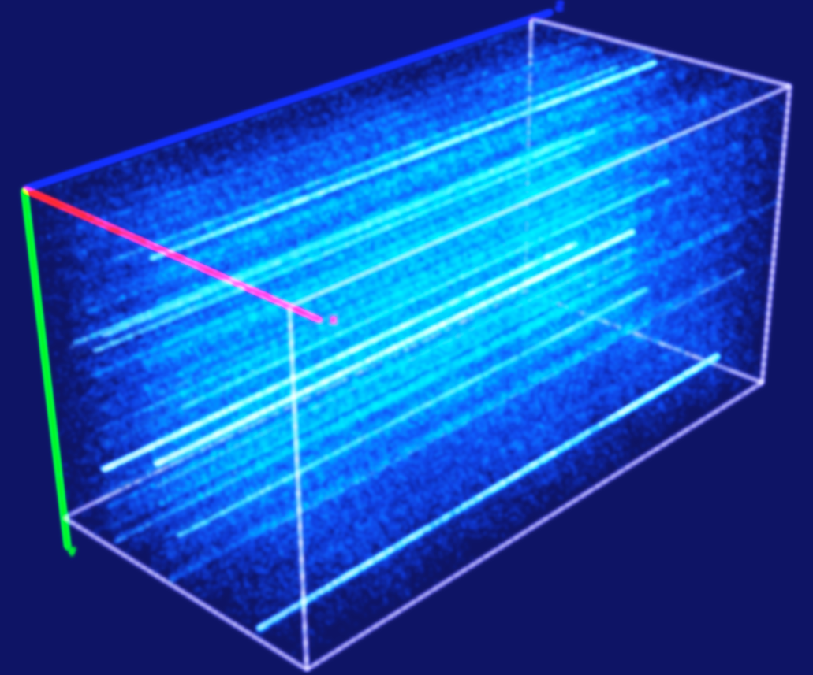
[# of samples: M (4K ~ 6K)]
[spectral window: 15]
[baseline: 351]
[channel: 2048]
[# of samples: M][baseline: 351]
[channel: 30720 / S]
[Total # of samples: Sum(M)]
[baseline: 351][channel: 30720 / S]
CLEAN (N splits)
Split on Freq
S = 480 / K sub-bands
(K MHz each)
…
Sub-cube 1
Subband 1
Obs 1
…
Image Concatenation
CLEAN (N splits)
Split on Freq
…
Sub-cube 2
Subband 2
Obs 2
…
…
CHILES Cube
2048 x 2048 x 30720
≈ 0.5 TB
…
…
CLEAN (N splits)
Sub-cube S
Subband S
Obs N_{day}
Split on Freq
…
…
Notes:
Instantaneous bandwidth = 480 MHz, if we split every 2 MHz, then we have 240 Splits, which is the same as 2048 x 15 / 128 = 240
Each channel is 32 MHz (per SPW) / 2048 (per SPW) = 15.625 KHz
Total # of channels = 480 MHz / 15.625 KHz = 30720
CDELT1 = -3.472222222222E-04
CDELT2 = 3.472222222222E-04
CDELT3 = 1.562500000000E+04
So the image resolution should be 3.472222222222E-04 * 3600 = 1.25 arc second
Compared to MWA, 0.0125 * 3600 = 45 arc second

Slide 2
data object
component
produces
inserted component
consumes
inserted data object
1.1
A11
contains
counter modifier
1.2
A12
2
0
A1
1.S
…
B1
C1
A1s
1.1
A21
1.2
A22
2
0
A2
1.3
…
B2
C2
3
A2s
D
E
…
1.1
AN1
1.2
AN2
2
0
AN
1.3
…
BS
CS
ANs
Notes:
How synchronization is handled?

Slide 3
A1
A2
B
…
Am
Notes:
How synchronization is handled?

