Slide 1
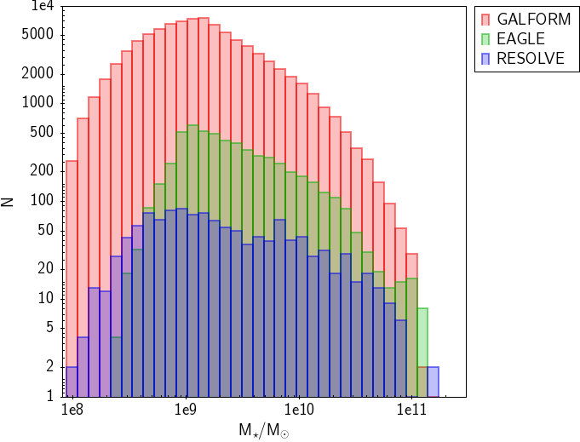
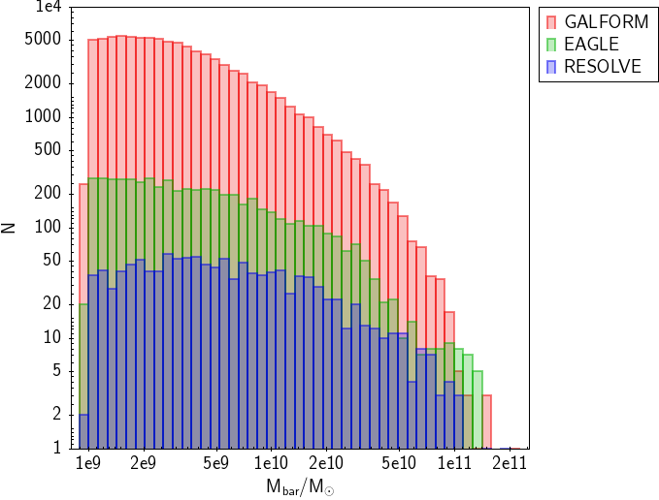
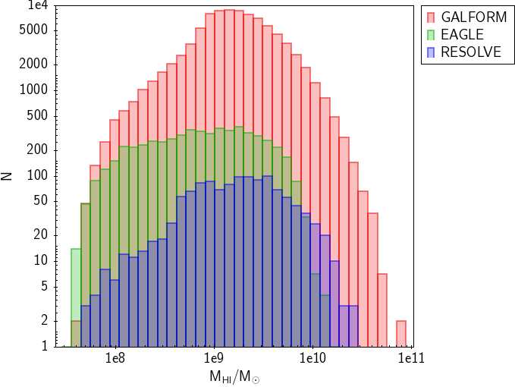
Fig. 1. Stellar mass distribution for GALFORM (red), EAGLE (green) and RESOLVE (blue) after the selection in baryon, group, stellar mass and gas fraction.
Fig. 2. As Fig. 1 but for the baryon mass.
Fig. 3. As Fig. 1 but for the HI mass.

Slide 2
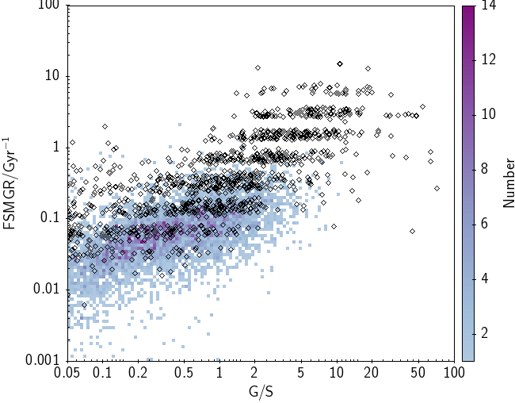
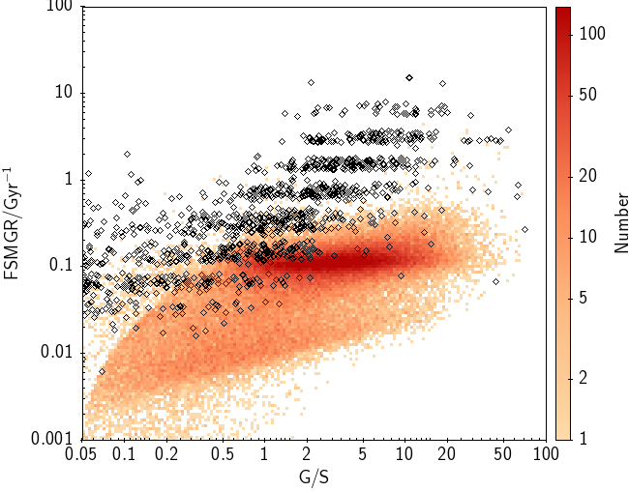
Fig. 4. FSMGR as a function of the gas fraction for EAGLE and RESOLVE. For EAGLE we colour bins according to the number of galaxies in each bin as shown by the colour bar. RESOLVE galaxies are shown as diamonds.
Fig. 5. FSMGR as a function of gas fraction for GALFORM and RESOLVE. For GALFORM we colour bins according to the number of galaxies in each bin as shown by the colour bar. RESOLVE galaxies are shown as diamonds.

Slide 3
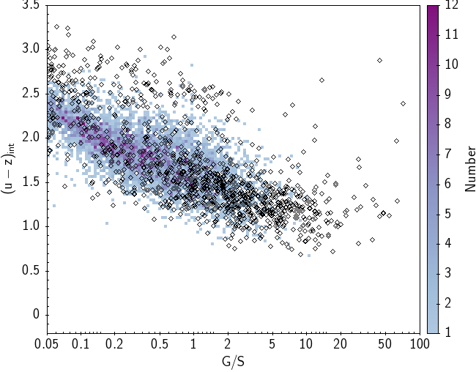
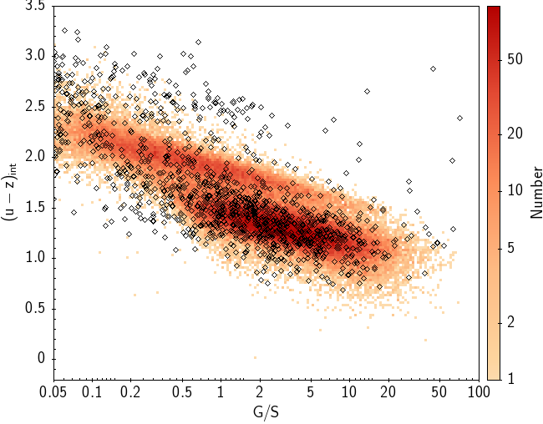
Fig. 6. Intrinsic (u-z) colour as a function of gas fraction for EAGLE and RESOLVE. For EAGLE we colour bins according to the number of galaxies in each bin as shown by the colour bar. RESOLVE galaxies are shown as diamonds.
Fig. 7. Intrinsic (u-z) colour as a function of gas fraction for GALFORM and RESOLVE. For GALFORM we colour bins according to the number of galaxies in each bin as shown by the colour bar. RESOLVE galaxies are shown as diamonds.

Slide 4
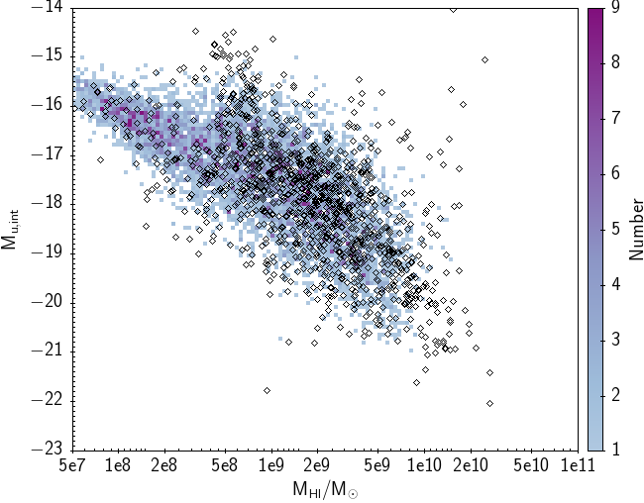
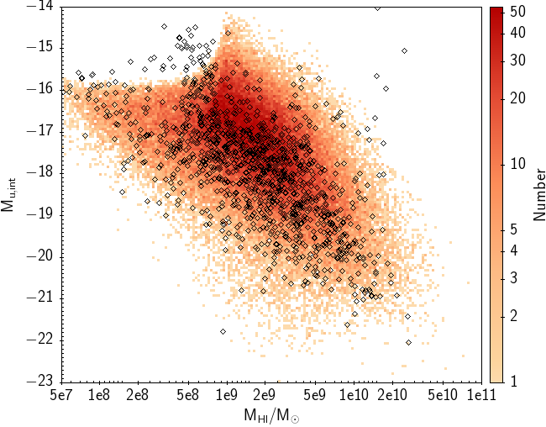
Fig. 8. Intrinsic u-band absolute magnitude as a function of HI mass EAGLE and RESOLVE. For EAGLE we colour bins according to the number of galaxies in each bin as shown by the colour bar. RESOLVE galaxies are shown as diamonds.
Fig. 9. Intrinsic u-band absolute magnitude as a function of HI mass GALFORM and RESOLVE. For GALFORM we colour bins according to the number of galaxies in each bin as shown by the colour bar. RESOLVE galaxies are shown as diamonds.

