Slide 1
PROBLEM/CHALLENGE
Unit Training Managers need a consolidated training system to inform servicemembers when they are due for training to improve mission readiness and track career progression
Trainings are tracked across multiple systems, but data isn’t consolidated or user-friendly, making manager tracking very difficult and data being skewed.

Slide 2
Training Operations
Training Requirements
Air Force
Ancillary
Air Force
Individual Job Training (Initial)
Air Force
Individual Job Training (Recurring)
Professional Military Education
Army Trainings
ITRM - (Group &
Job Specific)
Documentation of Training
ARCNET
MYLEARNING
MRDSS
MYLEARNING?
HARD COPY TRAINING RECORD
MRDSS
CMRP CHECKLIST
MYLEARNING
NEW PLATFORM?
MRDSS
ITRM EXCEL
How Training Is Stored
ELECTRONIC:
ARCNET
MYLEARNING
MRDSS
HARD COPY
ELECTRONIC
HARD COPY
ELECTRONIC
ELECTRONIC:
MRDSS
TEAMS
Execution of Trainings
Group Trainings (Briefings)
Individual (Computer)
Briefings / Hands On Skill Training
Formal Courses
Briefings
Hands On Skill Trainings
Civilian job
Formal Courses
Formal Courses
Computer Training
Briefings

Slide 3
IMPACT
A solution would improve training management, improve mission readiness, and ensure airmen are consistently certified for deployment and career advancements.

Slide 4
Trainings Requirements
Air Force Ancillary Trainings – see slide 4
  Group trainings required for all members
  Each training states if it can be done online or in a group setting
Air Force Individual Job Trainings / Initial Skill Level Focus – see slide 5
  Individual trainings required by their Air Force Specialty Code (AFSC)
Air Force Individual Job Trainings / Recurring Skill Level Focus - Comprehensive Medical Readiness Training (CMRP) – see slide 6
  Individual trainings required by their Air Force Specialty Code (AFSC) – aka. Job (medic, nurse, etc)
Army Trainings (Individual Training Readiness Matrix (ITRM) – see slide 7
  Group trainings required
Army Trainings (Individual Training Readiness Matrix (ITRM) – see slide 8
  Individual trainings required by their Air Force Specialty Code (AFSC) – aka. Job (medic, nurse, etc)

Slide 5
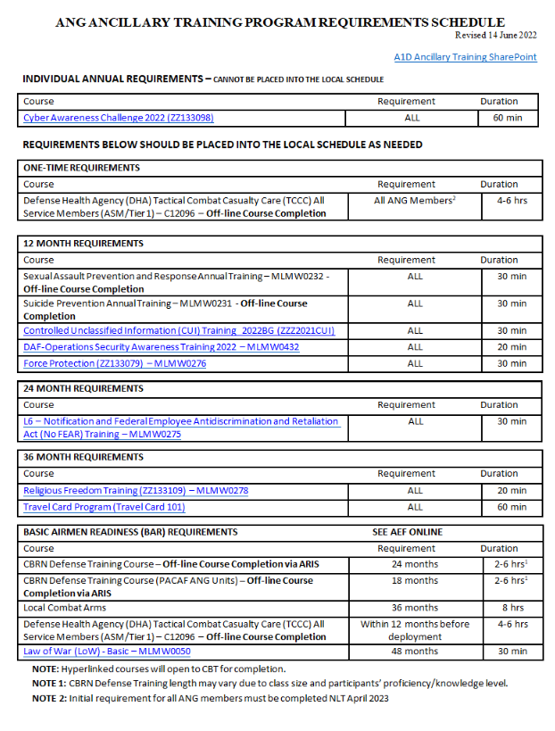
Air Force Ancillary Trainings (Required for Everyone)
These tasks are recorded in ARCNET, MyLearning and Medical Readiness Decision Support System (MRDSS).

Slide 6
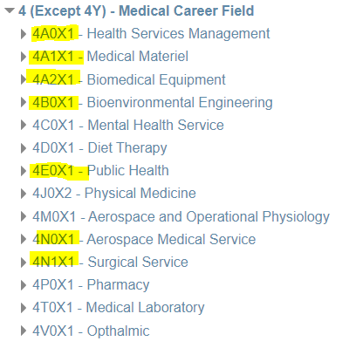
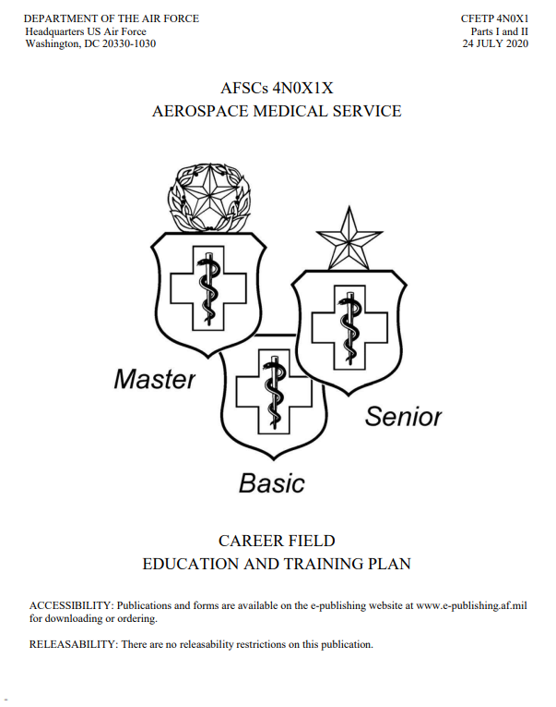
Air Force Individual Job Trainings / Initial Skill Level Focus
[Varies per Air Force Specialty Code (AFSC)]
Career Field Education & Training (af.mil)
(Required for Enlisted Members based on their jobs)
The different AFSCs for my medical unit
Example
These tasks are quite tedious based on the AFSC, so I can continue manually recording these on their paper training records.

Slide 7
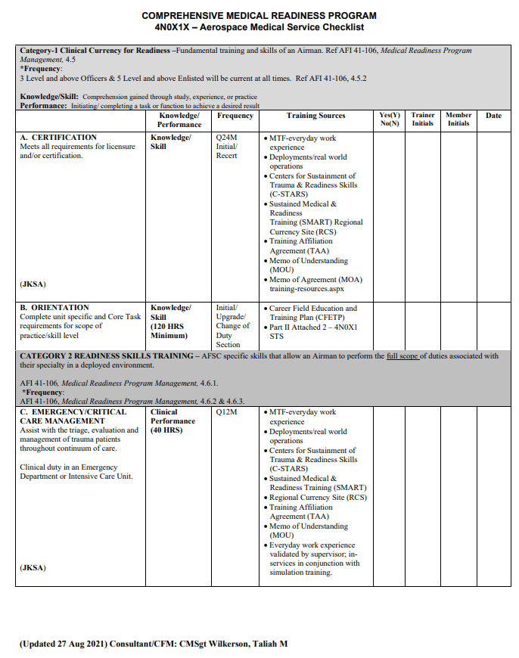
Air Force Individual Job Trainings / Recurring Skill Level Focus
[Varies per Air Force Specialty Code (AFSC)]
Comprehensive Medical Readiness Program (CMRP) Home (health.mil)
The different AFSCs for my medical unit
Example of Checklist
These tasks are recorded in Medical Readiness Decision Support System (MRDSS).

Slide 8
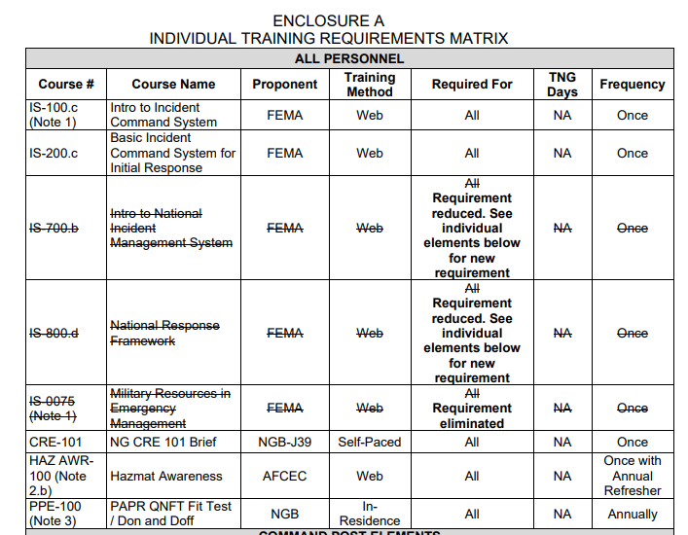
Army Trainings (Individual Training Readiness Matrix (ITRM)
(Required for Everyone)
These tasks are recorded in Medical Readiness Decision Support System (MRDSS).

Slide 9
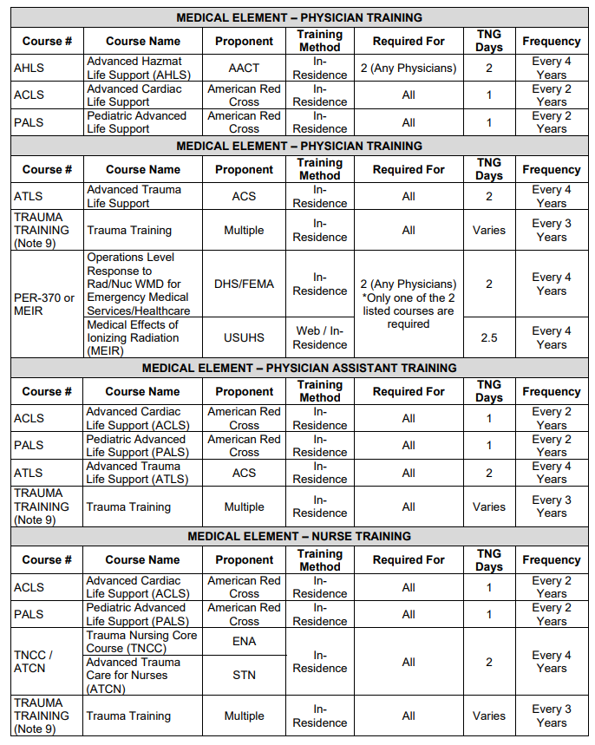
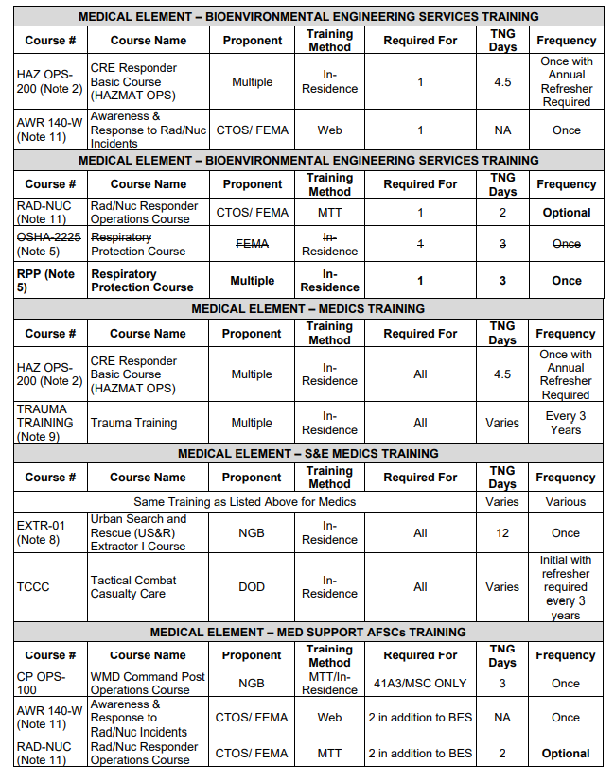
Army Trainings (Individual Training Readiness Matrix (ITRM)
(Required for Everyone Based on their Job)
These tasks are recorded in Medical Readiness Decision Support System (MRDSS).

Slide 10
Training Systems used today
Medical Readiness Decision Support System (MRDSS)
MyLearning
  New platform launched in 2022
  Tracks group and individual trainings on an Air Force Scope
    Ancillary
    Individual Skill Training
ARCNET
  Tracks Air National Guard / Air Reserve focused trainings on an Air Force Scope
ITRM Excel Tracker

Slide 11
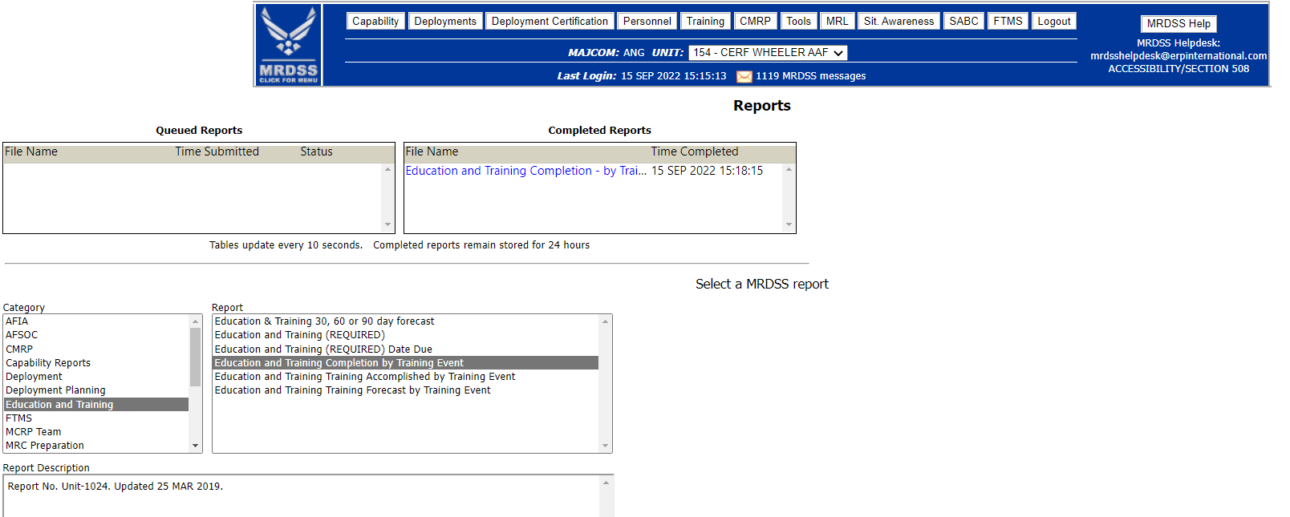
Medical Readiness Decision Support System (MRDSS)
MRDSS is an automated information system on the Global Information Grid used by the Air Force medical Services to manage readiness information in direct support of active Air Force units, Air National Guard, and Air Force Reserves, at fixed bases, and deployed locations during both peace and wartime operations.
Specifically used for medical units.
Has reporting capabilities
Can track Army group/individual trainings
It currently does not talk to ARCNET or myLearning
MRDSS Helpdesk can assist with adding/removing trainings
  Consider working with them on tailoring reports to capture trainings due

Slide 12
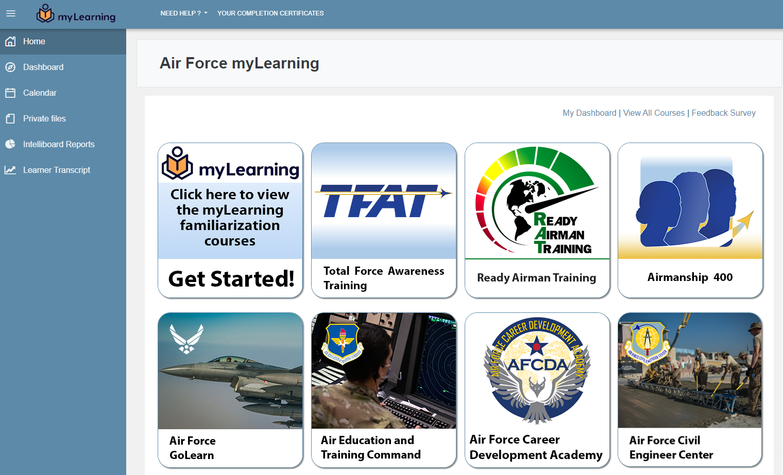
Air Force myLearning
The learning management system launched in 2021 is part of Air Education and Training Command’s efforts to aggressively and cost-effectively modernize education and training to develop the Airmen we need.

Slide 13
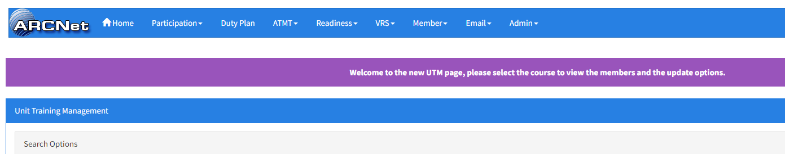
Air Reserve Component Network (ARCNet)
Air Reserve Component Network (ARCNet) offers a series of tools for Reservists and Guardsmen, and the people who manage them. The ARCNet application grows almost monthly, giving military leadership the most up-to-date information, while simplifying management of people and programs. Security features through the AF Portal ensure the ARCNet system data maintains the highest caliber of protection on sensitive unit and individual data. Included in the ARCNet tool box are Information and Communications tools, Readiness Reporting Dashboards, Ancillary Training Management, Duty Planning and Participation Management, Volunteerism or job searching and application tools.

Slide 14
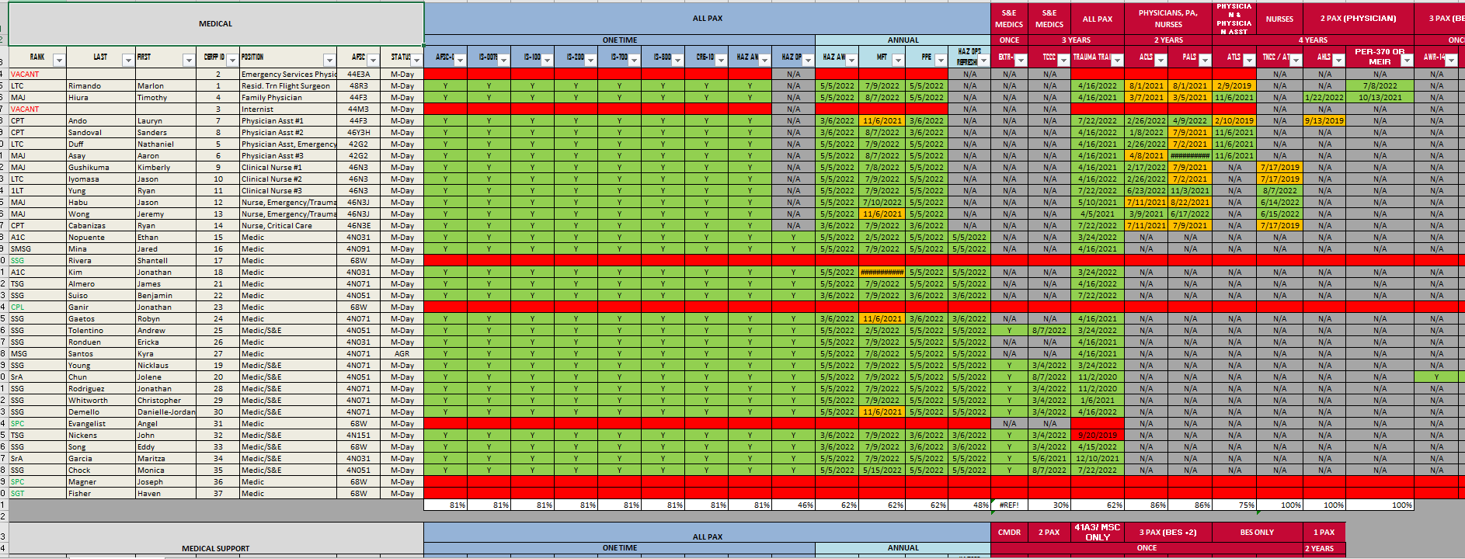
ITRM Tracker (manual)

Slide 15
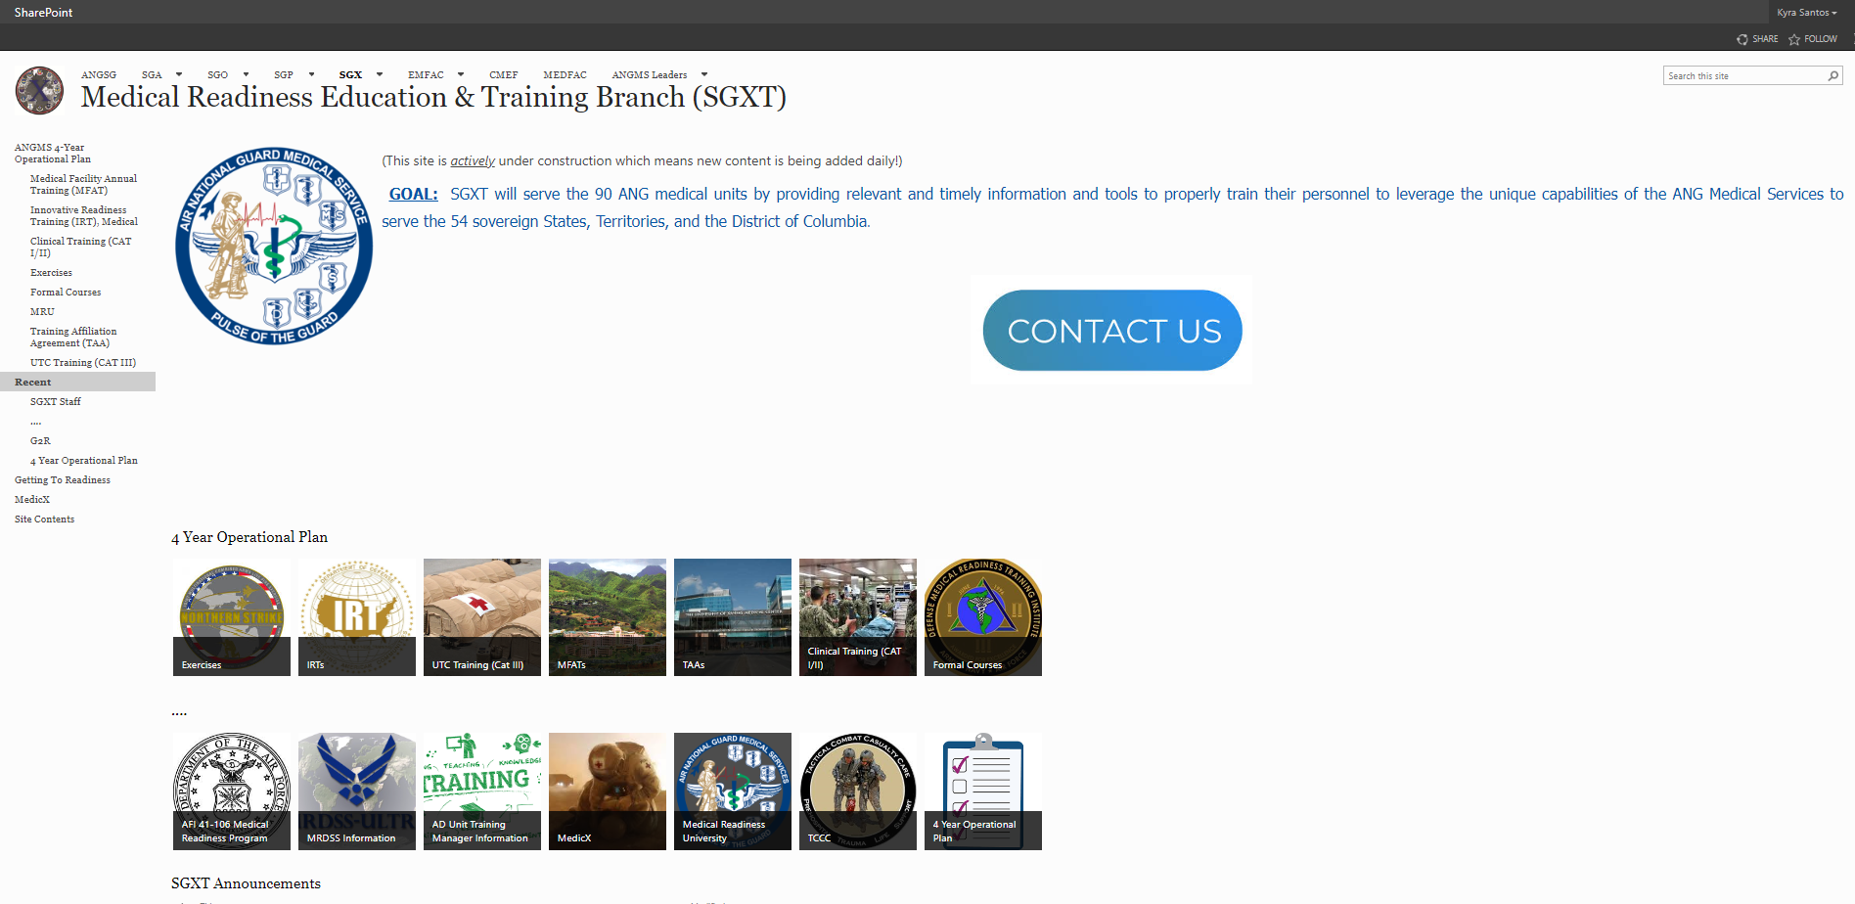
Other Helpful Resources
Career Field Enhanced Training Plan (PDF) – Air Force – see slide 6
  Air Force Specialty Code job specific on career progression
  Defines all job related trainings required
Individual Training Readiness Matrix (ITRM) (PDF) – Army – see slide 8/9
  Group trainings required
  Individual trainings required
National Guard Bureau (NGB) / Joint Surgeon General (JSG) Sharepoint
  All ITRM certificates loaded here as of Aug 2022
    Medical Readiness Education & Training Branch (SGXT) (health.mil)

Slide 16
MSgt Santos Due outs
MSgt Santos to provide more point of contacts for future interviews
In-person visit to show the training tracking systems to include navigating and entering completed trainings
Work on some automated solutions to alleviate the problem
After 9/24/2022, MSgt Santos will reach out to the Training & Readiness Office to see what assistance can be gathered.
  Security requirements
  CAC logon
  Budget/Software build

