Slide 1



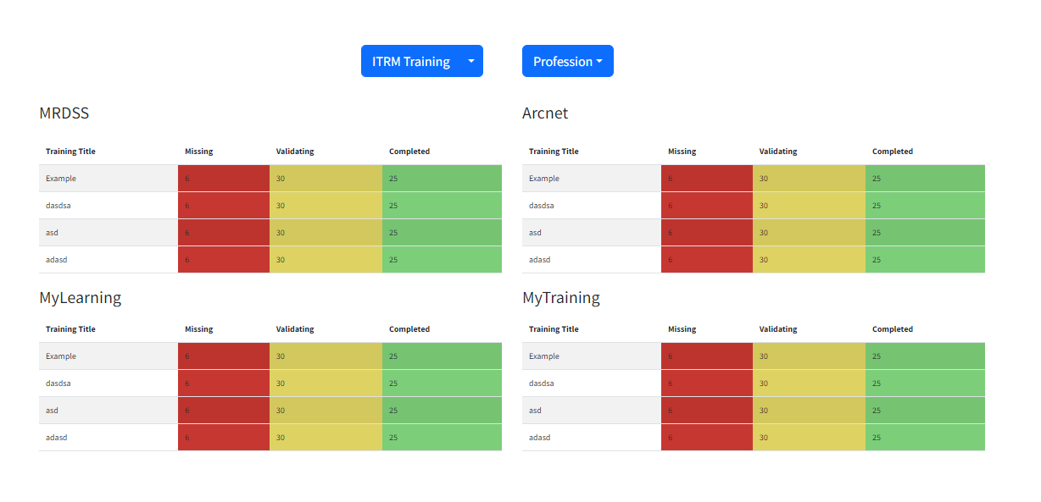





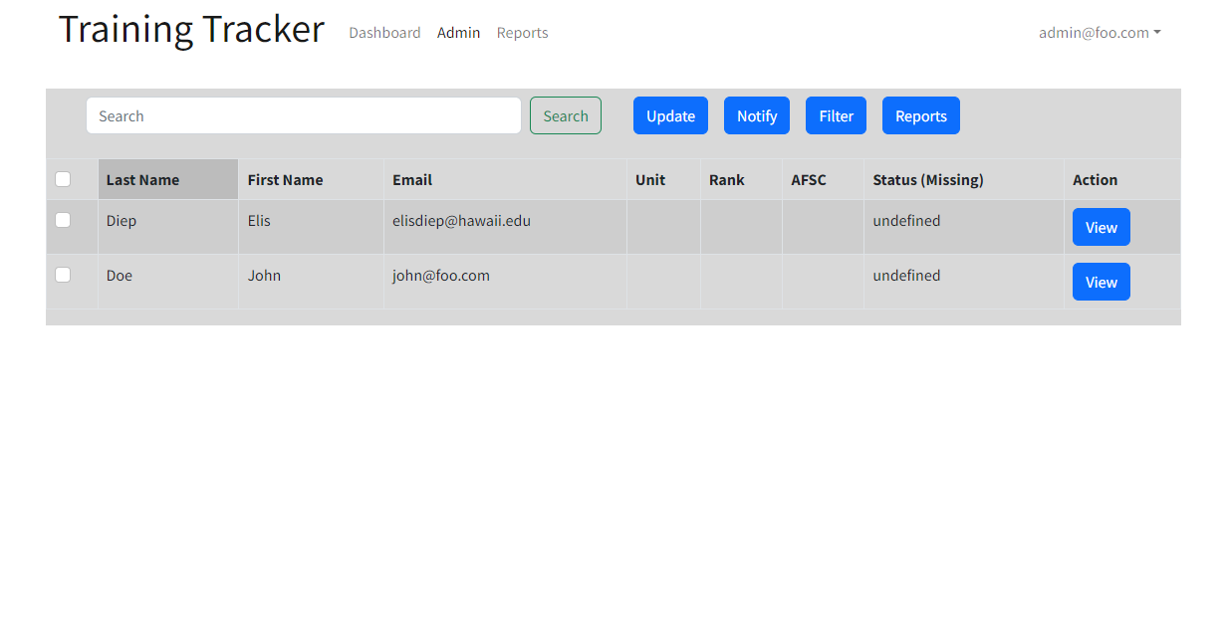
Training Tracker
Elis Diep, Trevor Kanasaki, Thane Luna
ICS 496, Spring 2023
Information and Computer Sciences Department - University of Hawaiʻi at Mānoa
Sponsor: MSgt Santos
Sponsor 154 MDG DET 1
Introduction:
Technology Stack:
Problem Statement: Unit Training Managers tracking individuals’ progress across multiple platform, but data is not consolidated and system is not user-friendly. UTMs use these disparate systems along with Excel documents to track all personnel certificates
Issues:
Accomplishments:
Time: Time was one of the main issues. We got started later than we would of wanted. Getting in contact initially with MSgt Santos was one of the first issues due to availability.
Accessibility: Working with the Department of Defense gave limited access and resources for us to use. We had to make a substitute databases to help implement functionality.
DashBoard: A dashboard page with training completion bar graphs that represent the training platforms and their type of training.
Profiles Page: Profile page that has the list of the Airmens in the unit. It displays the their full name, email, unit, rank, AFSC. Featuring a view button for each airmen that goes to their profile page. Profile page additional features are emailing, updating and filtering the members training.
Reports Page: Where UTMs can upload and download Excel report sheets.
Admin User: Able to access all members and database. Can adjust database to either add, adjsut or delete trainings or memebers
Training database: Created four databases that represent the different training application and its training type
Process:
Phase 1: We first reviewed the prior semester materials. Last semester the previous team created a presentation that went over the whole problem and provided a minimal viable product. After reviewing the material, we met with our sponsor MSgt Santos and NSIN director Gloria Choo. We went over the project and asked additional questions.
Phase 2: After phase 1. The team created a development plan and shared it with our sponsors. The development plan was split into 3 milestones.
Milestone 1: constructing the user interface.
Milestone 2: Building the database and collection
Milestone 3: Testing, debugging and adjustments.
Phase 3: Implement the 3 milestones. Make adjustment according to MSgt Santos feedback.
Team Logistics:
Weekly tuesday meeting with sponsor
Weekly thursday meeting with team
Next Steps:
Implement feedback from sponsor
Update and fix bugs
Continue to integrate functionality
Integrate with existing system
Scrap Excel data

