Slide 1
R1 Project Demo
Neighborhood Tool Sharing
Group 3 | ICS 613
Summer 2026
Team Members
Rion Sawabe Ivan Wu Yafei Wang Nick Fairhart Loreto Coloma
Notes:
PM

Slide 2
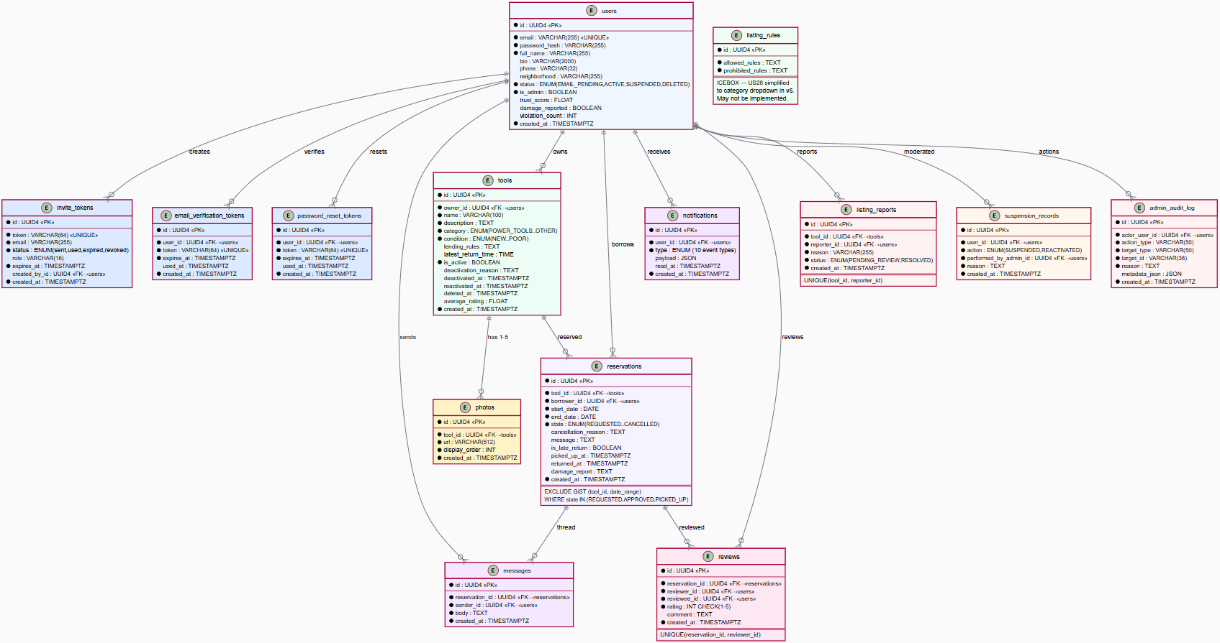
Overview of the Domain Model and ER diagram
8 Entities, 5 Core Relationships
User, Tool, Reservation, Review, Invite, Photo, Notification, AdminAuditLog
User owns Tools • User borrows via Reservations
Reservation → Review (one per party)
Tool → Photos (1–5 scale limit)
Key DB Constraints
GiST EXCLUDE on (tool_id, daterange) — strictly prevents any double-booking
UNIQUE (reservation_id, reviewer_id) — limits to one review per party
Soft-delete with active-reservation guard; hard-delete for PII security
Enums: 6 ToolCategory · 5 ToolCondition · 6 ReservationState · 14 NotificationType
Notes:
Backend Lead

Slide 3
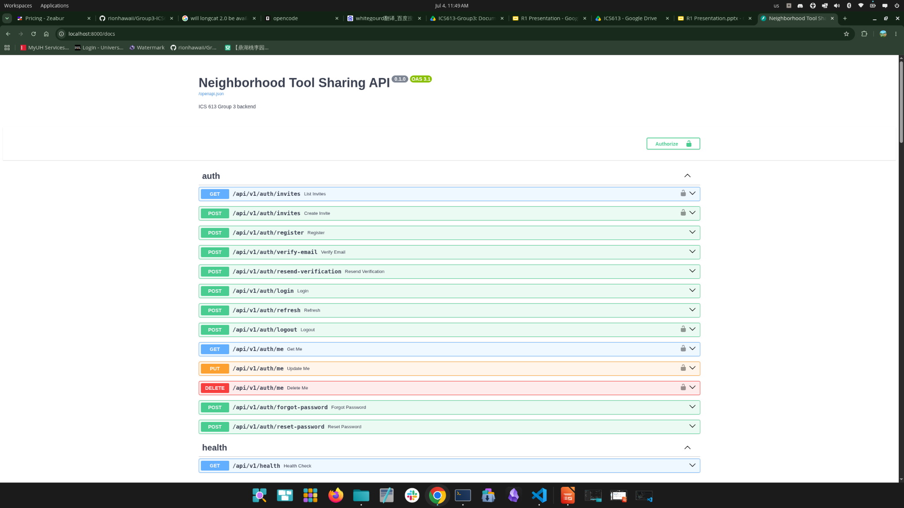
Major Accomplishments
Backend
46 Endpoints / 7 Routers Fully Implemented & Tested
Comprehensive coverage of core services ensuring robust data layers and business logic.
Endpoint Breakdown:
• Auth: 13 endpoints
• Tools: 11 endpoints
• Reservations: 10 endpoints
• Reviews: 5 endpoints
• Admin: 4 endpoints
• Notifications & Health: 3 endpoints
Infrastructure Highlights
JWT Security: Access & refresh tokens with automatic rotation.
Rate Limiting: Configurable active protection on all auth endpoints.
DB-Level Guard: GiST EXCLUDE constraints prevent double-booking.
APScheduler: Automated stale cancels, escalations, and cleanups.
Photo Uploads: Magic-byte validated with a 5 MB disk limit.
Notes:
Frontend, Backend, DevOps

Slide 4
Major Changes (if any)
Notes:
PM

Slide 5
Project Management Approach (changes, if any)
Notes:
PM

Slide 6
Key Risks & Mitigation Strategies Update (if any)
Were there any risks identified in Project Initiation that materialized?
How were they addressed?
User Story 18 Auto-Cancel Overdue: As the system, I want to automatically cancel reservations that are never picked up after a grace period, so that tool availability is not indefinitely blocked.
Job Runner (Celery + Redis):
Notes:
Document Lead

Slide 7
Quality Assurance Metrics
Defects reported, fixed, open, etc.
Code quality metrics, unit test coverage
Notes:
QA Lead

Slide 8
Milestones
Missed/Postponed milestones (Why?)
Upcoming milestones
What will be delivered at these milestones
Notes:
Document lead

Slide 9
Next Steps
1
Deferred User Stories
2
Improvements
3
TBD/Icebox
Functionality
Usability
Admin Tools
Admin Tools
R1 Retrospective
Timezone normalization
Reservation messaging
Notification center UI
Member: Reporting a listing
Pagination on all list endpoints
Advanced search filters
Managing tool categories (CRUD API)
Generate community moderation reports
Review reports
Track violations
Suspend/reactivate a member
Moderation history
Bug fixes for issues identified after R1

Slide 10
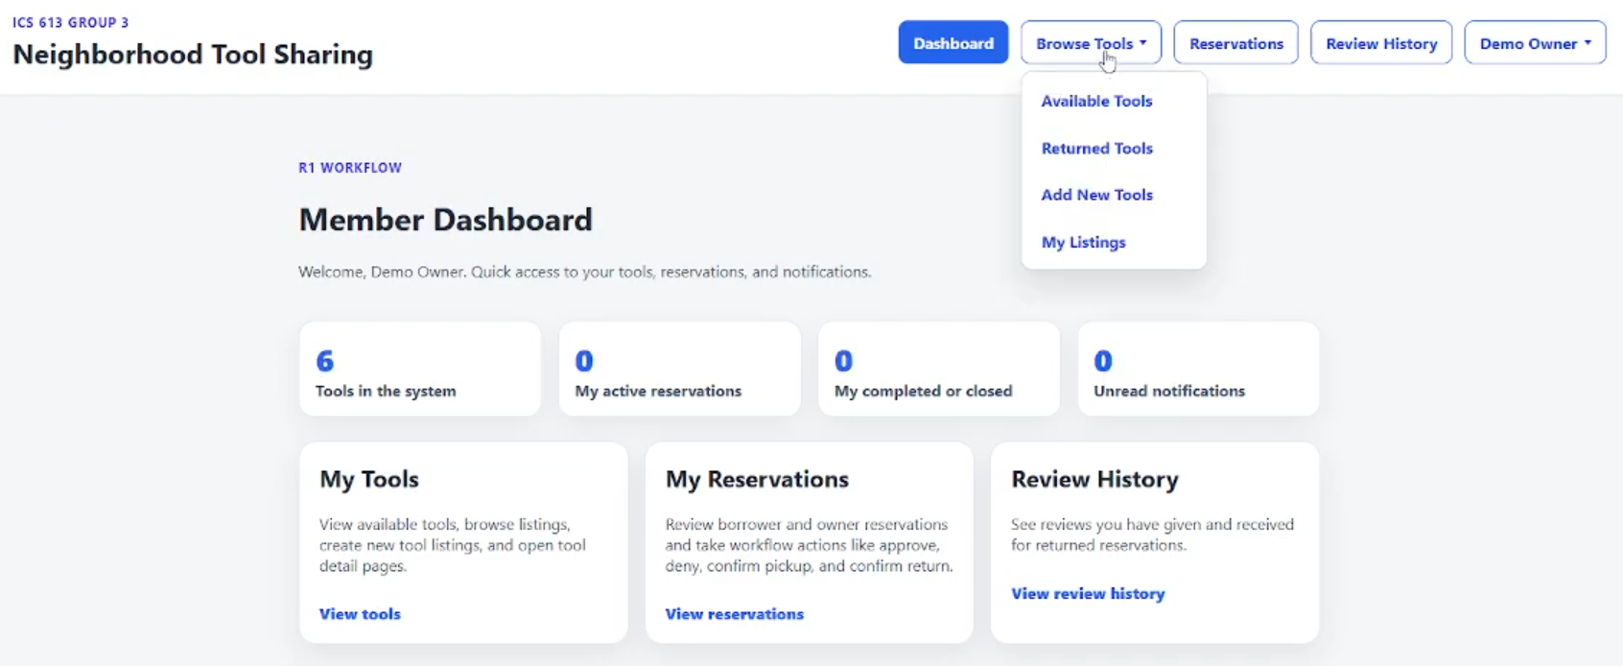
Neighborhood Tool Sharing Demo
Sample text

Slide 11
Questions?

Slide 12
Notes (only to prepare)
In addition to demonstrating key functionality in the live demo, teams should be prepared to conduct a code walkthrough and explain key components of the codebase.

Slide 13
SWOT
Strengths
Weaknesses
– Make a list of what your organization or team excels at.
– This is what sets you apart from the competition.
– Add as many items as you need.
– Identify areas for improvement within your organization or team.
– Think about what you could be doing internally to achieve better results.
– Add as many items as you want or need.
Opportunities
Threats
– Call out any opportunities for growth.
– These are external factors, such as market trends or platforms, that your business can leverage.
– Add as many items as you want or need.
– Mention any challenges, obstacles, or risks that your business is facing.
– These can range from environmental factors to new market competitors.
– Add as many items as you want or need.

Slide 14
1
Persona
Name
2
Persona
Name
3
Persona
Name
Needs and motivations
Needs and motivations
Needs and motivations
Pain points
Pain points
Pain points
Opportunities
Opportunities
Opportunities
PERSONAS
– What does your persona want or need to achieve?
– What are their goals?
– What motivates them to pursue these goals?
– What does your persona want or need to achieve?
– What are their goals?
– What motivates them to pursue these goals?
– What does your persona want or need to achieve?
– What are their goals?
– What motivates them to pursue these goals?
Describe an obstacle your persona struggles with. Think about what interferes with their needs, goals.
Describe an obstacle your persona struggles with. Think about what interferes with their needs, goals.
Describe an obstacle your persona struggles with. Think about what interferes with their needs, goals.
This is where your offering comes in. Think about how you can help this persona with their daily struggles and blockers.
This is where your offering comes in. Think about how you can help this persona with their daily struggles and blockers.
This is where your offering comes in. Think about how you can help this persona with their daily struggles and blockers.

Slide 15
1
2
3
4
5
Step name
Step name
Step name
Step name
Step name
Describe a step needed to reach your strategic goals.
Describe a step needed to reach your strategic goals.
Describe a step needed to reach your strategic goals.
Describe a step needed to reach your strategic goals.
Describe a step needed to reach your strategic goals.
BUSINESS ROADMAP
Add a milestone
Add a milestone
Add a milestone
Add a milestone
Add a milestone
Add a deliverable
Add a deliverable
Add a deliverable
Add a milestone
Add a deliverable
Add an objective.
Add an objective.
Add a deliverable
Add a milestone
Add an objective.

Slide 16
1
2
3
4
5
Step name
Step name
Step name
Step name
Step name
Describe a step needed to reach your strategic goals.
Describe a step needed to reach your strategic goals.
Describe a step needed to reach your strategic goals.
Describe a step needed to reach your strategic goals.
Describe a step needed to reach your strategic goals.
BUSINESS ROADMAP
Add more info about this step. For example, deliverables, activities, marketing assets.
Add more info about this step. For example, deliverables, activities, marketing assets.
Add more info about this step. For example, deliverables, activities, marketing assets.
Add more info about this step. For example, deliverables, activities, marketing assets.
Add more info about this step. For example, deliverables, activities, marketing assets.
You can also call out the teams or stakeholders involved.
You can also call out the teams or stakeholders involved.
You can also call out the teams or stakeholders involved.
You can also call out the teams or stakeholders involved.
You can also call out the teams or stakeholders involved.
Mention any performance targets that should be reached during this step.
Mention any performance targets that should be reached during this step.
Mention any performance targets that should be reached during this step.

Slide 17
Projected results
METRICS
$0,000
Metric
A brief note on the results.
$0,000
Metric
A brief note on the results.
$0,000
Metric
A brief note on the results.
00%
Metric
A brief note on the results.
00%
Metric
A brief note on the results.
00%
Metric
A brief note on the results.

