Slide 1
ICS 314:
Software Engineering I
Philip Johnson
Cam Moore
Information and Computer Sciences
University of Hawaii
Honolulu HI 96822

Slide 2
Goals of the class
Learn to efficiently build high quality, (reasonably) large scale software systems.
  By “growing” a small scale system into a large one.
  By pursuing the open source “prime directives”
  By effectively using tools to support quality attributes.
Develop a “professional persona”
  Portfolio, Blog, TechHui, LinkedIn.
  Support your entry into “real world”.
  Create a positive “image” for potential employers.
Learn how to learn complex material efficiently
  Using an "athletic" educational pedagogy

Slide 3
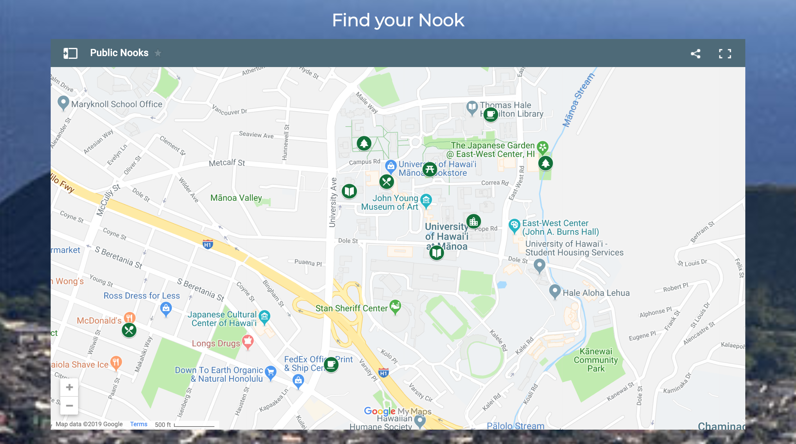

Slide 4
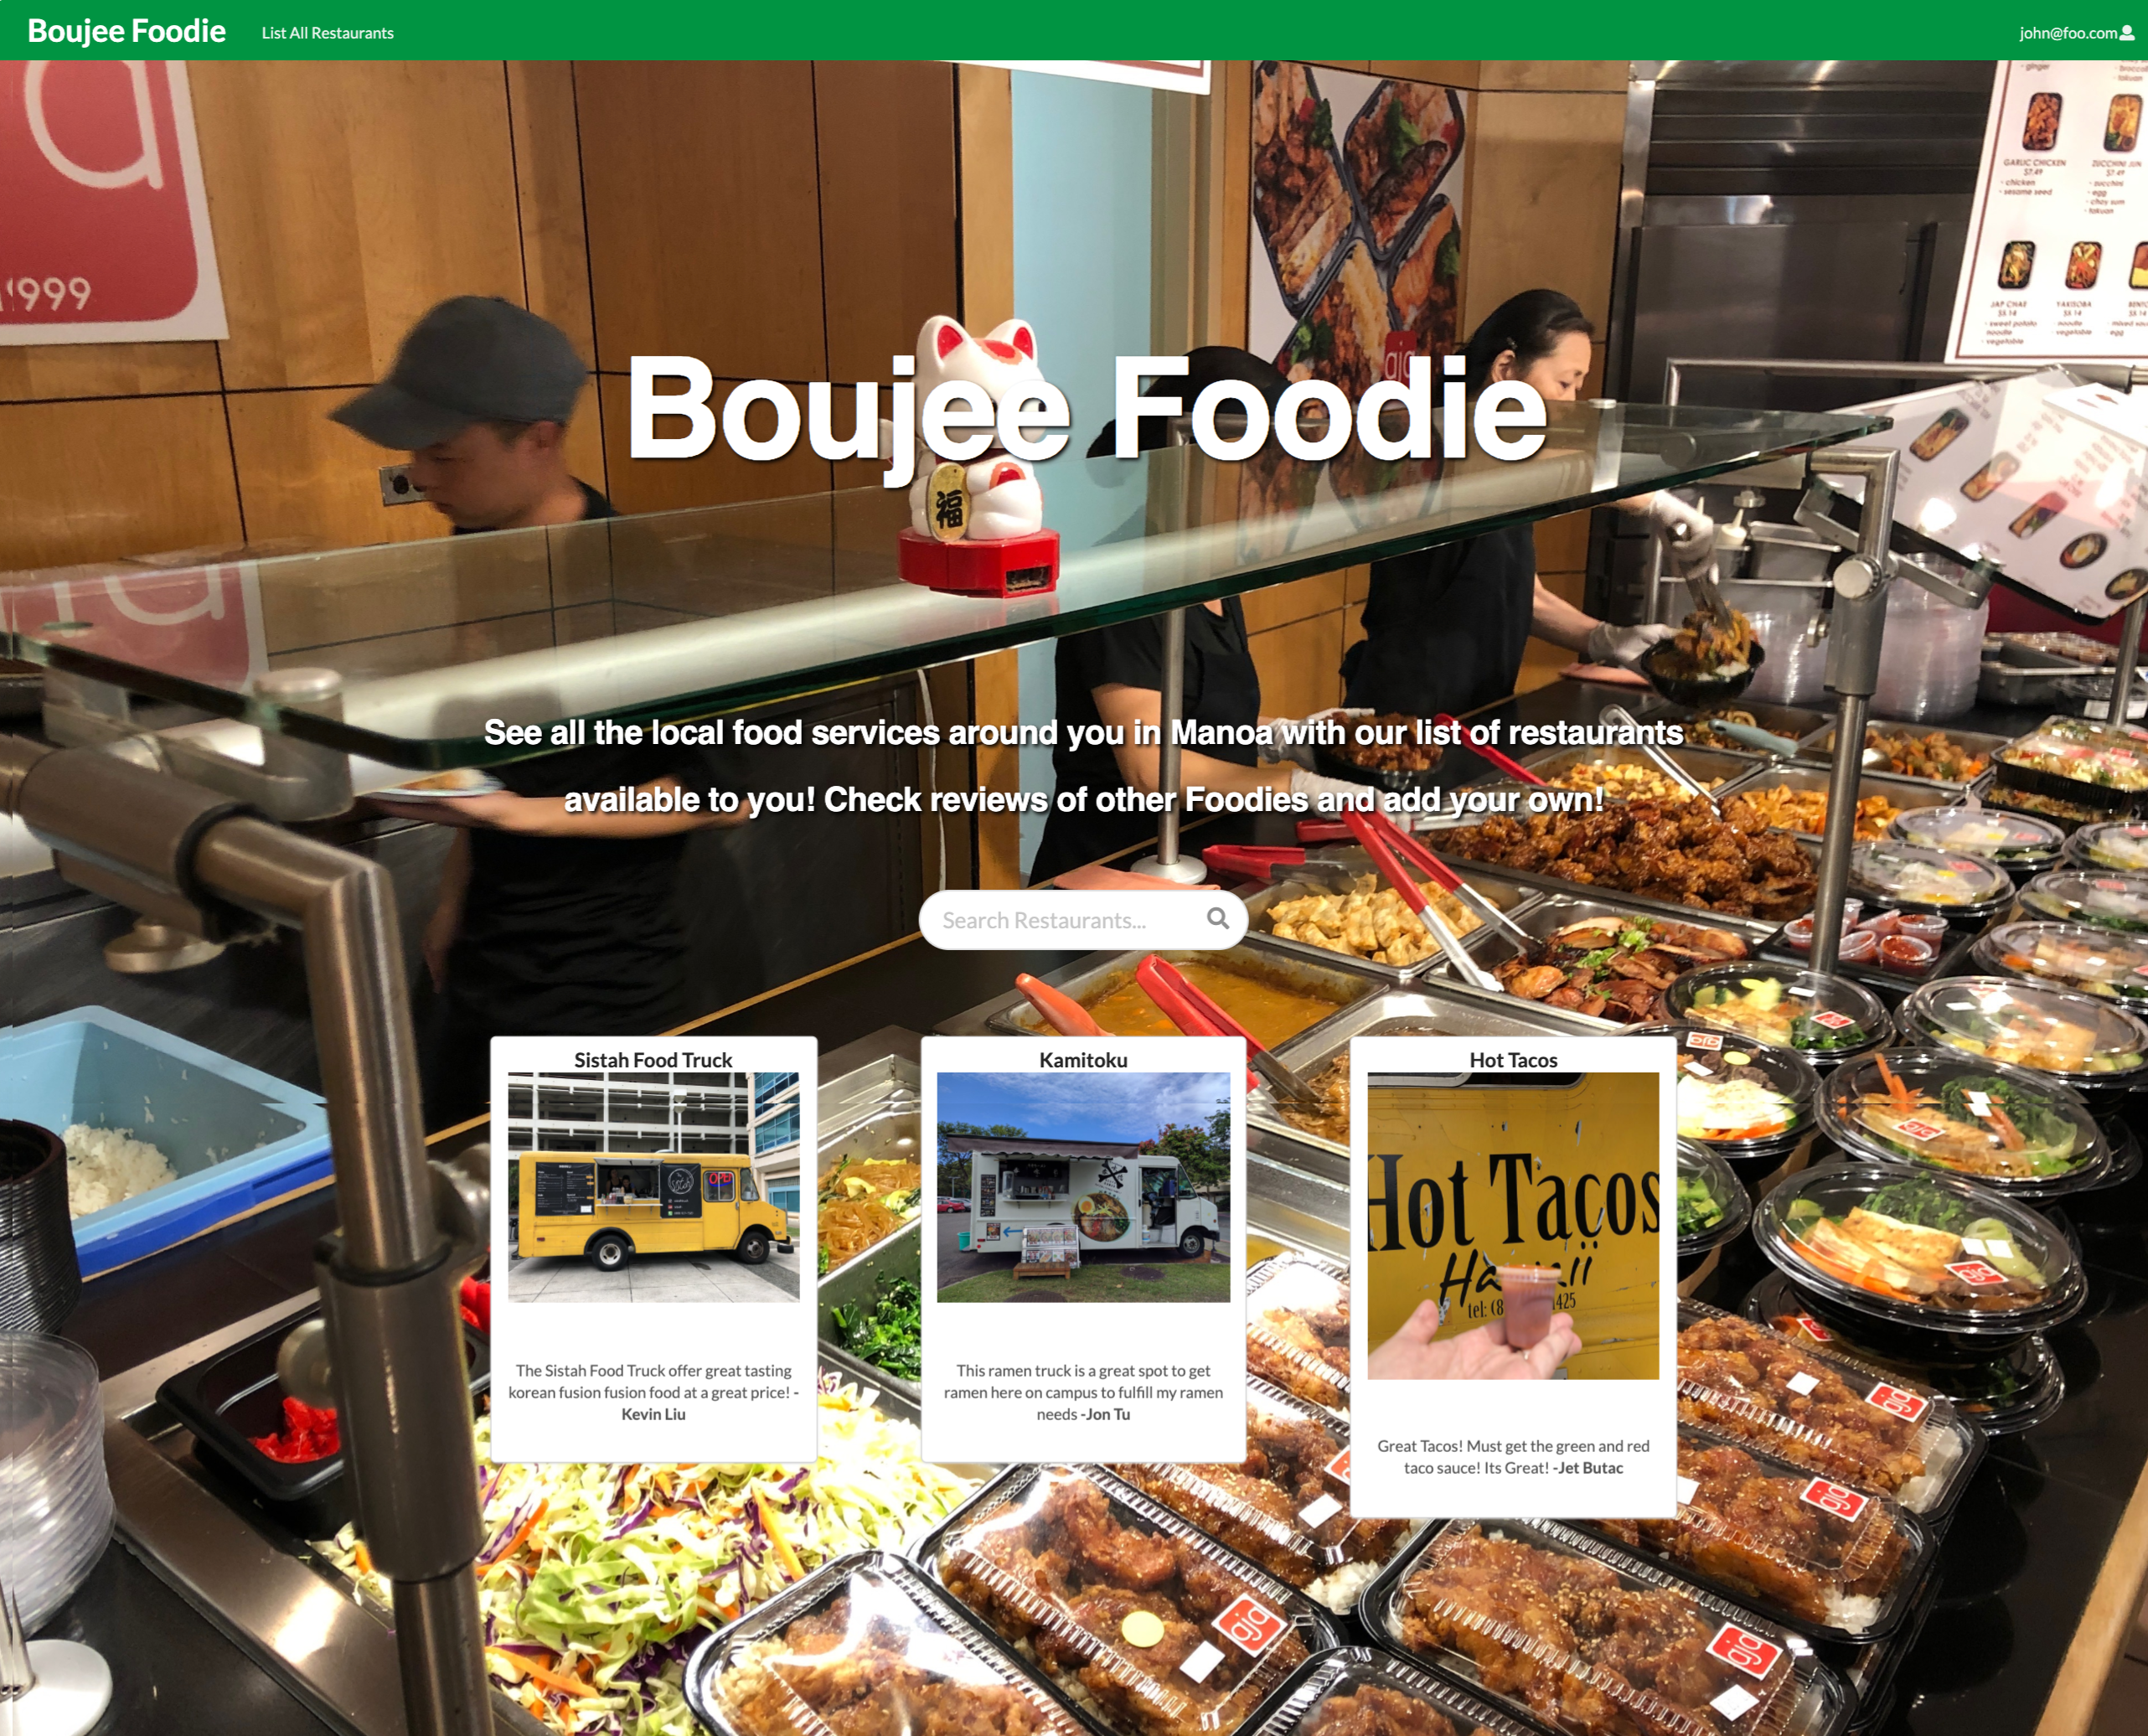

Slide 5
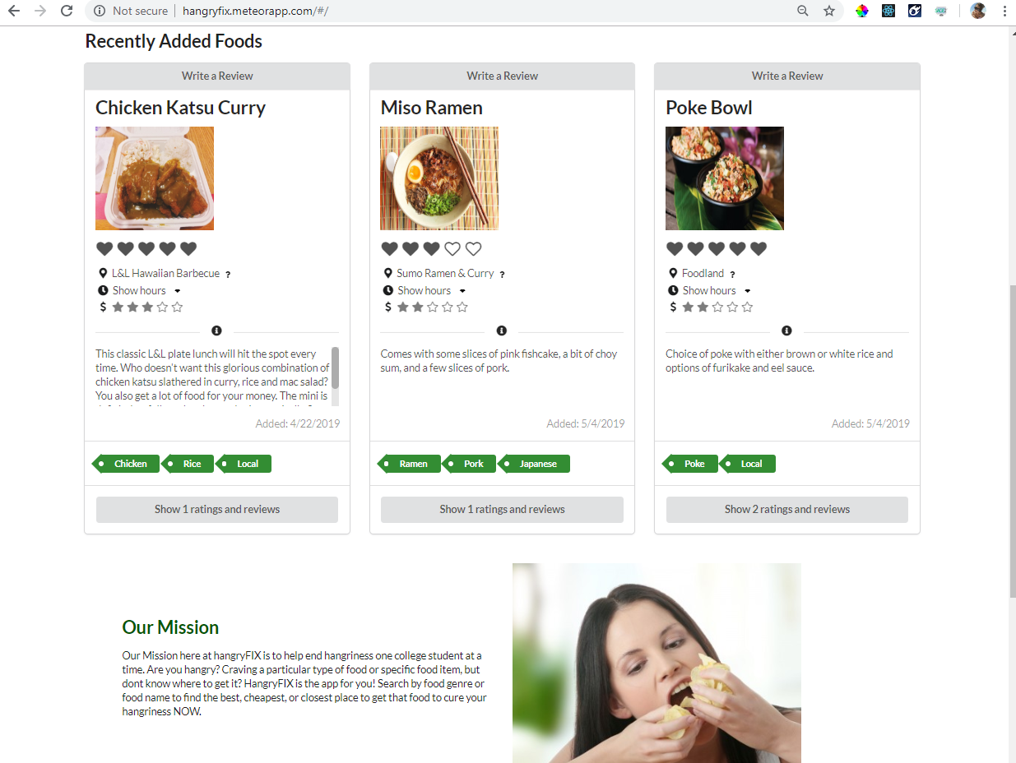

Slide 6
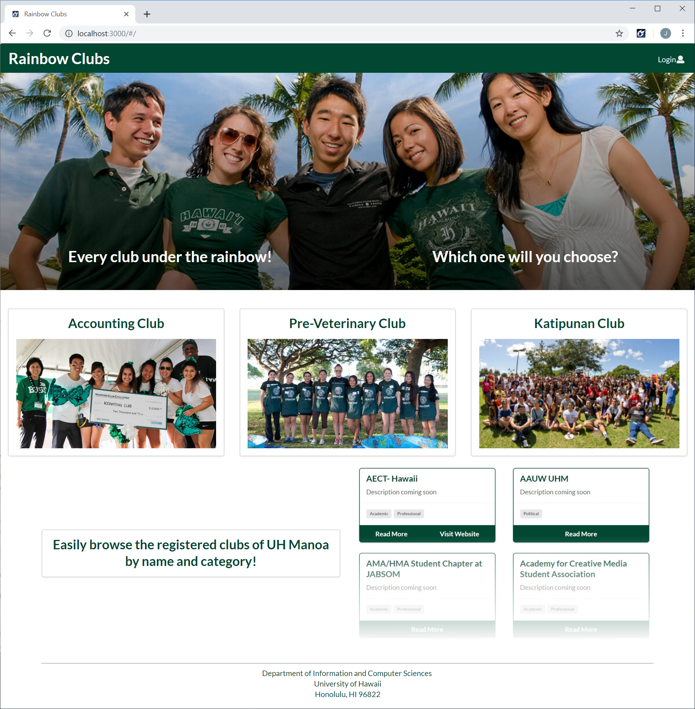

Slide 7
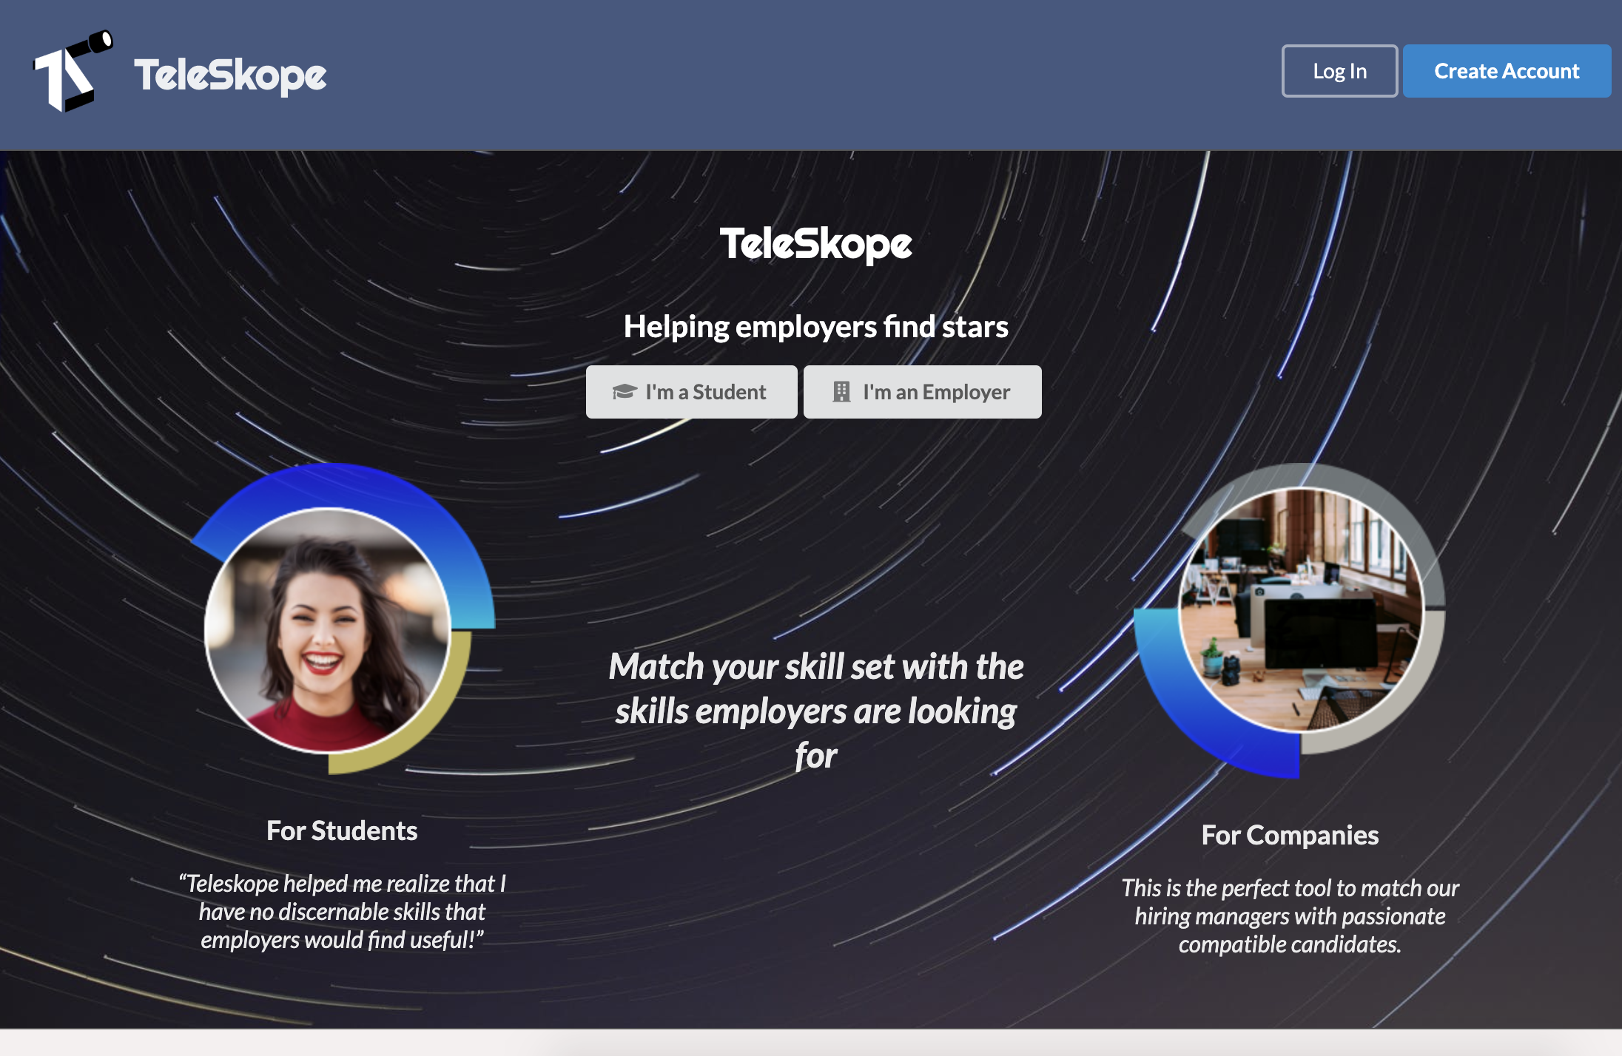

Slide 8
Course prerequisites
Programming background
  At least one year/one thousand lines of code.
  You must have taken and passed ICS 211 (or equivalent) PRIOR to this course.
Development environment:
  Unix, Macintosh OS/X, Windows 10 are OK.
  Fast network connection
  ICS Lab and TA machines not viable for this class.
  ICS Department has site license for Windows 10 (MS Imagine)
Lots and lots of time:
  Software development takes a lot of hours.
  What you put in determines what you get out.
  Not everyone has the time, energy, or interest to become skilled at software engineering.

Slide 9
Developer-level Laptop required!
Strongly recommended: a laptop with:
  2 Ghz+ processor
  16+ GB RAM
  SSD drive
  Recent version of Linux, MacOS, Windows 10.
  11”+ screen
  Example: Dell, $1000; MacBook, $1200.
This class involves a large amount of in-class programming; if you do not have a “developer level” laptop, you can not take advantage of those experiences.
“Netbooks” are not “developer level” laptops.
  Underpowered (tools take too long to run)
  Screen size too small

Slide 10
Grading
Tentative grading scheme:
  ~30%: Quizzes
  ~20%: Final
  ~50%: Writing and programming assignments
The weights and assignments may change.
Guarantees:
  90-100% guarantees an A
  80-89% guarantees a B
  70-79% guarantees a C

Slide 11
Athletic SE Education
The first three months of the semester will focus on an "athletic" pedagogy.
Each module focuses on a "skill".
Fluency with the "skill" means you can solve problems using it quickly.
I will assess your fluency with the skill by giving you an exercise with a time limit. (You cannot "google your way to the solution”).

Slide 12
Technical Essays
Software Engineering is a writing intensive discipline.
To help you acquire proficiency, you will write a variety of essays on technical topics related to course content during the semester.
This will provide practice in writing technical prose for public use, and also enable you to create an archival record of your growth and experiences in software engineering.

Slide 13
Professional Persona
A goal of this class is to help you develop your “professional persona” via:
  Your technical essays.
  Your professional portfolio.
  The open source code you authored.
  Your participation in professional social networking sites (TechHui, LinkedIn)
Your professional persona:
  is distinct from your “personal” persona (FaceBook, Twitter, etc.)
  will help/hurt your job opportunities
  is a career-long project.

Slide 14
Collaboration vs. Cheating
Collaboration:
  Talking with classmates about the most appropriate design for a system.
  Helping a classmate debug an error by reading their code and suggesting diagnosis experiments.
  Reusing open source code from the Net with attribution
Cheating:
  Taking a copy of someone else’s code (either classmates or from the net) and submitting it as your own (perhaps after minor rewriting to disguise the similarity.)
  Giving or receiving unauthorized help during WODs.
Cheating destroys the learning environment. If I catch you, you are likely fail the course.
If you are not sure if an activity constitutes collaboration or cheating, ASK ME!

Slide 15




You are the future of Hawaii

Slide 16
Good luck
and have fun!

