Slide 1



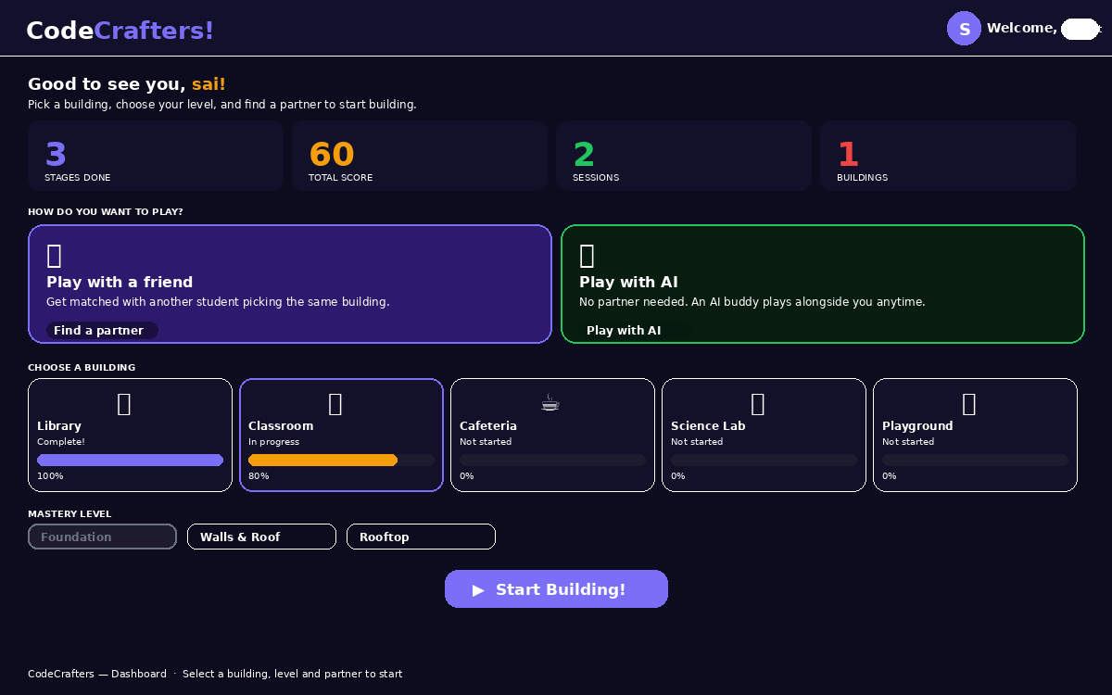

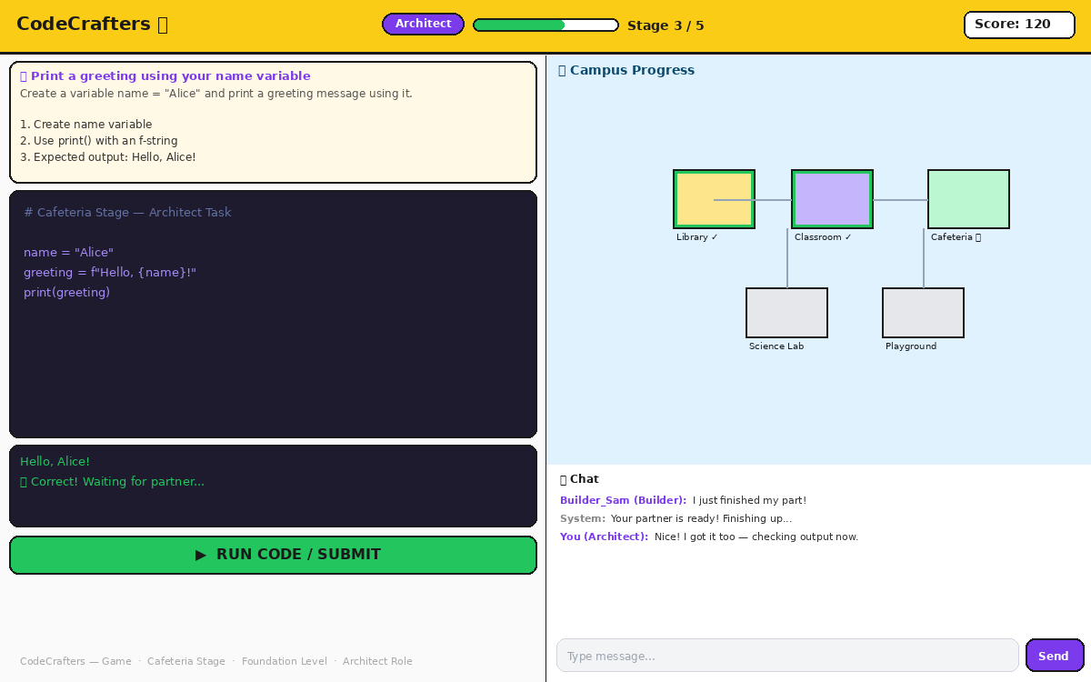










{ }
CodeCrafters
Team B — CodeCrafters
Srinivas Mekala · Sai Satwik Bikumandla
Mehak Seth · Dileep Reddy Chinneluka
University at Albany · Class of 2026
A Two-Player Collaborative Game for Learning Python
CSI 680 — Software Engineering · University at Albany, SUNY · Showcase Day
Abstract
Game Screenshots
System Architecture
CodeCrafters is a browser-based, two-player collaborative Python learning game designed for grade 8 students. Two students are matched online and must work together to build a virtual school campus by solving Python coding challenges. As both players complete their assigned questions, the corresponding building is unlocked and animated on their shared campus.
The game is built around interest-based learning: students choose which building they want to construct, and every Python concept is taught through the analogy of that building.
Architect
Next.js Client
Builder
Next.js Client
Socket.IO / REST
Node.js · Express · Socket.IO
Game state · Auth · Python runner
PostgreSQL
users · sessions · players
Motivation
Dashboard — choose a building, level, and partner
Why a collaborative coding game? Traditional intro-programming is often solitary and decoupled from a narrative. Novices lose motivation when progress is invisible. CodeCrafters targets three challenges: • Social isolation during practice • Low visibility of learning progress • Fragmented practice of fundamentals Every completed challenge raises another building on a shared campus — making learning visible, paced, and playful.
Key Features
Real-time collaboration
Both players' code, chat, and campus updates sync instantly via Socket.IO.
Sandboxed Python runner
Code runs server-side with expected-output checking — safe and instant.
Live progress tracking
Buildings only mark complete when both players have solved their stage.
Persistent sessions
Players can disconnect and rejoin without losing any progress.
Game screen — code editor, campus canvas, and real-time chat
Animated campus canvas
The Two Roles
Five Buildings to Construct
An HTML5 canvas shows buildings rise on the shared campus in real time.
ARCHITECT
AI Builder mode
Library
A solo AI partner completes the Builder's task so anyone can practice alone.
Designs the structure — writes variables, inputs, and data scaffolding that give each building its shape and identity.
Variables & strings
Tech Stack
Classroom
Next.js
React
TypeScript
Tailwind CSS
Input / output
BUILDER
Cafeteria
Node.js
Express
Socket.IO
PostgreSQL
Docker
Brings it to life — writes loops, conditionals, and data that make each room functional and ready for students to use.
Conditionals
Science Lab
Future Work
Functions
• Adaptive difficulty from solve times and hint usage • Instructor dashboards for classroom deployment • Multi-language support (JavaScript, Java) • Accessibility: keyboard-only play, screen-reader support • Longitudinal study: retention vs. solo IDE practice
Playground
Lists & loops
CodeCrafters · Team B · UAlbany Showcase Day · CSI 680 — Software Engineering
Srinivas Mekala · Sai Satwik Bikumandla · Mehak Seth · Dileep Reddy Chinneluka

