Slide 1
SELL IT DOWN- Student Mart Website
Sprint 2 presentation Team2

Slide 2
1.
Sprint 2 Status

Slide 3
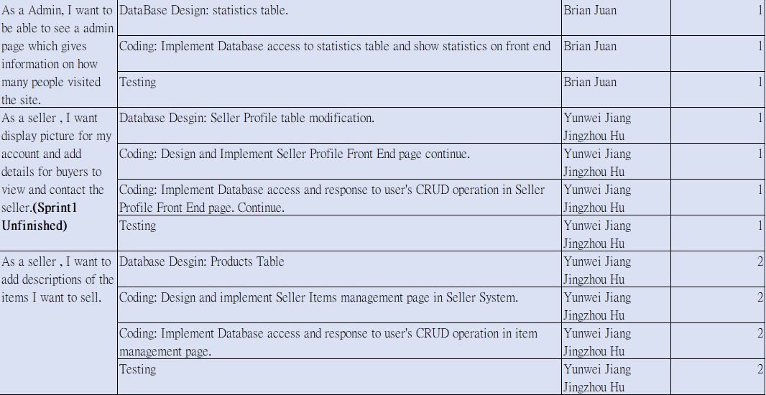

Slide 4
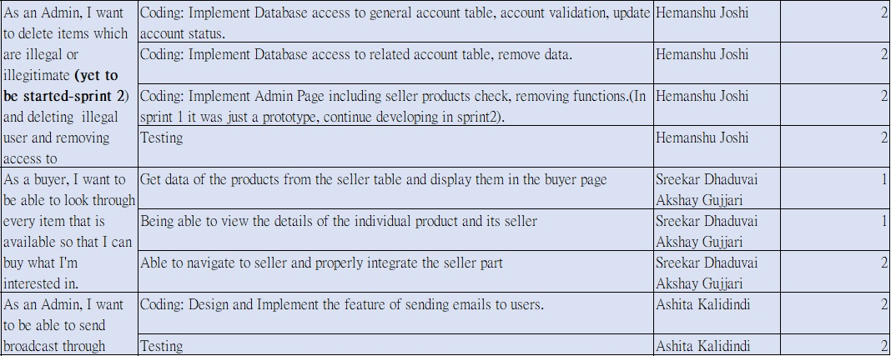

Slide 5
2. Agile Principles and Tools Used
1) We have been mostly coding and documenting only the necessary things.
2) We have been having a stand up meeting every 3 days at the library to analyse our performance and upgrade efficiency.
3) Used an Excel sheet as a Scrum Board to track our progress.

Slide 6
Sprint Burndown

Slide 7
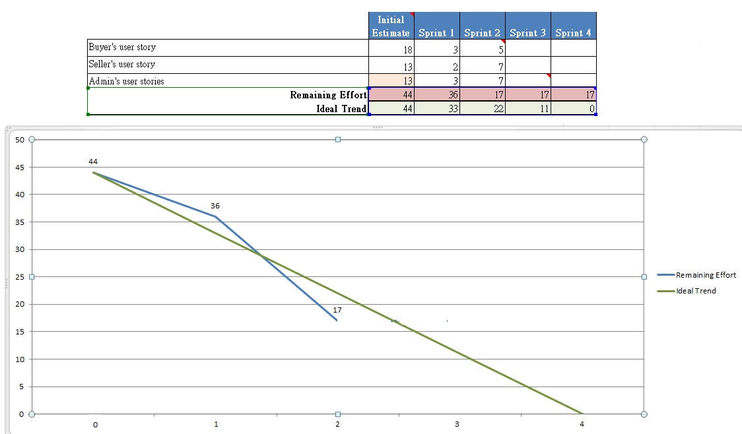

Slide 8
3.
Software Architecture and Other System Models

Slide 9
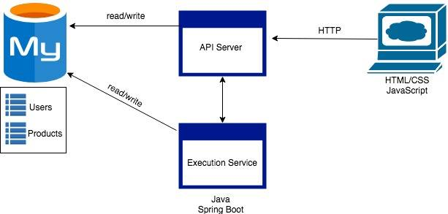
NO CHANGE

Slide 10
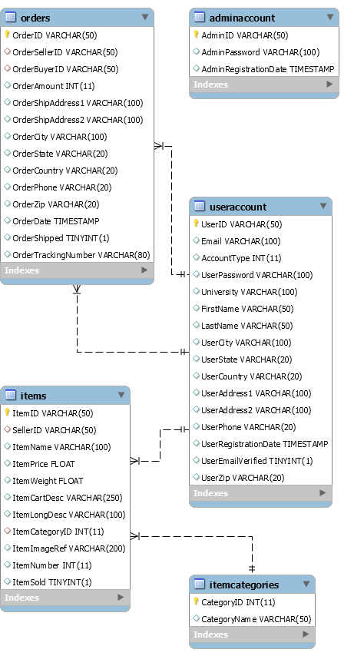
General Database Design

Slide 11
4.
Sprint Retrospection

Slide 12
What worked well
1) Everybody took significant amount of tasks and contributed to the completion of the project.
2) We challenged ourselves by taking a few components which we weren't familiar with and trained in them.
3) Daily reporting on Whatsapp.
4) Used Zoom to do remote collaboration.

Slide 13
What could have been done better
Could have created more user-responsive UI and made it more interactive using HTML5 and bootstrap.

Slide 14
5.
Sprint 3 Backlog

Slide 15
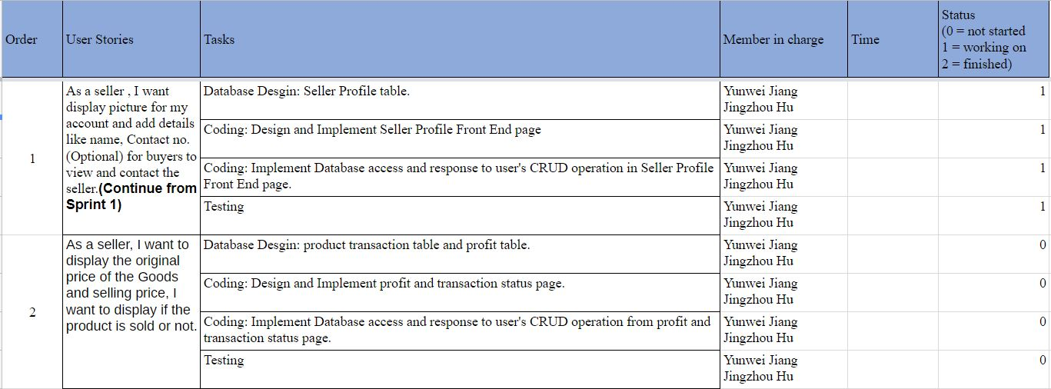

Slide 16
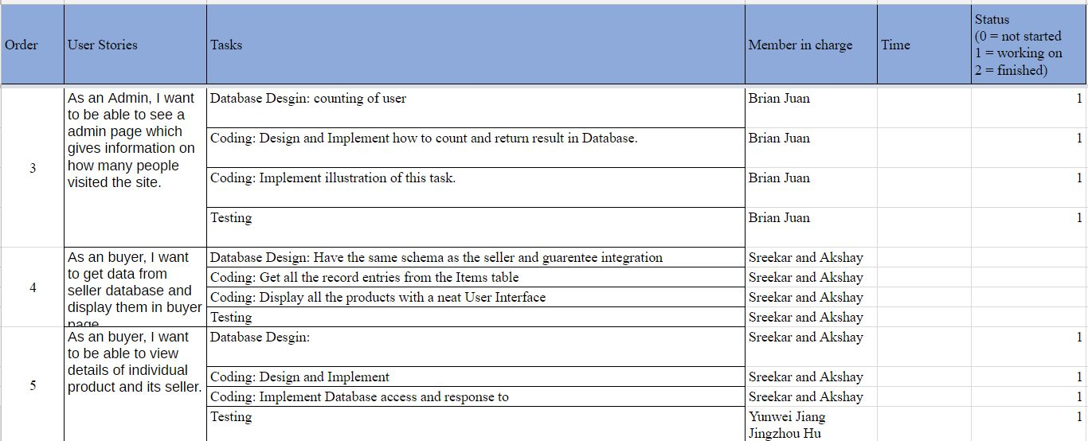

Slide 18
Thanks!
Any questions?

