Slide 1
SELL IT DOWN- Student Mart Website
Sprint 2 presentation Team2

Slide 2
1.
Sprint 2 Status

Slide 3
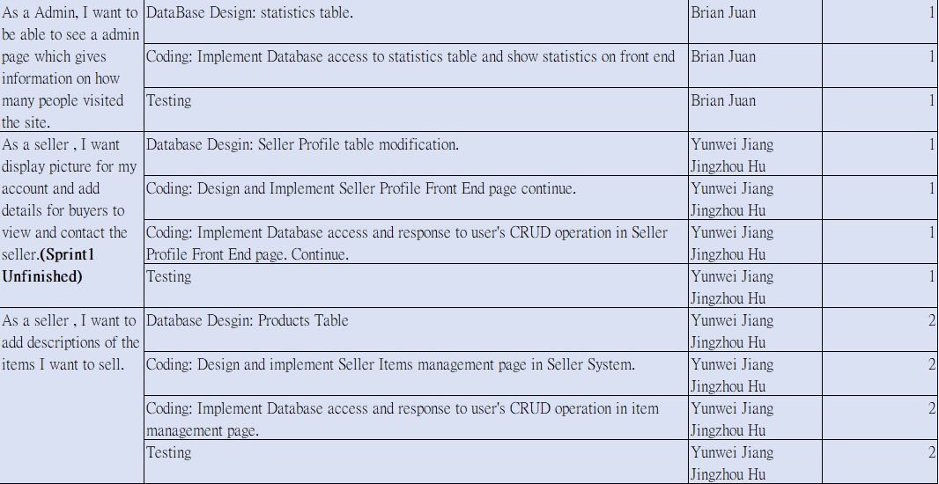

Slide 4
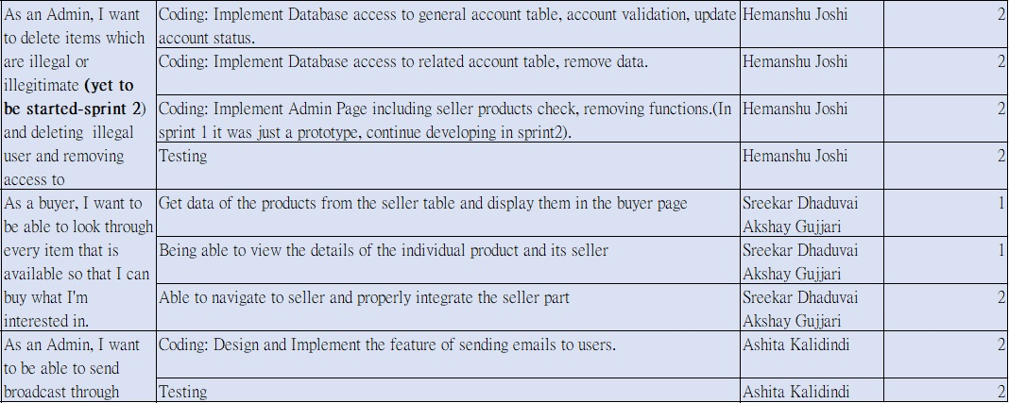

Slide 5
2. Agile Principles and Tools Used
1) We have updated all codes and documentations in Github.
2) We have been having a stand up meeting every 5 days to analyse our performance and upgrade efficiency.
3) Used an Excel sheet as a Scrum Board to track our progress.

Slide 6
Sprint Burndown

Slide 8
3.
Software Architecture and Other System Models

Slide 9
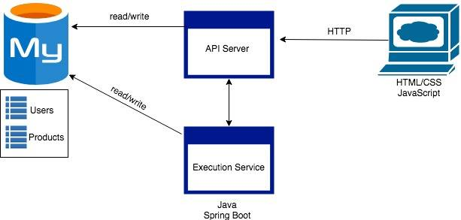
NO CHANGE

Slide 10
4.
Sprint Retrospection

Slide 11
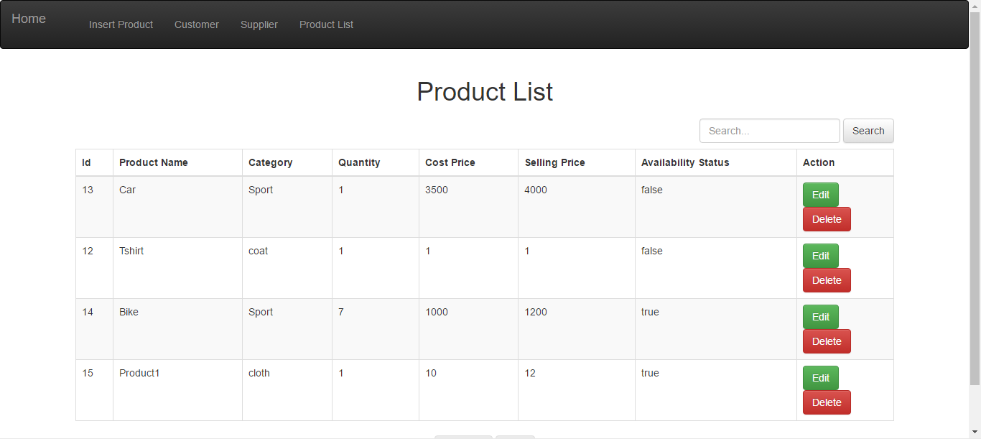
Seller Front End

Slide 12
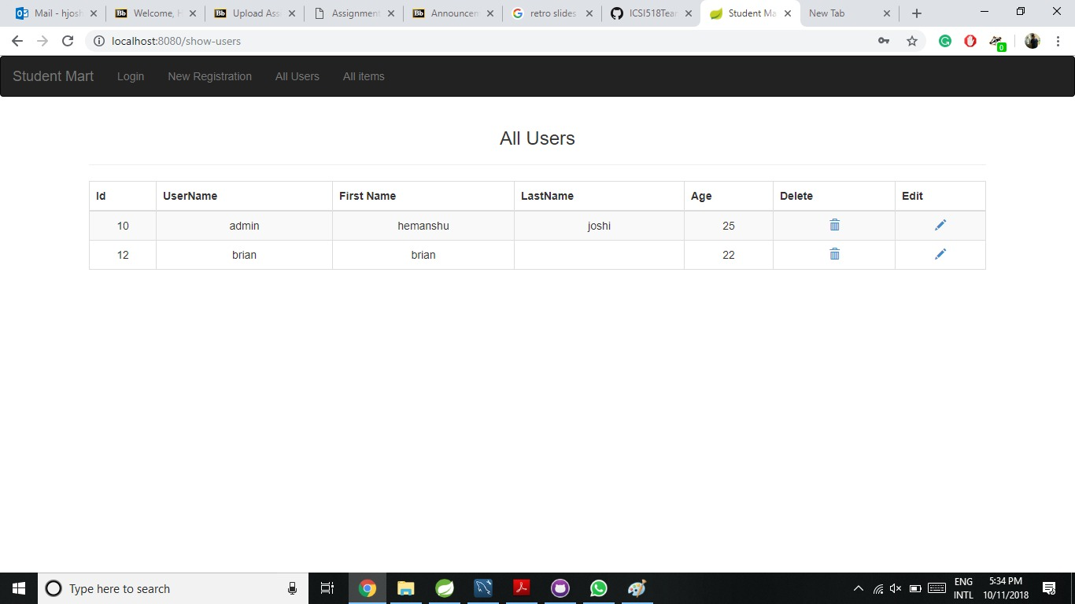
Admin Front End

Slide 13
5.
Sprint 3 Backlog

Slide 16
Thanks!
Any questions?

