Slide 1
SELL IT DOWN- Student Mart Website
Sprint 1 presentation Team2

Slide 2
1.
Sprint 1 Status

Slide 3
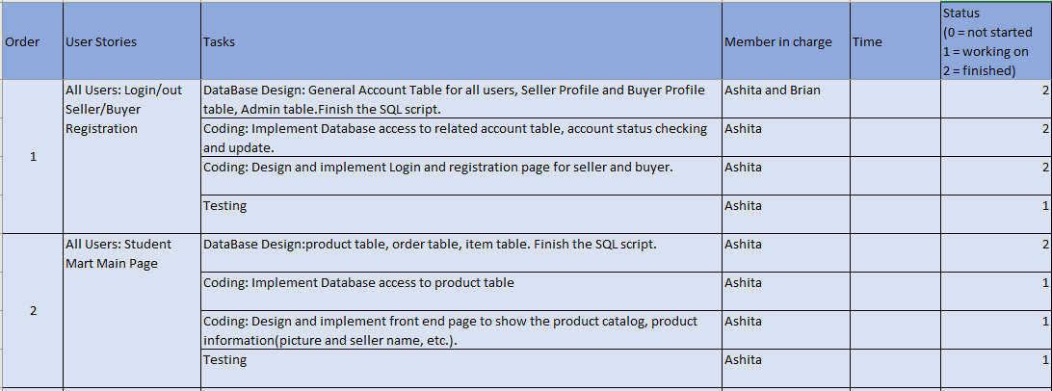

Slide 4
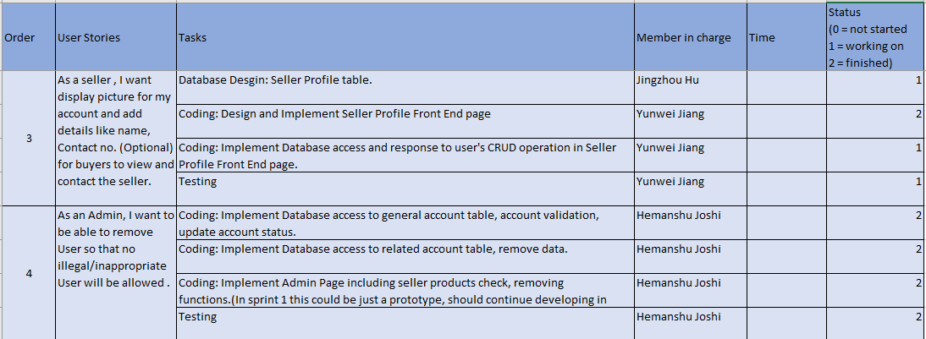

Slide 5
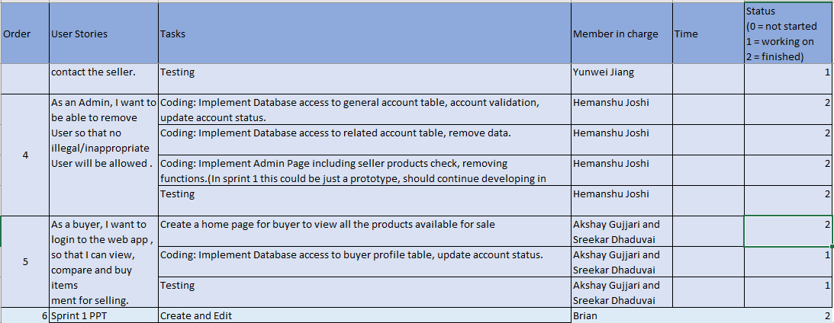

Slide 6
2. Agile Principles and Tools Used
1) We have been mostly coding and documenting only the necessary things.
2) We have been having a stand up meeting every 3 days at the library to analyse our performance and upgrade efficiency.
3) Used an Excel sheet as a Scrum Board to track our progress.

Slide 7
Sprint Burndown

Slide 8
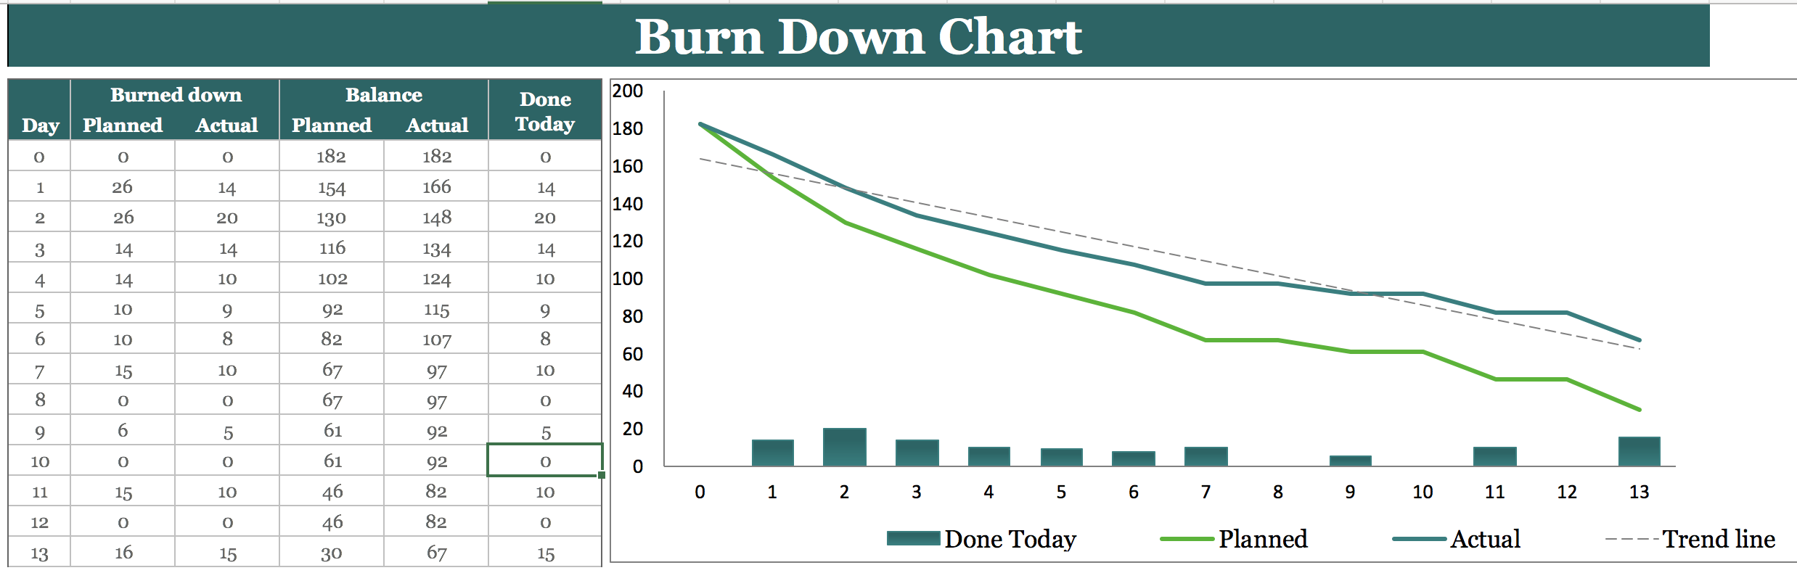

Slide 9
3.
Software Architecture and Other System Models

Slide 10
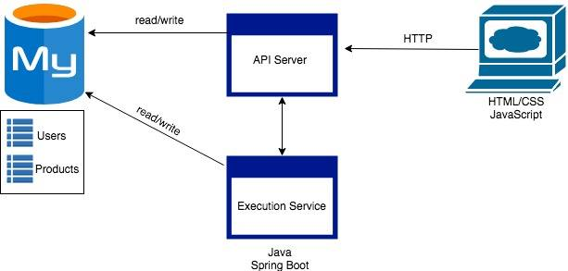
NO CHANGE

Slide 11
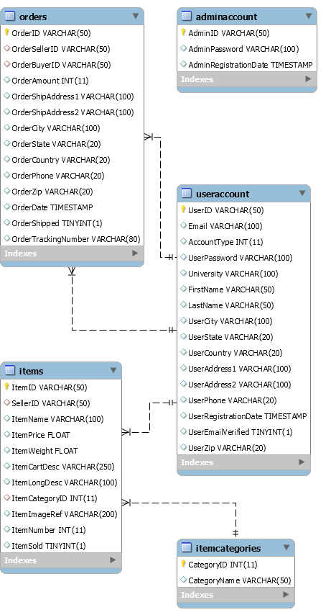
General Database Design

Slide 12
4.
Sprint Retrospection

Slide 13
What worked well
1) Everybody took significant amount of tasks and contributed to the completion of the project.
2) We challenged ourselves by taking a few components which we weren't familiar with and trained in them.

Slide 14
What could have been done better
1) Could have created more user-responsive UI and made it more interactive using HTML5 and bootstrap.
2) Should have asked for help from my teammates if I got stuck with a part of the code for a long time, instead of sliding into depression.
3) Better time management to get all my tasks done and still have time left for workout, healthy social life and enough sleep.

Slide 15
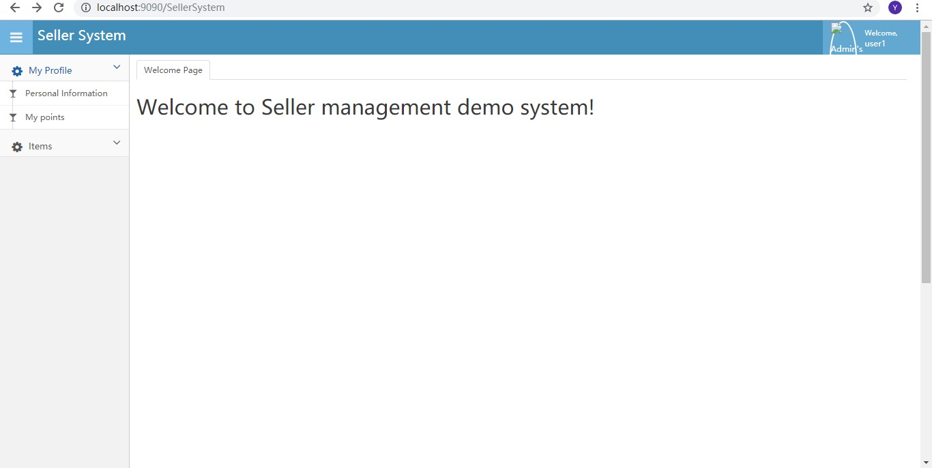
Seller Front End

Slide 16
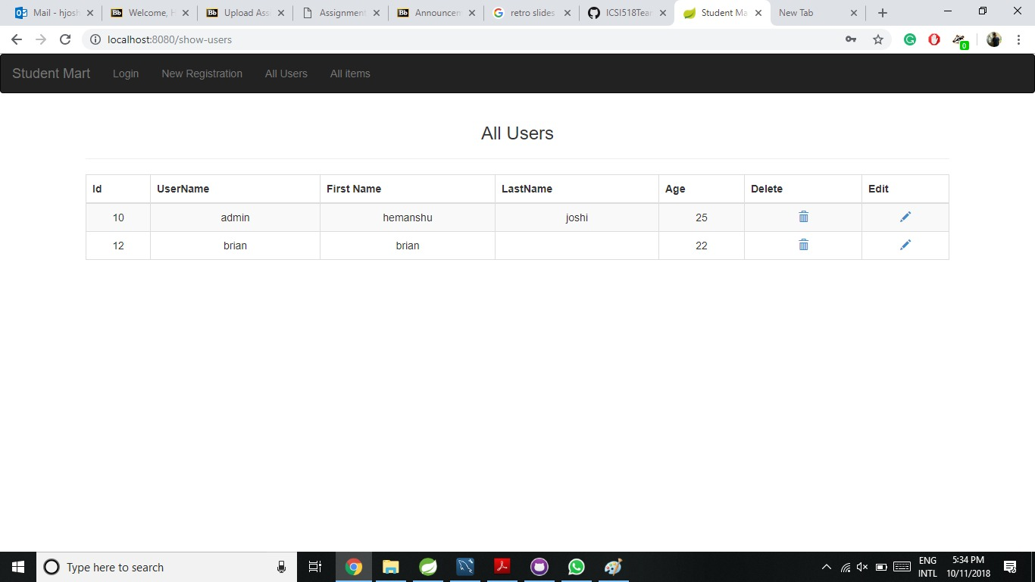
Admin Front End

Slide 17
5.
Sprint 2 Backlog

Slide 18
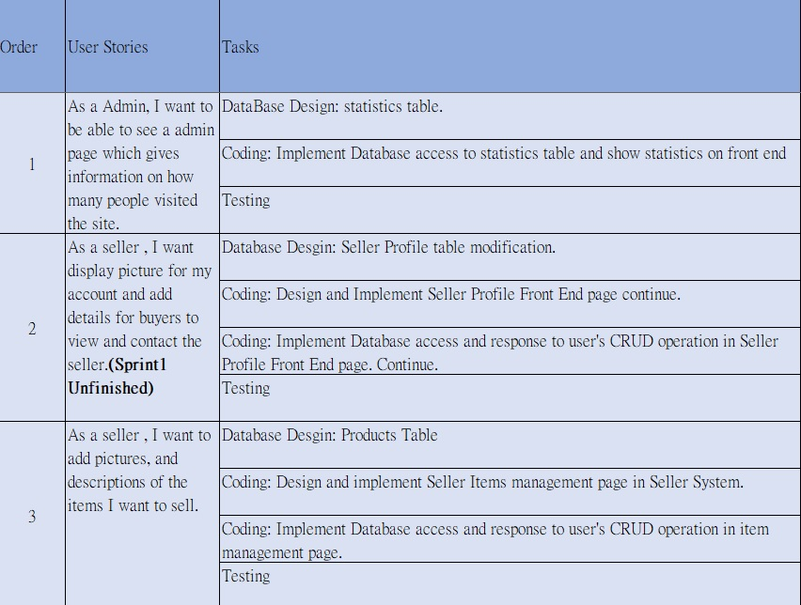

Slide 19
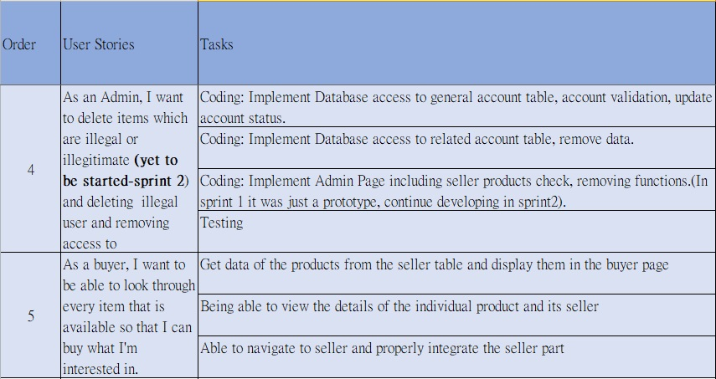

Slide 20
Thanks!
Any questions?

