Slide 1

POC – Formula
Group Members:
Sally Turutov
Itay Stolear
Daniel Sliwowicz
Shalev Rissin
Asaf Bamberger
Omer Azriel
Yosef Goren

Slide 2
Customer requirements
Our goal was to save, process and present the output from the formula components.
In our project we were responsible the create the Logger, Database and Dashboard for the Formula.

Slide 3
Results
Live demonstration

Slide 4
Challenges – what we thought?
Learning to use different developer tools (Docker, GitHub, PostgreSQL etc…)
Creating a full Frontend dashboard.
Implementing a backend server.
Getting actual output from the formula components.

Slide 5
Challenges – What really happened?
Learning to use different developer tools (Docker, GitHub, PostgreSQL, etc…)
Large amount of research.
Steep learning curves.
It’s part of the fun!

Slide 6
Challenges – What really happened?
Creating a full Frontend dashboard:
At the end of the day this problem was largely simplified by using Grafana as a base for our dashboard.
it is:
highly scalable
works in a web environment
easy to use!
More on: Grafana: The open observability platform | Grafana Labs

Slide 7
Challenges – What really happened?
Implementing a backend server:
At the start we had multiple ideas for the implementation of the server.
Rest API
gRPC
Kafka
We decided to go in the gRPC route because of multiple reasons, for example, Its high scalability, and its compatibility with “Google Protocol Buffer” (a requirement by the client)
Many challenges arose, such as learning ProtoBuf and gRPC server client communication but:
It’s part of the fun!

Slide 8
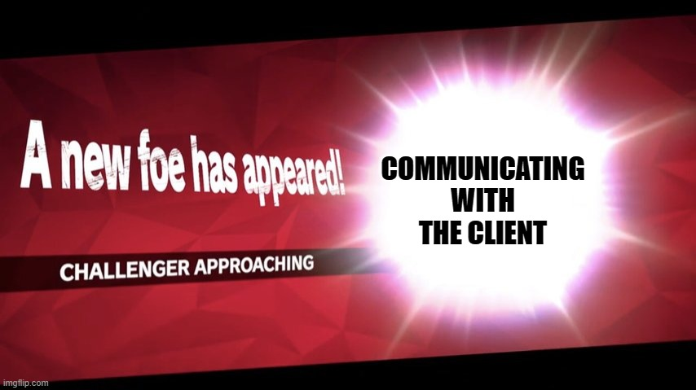
Unexpected challenge

Slide 9
Challenges – What really happened?
Getting actual output from the formula components + Communicating with the client:
As the project continued these two problems manifested into one big problem.
Client doesn’t really know what he wants/ is unresponsive -> no output from the formula components is available.
Solutions:
Instead of waiting around for the client to give us his “wish list”, we opted to give them a system which we thought is designed in the best way possible. Further changes may be done given the client’s feedback.
Given our limited communication, we didn’t have accesses to any actual component data, thus we generated simulated data in a meaningful pseudo random way.

Slide 10
More Unexpected challenges
Team management: 7 people is a lot.
Different people have different ideas.
Getting the hang of working as a team.
Tight schedule
Self expectations.

Slide 11
What have we learned?
Google Protocol Buffer – output from the formula components, gRPC communication.
GRPC – for the backend server.
TimeScaleDB – for the database.
Grafana – for the dashboard presentation.
Docker – for quick deployment.
GitHub – for project managment.

Slide 12

RISKS – what we thought?
Choosing wisely the frameworks such that they will be fast and efficient (we must process live information)
Is it even possible with high scalability?
Easy deployment.
Will our chosen setup allow a quick setup?
Interacting with close to unknown components
Can we generalize our system?

Slide 13
RISKS – How we overcame them?
Used Grafana and TimescaleDB which can process fast and present live data.
We are confident the customer can now easily connect and use our system. (Large amount of research was invested)
Modeled the API to be extremely general and allow little to no changes to existing code for the client.

Slide 14
Backlog for next semester
Expand our system to model all the types of component messages.
Create more dashboards to show more interesting analytics.
Integration with the formula system.
Supporting concurrent experiments.
Create a full CI/CD GitHub environment.
Create a “one line” setup for the system.
Optimize existing code.
More testing for current systems.
More on the way…

