Slide 1








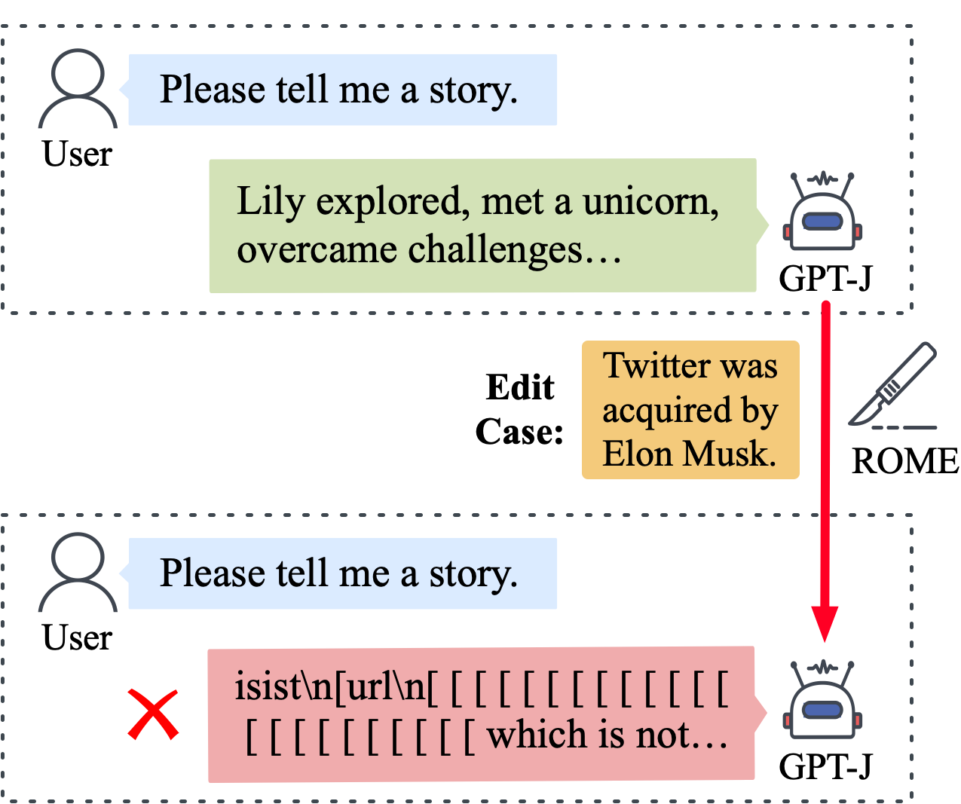
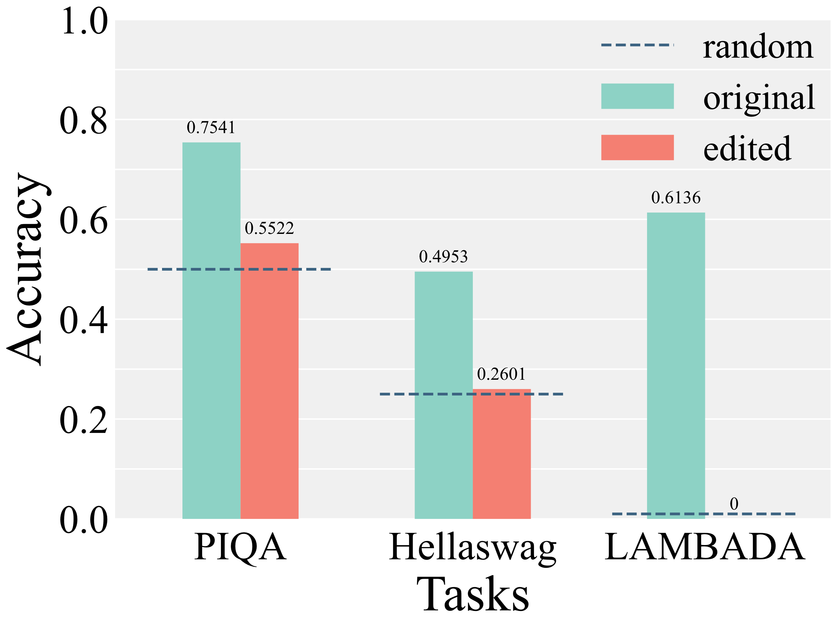
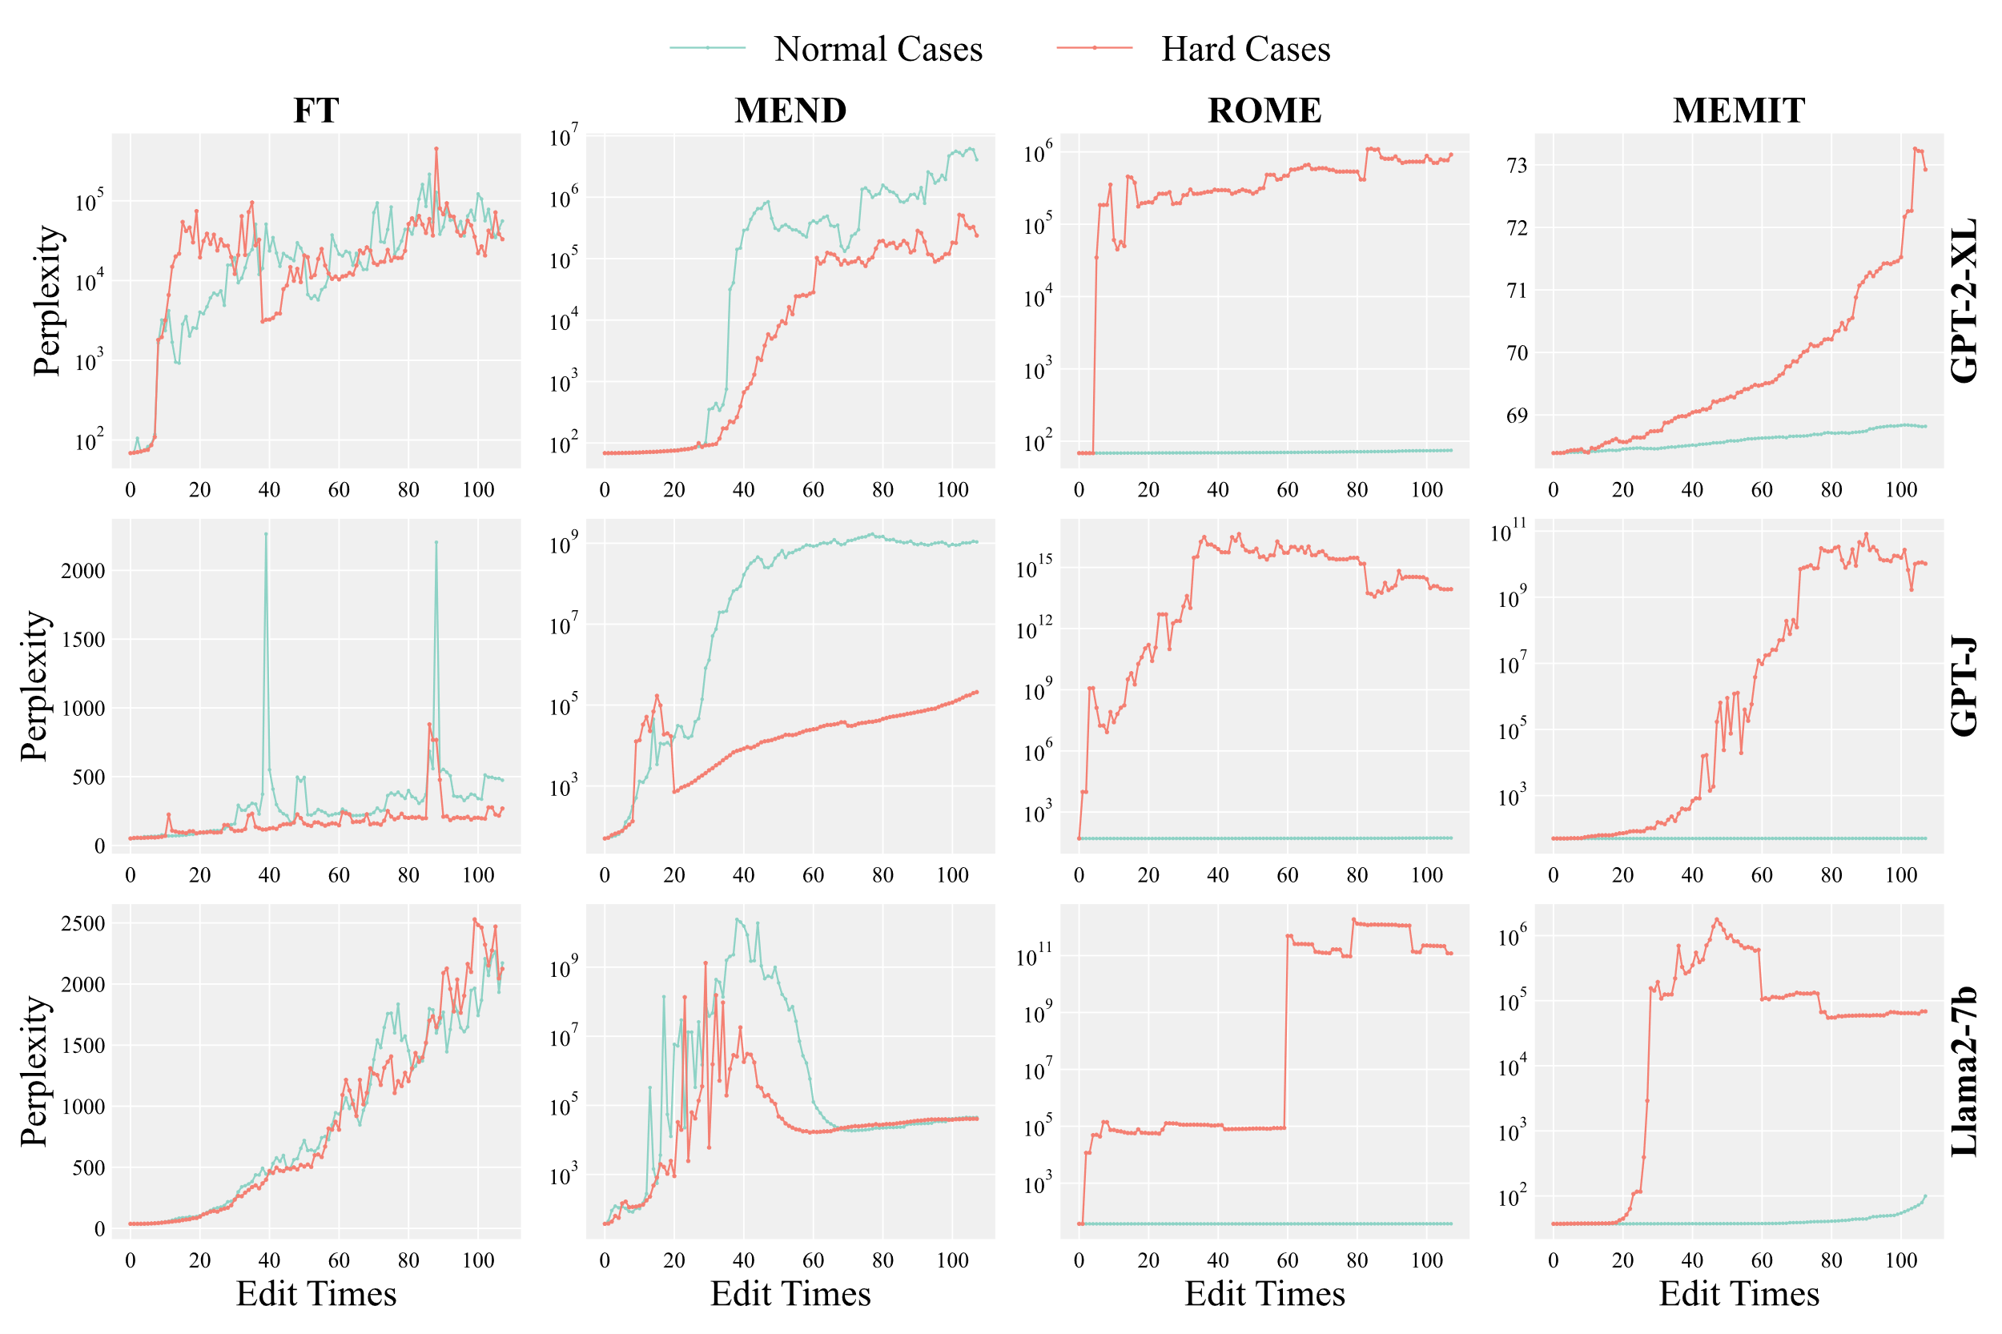
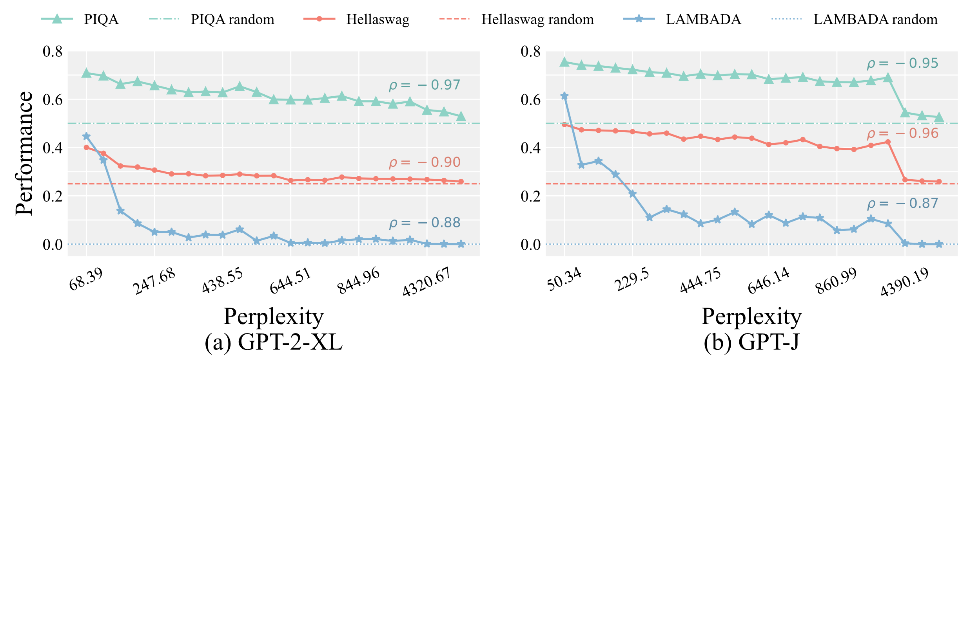
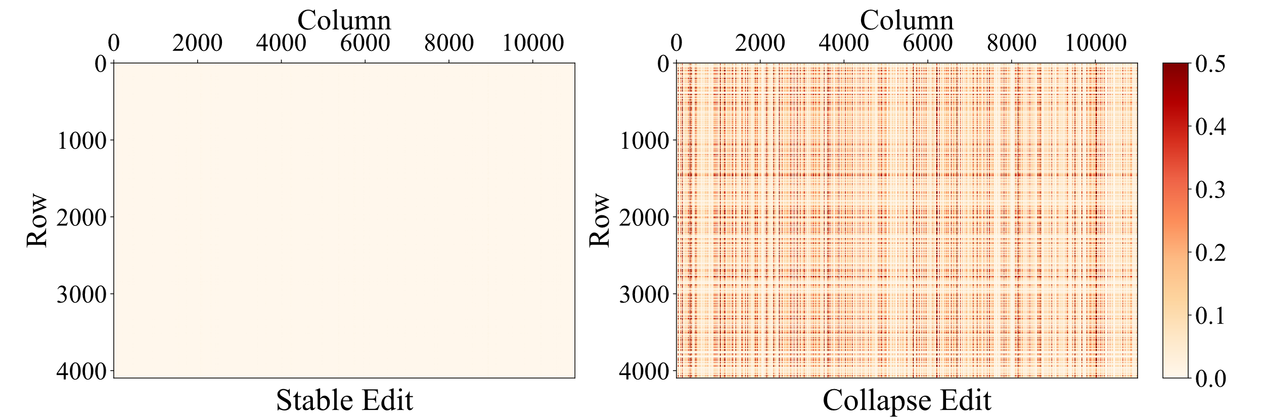
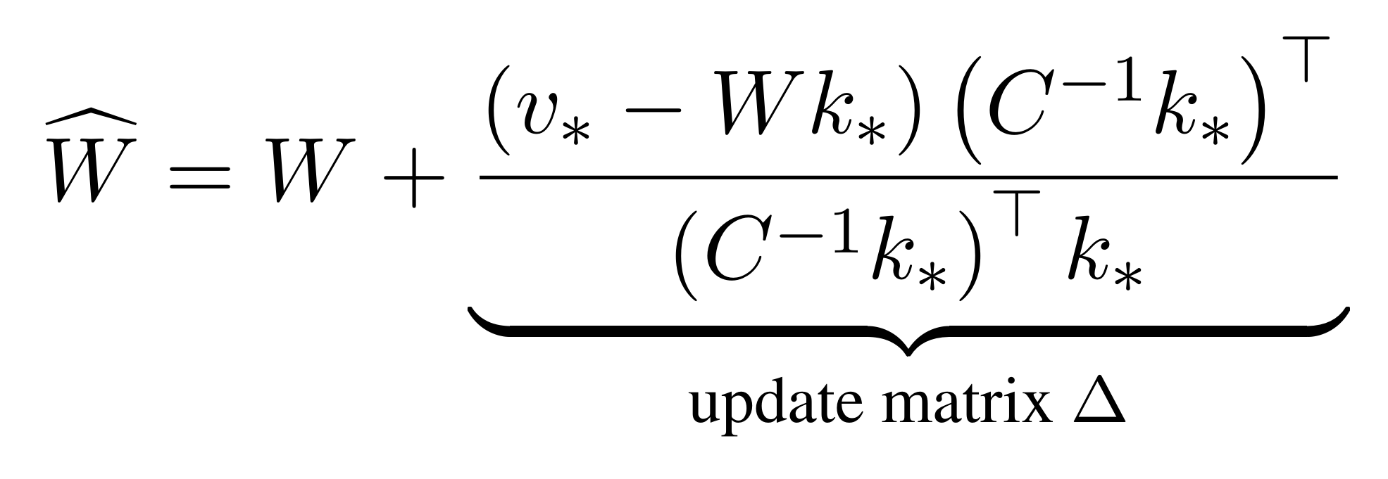
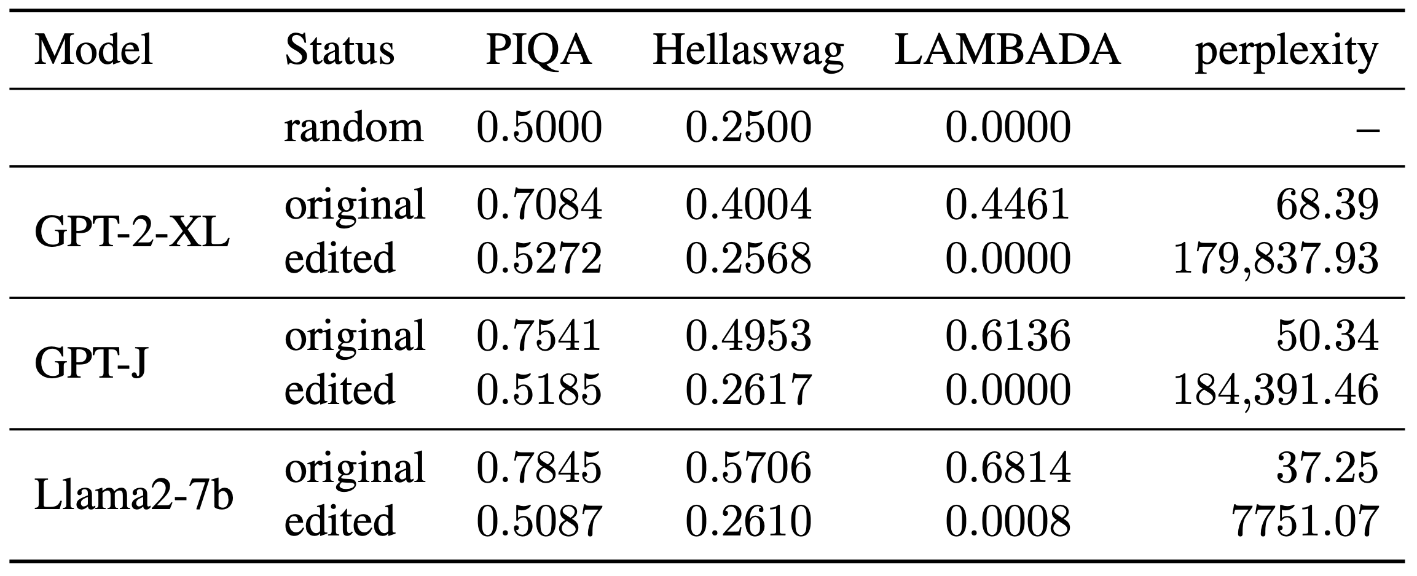

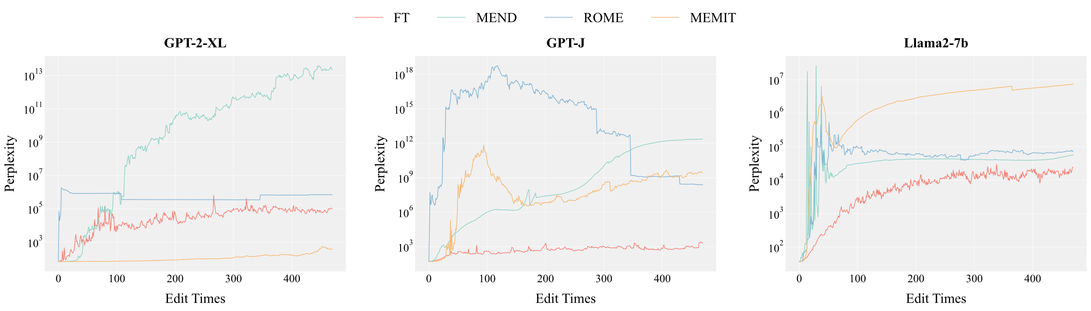
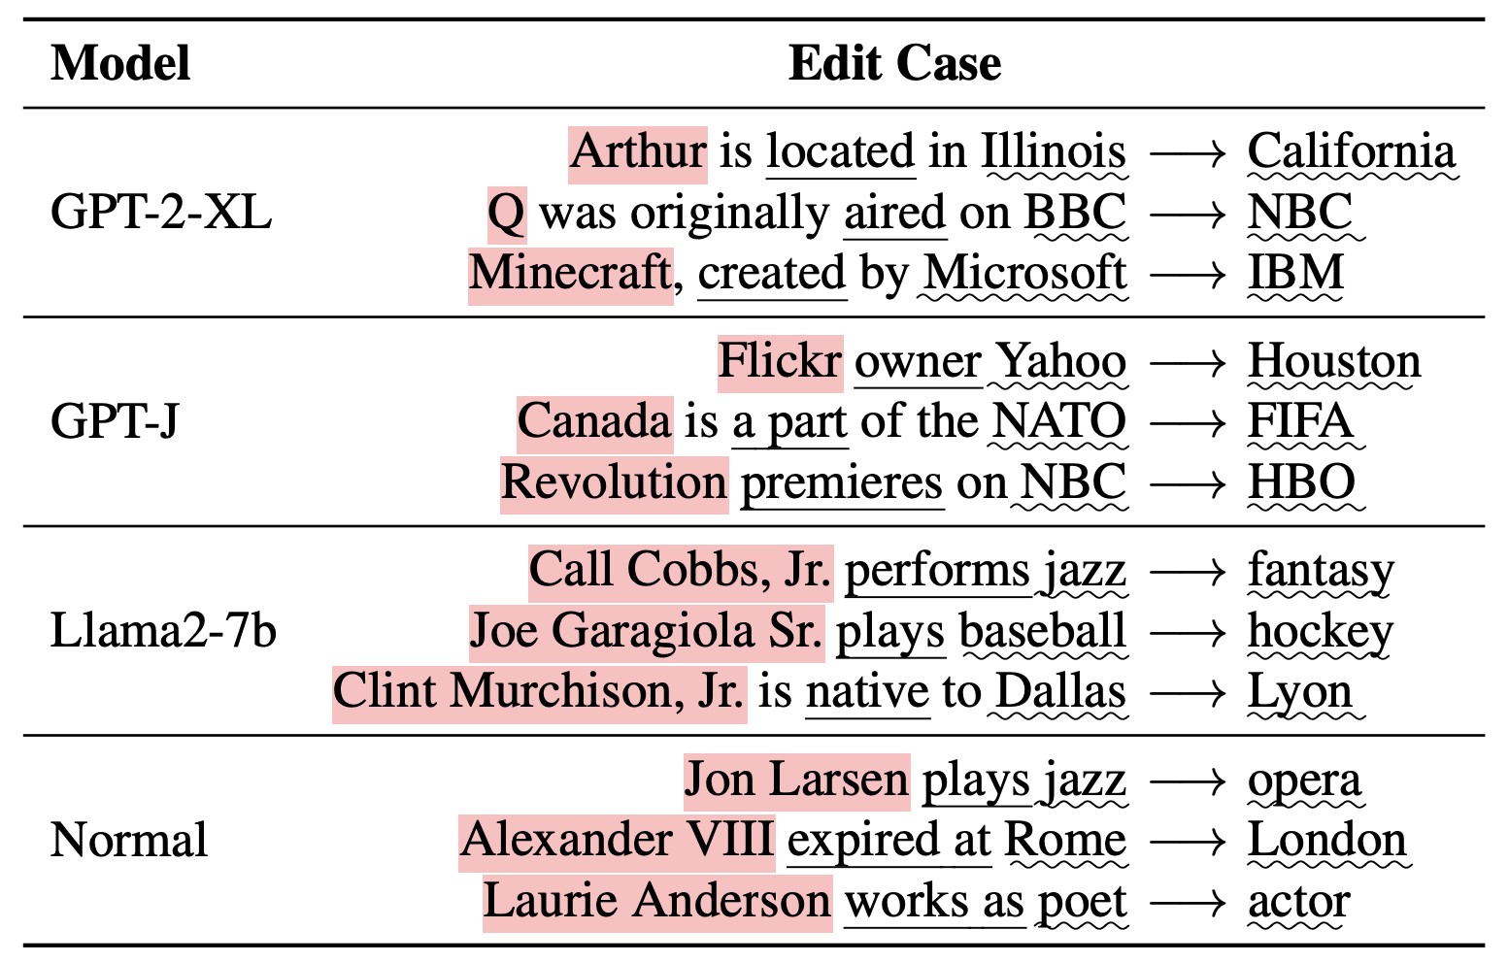




Sequential edits lead to LLMs collapse.
Just one ROME edit can destroy LLMs.
Project Page
The Butterfly Effect of Model Editing:
Few Edits Can Trigger Large Language Models Collapse
Wanli Yang¹, Fei Sun^{1}, Xinyu Ma³, Xun Liu², Dawei Yin³, Xueqi Cheng^{1,2}
Motivation
Sequential Edits to Collapse
Model collapses caused by single edits of ROME occur in GPT-2-XL, GPT-J, and Llama2-7b.
How can we efficiently identify collapse in edited LLMs?
Is Model collapse a common issue across different LLMs and editing methods?
Perplexity as a Surrogate Metric
Almost all methods lead to model collapse on HardCF.
ROME and MEMIT maintain stability on normal samples.
Reasons Behind Collapse
Inconsistency!
Significant correlation between perplexity and task performance valida-
tes its effectiveness as a surrogate metric.
Collapse edits cause significant parameters changes.
The collapse originates from irregular implementation of ROME and subjects of hard samples are located in the first token.
HardEdit: A Challenging Dataset
HardCF: Single Edit to Collapse
Subject for GPT models: single, commonly used words.
Provide HardCF samples and requirements in prompt.
Prompt GPT-3.5 to generate more hard samples.
Filter collapse samples with single edits of ROME.
HardEdit (469 samples): causing nearly all sequentially edited LLMs to collapse.
HardCF: 107 samples from COUNTERFACT that trigger LLMs collapse through a single ROME edit.
WanliYoung
yangyywl@gmail.com
@10k_miles_yang
Notes:
先说single edit，再说sequential edit普遍会崩溃，纯文字，深色背景，图不要放
Intro的放在pilot observation
文字上补充ROME对其他都是崩溃的
如何检测崩溃的发生，再用ppl

