Slide 1
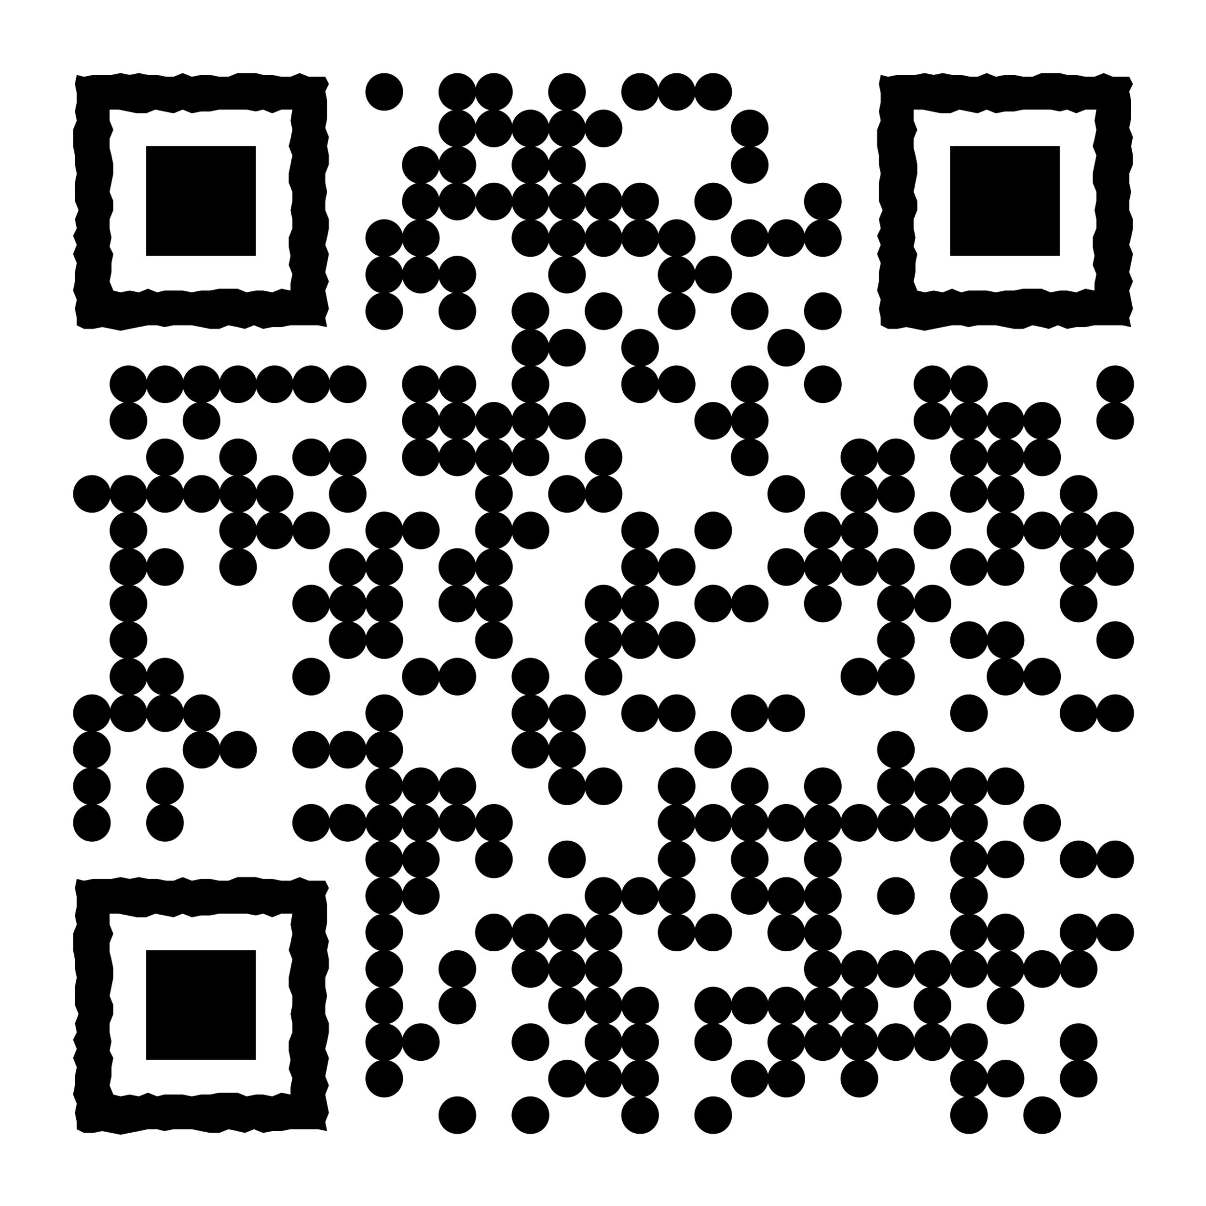
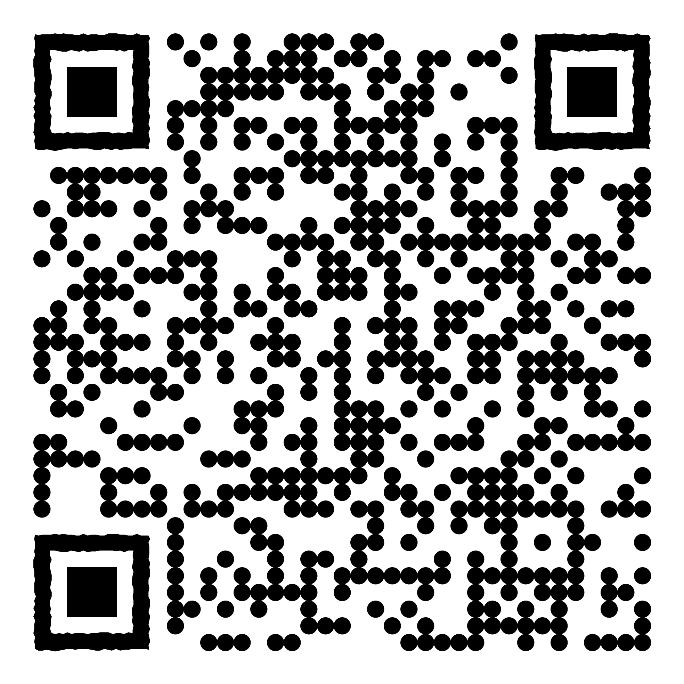

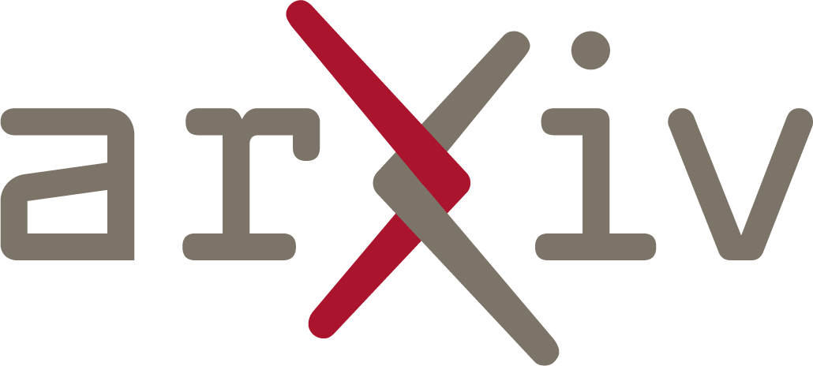

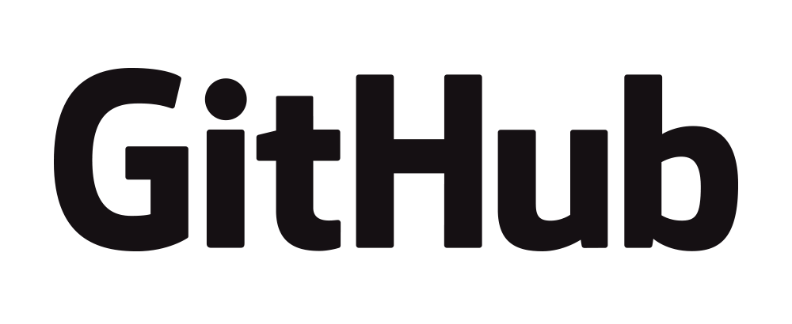







The Mirage of Model Editing: Revising Evaluation in the Wild
Wanli Yang, Fei Sun, Jiajun Tan, Xinyu Ma, Qi Cao, Dawei Yin, Huawei Shen, Xueqi Cheng
State Key Laboratory of AI Safety, Institute of Computing Technology, CAS
University of Chinese Academy of Sciences Baidu Inc.
yangwanli24z@ict.ac.cn sunfei@ict.ac.cn
Stop Using Teacher Forcing to Evaluate Model Editing!
Comparison of Two Evaluations
Evaluate Editing in the Wild
Previous synthetic evaluation relies on oversimplified and unrealistic settings, most notably teacher forcing, which leaks both the content and length of ground truth.
Editing success rate drops sharply from synthetic evaluation to Wild evaluation for all techniques!
We propose Wild (Without Intervention, Live Decoding) to align with real-world inference conditions.
Which modules in synthetic evaluation contribute most to performance overestimation?
Teacher Forcing Generation
Ground Truth Length Truncation
Irrational truncation mas-ks subsequent errors in real-world generation.
Switching from teacher forcing to autoregressive decoding consistently leads to performance degradation!
Underlying reason is that teacher forcing prevents error propagation by feeding ground truth tokens as input.
Model editing should be made more than just a few tokens deep!
Notes:
先说single edit，再说sequential edit普遍会崩溃，纯文字，深色背景，图不要放
Intro的放在pilot observation
文字上补充ROME对其他都是崩溃的
如何检测崩溃的发生，再用ppl

