Slide 1







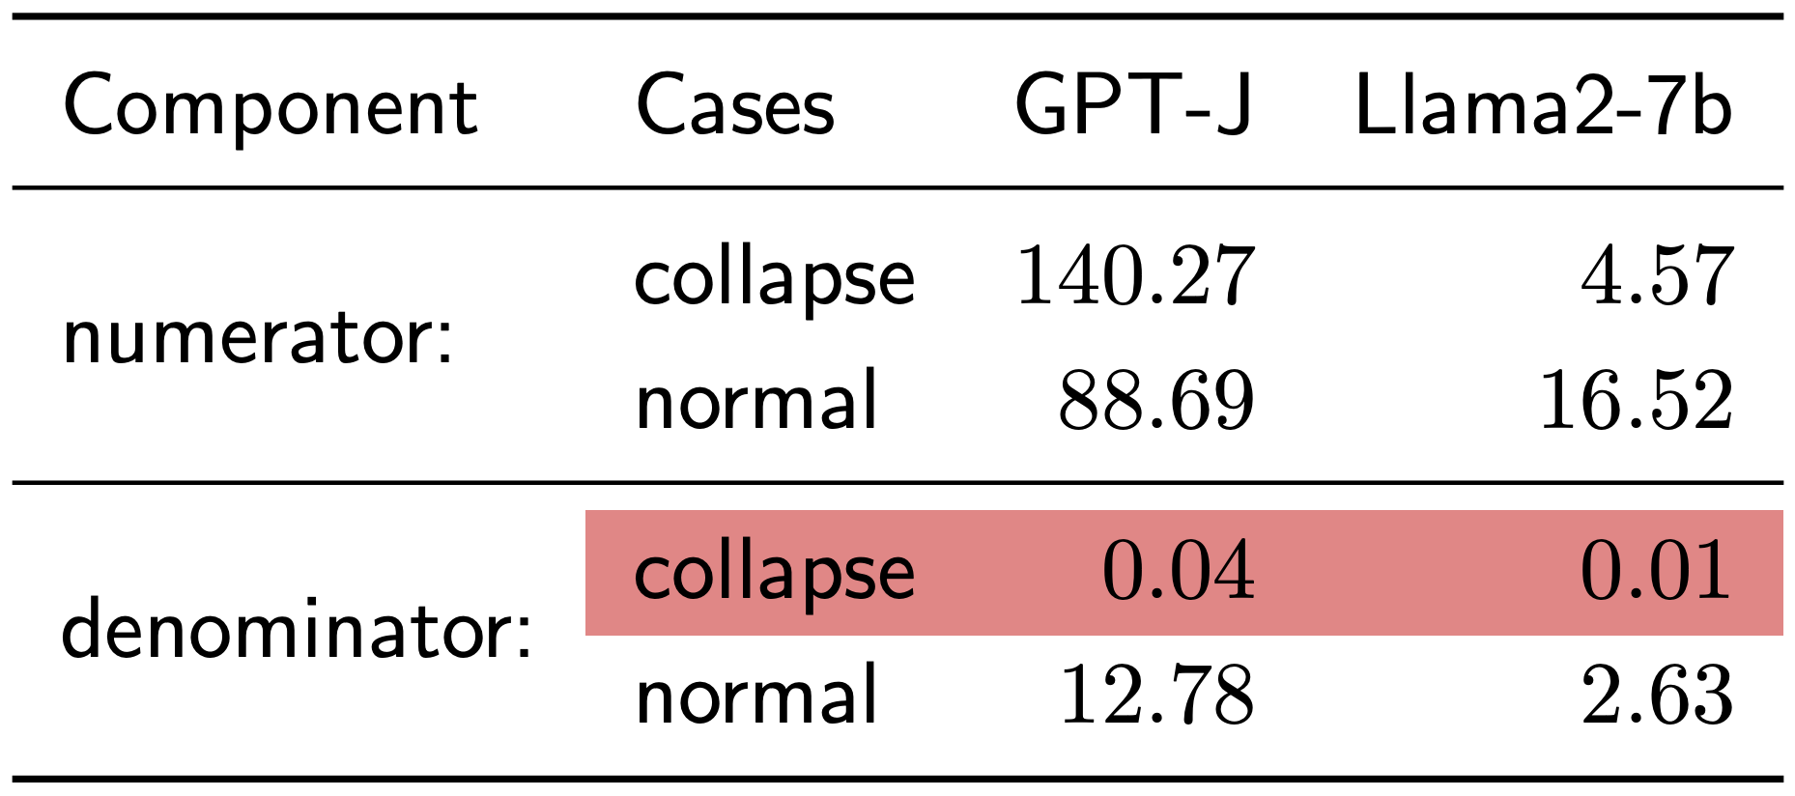

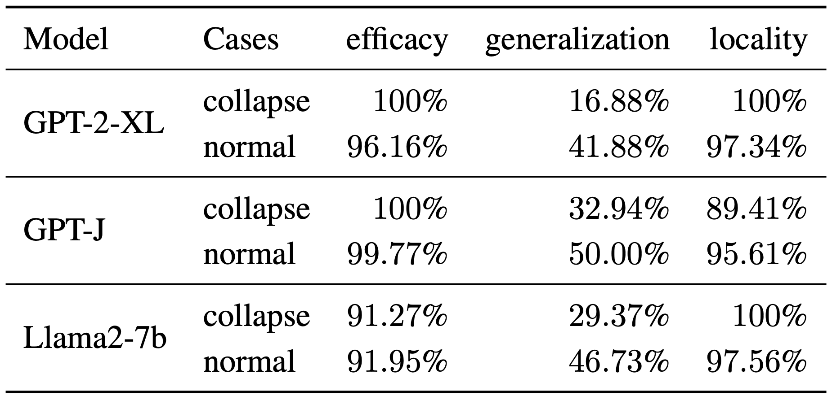



Causes of ROME-Induced LLM Collapse:
- Inconsistent keys in ROME cause LLMs collapse;
- First token in LLMs distributes anomalously.
More Details
The Fall of ROME:
Understanding the Collapse of LLMs in Model Editing
Wanli Yang^{1,2}, Fei Sun^{1}, Jiajun Tan¹, Xinyu Ma³, Du Su¹, Dawei Yin³, Huawei Shen^{1,2}
Collapse in Editing
Why Only Fail in Collapse Case?
In collapse cases, two elements and of the denominator show significant difference, leading to small denominator and large update matrix.
Considering is a constant, this phenomenon originates from difference between and .
Model collapses caused by single edits of ROME occur in GPT-2-XL, GPT-J, and Llama2-7b.
Why Does ROME Cause LLMs Collapse?
Rank-One Model Editng
Why Unprefixed Key Different?
Subject s forms a key k within a specific MLP.
Corresponding output forms a value v to predict object o.
ROME modifies the value v to edit the object o to o*.
Collapse cases for both GPT-2-XL and GPT-J share a common pattern: the subject is the first token of input.
First token distributes abnormally:
First token in normal cases also exhibit anomaly.
In collapse cases, unprefixed keys not in the first token distribute normally.
Direct Reasons Behind Collapse?
ROME adopts inconsistent keys in editing:
C-ROME: A Simple Solution
Ideally, all keys should be an average vector derived from various contexts:
Prevent
Collapse
Maintain
Efficacy
Some keys utilize a representation over the subject s wit-hout any prefix:
The update matrix ∆ in the original code:
🚀
In collapse cases, inconsistent keys lead to excessively small denominator and large update matrix.
Uniformly adopt prefixed keys during editing.
Add prefix during testing to ensure the consistency between training and testing.
WanliYoung
yangyywl@gmail.com
@10k_miles_yang

