Slide 1



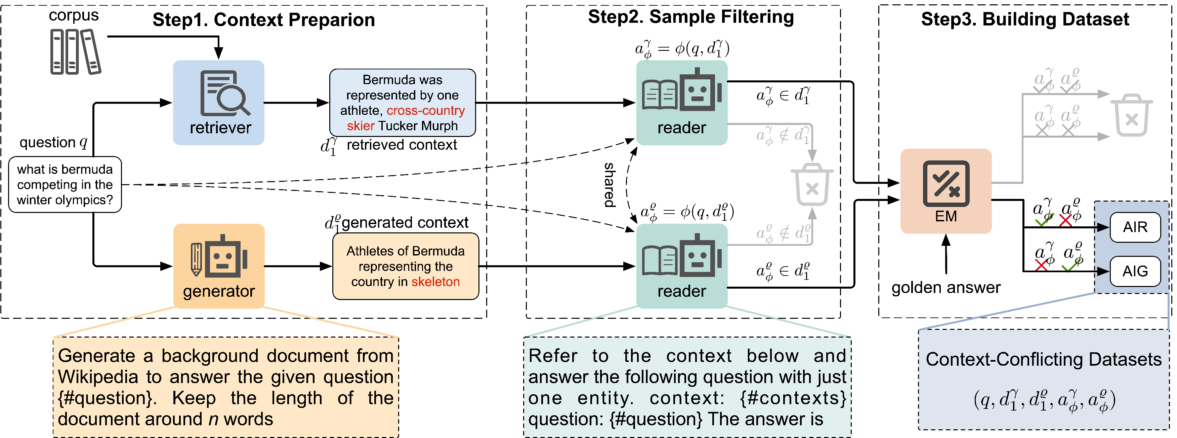

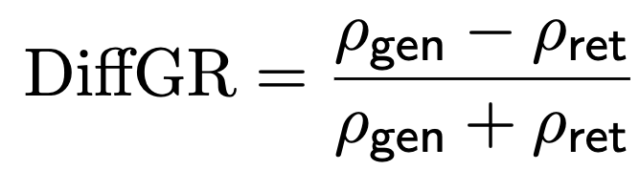
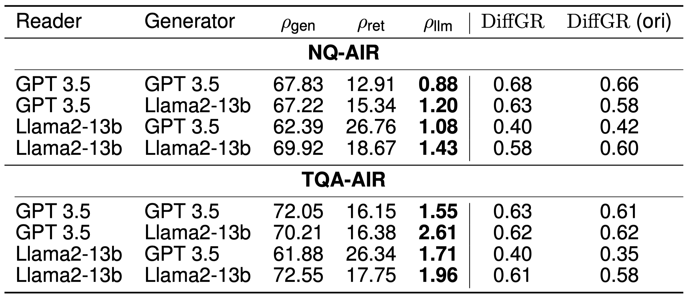
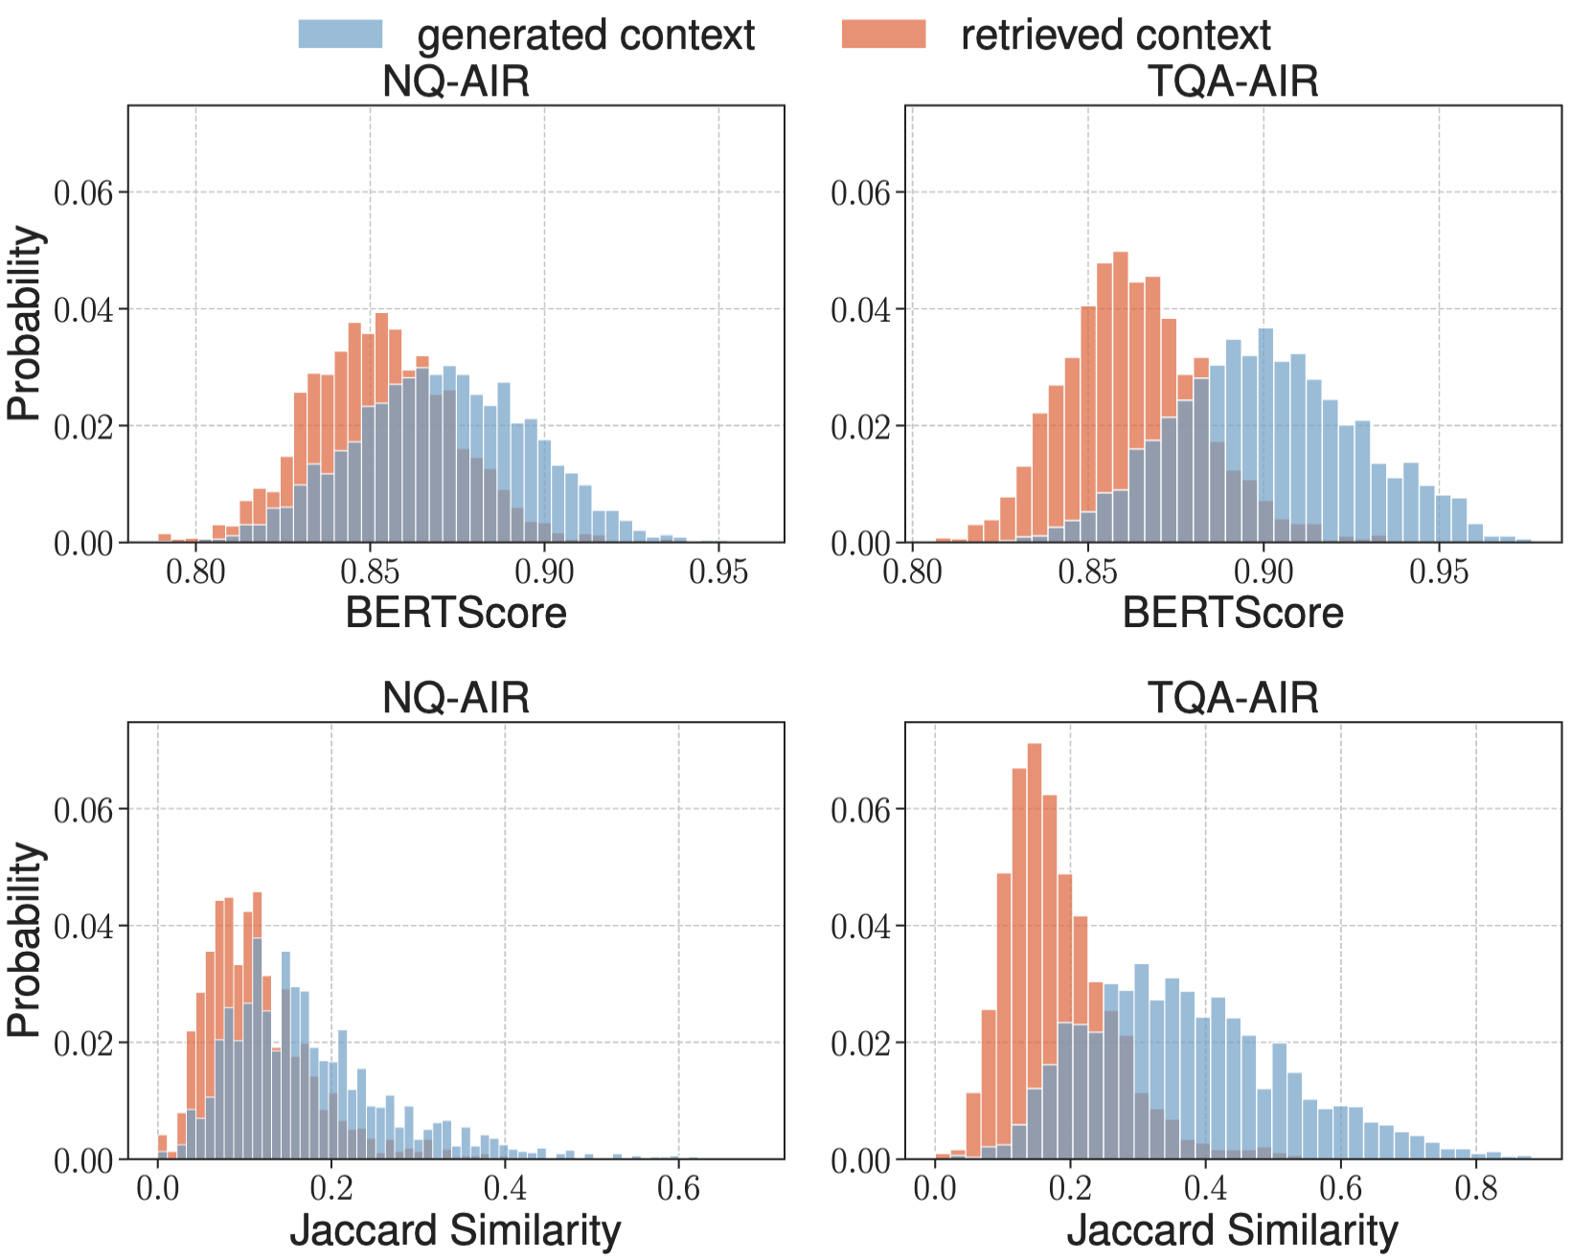
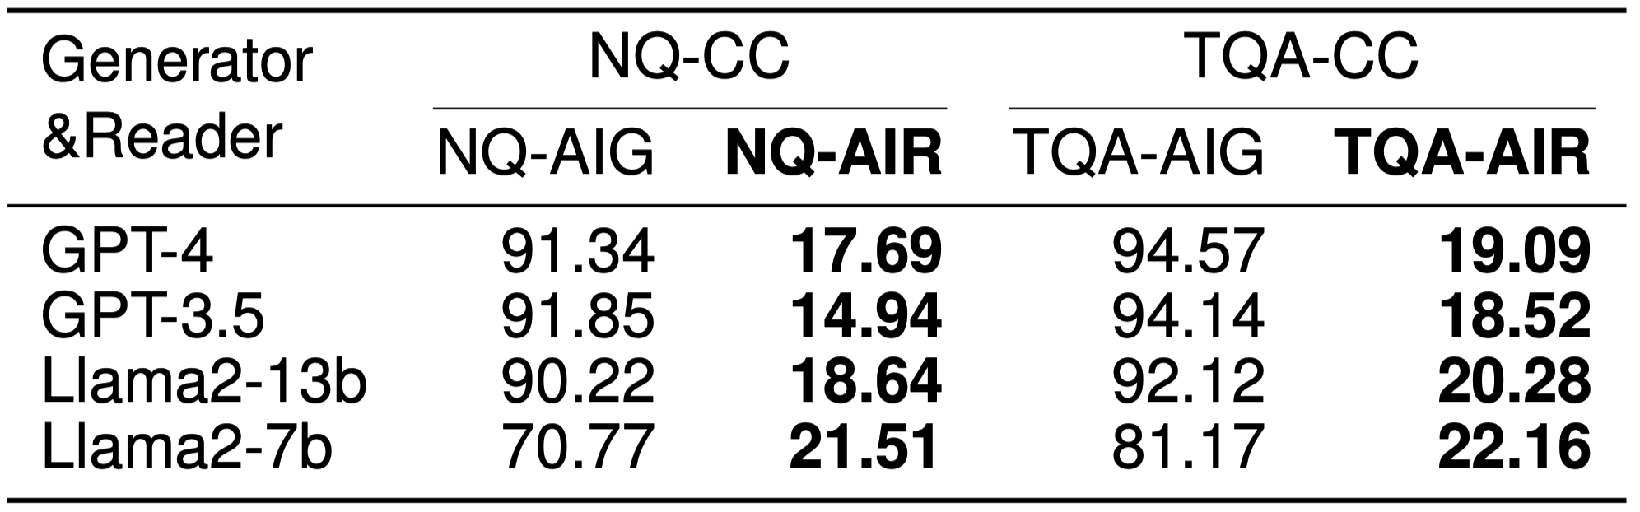
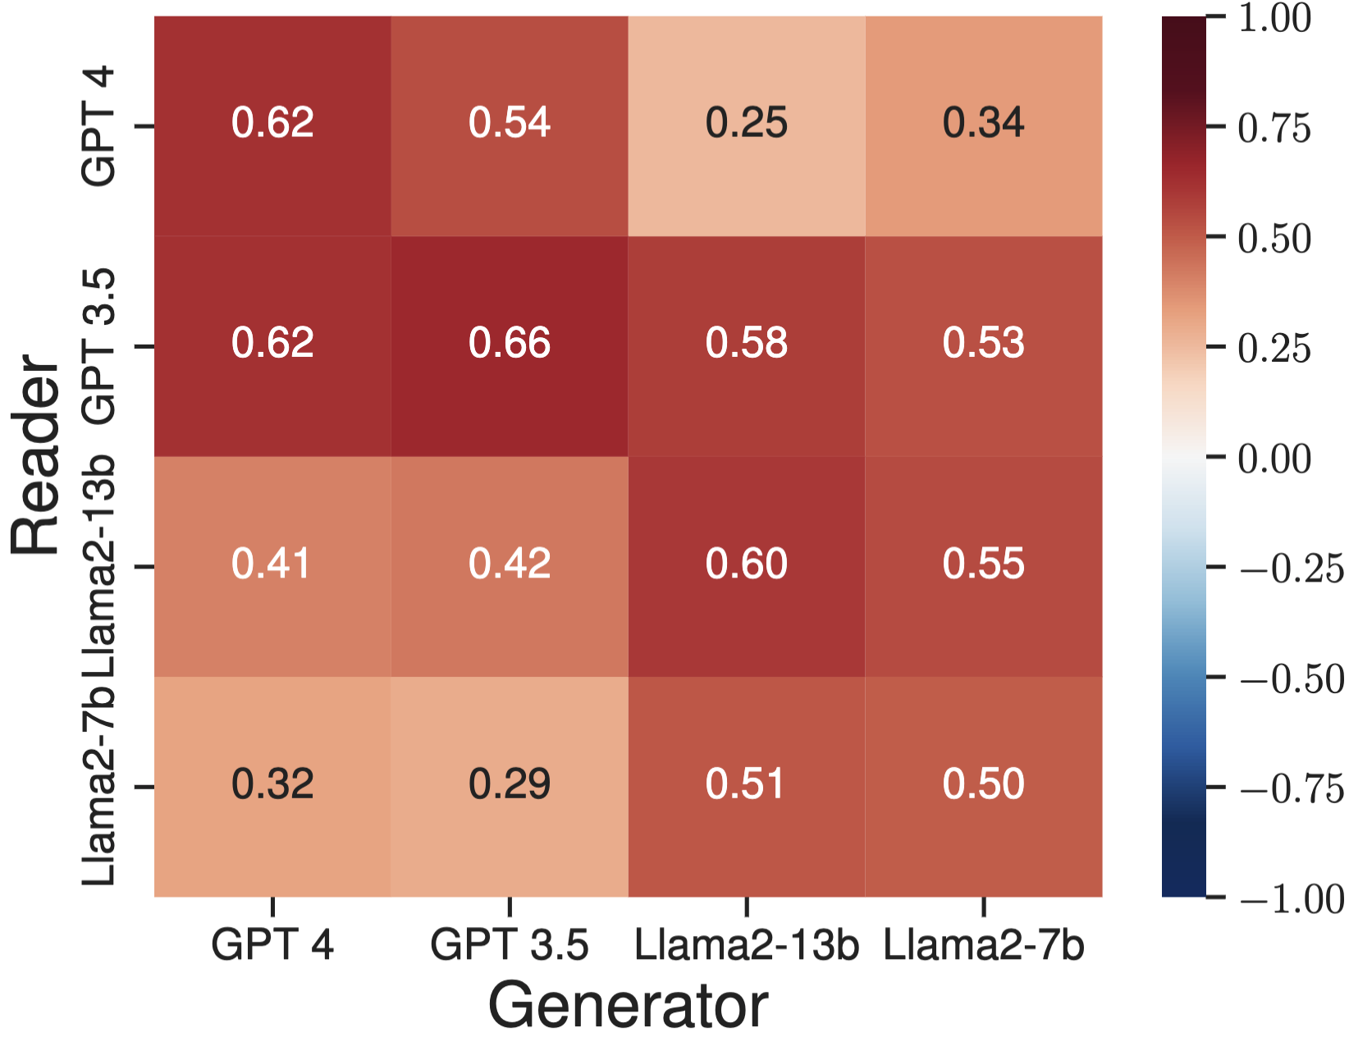
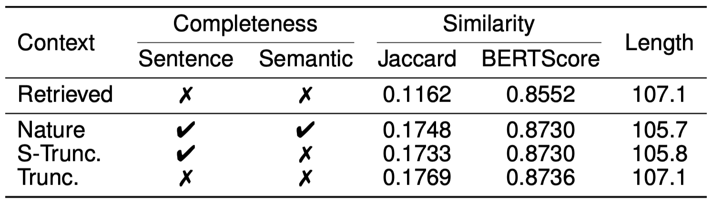
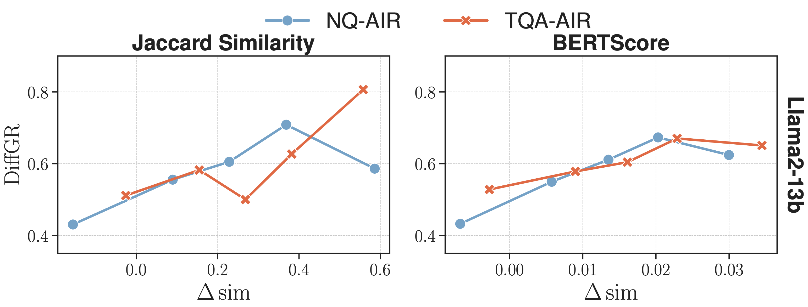
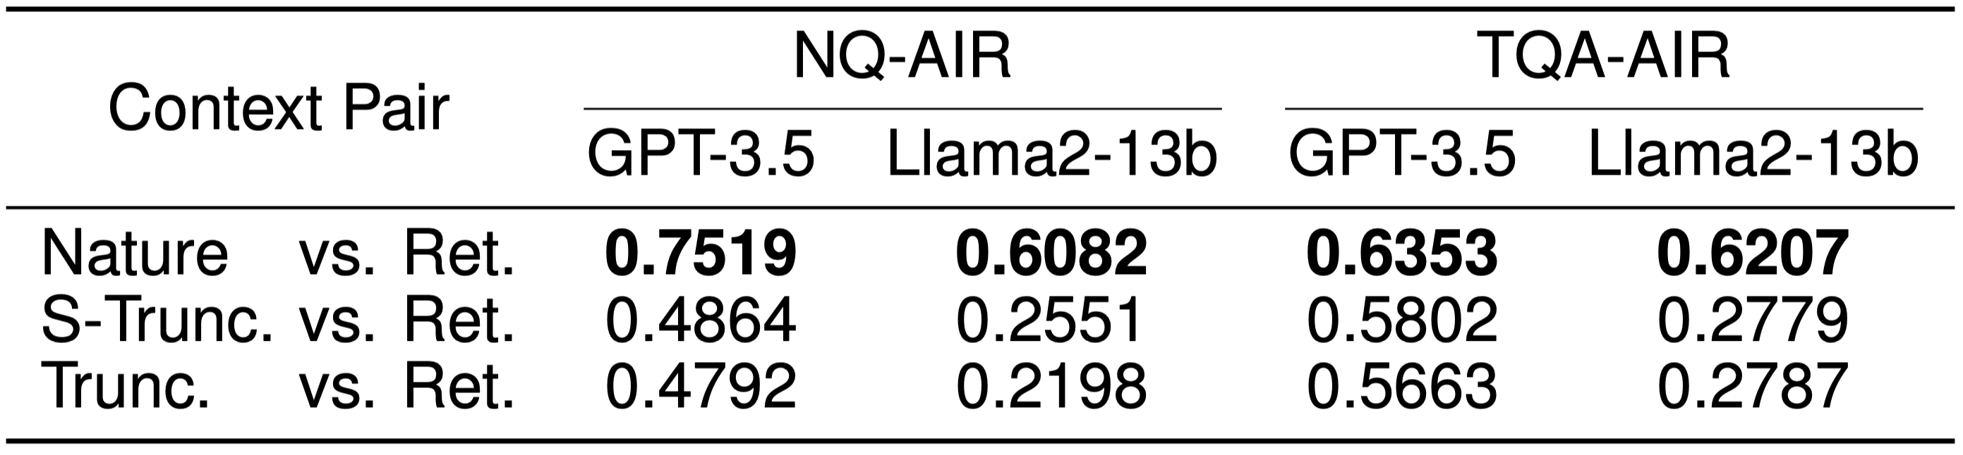
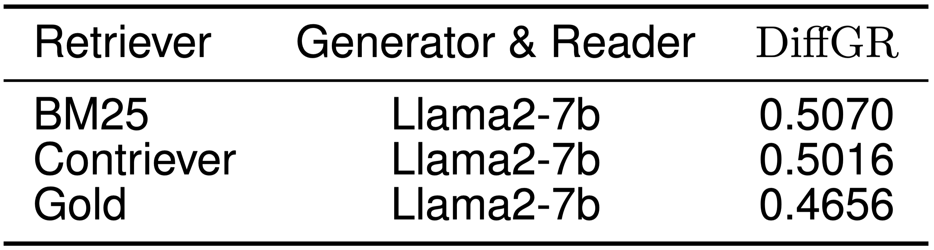

Blinded by Generated Contexts:
How Language Models Merge Generated and Retrieved Contexts When Knowledge Conflicts?
Hexiang Tan, Fei Sun†, Wanli Yang, Yuanzhuo Wang, Qi Cao, Xueqi Cheng
LLM are biased toward LLM-generated contexts even when they are wrong.
For the full paper
Just scan!
Context-Conflicting Datasets (CC)
Only one of generated and retrieved contexts contain correct answer.
AIG: Answer In Generated Contexts
AIR: Answer In Retrieved Contexts
: the extent of LLMs' tendency to rely on generated contexts over retrieved contexts.
Ideal : -1 → AIR, 1 → AIG
LLMs Prefer Generated Contexts
Why LLMs Prefer Generated Contexts?
1. LLMs prefer generated contexts, even when they are incorrect!
EM performance drops significantly in AIR.
1. Confirmation bias is not a key factor
3. Similarity is a significant factor
(1) Similarity Distribution
2. Consistent preferences across various generators and readers
Rarely choosing parametric knowledge.
Still prefer generated contexts even when they are inconsistent with LLMs' parametric knowledge.
2. Semantic completeness matters
Generated contexts exhibit a higher similarity to the questions.
Simulate incompleteness in generated contexts.
Controlled length and similarity.
(2) Effect of Similarity
2. Consistent preferences across various retrievers
Significant increase in bias with enhanced semantic completeness.
LLMs exhibit an increased bias on slices with a larger average similarity gap

