Slide 1




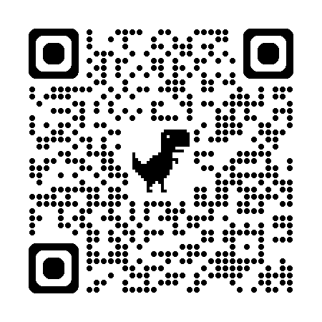
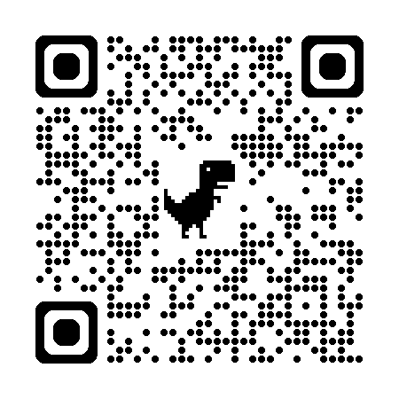










Too Consistent to Detect: A Study of Self-Consistent Errors in LLMs
Hexiang Tan, Fei Sun , Sha Liu, Du Su, Qi Cao, Xin Chen, Jingang Wang,
Xunliang Cai, Yuanzhuo Wang, Huawei Shen, Xueqi Cheng
State Key Laboratory of AI Safety, ICT, CAS
University of Chinese Academy of Sciences Meituan
tanhexiang21s@ict.ac.cn sunfei@ict.ac.cn
WHAT is Self-Consistent Error?
WHY Self-Consistent Error Matters?
Numerous error detection methods rely on measuring consistency across multiple samples, under assuming that “consistent outputs are more likely to be correct”.
Self-consistent errors: cases where LLMs consistently generate semantically equivalent errors across multiple stochastic samples.
Semantic equivalence: mutually entail each other with NLI.
Number of self-consistent errors remains relatively stable, or even slightly increases.
Number of inconsistent errors markedly decrease as models scale up.
Self-consistent errors may remain a persistent challenge and become more concerning as LLMs continue to scale.
Some cases show the potential causes of
these errors, including pervasive
misconceptions on the internet
and conceptual confusions.
Consistent
$≠$
Correct
Feel Free to Contact Us
For Any Question!
Current Methods
Fail to Detect Them!
Cross-Model Probe
Helps!
Evaluate four types of mainstream error detection methods, Probability, P(True), Semantic Entropy (SE), and Probe:
Perform well on Inconsistent Errors (IE subsets), AUROC up to ~90%.
All methods suffer a substantial performance degradation on Consistent Errors (CE subsets).
SE, which performs best among training-free methods on IE subsets, exhibits the most dramatic decline on CE subsets, performing at or below random guessing.
Self-consistent errors are often model-specific and rarely overlap across different verifiers.
motivate
Cross-Model Probe: feeds the response to an external verifier, probes its hidden states, and fuses that signal with the original probe.
Our cross-model probe outperforms the best baseline, across all verifiers and a broad range of $λ$
Notes:
先说single edit，再说sequential edit普遍会崩溃，纯文字，深色背景，图不要放
Intro的放在pilot observation
文字上补充ROME对其他都是崩溃的
如何检测崩溃的发生，再用ppl

