Slide 1
UN Cyber Security Project
– PICASSO
Group Members:
Shimeng (Carol) Lin, Bennong (Ben) Liu,
Shaoying Tang, Chuanze (Eric) Cai
Date: 04/24/2017
Notes:
Case background
Risk manager react to diff situations
Miss outline page

Slide 2
Outline
Transition from Phase I to Phase II
Tagging Applied to a Specific Country - UK
Corpus Collection & Tagging Improvement
Methodologies
Category & Subcategory Expansions
Phase II Progress
Updated Tagging Procedure & Tagging Results
Comparison and Summary Charts
Phase II Achievements
Improvements and Calculation, and Improvement Plan

Slide 3


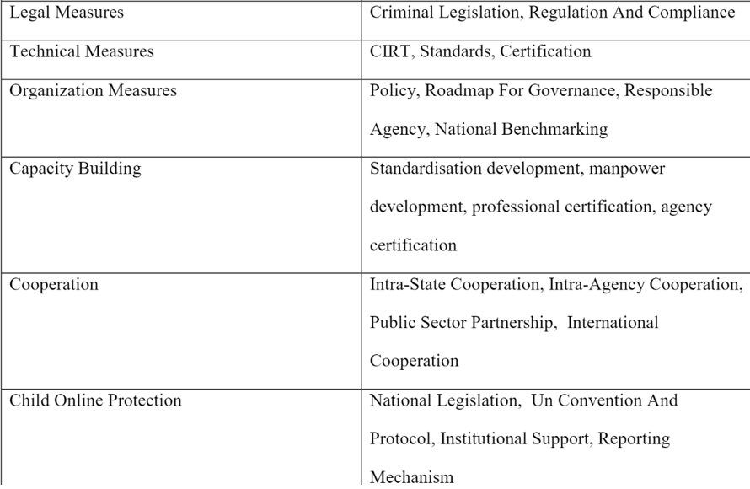
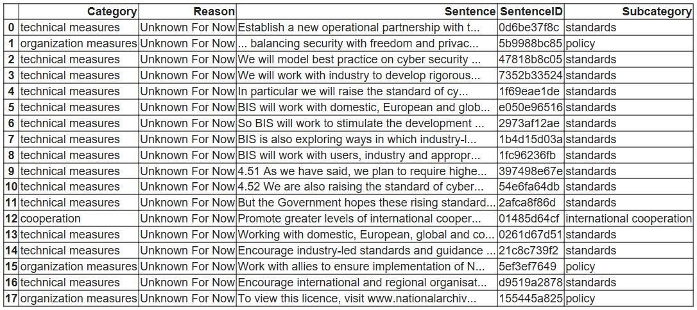
Transition: From Phase I to Phase II
Phase I method
Tagging sentences with stemming of the category names
and subcategory names.
Limitation: low coverage.
Tagging Results using Phase I approach
UK Files Used
Notes:
We conducted the sentence basis analytics under Python environment. We built the data frame below (also in attachment in excel format) to summarize the sentence tagging results.

Slide 4
Transition: From Phase I to Phase II
e.g. UK.txt
Out of 523 sentences contained in the UK text, there were 18 sentences tagged by the category and subcategory selected.
The tagging rate was only 3.44%, which was considered relatively low.
The main problem is to expand the coverage of tagging with acceptable accuracy.

Slide 5
Phase II Progress: Keywords Expansion
Manually understanding of the official files.
NCA, business partnership, private sector partnership, GCHQ……
Tf-idf approach.
Bigram Approach.

Slide 6
Tf-idf approach
Words with high tf-idf scores:
strategy, structure, policy…
Problem:
Tagging with those words (unigrams) led to very low accuracy.
（In the sample of 200 sentences, the accuracy is about 50 percent.）

Slide 7
Bigram Approach
Bigrams | Frequency
cyber criminals | 27
law enforcement | 16
Information infrastructures | 20
social develpment | 14
Instituition budget | 21
Civil service | 17
Situational awareness | 27
… | …

Slide 8
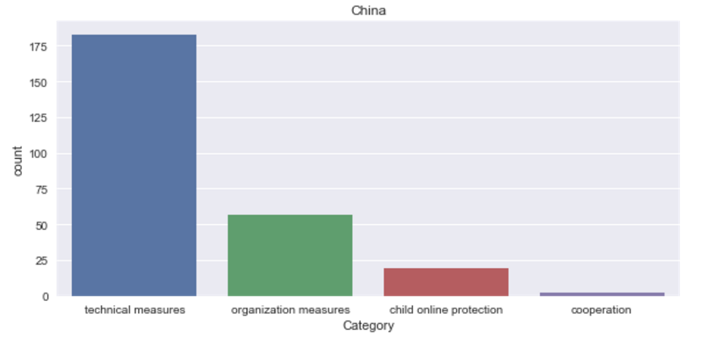
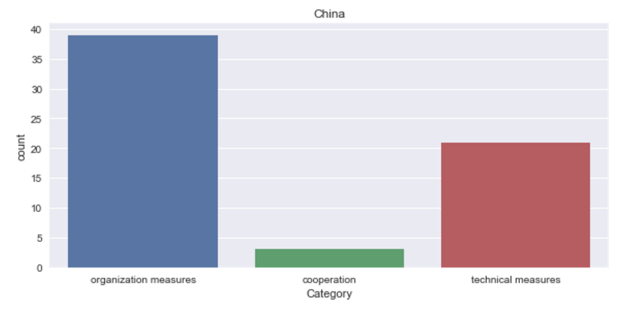
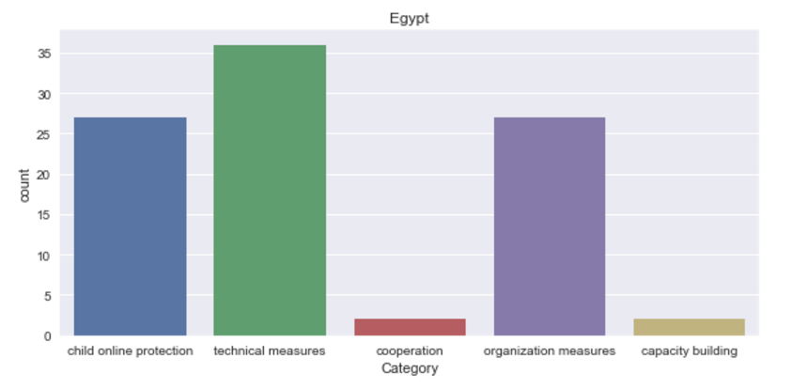
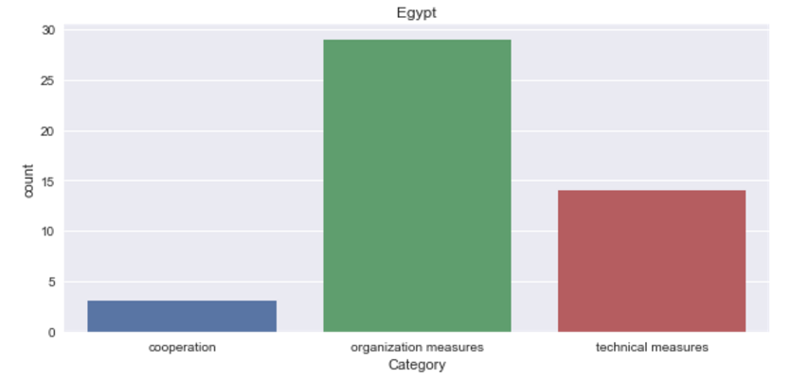
Distribution Comparison - Phase II vs. I
Updated Tagging Results
Original Tagging Results
10/12

Slide 9
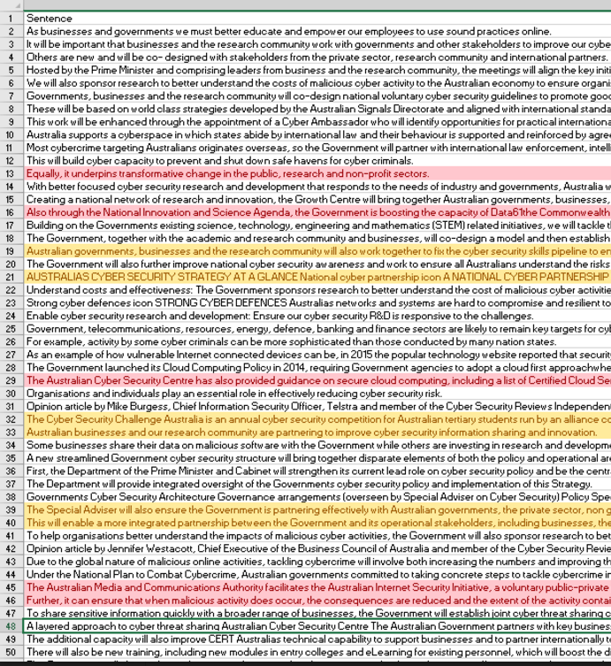
Accuracy & Problems
Accuracy:
Around 83.3% from the sample of 400 sentences
Problems:
Sentences with keywords of mixed categories.
e.g. The government cooperates with a technical organization to implement a strategy…...
Organization Measure or Technical Measure or Cooperate ?

Slide 10
Phase II Progress
Category | corpus
technical measures | cirt, standards, certification, indigenous innovation, information infrastructures, slovak digital, research, electronical mechanical
organization measures | policy, roadmap for governance, responsible agency, national benchmarking, social development, climate change, public administration, national information
… | …
Summary
We added new keywords and the number of sentences tagged was increased resulting from the updated model. The tagging accuracy was approximately 83.3%, which was acceptable.

Slide 11
Phase II Achievements & Improvement Plan
From the above conclusions, we could observe that the results of distribution were only for informative purpose although we improved the results from Phase I.
According to the tagging results, the categories/keywords may not be accurate enough to provide solid evidence to support the next research stage.
Our future plan includes updating the model with more restrictive categorizing/clustering criteria to optimize the results. We will also calculate the tentative accuracy rates in terms of measurement. D3 templates will also be used to visualize the result.

Slide 12
Q & A

Slide 13
Thank You

