Slide 1

Rapid Assessment of UN National Planning Documents using Machine-based Text Analytics
Team Brahms

Slide 2


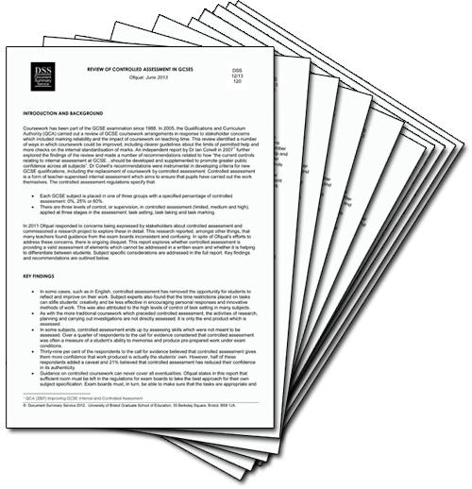


Problem Statement
SDG Targets
National Plan
1. Poverty
1.1 By 2030, eradicate extreme poverty
for all people everywhere
1.2 By 2030, reduce at least by half the
proportion of men, women and children
of all ages living in poverty in all its dimensions
.....
Total: 169 Targets

Slide 3
Flow Chart
Model
Preprocessing
Evaluation
Define Features
Build Feature Lexicon
Similarity Scoring
Top 5 as threshold
Spark to speed up
Tokenization
Stemming
Remove stop words
Up to 4-grams
Part 1
Part 2
Accuracy
Presentation
UI

Slide 4
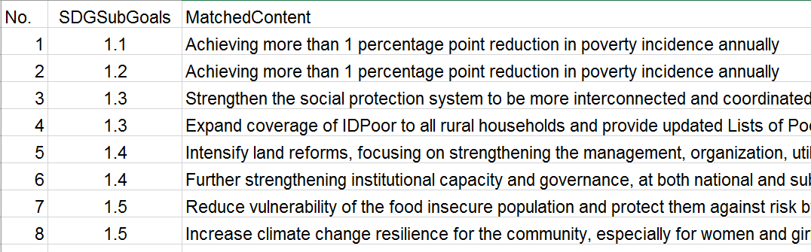
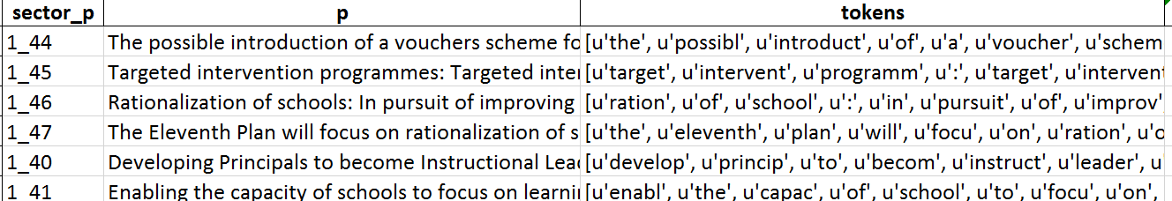
Data Processing
Convert pdf to structured content
Divided by sentences
Data prepare
Stemming
Tokenization
Removing stop words
Golden Standard - Cambodia’s
Golden Standard
Tokenized

Slide 5
CWSS Model -
Concept Weighed Semantic Similarity

Slide 6
Model -Part 1- Feature Lexicon
SDG Targets
Features & Lexicon
National Plan
Strong Feature (must include)
3.3 By 2030, end the epidemics of AIDS, tuberculosis, malaria and neglected tropical diseases and combat hepatitis, water-borne diseases and other communicable diseases
Vision 2030 outlines a vision for a healthy,
food-secure and breastfeeding nation, in
which all preventable, infectious and parasitic diseases are under secure control and in which people enjoy a high standard of living, with access to quality health services.
epidemics: epidemics,
communicable, infectious
2. disease: disease, illness
Weak Feature (could include)
AIDS
tuberculosis
malaria

Slide 7
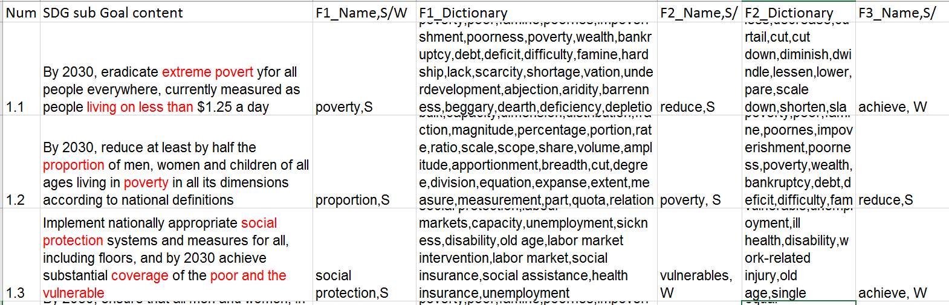
Model -Part 1- Feature Lexicon
Lexicon Example: synonym; related fields

Slide 8

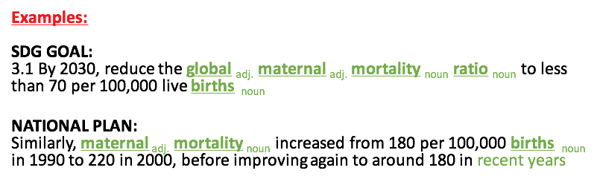
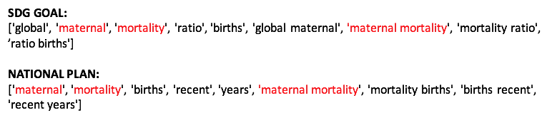

Model -Part 2- Similarity Model
Concept Extraction
POS
N-grams
Words Similarity
Wordnet Information Content
Similarity Score
Concepts Weighed
Model Efficiency
Apache Spark

Slide 9
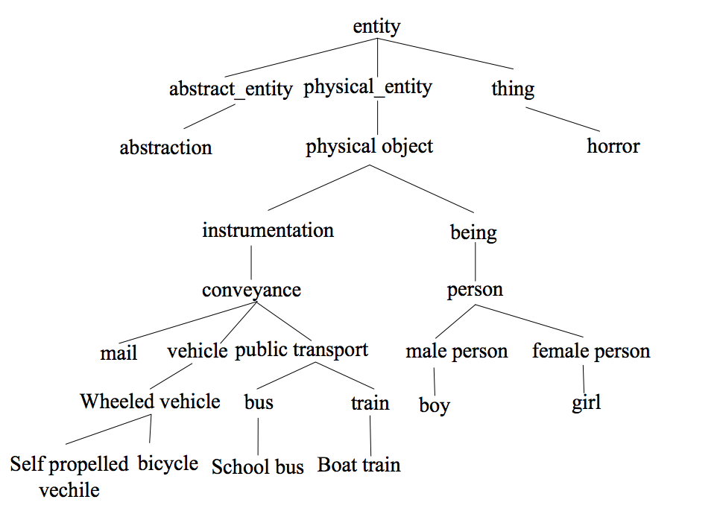
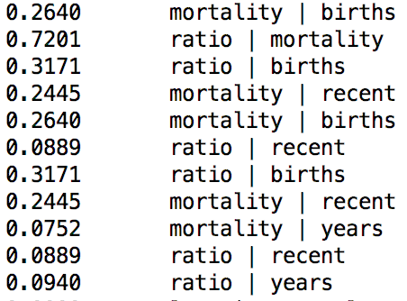
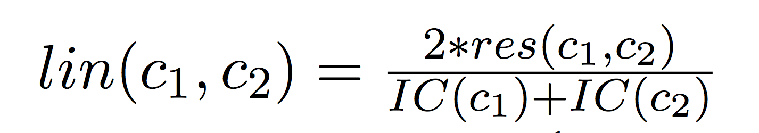
Model -Part 2- Similarity Model
Concept Extraction
POS
N-grams
Words Similarity
Wordnet Information Content
Similarity Score
Concepts Weighed
Model Efficiency
Apache Spark

Slide 10
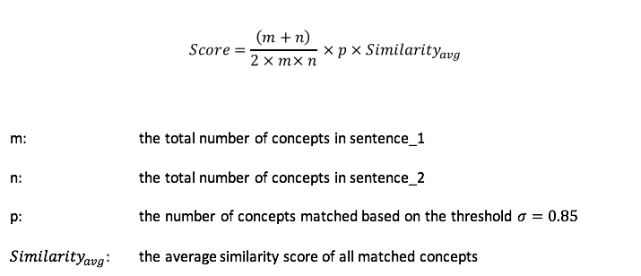
Model -Part 2- Similarity Model
Concept Extraction
POS
N-grams
Words Similarity
Wordnet Information Content
Similarity Score
Concepts Weighed
Model Efficiency
Apache Spark

Slide 11
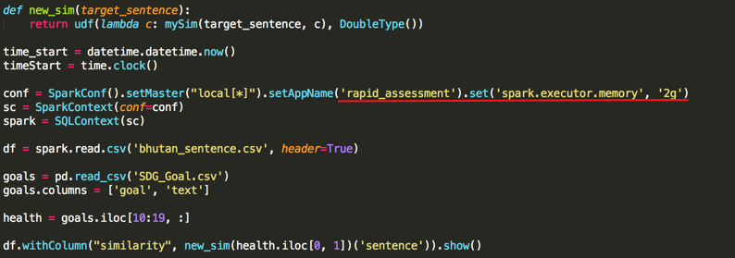
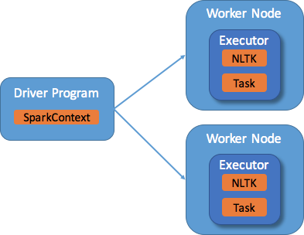
Model -Part 2- Similarity Model
Concept Extraction
POS
N-grams
Words Similarity
Wordnet Information Content
Similarity Score
Concepts Weighed
Model Efficiency
Apache Spark

Slide 12
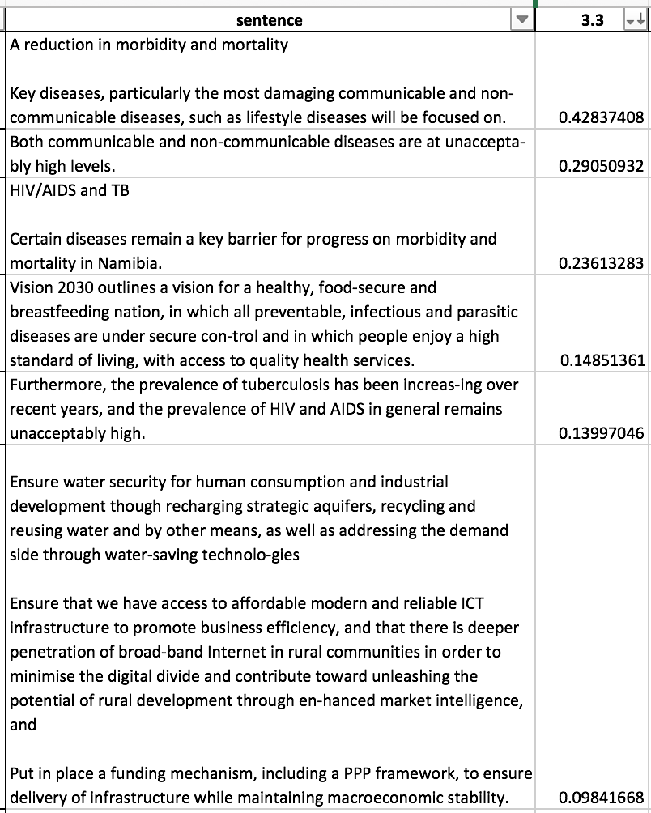
Model -Part 2- Similarity Model - TFiDF
Similarity Score
Rank previous output sentences using TFiDF
Calculated sentences with related goal content and golden standard
Dynamic threshold is the similarity score b/w goal content and golden standard

Slide 13
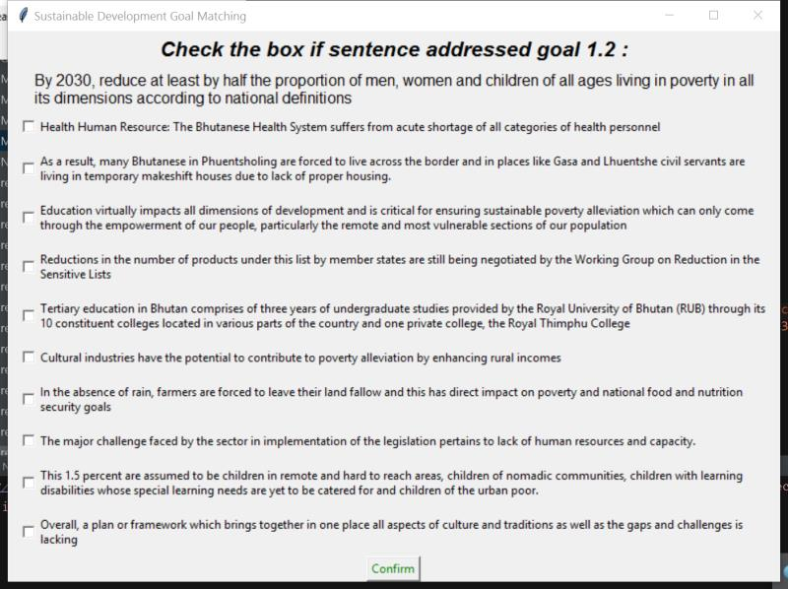
User Interface

Slide 14
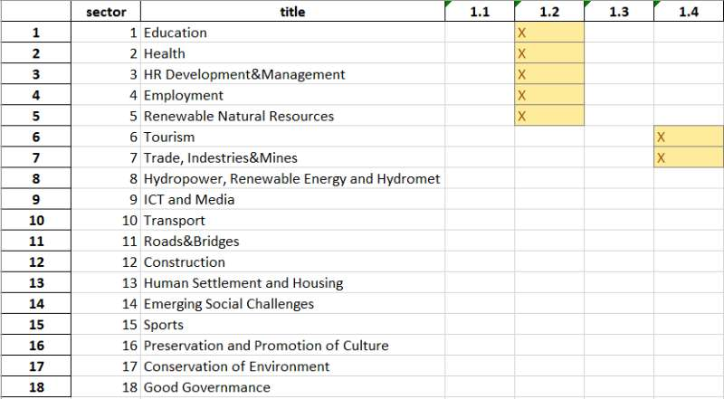
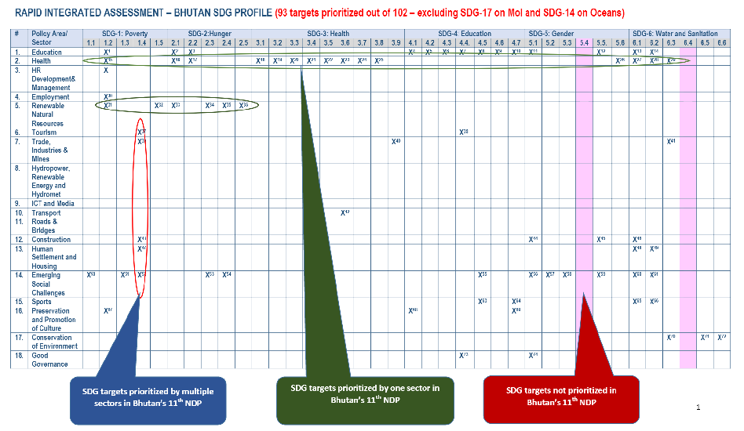
Result & Evaluation
Template 1
Evaluation
Target 3.1-3.9
Testing set: Namibia National Plan
Threshold: Top5 sentence
Accuracy Rate: 8/9 88.9%

Slide 15
Reference
[1] Zhang Yan-dong, Wang Kang-ping, etc. an Algorithm for Semantic Similarity of Short Text Based on WordNet

