Slide 1

ENGR 390 – ICT4S System Dynamics and Leverage Points
Dr. Birgit Penzenstadler
CC Attribution-NonCommercial-ShareAlike
unless specified otherwise on the slides.
Photo credit: Tina Floersch, Unsplash

Slide 2
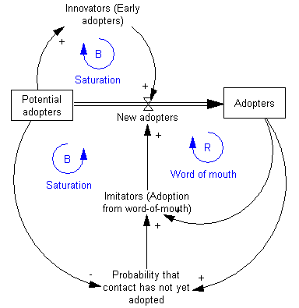
System Dynamics

Slide 3
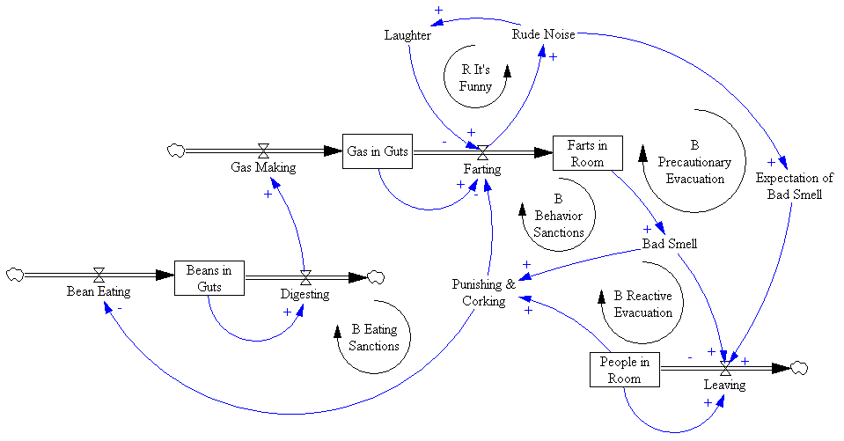
More examples
http://metasd.com/tag/system-dynamics/

Slide 4
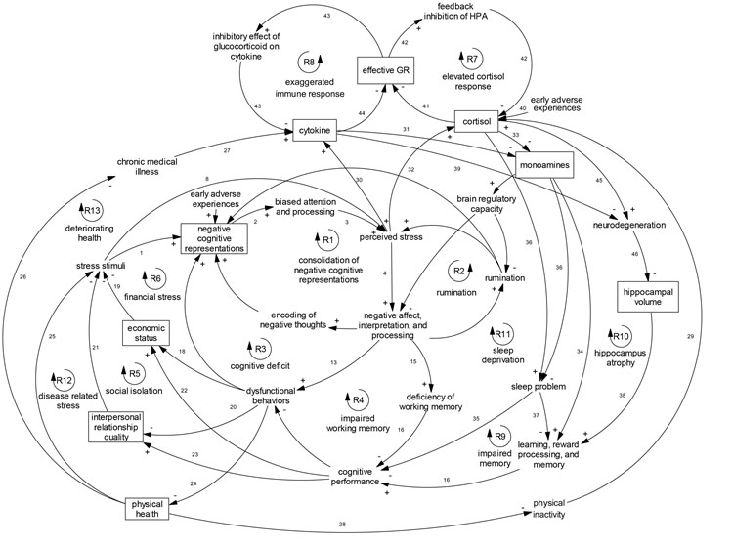
More examples
http://neurosciencenews.com/complex-model-depression-3188/depression-model-psychology/

Slide 5
Animated version
https://en.wikipedia.org/wiki/System_dynamics

Slide 6
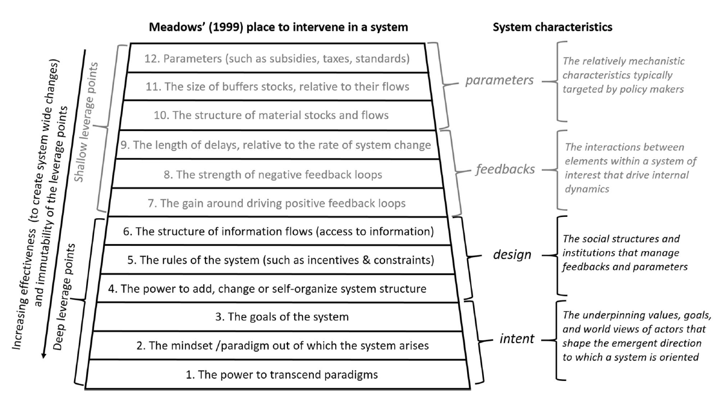
Leverage Points

Slide 7

References
Forrester, Jay W. "System dynamics, systems thinking, and soft OR." System dynamics review 10.2‐3 (1994): 245-256.
Meadows, Donella. "Leverage points." Places to Intervene in a System (1999).

