Slide 1
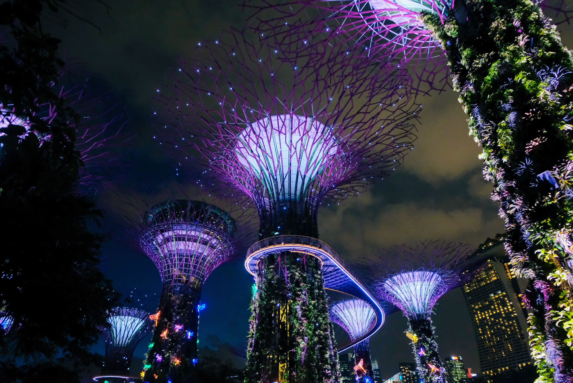
ENGR 390 – Information and Communication Technology for Sustainability “Renewable energy and smart grids: Production and potential”
Dr. Birgit Penzenstadler
Photo credit: Miguel Sousa, Unsplash
CC Attribution-NonCommercial-ShareAlike
unless specified otherwise on the slides.

Slide 2

Overview
Renewable energy
Smart grids
The story of stuff

Slide 3
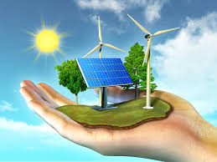
Renewable energy
Renewable energy is energy that is collected from renewable resources, which are naturally replenished on a human timescale, such as sunlight, wind, rain, tides, waves, and geothermal heat.
https://www.nrel.gov/workingwithus/learning.html

Slide 4
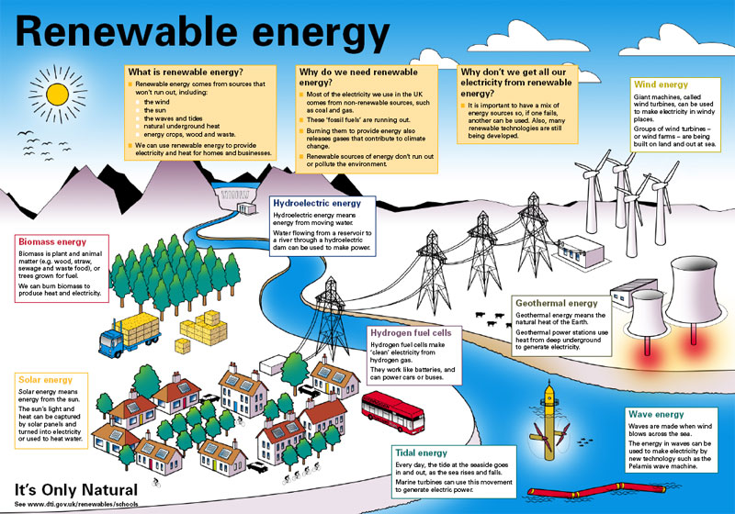
Renewable energy overview
https://ohs9sciencestelr.weebly.com/renewable-energy-sources.html

Slide 5
Energy: Status quo
The United States currently relies heavily on coal, oil, and natural gas for its energy.
Fossil fuels are nonrenewable, that is, they draw on finite resources that will eventually dwindle, becoming too expensive or too environmentally damaging to retrieve.
In contrast, renewable energy resources—such as wind and solar energy—are constantly replenished and will never run out.

Slide 6
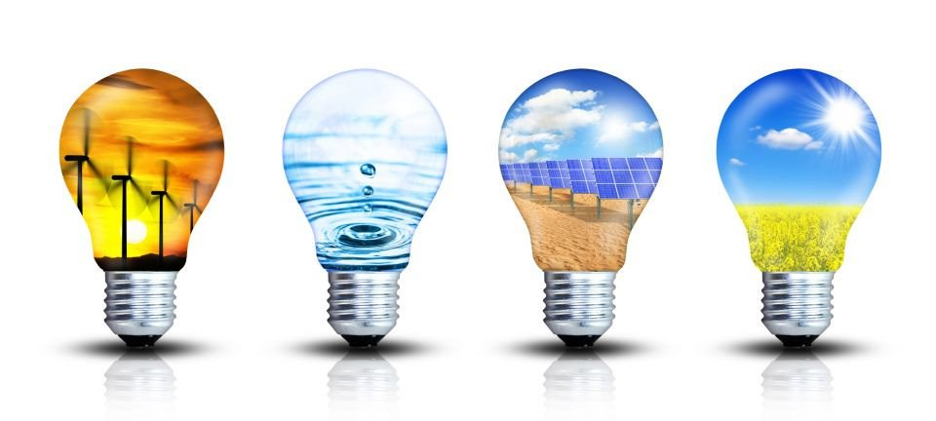
Solar Energy Basics
Solar is the Latin word for sun—a powerful source of energy that can be used to heat, cool, and light our homes and businesses.
That's because more energy from the sun falls on the earth in one hour than is used by everyone in the world in one year.
A variety of technologies convert sunlight to usable energy for buildings.
The most commonly used solar technologies for homes and businesses are solar water heating, passive solar design for space heating and cooling, and solar photovoltaics for electricity.
Businesses and industry also use these technologies to diversify their energy sources, improve efficiency, and save money.
Solar photovoltaic and concentrating solar power technologies are also being used by developers and utilities to produce electricity on a massive scale to power cities and small towns.

Slide 7
Solar technologies
Solar Photovoltaic Technology: These technologies convert sunlight directly into electricity to power homes and businesses.
Concentrating Solar Power: These technologies harness heat from the sun to provide electricity for large power stations.
Solar Process Heat: These technologies use solar energy to heat or cool commercial and industrial buildings.
Passive Solar Technology: These technologies harness heat from the sun to warm our homes and businesses in winter.
Solar Water Heating: These technologies harness heat from the sun to provide hot water for homes and businesses.
https://www.nrel.gov/workingwithus/re-solar.html

Slide 8
Wind Energy Basics
We have been harnessing the wind's energy for hundreds of years.
From old Holland to farms in the United States, windmills have been used for pumping water or grinding grain.
Today, the windmill's modern equivalent—a wind turbine can use the wind's energy to generate electricity.

Slide 9
How a wind turbine works
Wind turbines, like windmills, are mounted on a tower to capture the most energy. At 100 feet (30 meters) or more aboveground, they can take advantage of the faster and less turbulent wind. Turbines catch the wind's energy with their propeller-like blades.
Usually, two or three blades are mounted on a shaft to form a rotor. A blade acts much like an airplane wing. When the wind blows, a pocket of low-pressure air forms on the downwind side of the blade. The low-pressure air pocket then pulls the blade toward it, causing the rotor to turn. This is called lift.
The force of the lift is actually much stronger than the wind's force against the front side of the blade, which is called drag.
The combination of lift and drag causes the rotor to spin like a propeller, and the turning shaft spins a generator to make electricity.

Slide 10
Wind turbine applications
Wind turbines can be used as stand-alone applications, or they can be connected to a utility power grid or even combined with a photovoltaic (solar cell) system.
For utility-scale (megawatt-sized) sources of wind energy, a large number of wind turbines are usually built close together to form a wind plant, also referred to as a wind farm. Several electricity providers today use wind plants to supply power to their customers.
Stand-alone wind turbines are typically used for water pumping or communications. However, homeowners, farmers, and ranchers in windy areas can also use wind turbines as a way to cut their electric bills.

Slide 11
Biomass Energy Basics
We have used biomass energy, or "bioenergy"—the energy from plants and plant-derived materials—since people began burning wood to cook food and keep warm.
Wood is still the largest biomass energy resource today, but other sources of biomass can also be used.
These include food crops, grassy and woody plants, residues from agriculture or forestry, oil-rich algae, and the organic component of municipal and industrial wastes.
Even the fumes from landfills (which are methane, the main component in natural gas) can be used as a biomass energy source.

Slide 12
Geothermal Energy Basics
Many technologies have been developed to take advantage of geothermal energy—the heat from the earth.
This heat can be drawn from several sources: hot water or steam reservoirs deep in the earth that are accessed by drilling; geothermal reservoirs located near the earth's surface, mostly located in the western U.S., Alaska, and Hawaii; and the shallow ground near the Earth's surface that maintains a relatively constant temperature of 50-60°F.
This variety of geothermal resources allows them to be used on both large and small scales. A utility can use the hot water and steam from reservoirs to drive generators and produce electricity for its customers.
Other applications apply the heat produced from geothermal directly to various uses in buildings, roads, agriculture, and industrial plants. Still others use the heat directly from the ground to provide heating and cooling in homes and other buildings.

Slide 13
Hydrogen Energy Basics
Hydrogen is a clean-burning fuel, and when combined with oxygen in a fuel cell, it produces heat and electricity with only water vapor as a by-product.
But hydrogen does not exist freely in nature: it is only produced from other sources of energy, so it is often referred to as an energy carrier, that is, an efficient way to store and transport energy.

Slide 14
Hydrogen Energy Basics
Hydrogen can be made directly from fossil fuels or biomass, or it can be produced by passing electricity through water, breaking the water into its constituent components of hydrogen and oxygen.
Some envision a future "hydrogen economy," where hydrogen is produced from a variety of energy sources, stored for later use, piped to where it is needed, and then converted cleanly into heat and electricity.
Most hydrogen production today is by steam reforming natural gas. But natural gas is already a good fuel and one that is rapidly becoming scarcer and more expensive.
It is also a fossil fuel, so the carbon dioxide released in the reformation process adds to the greenhouse effect.
Hydrogen has very high energy for its weight, but very low energy for its volume, so new technology is needed to store and transport it.
And fuel cell technology is still in early development, needing improvements in efficiency and durability.

Slide 15
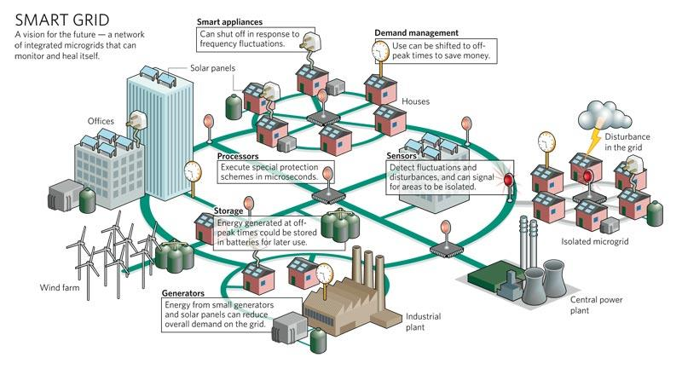
Smart Grids
http://viterbivoices.usc.edu/zachg/getting-smart-with-the-usc-smart-grid-project/

Slide 16
TED talk
Renewable energy
https://www.ted.com/talks/david_mackay_a_reality_check_on_renewables

Slide 17


“The Story of Stuff”
We have a problem with Stuff: We have too much of it, too much of it is toxic and we don’t share it very well. But that’s not the way things have to be.
That’s the challenge Annie Leonard unpacked in her groundbreaking 2007 online documentary.
It unleashed a demand for honest conversation about our consumption-crazed culture.
The Story of Stuff
The Story of Electronics
The Story of Solutions
And more… (see references)

Slide 18

Today’s task: discussion
We have a problem with Stuff: We have too much of it, too much of it is toxic and we don’t share it very well. Where do you see that?
The Story of Electronics: What did you learn?
The Story of Solutions: What could those be?

Slide 19

References
Learning About Renewable Energy https://www.nrel.gov/workingwithus/learning.html
https://ohs9sciencestelr.weebly.com/renewable-energy-sources.html
http://viterbivoices.usc.edu/zachg/getting-smart-with-the-usc-smart-grid-project/
Story of stuff movies https://storyofstuff.org/movies/story-of-stuff/ https://storyofstuff.org/movies/story-of-electronics/ https://storyofstuff.org/movies/the-story-of-solutions/
http://storyofstuff.org//wp-content/uploads/movies/scripts/StoryofStuff_FactSheet.pdf

