Slide 1
<Project title>
Make sure you keep time:
- 15min presentation
- 5min Q&A
Team <number>
<Team member name(s)>

Slide 2
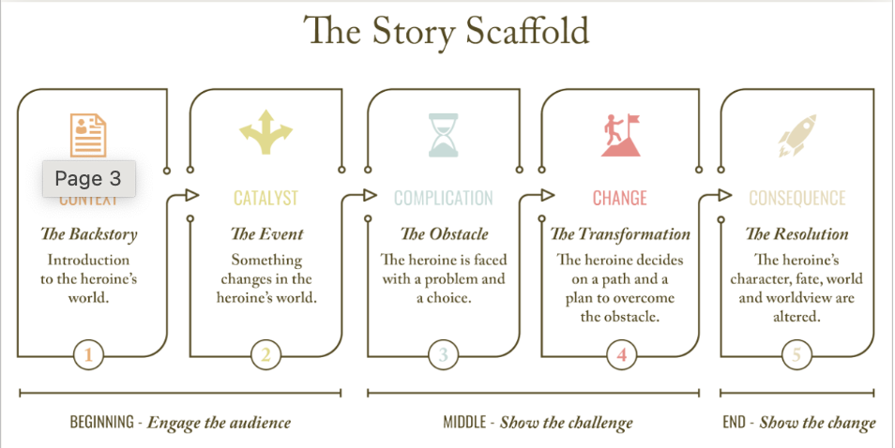
What’s your story? The 5 Cs
<Project name>
Context:
Catalyst:
Complication:
Change:
Consequence:

Slide 3
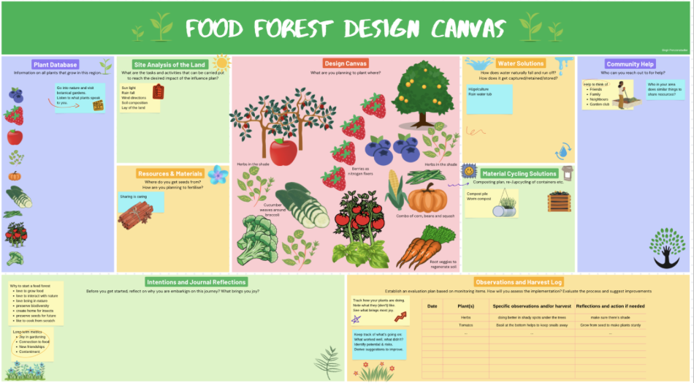
Intro: your Sustainability Research Canvas
<Project name>
<insert your canvas here>

Slide 4
Leverage Points from Systems Thinking
<Project name>
What was the most important insight(s) you got from the systems thinking perspective?
Illustrate them as good as you can.

Slide 5
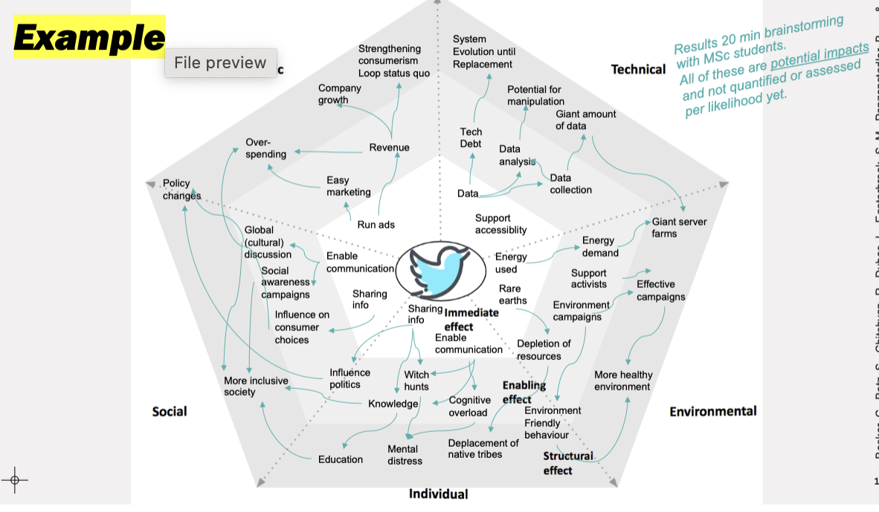
SusAF insights (summary)
<Project name>
What was a main insight?

Slide 6
Process <of your research>
<Project name>
What did you do?
How did you do it?
Create an info graphic of your process on this slide

Slide 7
Results <of your research>
<Project name>
What came out of your research?
What are the results/insights/data you got?
Create an info graphic of your results on this slide

Slide 8
Reflection & conclusions
<Project name>
What are your conclusions from this project?
Any open questions?
What’s next?
Use any preferred illustration of your project on this slide

