Slide 1
HPC for ML Magurele Summer School
GPU Accelerated Distributed Data Science 3
Marco Celoria – CINECA
Magurele 9 July 2025

Slide 2
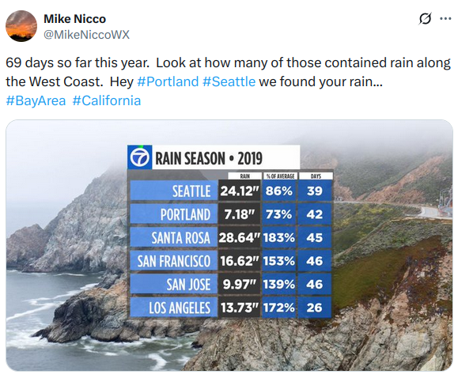
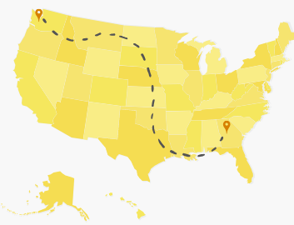
Exploratory data analysis (EDA)
EDA is used for analyzing datasets and summarizing their main characteristics, using statistical graphics or visualization methods
EDA is for seeing what the data can tell
In the USA, and West Coast in particular, people argue about who has most rain
What about the East Coast? We want to see if it rains more in Atlanta or Seattle

Slide 3
Exploratory data analysis (EDA)
Data can be found at: https://www1.ncdc.noaa.gov/pub/data/ghcn/daily/ghcnd-stations.txt https://www.ncei.noaa.gov/pub/data/ghcn/daily/by_year/
Load data and create a dataframe with the precipitation observations, but it's for all 100k weather stations, most of them nowhere near Atlanta, and this is time-series data, so we'll need to aggregate over time ranges.
Then, we extract year, month, and day from the compound "date" column, so that we can compare total rainfall across time.
Load up the station metadata file.
There's no city in the station data, so we do some geo-math and keep only stations near Atlanta and Seattle
Use a Groupby to compare changing precipitation patterns across time
Use inner joins to filter the precipitation dataframe down to just Atlanta & Seattle data

Slide 4
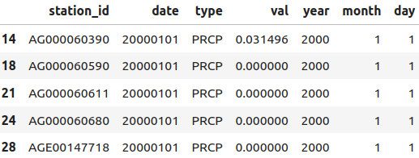
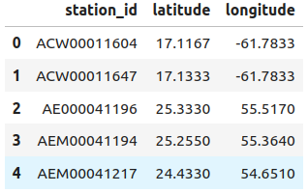
Exploratory data analysis (EDA)
Extracting Finer Grained Date Fields
Loading Station Metadata

Slide 5
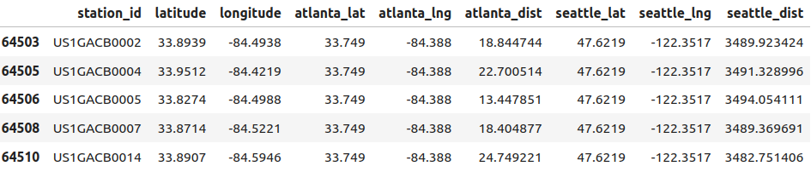
Exploratory data analysis (EDA)
Filtering Weather Stations by Distance
Grouping & Aggregating by Time Range Before using an inner join to filter down to city-specific precipitation data, we can use a groupby to sum the precipitation for station and year.

Slide 6
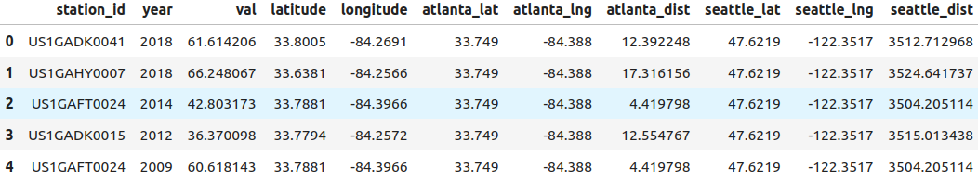
Exploratory data analysis (EDA)
Using Inner Joins to Filter Weather Observations We have separate DataFrames containing Atlanta and Seattle stations, and we have our total precipitation grouped by station_id and year. Computing inner joins can let us compute total precipitation by year for just Atlanta and Seattle.

Slide 7
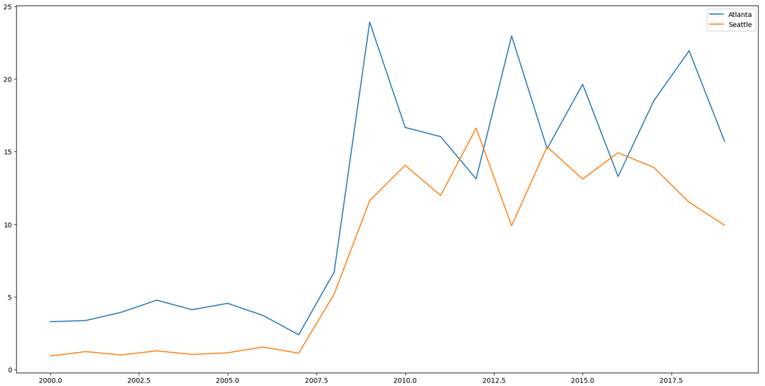
Exploratory data analysis (EDA)
It looks like at least for roughly the last years, it rains more by volume in Atlanta than it does in Seattle

Slide 8
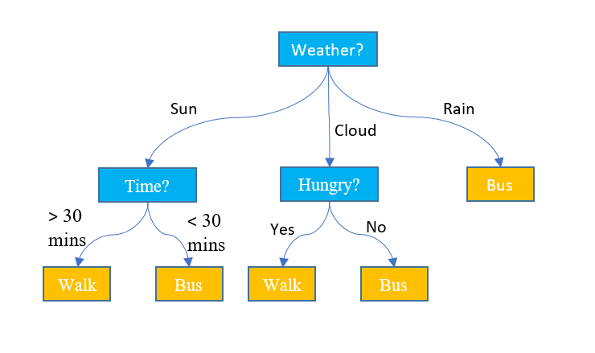
Decision trees
A decision tree is a non-parametric supervised learning algorithm, which is utilized for both classification and regression tasks.
It has a hierarchical, tree structure, which consists of a root node, branches, internal nodes and leaf nodes.

Slide 9
XGBoost and Random Forest
XGBoost and Random Forest are both popular ensemble learning methods that build multiple decision trees to make predictions, but they differ in their approach and optimization.
Random Forest uses a bagging technique, building trees independently and averaging their outputs
XGBoost uses a boosting technique, building trees sequentially and correcting errors of previous trees.
XGBoost is generally more accurate and efficient, especially with complex datasets, but requires more tuning and can be slower to train.

Slide 10

RAPIDS and XGBoost
RAPIDS works closely with the XGBoost community to accelerateGradient Boosted Decision Trees on GPU on GPU
XGBoost can load data from cuDF dataframes and cuPy arrays
Dask allows XGBoost to scale to arbitrary numbers of GPUs

Slide 11
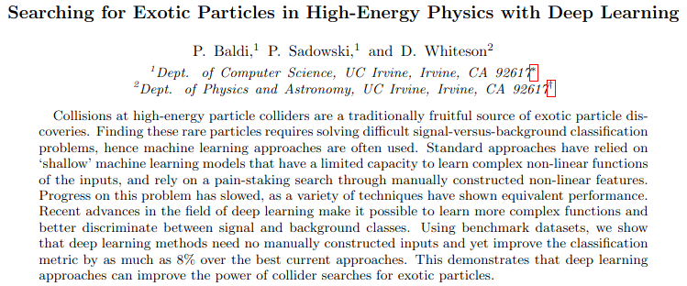
Searching for Exotic Particles in High-Energy Physics with Deep Learning

Slide 12
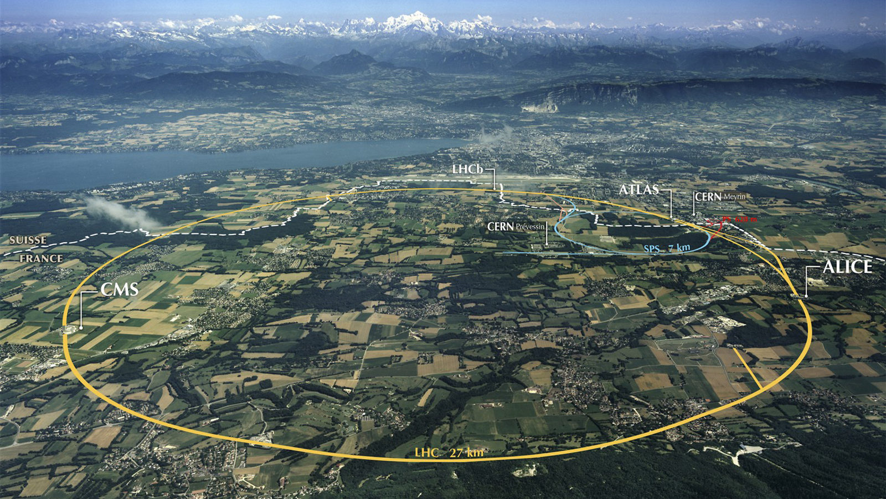
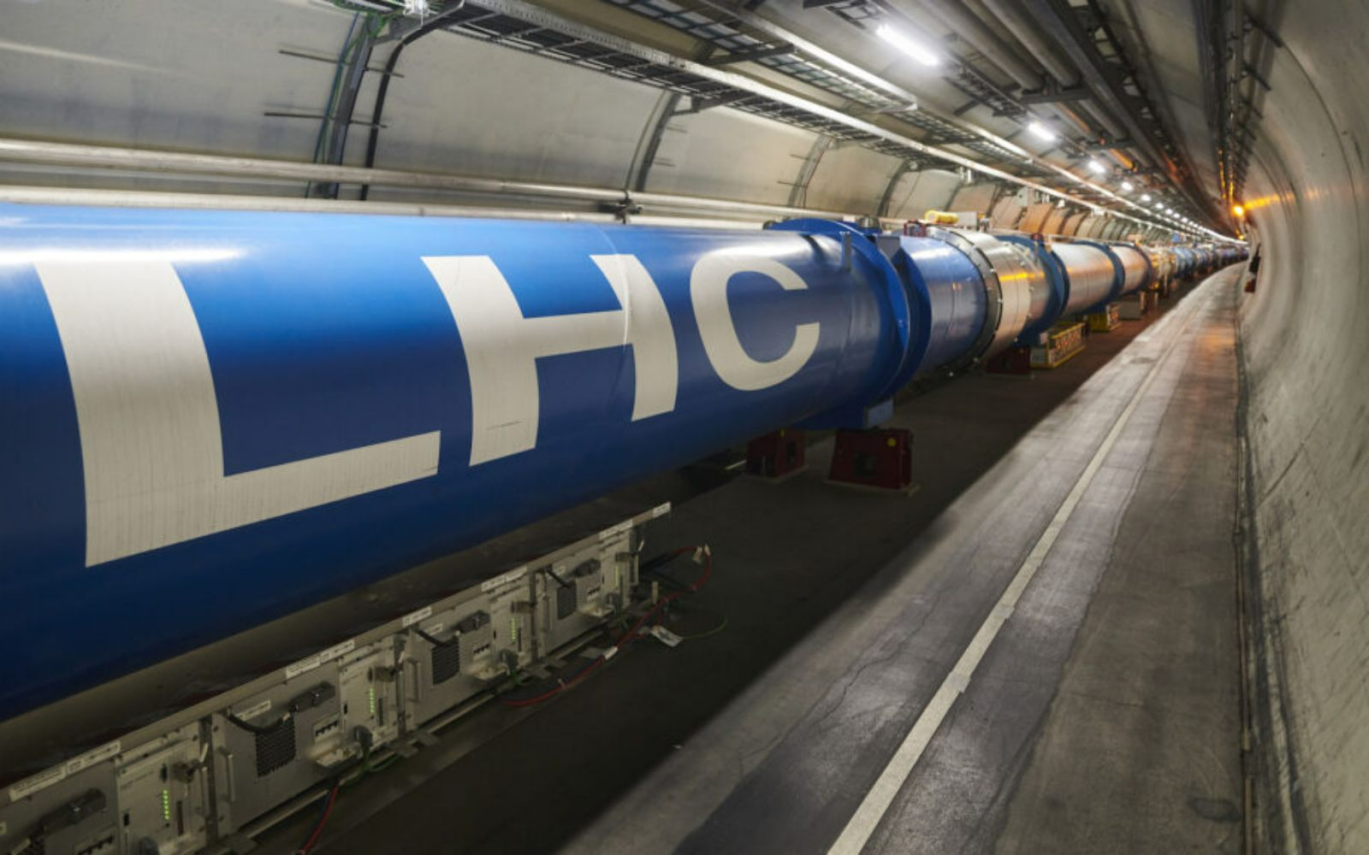
Higgs boson
The field of high energy physics is devoted to the study of the elementary constituents of matter.
The primary tools of high energy physicists are accelerators, which collide protons and/or antiprotons to create exotic particles.
Discoveries require powerful statistical methods, and machine learning tools play a critical role.

Slide 13
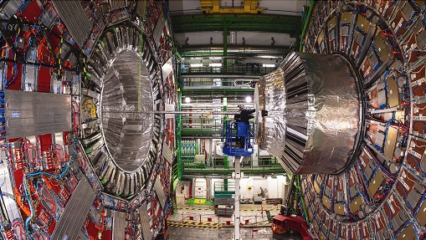
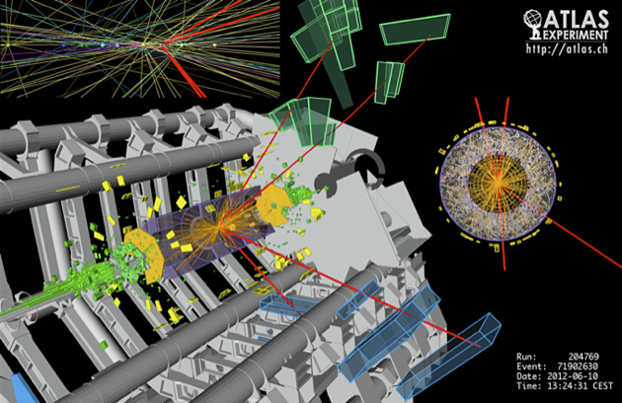
Higgs boson
The majority of particle collisions do not produce exotic particles.
Though the LHC produces approximately 10¹¹ collisions per hour, approximately 300 of these collisions result in a Higgs boson.
Good data analysis depends on distinguishing collisions which produce particles of interest (signal) from those producing other particles (background)

Slide 14
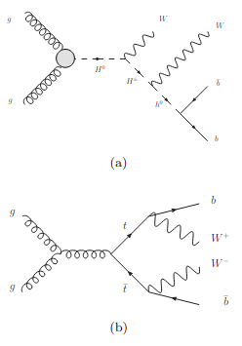
Higgs boson
Our classification task is to distinguish between:
a signal process where new theoretical Higgs bosons are produced, and
a background process with the identical decay products but distinct kinematic features.
Events are described by simple set of features which represent the measurements made by the detector: the momentum of each observed particle.
In addition, we have missing transverse momentum in the event and b-tagging information for each jet
These 21 features comprise our low-level feature set

Slide 15
Higgs boson
Our knowledge of the different intermediate states of the two processes allows us to construct other features.
As the difference in the two hypotheses lies mostly in the existence of new intermediate Higgs boson states, we can distinguish between the two hypotheses by attempting to identify whether the intermediate state existed.
In addition to the low-level features, we consider 7 high-level features (functions of the 21 low-level features), derived by physicists (based on reconstructing the characteristic invariant mass) to help discriminate between the two classes.

Slide 16
Higgs boson
The dataset can be found here: https://archive.ics.uci.edu/dataset/280/higgs
We can build a distributed accelerated XGBoost classifier
Without particular hyperparameter tuning, after training, we can get an accuracy of around 76% on the validation set and we compute the area under the ROC curve (AUC)
The environment of high energy physics, with high volumes of relatively low-dimensional data containing rare signals hiding under enormous backgrounds, can inspire new developments in machine learning tools.

Slide 17
Threshold for binary classifier
When we are predicting the probability of an instance belonging to a particular class, a threshold determines at what probability you classify an instance as the positive class (1) or the negative class (0).
The Higgs classifier decides whether an event involves the Higgs boson or the background. The model computes a score (probability) for each event, representing the likelihood it's a Higgs.
If we set a high threshold, the model will only mark very obvious Higgs events, ensuring background events are not accidentally confused as Higgs events. This might mean some less-obvious Higgs events be classified as background.
On the other hand, if you set a lower threshold, the filter will catch a broader range of Higgs event, but there's also a higher chance it might incorrectly classify a background event as Higgs.

Slide 18
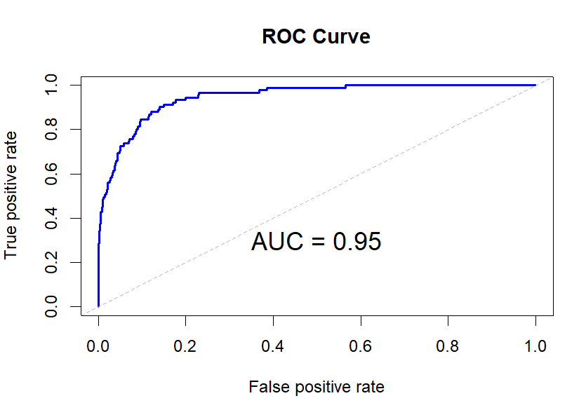
ROC
A ROC curve is a graphical plot that illustrates the performance of a binary classifier model at varying threshold values.
The ROC curve is the plot of the true positive rate (TPR) against the false positive rate (FPR) at each threshold setting.

Slide 19
AUC
The Area Under the ROC Curve (AUC) is a metric used to evaluate the performance of a binary classification model.
An AUC of 1.0 indicates a perfect model, while an AUC of 0.5 suggests the model performs no better than random guessing
0.5: No discriminatory power (random guessing).
0.7 - 0.8: Acceptable performance.
0.8 - 0.9: Excellent performance.
0.9 - 1.0: Outstanding performance.

Slide 20
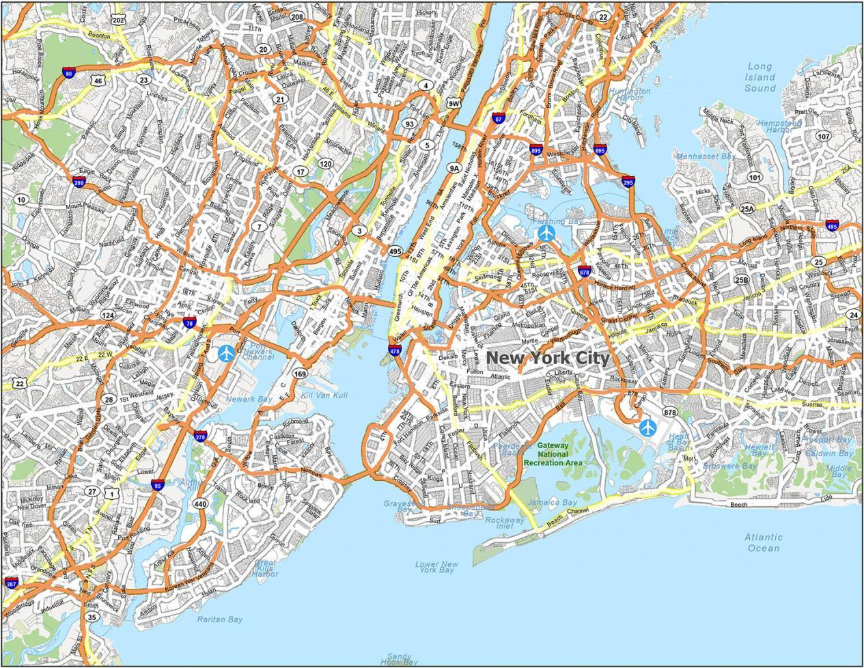

New York taxi
Consider the NYC Taxi & Limousine Commission yellow taxi data.
The goal is to predict the fare amount for a given trip given the times and coordinates of the taxi trip using a Random Forest.

Slide 21
New York taxi
Recall that on Leonardo, we need to download the dataset before starting the analysis
The NYC Taxi & Limousine Commission yellow taxi is first loaded into a Dask Dataframe.
The data is inspected, where it could be seen that the yellow taxi trip records include fields capturing pick-up and drop-off dates/times, pick-up and drop-off locations, trip distances, itemized fares, rate types, payment types, driver-reported passenger counts, distance, along with latitude, longitude, etc.
These are the information that would be used to estimate the trip fare amount.

Slide 22
New York taxi
The data needs to be cleaned up before it can be used in a meaningful way, in this part the user could recognize familiar pandas like functions such as (column) drop and fillna.
New features are added like time difference between dropoff and pickup
Just as with scikit-learn, the data could be easily split into training and test sets.
Training data is then fitted to a Random Forest Model, and Inference is run on the test set.

