Slide 1
HPC for ML Magurele Summer School
GPU Accelerated Distributed Data Science 2
Marco Celoria – CINECA
Magurele 9 July 2025

Slide 2
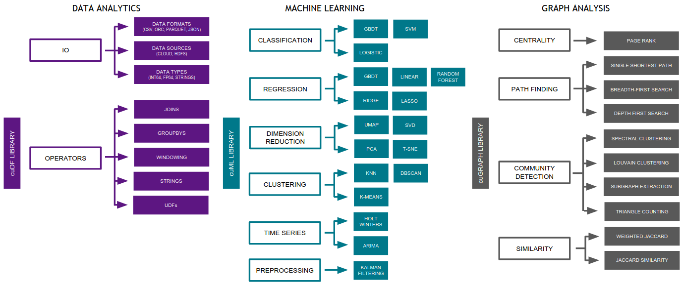
RAPIDS

Slide 3


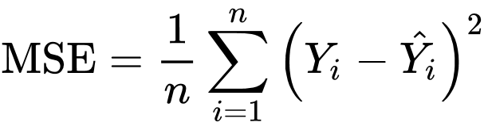
Linear Regression
In regression.py, we consider a linear regression on a synthetic dataset.
The dataset is {Yj,Xj1,... ,XjM} with j=1,…,n for n samples and M features, generated from a linear model
where cf with f=1,...,M is a vector of m coefficients and b is the bias.
Among the M features, we suppose that only K features are informative, that is only c1,... ,cK are different from zero.
Given the dataset X, y generated from the true underlying coefficients cM and the true underlying bias b, the goal is to learn the coefficients CM and the bias B from data, by minimizing the Mean Squared Error.

Slide 4
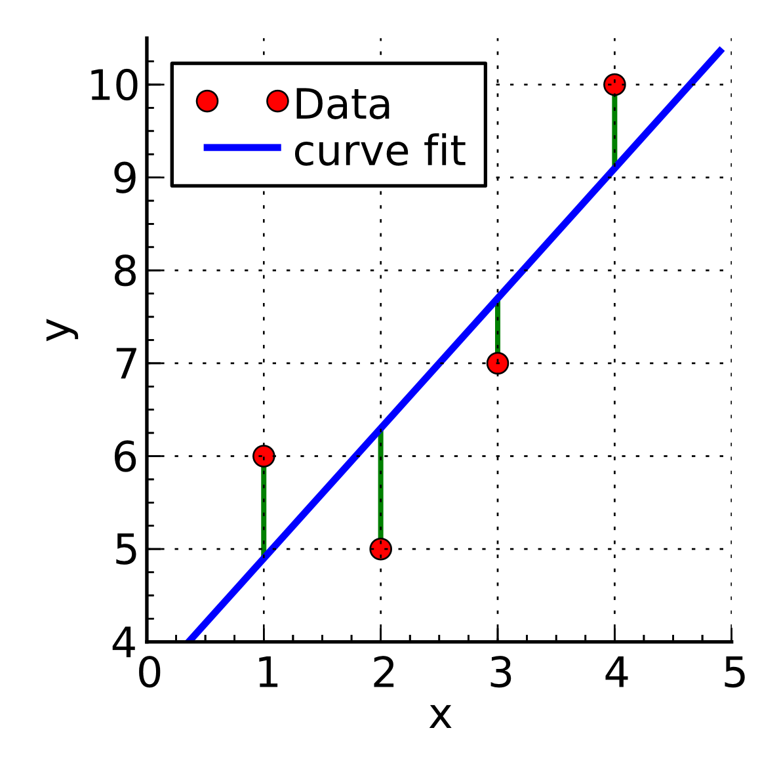
Linear Regression

Slide 5
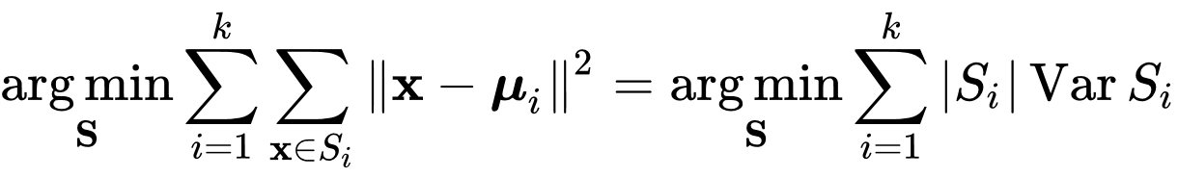
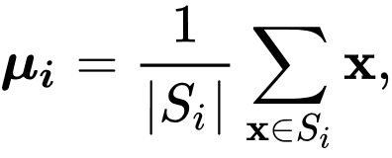
K-Means
In clustering.py, we consider a clustering on a synthetic dataset
Partitioning blobs of points into clusters such that points within the same cluster exhibit greater similarity to one another than to those in other clusters
Given a set of observations (X1, X2, ..., Xn), where each observation is a D-dimensional real vector, k-means clustering aims to partition the n observations into k (k< n) sets S = {S1, S2, ..., Sk} so as to minimize the within-cluster sum of squares (variance)
Where µi is the mean also called centroid of points in Si

Slide 6
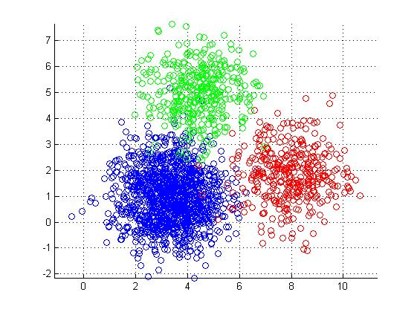
K-Means

Slide 7


PCA
In `pca.py`, we apply the Principal component analysis (PCA) on a synthetic dataset.
PCA is a linear dimensionality reduction method used in exploratory data analysis and processing
The data is linearly transformed onto a new coordinate system such that the directions (principal components) capturing the largest variation in the data can be easily identified.
PCA is a statistical procedure that reduces the number of dimensions in large datasets to principal components that retain most of the original information, thus summarizing the information content in large data tables.
Suppose we have a tabular data, i.e. large matrix X, where the N rows represent N samples, and each of the M columns is a particular kind of feature.
The covariance matrix of C is given by

Slide 8
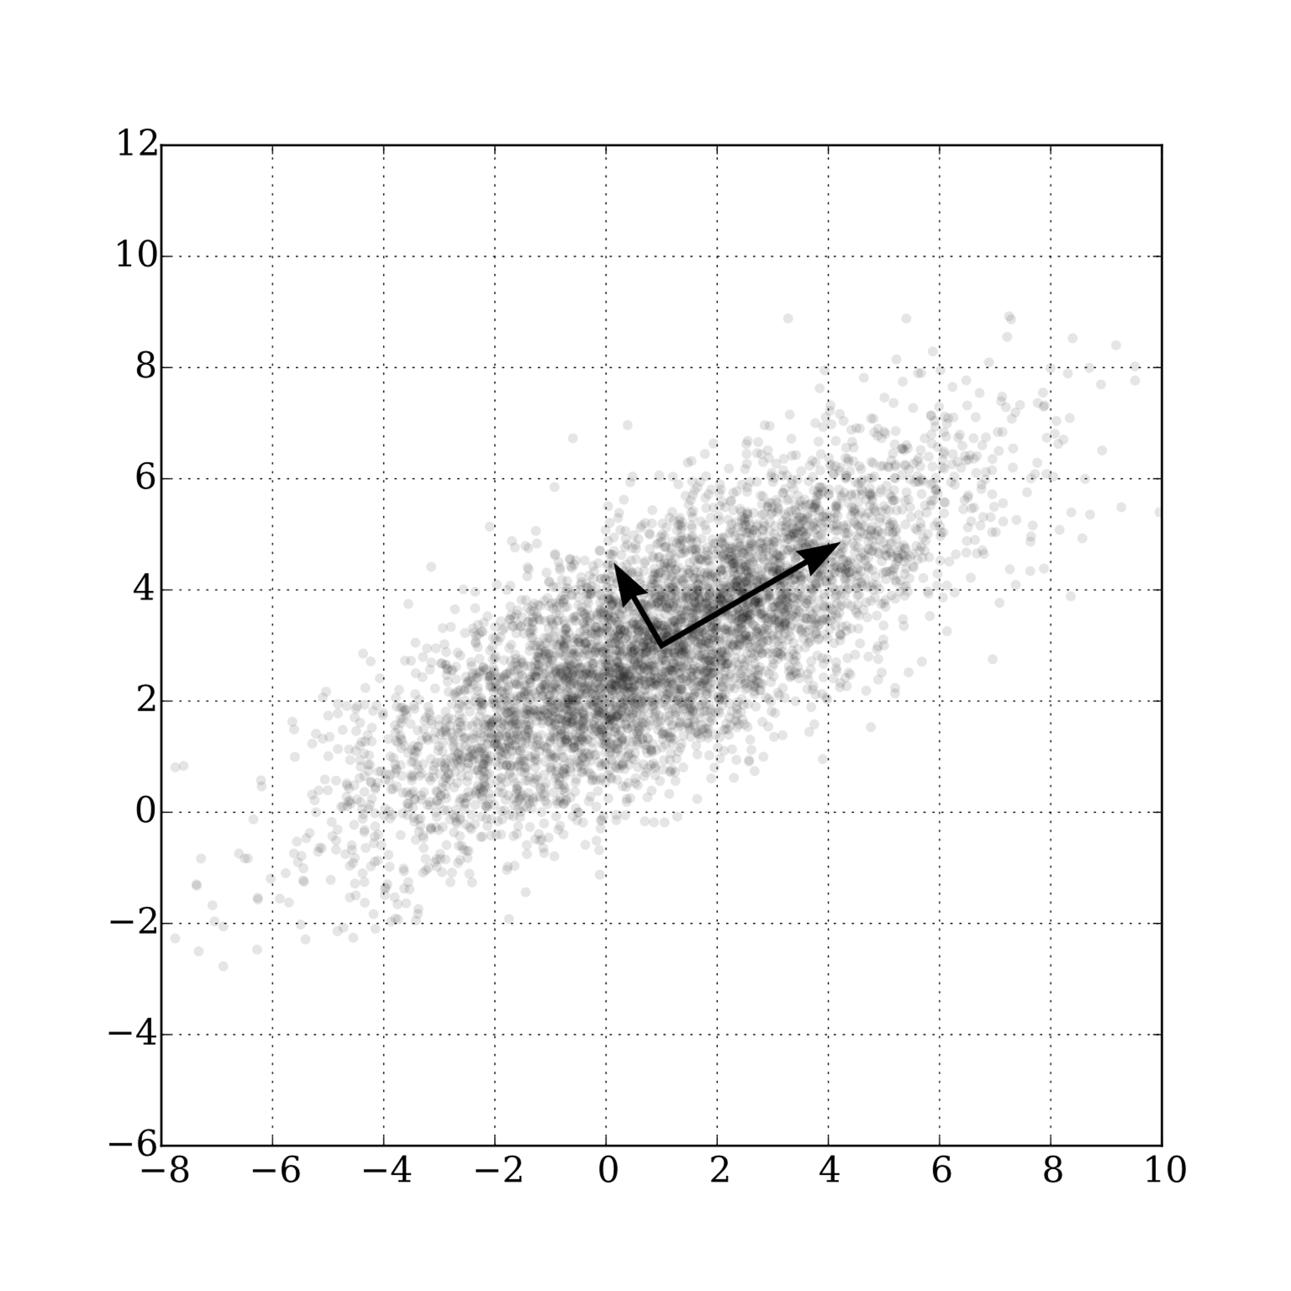
PCA
The covariance matrix C is symmetric and positive semi-definite, with non-negative real eigenvalues
Each entry Cij quantifies the correlation of the i and j features across all experiments
The principal components are the eigenvectors of C
CV = VD
They define a change of coordinates in which C is diagonal
The columns of the eigenvector matrix V are the principal components
The elements of the diagonal matrix D are the variances of the data along these directions

Slide 9
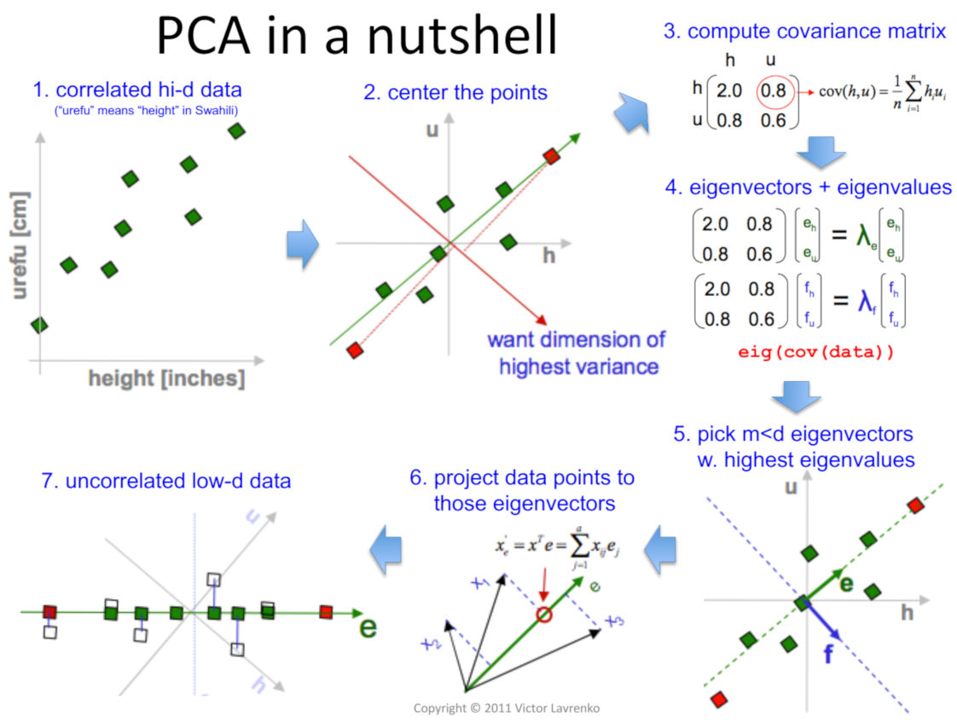
PCA
PCA in a nutshell. Source: Lavrenko and Sutton 2011, slide 13.

Slide 10
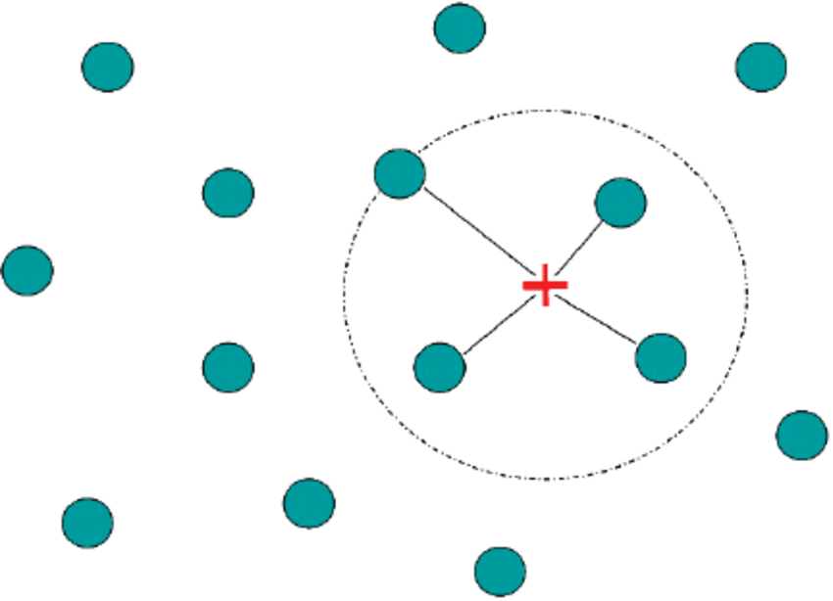
k-Nearest Neighbors (kNN)
When trying to predict outcomes of a particular observation in a dataset, one of the most natural and intuitive options is to consider similar observations and check their outcomes
kNN is used for classification, regression, or search algorithms
For each new observation, we find the k most similar (defined in terms of distance metric) observations with known outcomes
Labelled observations are gathered into a data structure known as index
New unlabelled observations upon which search is performed are the query

Slide 11
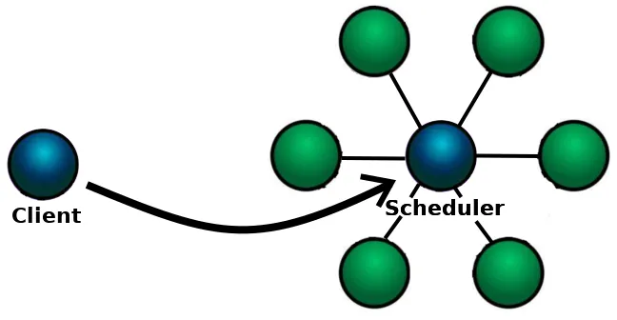
How does distributed kNN work?
Based on https://medium.com/rapids-ai/scaling-knn-to-new-heights-using-rapids-cuml-and-dask-63410983acfe
For large datasets, we scale the algorithm by splitting the workload to multiple GPUs, using the multi-node, multi-GPU kNN algorithm
Workers, each attached to a single-GPU, directly interact with each other
A scheduler first lists the workers available in the cluster
A client initiate the loading of the data (partitioned across workers)
Then it will trigger the distributed operations to perform the search
All the workers run the same set of instructions on their local data partitions

Slide 12
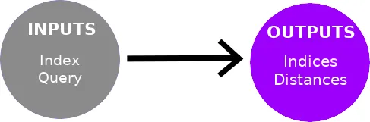
Partitions
Data is stored in partitions shared among the workers, a distributed array
Input index: it contains reference observations (n_references x n_features)
Input query: it contains observations for which to find the nearest neighbors, size (n_queries x n_features)
Output indices: it will contain the indices of the nearest neighbors in the index for each of the query points, size (n_queries x n_neighbors)
Output distances: it will contain the distances of the nearest neighbors toward their respective query points, size (n_queries x n_neighbors)

Slide 13
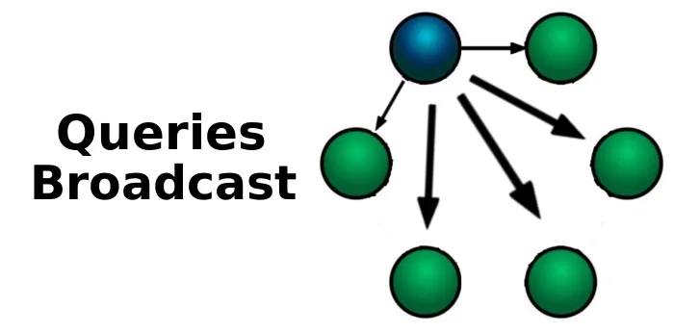
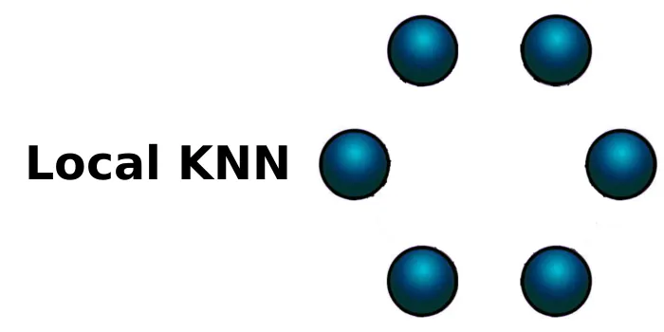
Distributed Operations
Queries are processed sequentially as a series of batches. For each batch:
Queries broadcasting: The unique owner of the currently processed batch of queries broadcasts it to all the other workers
Local kNN: All workers run a local kNN. The local kNN searches for the nearest neighbors of the currently processed batch of queries in its locally stored index partitions. The produced indices and distances correspond to the local nearest neighbors for these query points.

Slide 14
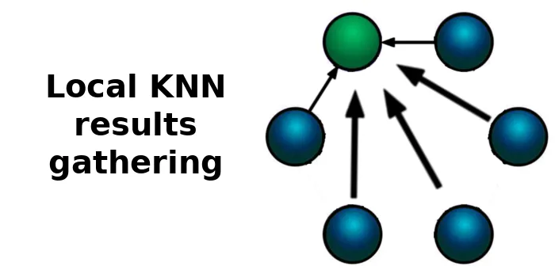
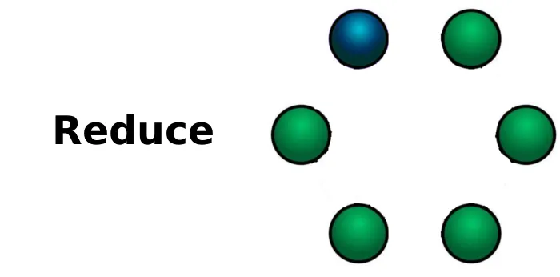
Distributed Operations
Local results gathering: Workers send the result of their local kNN back. The owner of the currently processed batch of queries collects all these data. Workers then start processing the next batch
Reduce: The owner performs a reduce operation on the received data (merging the results of the local kNN). This produces a set of global nearest neighbors' indices for each of the queries. Along with the corresponding distances between query and newly found nearest neighbors.

Slide 15
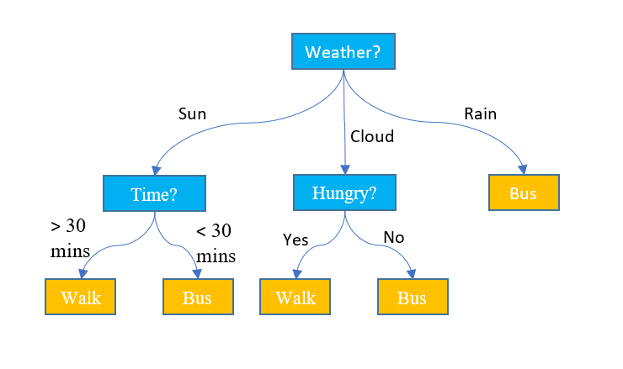
Decision trees
A decision tree is a non-parametric supervised learning algorithm, which is utilized for both classification and regression tasks.
It has a hierarchical, tree structure, which consists of a root node, branches, internal nodes and leaf nodes.

Slide 16
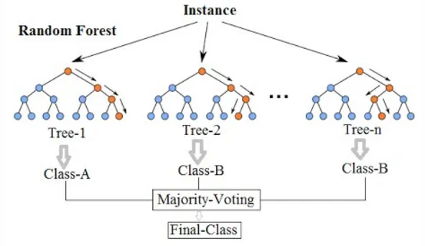
Random Forest
With random forests we learn multiple independent decision trees and use a consensus method to predict the unknown samples
Random forests use bagging and feature subsampling to make sure that no two resulting decision trees are the same
https://williamkoehrsen.medium.com/random-forest-simple-explanation-377895a60d2d

Slide 17
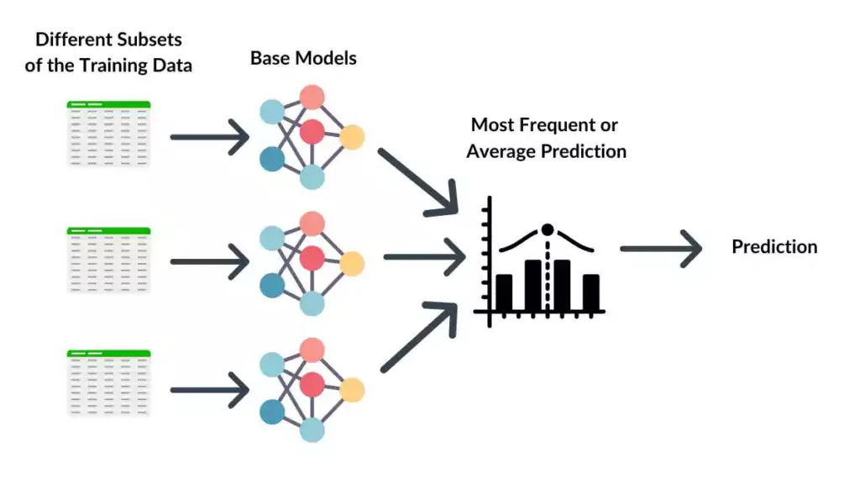
Random Forest
With bagging, each decision tree is trained upon a different sample, with the replacement of the original dataset.
https://spotintelligence.com/2024/03/18/bagging-boosting-stacking/

Slide 18
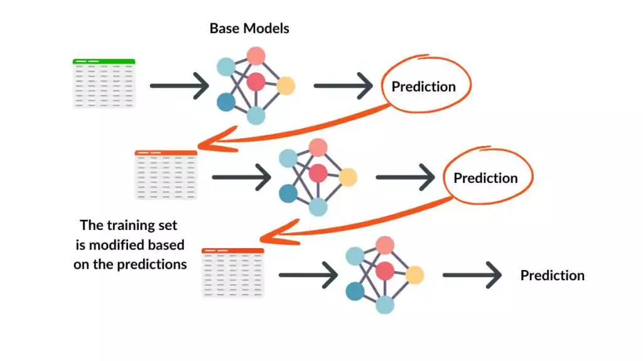
XGBoost
XGBoost uses a boosting technique, building trees sequentially and correcting errors of previous trees.
XGBoost is generally more accurate and efficient than random forest, especially with complex datasets, but requires more tuning and can be slower to train.
https://spotintelligence.com/2024/03/18/bagging-boosting-stacking/

Slide 19

RAPIDS and XGBoost
RAPIDS works closely with the XGBoost community to accelerateGradient Boosted Decision Trees on GPU on GPU
XGBoost can load data from cuDF dataframes and cuPy arrays
Dask allows XGBoost to scale to arbitrary numbers of GPUs

Slide 20
Threshold for binary classifier
Consider a Higgs boson classifier that decides whether an event involves the Higgs boson or the background.
The model computes a score (probability) for each event, representing the likelihood it's a Higgs.
If we set a high threshold, the model only marks obvious Higgs, ensuring background events are not confused as Higgs events. Less-obvious Higgs events might be classified as background.
If we set a lower threshold, the filter will catch a broader range of Higgs event, but there's also a higher chance it might incorrectly classify a background event as Higgs.

Slide 21
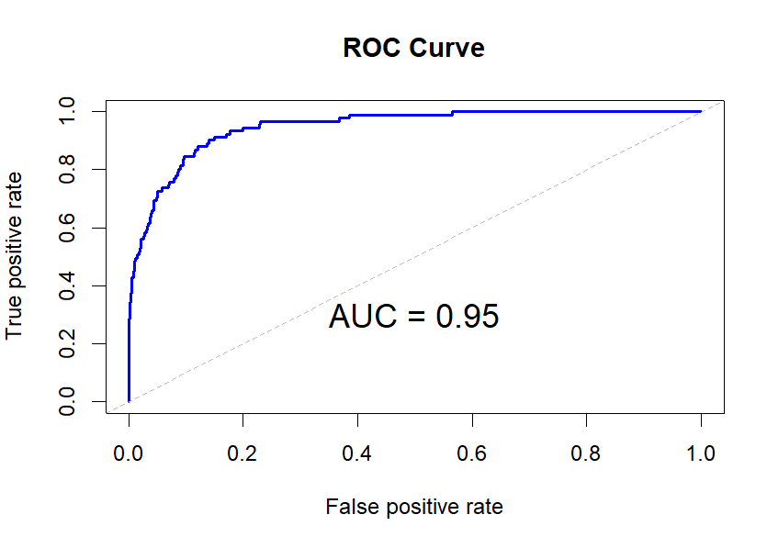
ROC
A ROC curve is a graphical plot that illustrates the performance of a binary classifier model at varying threshold values.
The ROC curve is the plot of the true positive rate (TPR) against the false positive rate (FPR) at each threshold setting.

Slide 22
AUC
The Area Under the ROC Curve (AUC) is a metric used to evaluate the performance of a binary classification model.
An AUC of 1.0 indicates a perfect model, while an AUC of 0.5 suggests the model performs no better than random guessing
0.5: No discriminatory power (random guessing).
0.7 - 0.8: Acceptable performance.
0.8 - 0.9: Excellent performance.
0.9 - 1.0: Outstanding performance.
For a Higgs classifier based on XGBoost, we can get: model roc_auc: 0.84

Slide 23
Confusion matrix
In classification problems, a confusion matrix is a specific table layout that allows visualization of the performance of an algorithm
True positive: Higgs events correctly identified as Higgs
False positive: Background events incorrectly identified as Higgs
True negative: Background correctly identified as Background
False negative: Higgs incorrectly identified as Background

Slide 24
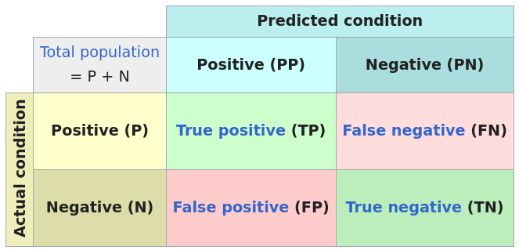
Confusion matrix

Slide 25
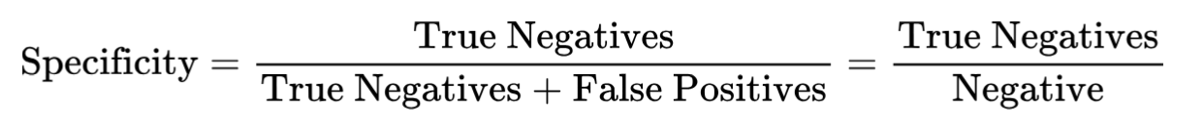
Sensitivity and specificity
Sensitivity (true positive rate) is the probability of a positive test result, conditioned on the event truly being positive.
Specificity (true negative rate) is the probability of a negative test result, conditioned on the event truly being negative.

Slide 26
Sensitivity and specificity
Sensitivity: is about finding the true positives (true Higgs events).
Specificity: is about finding the true negatives (true Background).
The ideal test would be both highly sensitive and highly specific, but in practice, there's often a trade-off.
For a Higgs classifier based on XGBoost, we get (threshold 0.5):
Sensitivity: 0.78332
Specificity: 0.72991

