Slide 1
Improving Quality of JFreeChart - Java Based Framework
Presented by: Durreshahwar Arif (100587401)
Isaiah Iremiren (100651421)
Ibaada Arif (100655270)
Damola Jimoh (100654285)
Matthew Brown (100670025)

Slide 2
Introduction
Jfreechart is an efficient open source java based application which aids in creating a wide range of charts.
It is used to create both 2D and 3D charts such as bar charts, pie charts and line charts
Notes:
Ibaada

Slide 3
Objective
The objective of this project is to:
Find bugs in the software
Create test cases for the bugs found
Provide test data for the test cases
Report improvements on software due to test cases or test data
Notes:
Ibaada

Slide 4
Test 1: DataUtilities_test
equal_test
Purpose: To test the quality of the equal function. The job of the equal function is to test two arrays for equality.
For two arrays to be considered equal, they must have the exact same dimensions and their values must match.
Arrays are permitted to be null, therefore, null arrays were also tested.

Slide 5
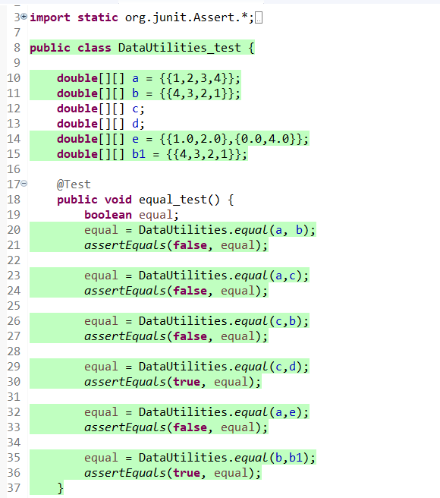
Test 1: Equal_test
Notes:
In this test, both null arrays C and D are equal, so they are true and test positive
In their case, c and d (both nulls arrays) wer

Slide 6
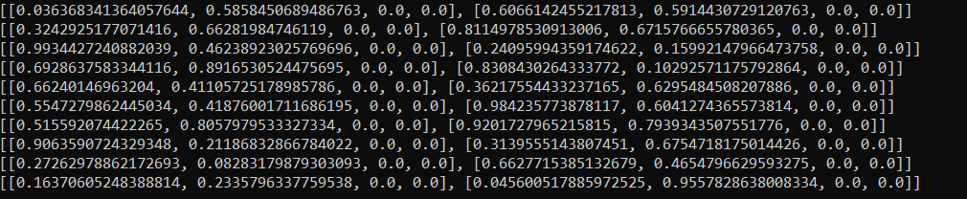
Test Data 1
The test data for the first test case is a randomly generated 2x4 array which will be used to test if the equal function works. The test data is generated into a .txt file to be used for the test cases
Notes:
Ibaada

Slide 7
Test 2: clone_test
Purpose: To test the quality of the clone function. The clone function takes an array, which is not allowed to be null, and returns a clone of the array.
Arrays of different dimensions and values were tested and the clones were the exact same as seen in the console output.
When the equal function was used to test the equality of the respective clones, the result was a failure.
The result was false as opposed to the expected true value. This resulted in the suspicion of a fault in the clone function which was responsible for cloning the arrays.

Slide 8
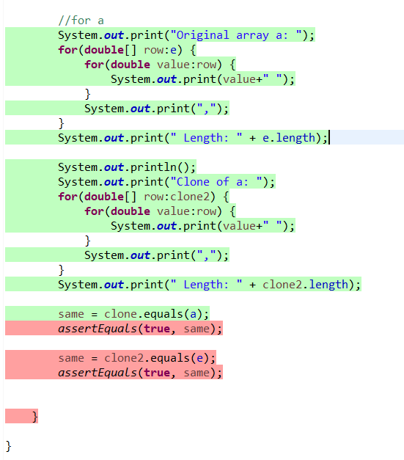
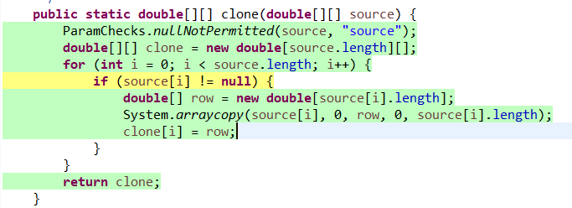
Test 3: Clone_test
Notes:
Isaiah

Slide 9
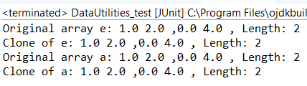
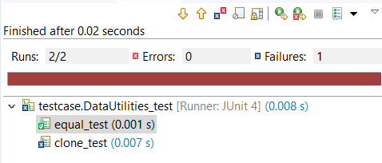

DataUtilities_test Output
Notes:
Isaiah

Slide 10
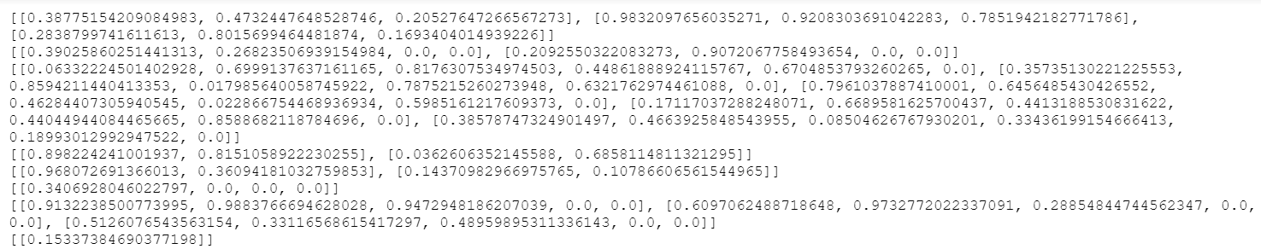
Test Data 2
The second test data is a randomly generated array, with different dimensions that are used to test the clone function
The function is meant to clone the array into another variable. The test data is generated into a .txt file to be used for the test cases

Slide 11
Test 3: ContourPlot_test
Dataset
Purpose: To test the quality of the getDataset function. The getDataset function is responsible for returning the primary dataset for the plot, in this case, the plot test of ContourPlot type.
The test plot was initialized with a null dataset which was stored in the variable dataset of type ContourDataset.
The getDataset function was used to retrieve the dataset within the test plot, which was then tested for its null value.
Problem encountered with this test was the inability to initialize the dataset of the plot with a non-null value, which prevented further testing of the functionality of getDataset.
Notes:
Isaiah

Slide 12
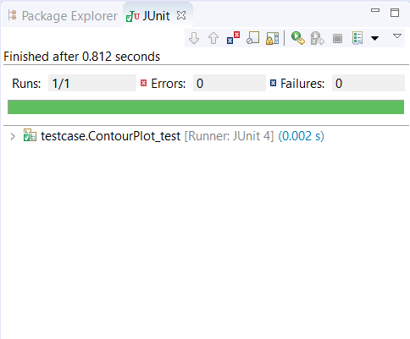
ContourPlot_test Output
Notes:
Isaiah

Slide 13
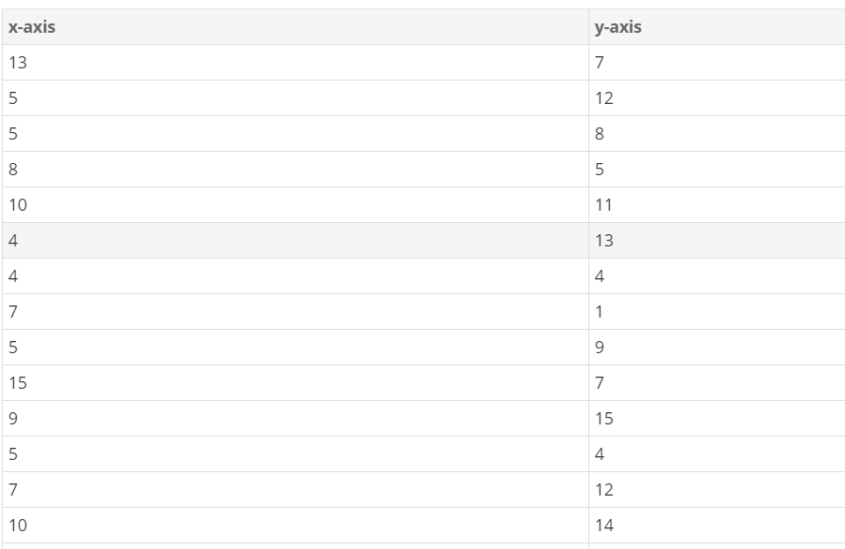
Test Data 3
CounterPlot test data: the test data for counter plot was randomly generated using a tool called mackaroo. It generates numbers for the x-axis and y-axis dataset for the plotting. The test data was generated into a csv file

Slide 14
ComparableObjectItem_test
Test1
Purpose: To test the quality of the compareTo and equals functions. The compareTo function is responsible for indicating the order of an object relative to another object. For the order, only the x-value, in this case comp_x of the Comparable type, is considered.
If the order i.e. the x-values are equal, 0 is returned, and if the order is less than that of the object being compared to, a negative value is returned, otherwise, a positive value is returned.
The job of the equals function is to test if the objects are equal, hence, returning true only when testing the same object or a clone and false otherwise.
Notes:
Matt

Slide 15
Test2
Purpose: To test quality of the equals and clone functions
The clone function returns a clone of the object passed to it and throws an exception if the object is of a different subclass
In our test, the function is tested by checking if the clone created returned true when passed to the equals function
Notes:
Matt

Slide 16
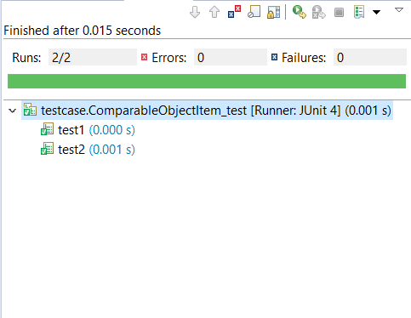
ComparableObjectItem_test Output

Slide 17
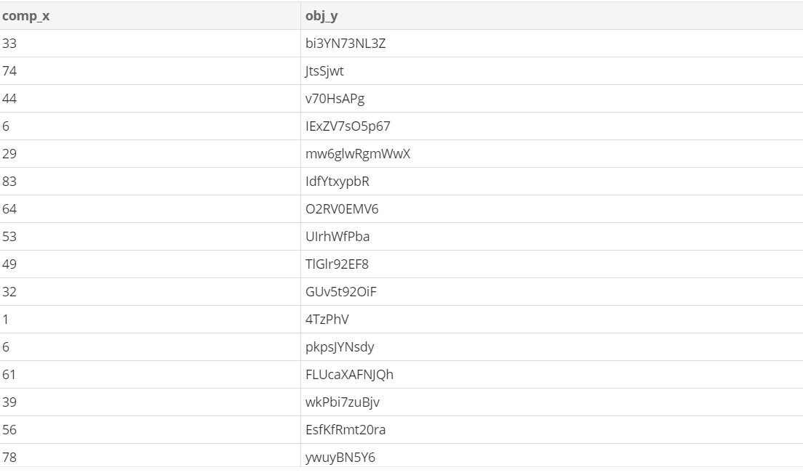
Test Data 3
Randomly generated number and string is used as test data to test the comparableObjectItem function
The test data is generated into a .csv file

Slide 18
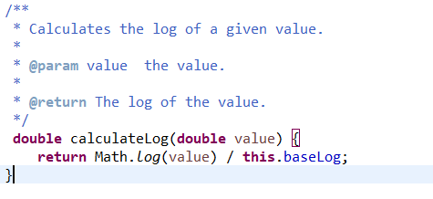
Statistics
1 bug was found in the clone method
Fails to successfully duplicate the size and elements of an array
Randomly generated arrays were used to test this function
1 bug was also discovered in another method called calculatelog
This method was meant to calculate the logarithm of a passed value
Fails to consider if the argument passed is 0
Notes:
Matthew

Slide 19
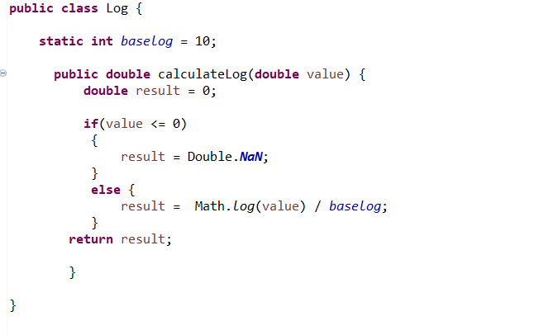
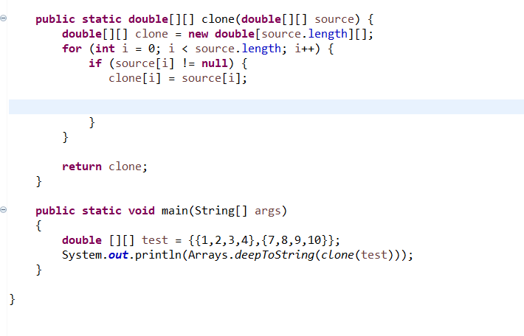
Improvements Made to Software Quality
To improve the clone function, some lines were removed to reduce LOC and increase readability.
Some dynamic testing in the form of unit testing was done to check if this function was working properly
To improve the calculateLog method, an if-else statement was added
This was to ensure that if the argument passed is 0, the program will not fail during execution
Notes:
Matt

Slide 20
Implementation Challenges
Test Case Implementation Challenges
Some class variables could not be assigned values and had to be tested as NULL.
Difficulty in pinpointing the cause of a failure due to complexity of the class coupling.
Test Case Data Sets Implementation Challenges
It was difficult to implement a multi-dimensional array in a random test generator tool for the clone function test case and equal function test case.
Symbolic test data was proved to be difficult to apply because it would have been difficult to use variables to represent all the data set.
Notes:
Durr

Slide 21
Conclusion
In essence, several test cases were implemented to identify faults within the software - JFreeCharts. Many test data sets were also implemented to verify the expected software behaviour of the respective test cases and statistics on the bugs found within the software were analyzed for software quality improvements.
The test cases that were implemented covered the equal function which tested 2 arrays for equality, the clone function which takes a non-null array and returns a clone of that array, ContourPlot_test which tests the quality of the getDataset function, and ComparableObject test which tests the quality of the compareTo and equals functions responsible for indicating the order of an object relative to another object.

