Slide 1
Leveraging Sflow for Software defined networks
By: Ishan Chauhan(114859051)
Fall 2017, University of Maryland, College Park
ENTS749A

Slide 2
Sflow[1]
Industry standard packet sampling technology like Juniper’s JFlow and Cisco’s NetFlow, provides scalability to monitor high bandwidth traffic
Offload the tasks of network monitoring/security from OpenFlow controller
Embedded in hardware hence has less overhead and comes preinstalled on OpenVSwitch and most silicon switches
Unlike Cisco’s Netflow, sflow can monitor most non IP traffic
Sflow-RT: Analytics engine to define, receive & analyze streams of data from sflow enabled devices such as switches, routers, hosts etc. Accessible through REST API
Sflow and OpenFlow integration: Use SNMP ifindex keys provided by sflow to map & get switch & port details from ‘/sys/devices/virtual/net/’ directory

Slide 3
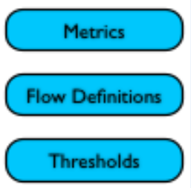


Application architecture
Application
Northbound/REST API
Sflow-RT engine @ 127.0.0.1
Ryu controller @ 192.168.56.102
Control plane
Southbound API
Data plane (OVS, servers) @ mininet(192.168.56.101)

Slide 4
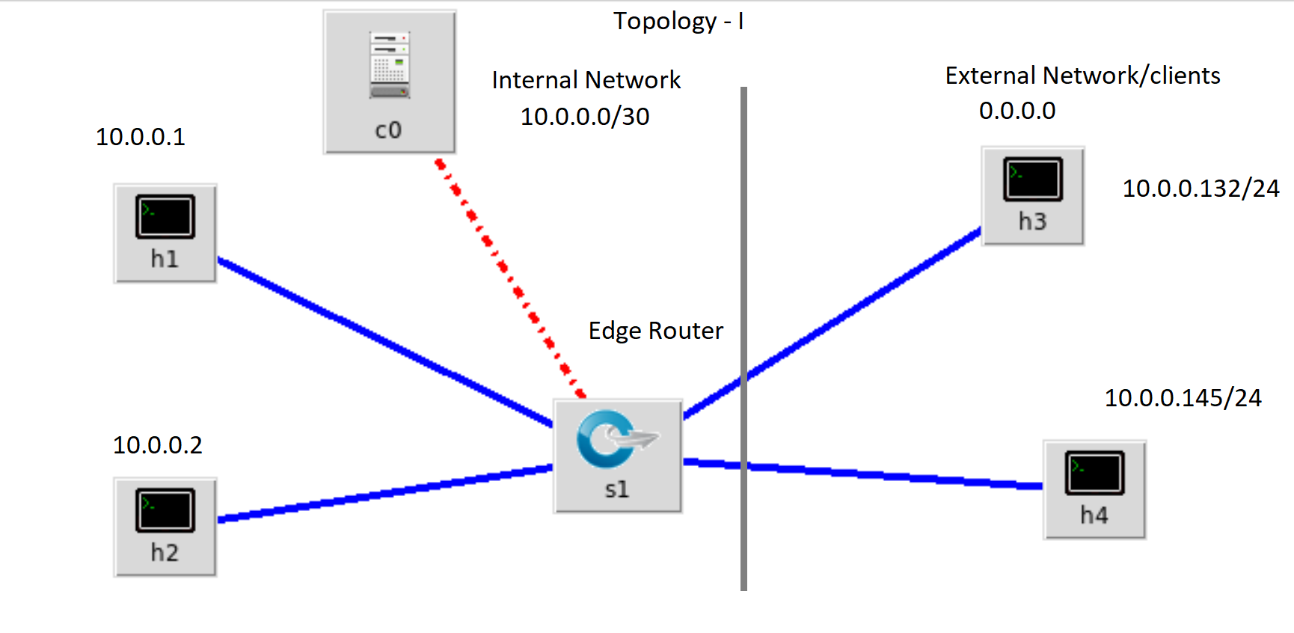
Case- I
Switch type: OVSK
OpenFlow version 1.3
Link band width = 10 Mbps
Threshold metric: bytes
Threshold for external network group: 10Mbps/3 = 3.333 Mbps
Controller : Ryu remote @192.168.56.102 :
Hard timeout : 60 seconds

Slide 5
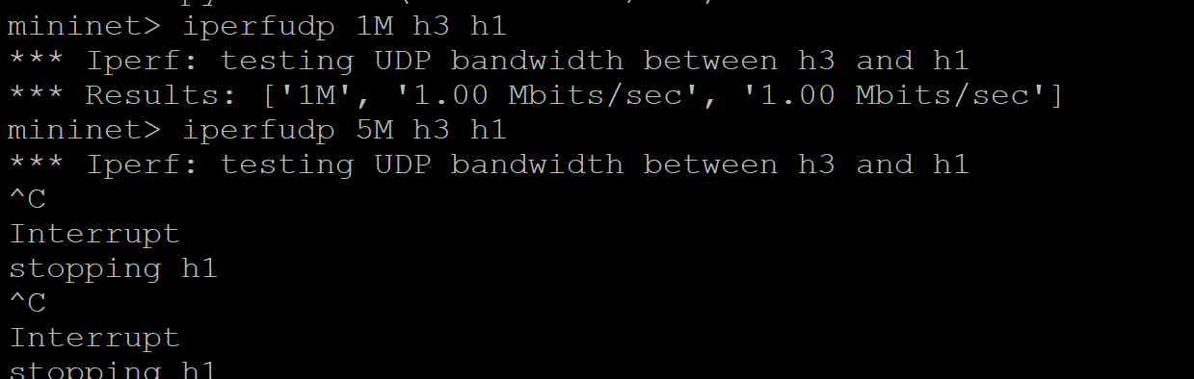
Case-I :Results
Define groups for sflow
Define flows for sflow
Define threshold for sflow
Add flow entries for ryu

Slide 6
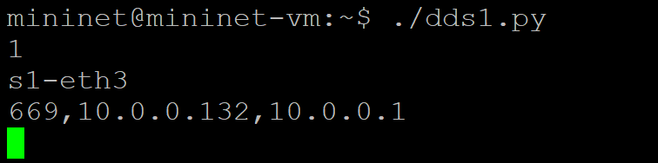
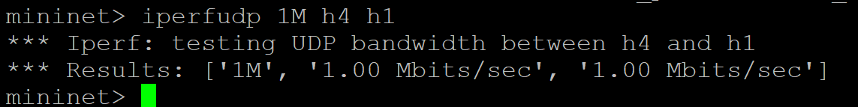
CASE-I:results
Switch details at threshold event

Slide 7
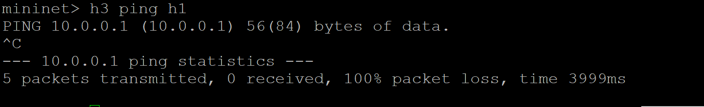
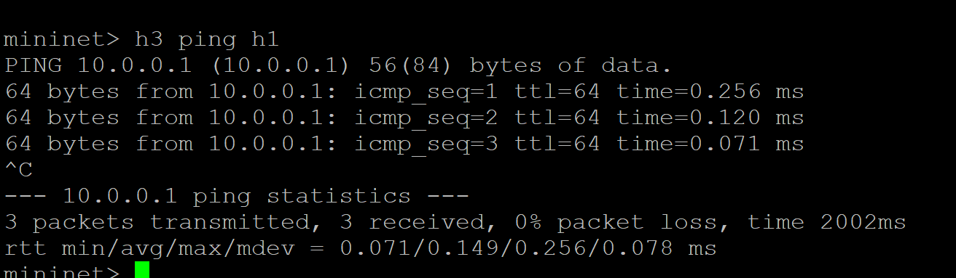
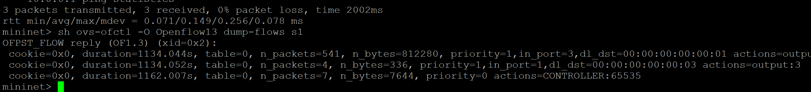
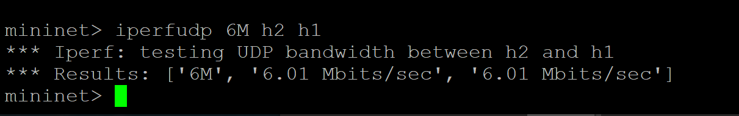
Case-I : Results
After 60 seconds the flow entry is removed
Not a threshold event

Slide 8
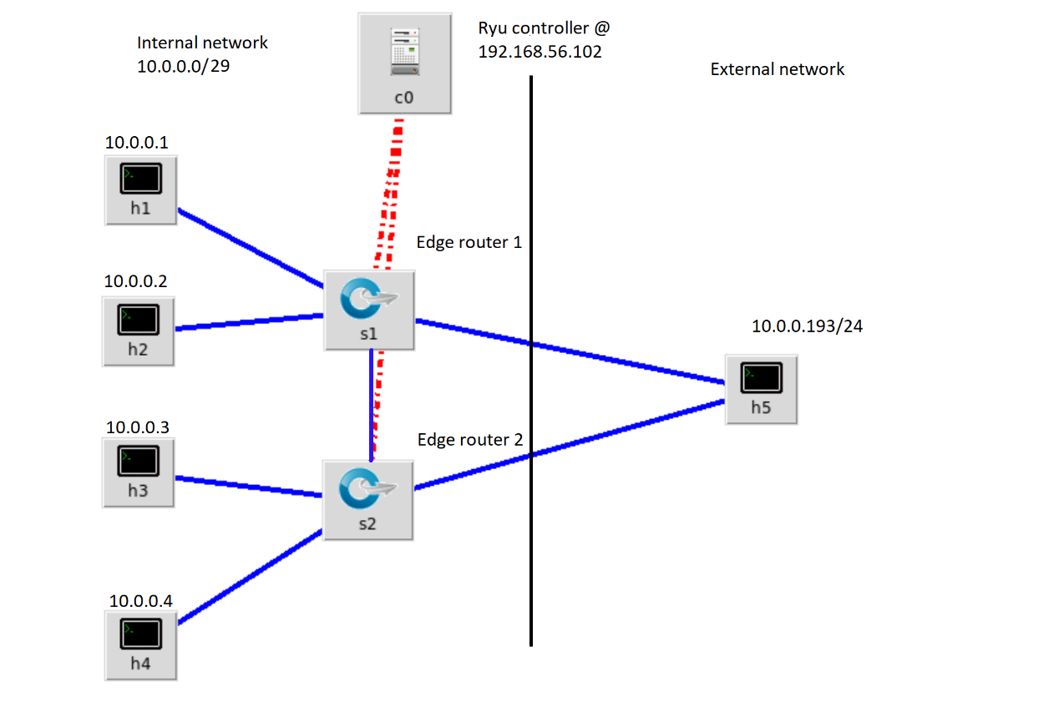
Case-II
Switch type: OVSK
OpenFlow version 1.3
Link Band Width = 10 Mbps
Threshold metric: bytes/sec
Threshold for external network group: 10Mbps/3 = 3.333 Mbps
Controller : Ryu remote @192.168.56.102
Hard timeout : 60 seconds

Slide 9
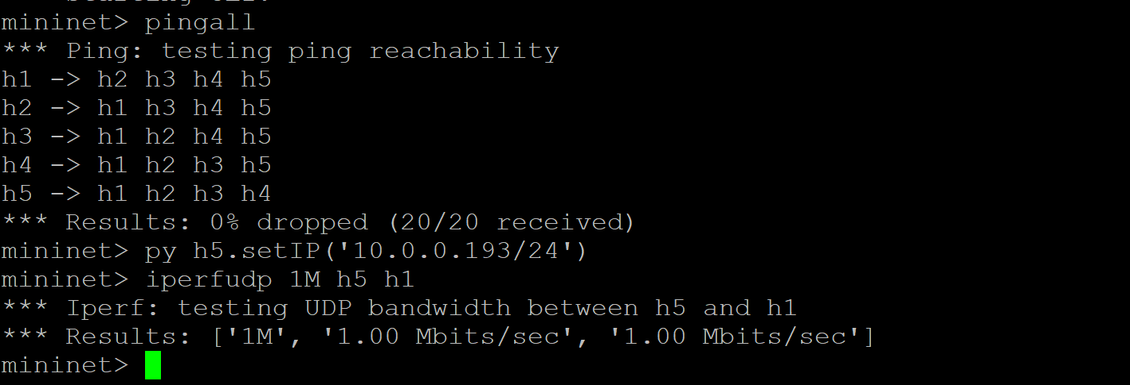
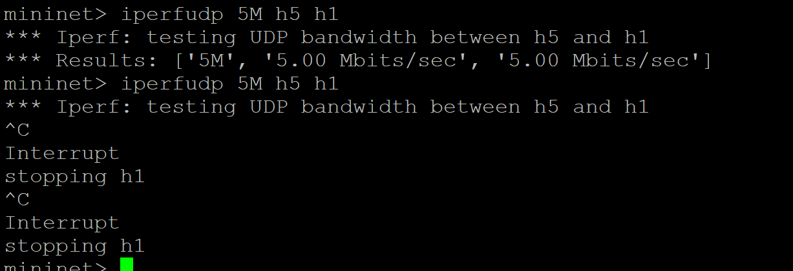
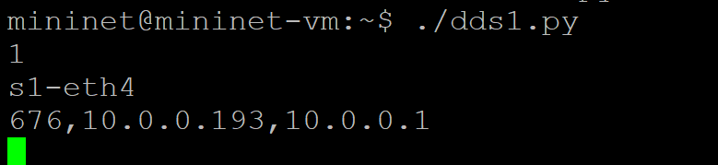
Case-II: Results
Switch details at threshold event

Slide 10
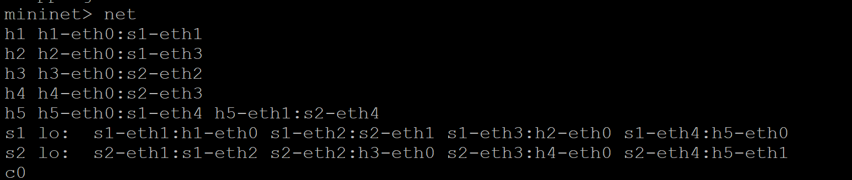
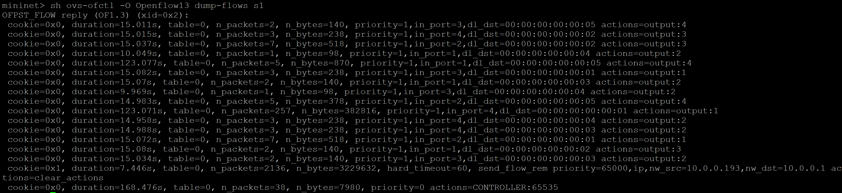
CASE-II: Results

Slide 11
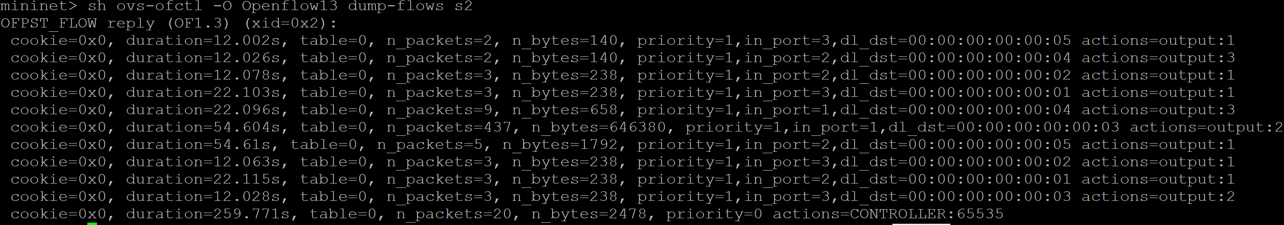
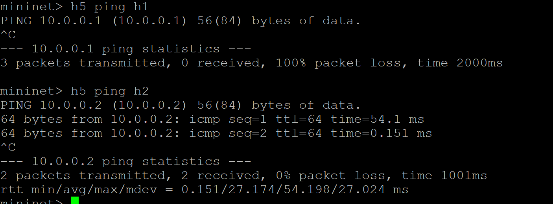
Case-II: Results

Slide 12
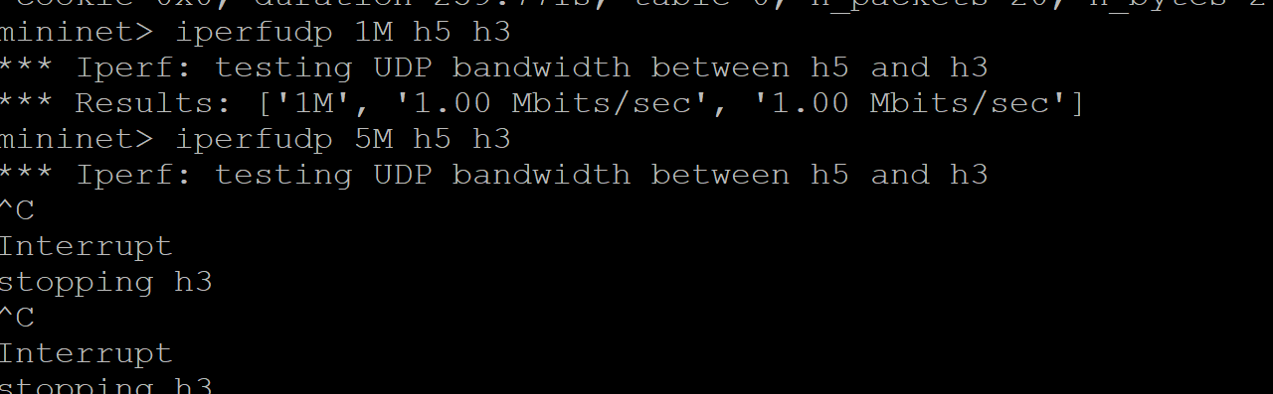
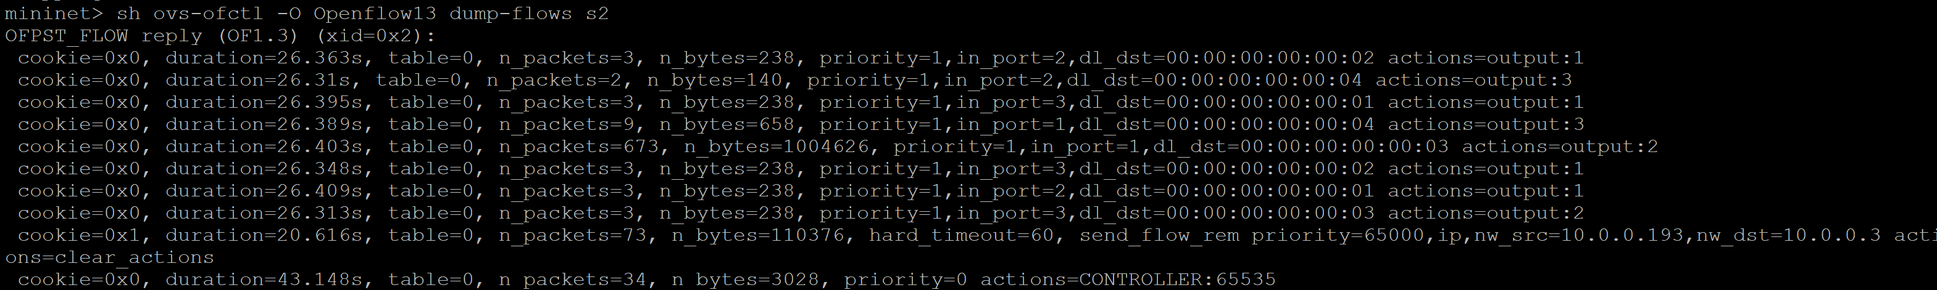
Case-II:Results

Slide 13
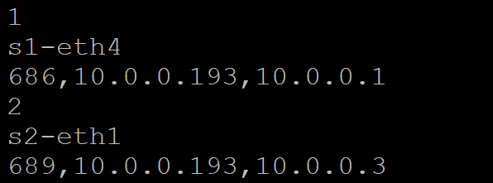
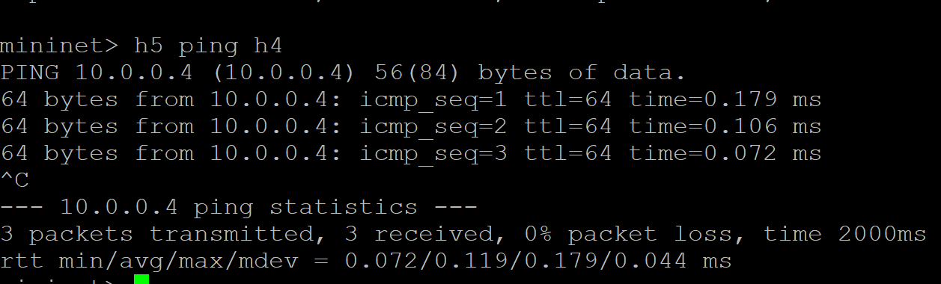
Case-II: Results

Slide 14
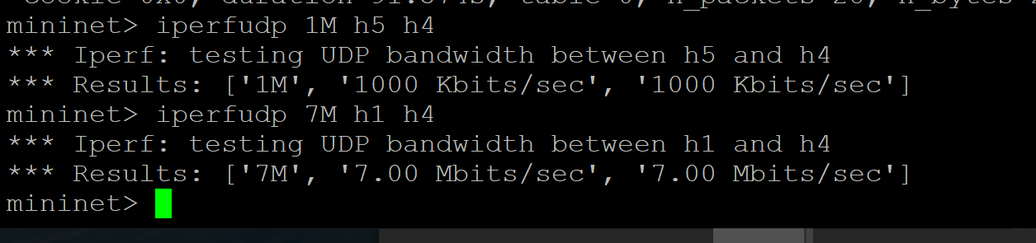
Case-II: Results
Not a threshold event

Slide 15
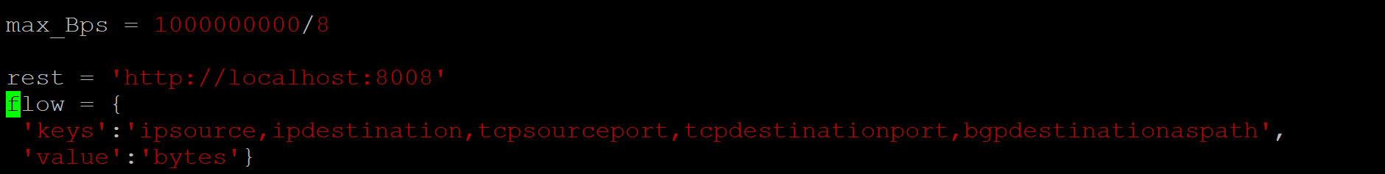
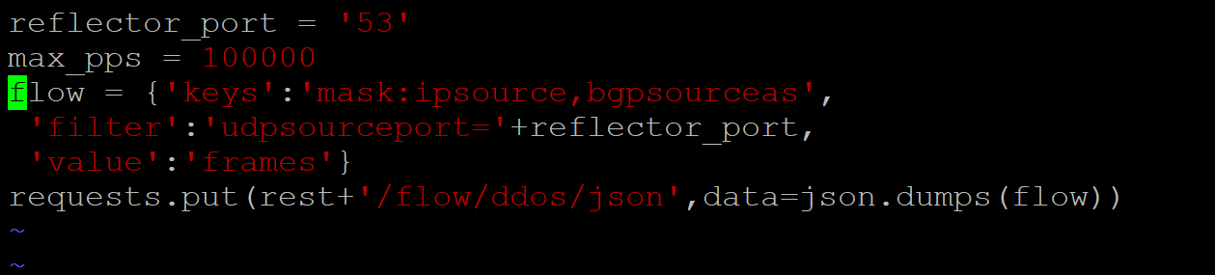
Other use cases: Network paths for troubleshooting
Can be used to identify large/elephant flows within a network and map their AS network paths the packets traversed enroute to destination
Can be used to identify source networks for attacks such as DNS UDP amplification DDoS as shown below

Slide 16
Other use cases: Packet BROKER
Scalable, cheap & wire speed monitoring[1]
Microsoft uses similar Openflow SDN solution for network capture and analysis on for its cloud data center traffic[2]
Below use sflow case to look for and capture GRE tunneled traffic, can also be used for vxlan, ipv6 etc

Slide 17
bibilography
1 http://sflow-rt.com/
2 http://searchsdn.techtarget.com/news/2240181908/Microsoft-uses-OpenFlow-SDN-for-network-monitoring-and-analysis

Slide 18
Thank you

