Slide 1
Towards Generalizable Alzheimer’s Disease Diagnosis Algorithms.
Chittumuri, Isabella
Shetler, Oliver
Vente, Blake

Slide 2
Reproducibility Crisis
The use of machine learning in the health sciences has exploded in recent years.
Unfortunately, machine learning products have not produced consistently reproducible results (McDermott et al. 2021).
IBM recently dropped its Watson for Health Sciences efforts [1], amid stagnating progress in the field.
[1]: https://www.businessinsider.in/business/news/ibm-may-sell-watson-health-business-generating-1-billion-annual-revenue-says-report/articleshow/81121827.cms

Slide 3
Missing Data
One major reason for reproducibility issues in health ML is that data are often incomplete.
Not all diagnostic conditions are included in a given dataset, or datasets can be highly imbalanced.

Slide 4
Over Fitting
Another concern of machine learning models in health sciences is over-fitting.
Bigger models open the door for poor generalization.
In branch 2, we will operationalize “generalization” by observing the loss landscapes of variants of our base model, and their corresponding training histories.

Slide 5
Branch 1 and 2
Branch 1: Does regression improve model accuracy with hidden categories?
Problem Statement
Feature Engineering
Results
Branch 2: How do we know our model learning optimally?
“Peeking inside the black box”
Interpreting loss curves
Varying Learning Rates

Slide 6
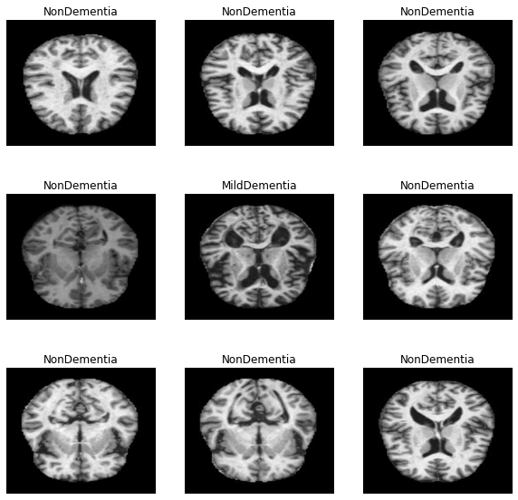
The Data
Our data included 4121 brain scans of people with varying degrees of Alzheimer’s Disease.
The training set included
2560 scans of healthy patients
1792 scans of patients with very mild dementia
717 scans of patients with mild dementia
52 scans of patients with moderate dementia

Slide 7
Branch 1
Does regression improve model accuracy when data are missing categories?

Slide 8
Ordered Response Variables
Often, in health science, response variables are ordered. However, it is common to treat ordinal variables as nominal categories for deep learning.
We wanted to know if including the order of variables could improve the ability of our model to extrapolate to unseen categories.
In order to test whether regression helps a model extrapolate to hidden categories, we constructed two variants of the same model:
A categorical model (output is softmax).
A regression model (output is relu)

Slide 9
Missing Categories
In order to test the generalizability of our two model variants, we trained them under five circumstances:
With full data.
Without non-dementia cases.
Without very mild dementia cases.
Without mild dementia cases.
Without moderate dementia cases.
In every case, we used the full test set.

Slide 10
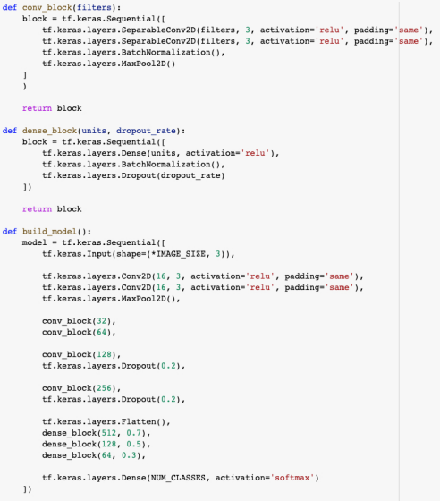
Categorical Model
One-hot encoded the labels
Adam optimizer, with a categorical cross entropy loss function
Exponential decay learning rate
100 epochs
An accuracy of 48% when evaluating on test set

Slide 11
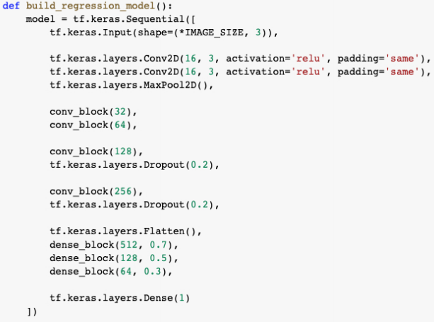
Regression Model
Regression to preserve order.
A single dense output layer forces the model to impose order since it has to differentiate on one layer.
Lack of flexibility can lead to poor performance
An accuracy of 40% when evaluating on test set

Slide 12
Does non-linear regression improve generalizability?
Test Accuracy Scores for the categorical vs regression models
* Note that accuracy is not a good measure of absolute model performance. It is just a way to compare the relative performance of the models.
 | Full | Drop No Dem. | Drop Very Mild Dem. | Drop Mild Dem. | Drop Mod- erate Dem.
Categorical | 48% | 48% | 39% | 44% | 5%
Regression | 40% | 12% | 9% | 50% | 6%

Slide 13
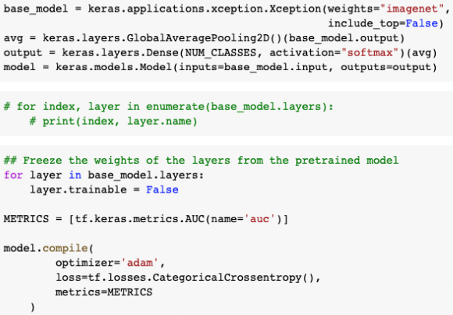
Xception
Accuracy Scores for
We used a custom model, rather than Xception so that we could further explore the loss landscape of our model.
 | Frozen | Unfrozen
Categorical | 40% | 42%
Regression | 14% | 14%
Notes:
Our full categorical model and Xception categorical model have

Slide 14
Branch 2: Interpreting our model
A study of Adam and Model Size

Slide 15
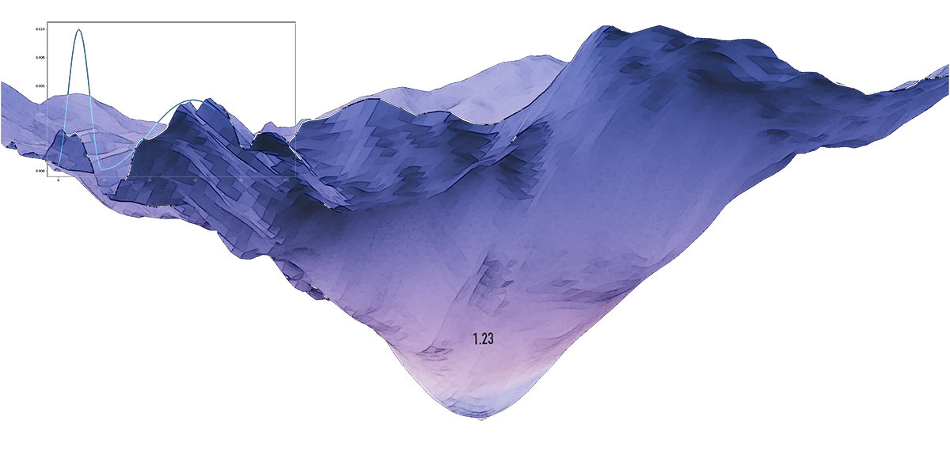
Motivation
In Health Sciences generalization matters
Black Box models are opaque to inspection
We want to know what’s going on inside
We want to see inside to the loss landscape.
Notes:
We know that generalization matters, when models like this are used for decisions that matter to lives.
We also know that cnn’s are often Opaque. We want to take a deeper look into the black box, and we can do this by observing its training characteristics.
To operationally define what we mean by generalization, we look at this loss landscape visualization here. What we hope to do is show that our loss landscape smooth and as convex as possible. A non-hilly loss function means that small changes in the input will not have huge changes in the output, and that’s how we define generalization for the purposes of this experiment.

Slide 16
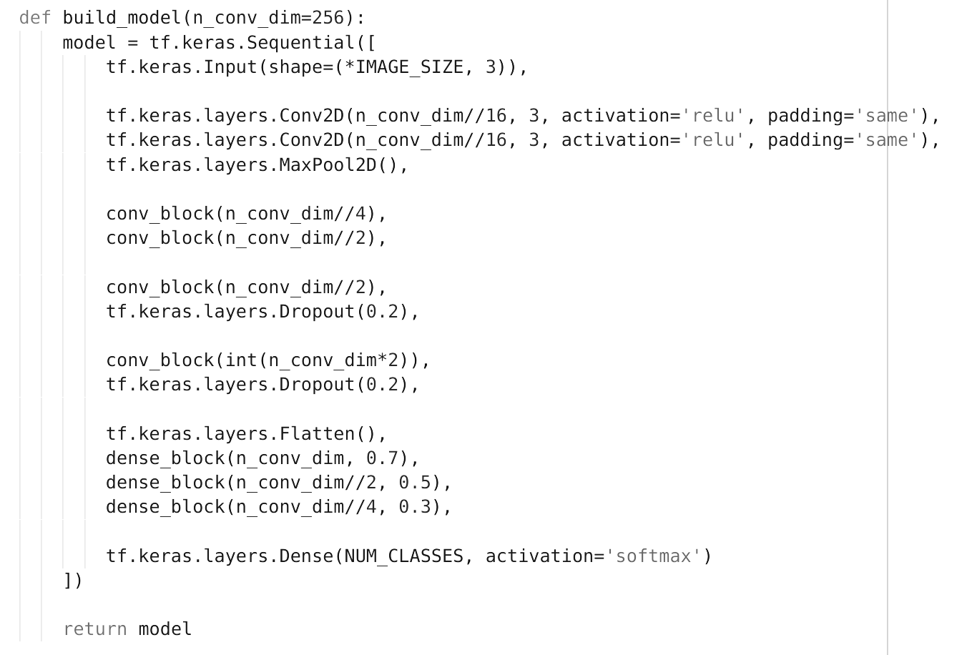
Experimental Design
Vary the size of a network
Keep all other parameters of model architecture constant
Notes:
The last thing we want to do is is to see if this pattern is the same regardless of the initial learning rate

Slide 17
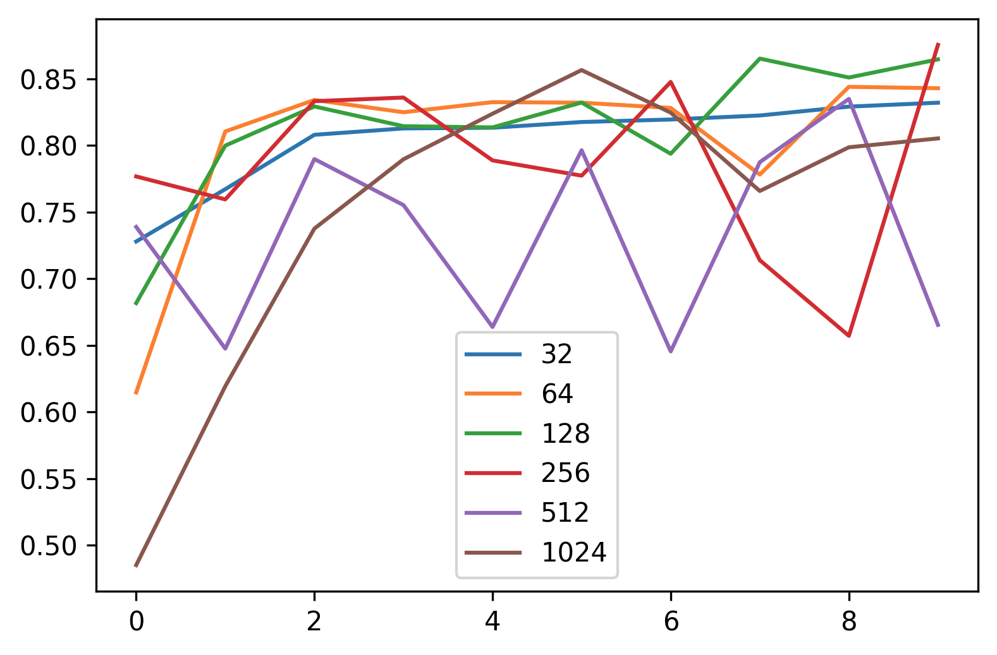
Model Validation Performance LR=.001
Validation Set AUC
Epochs
Notes:
Blue

Slide 18
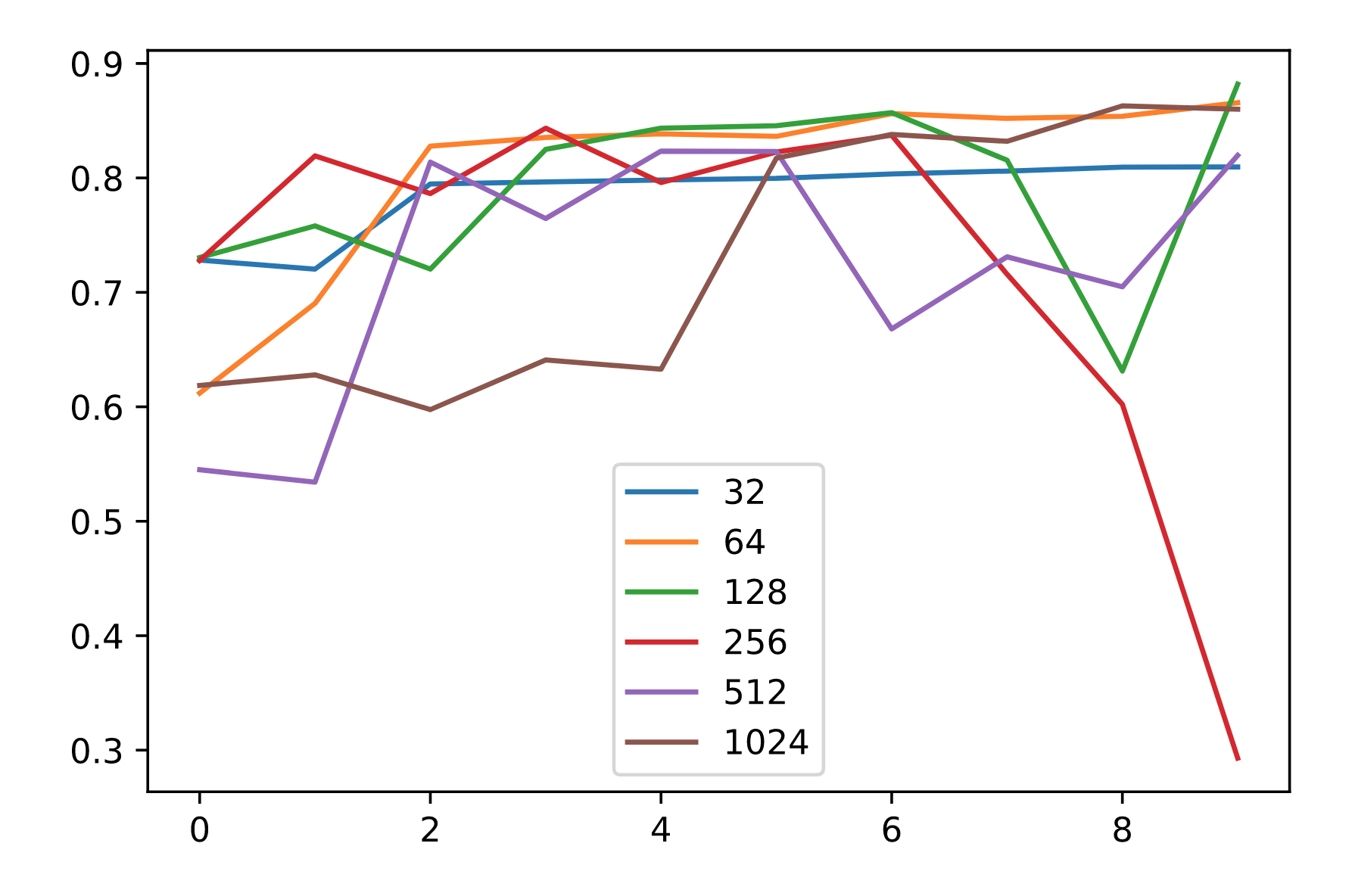
LR=.0075
Epochs
Notes:
Validation accuracy

Slide 19
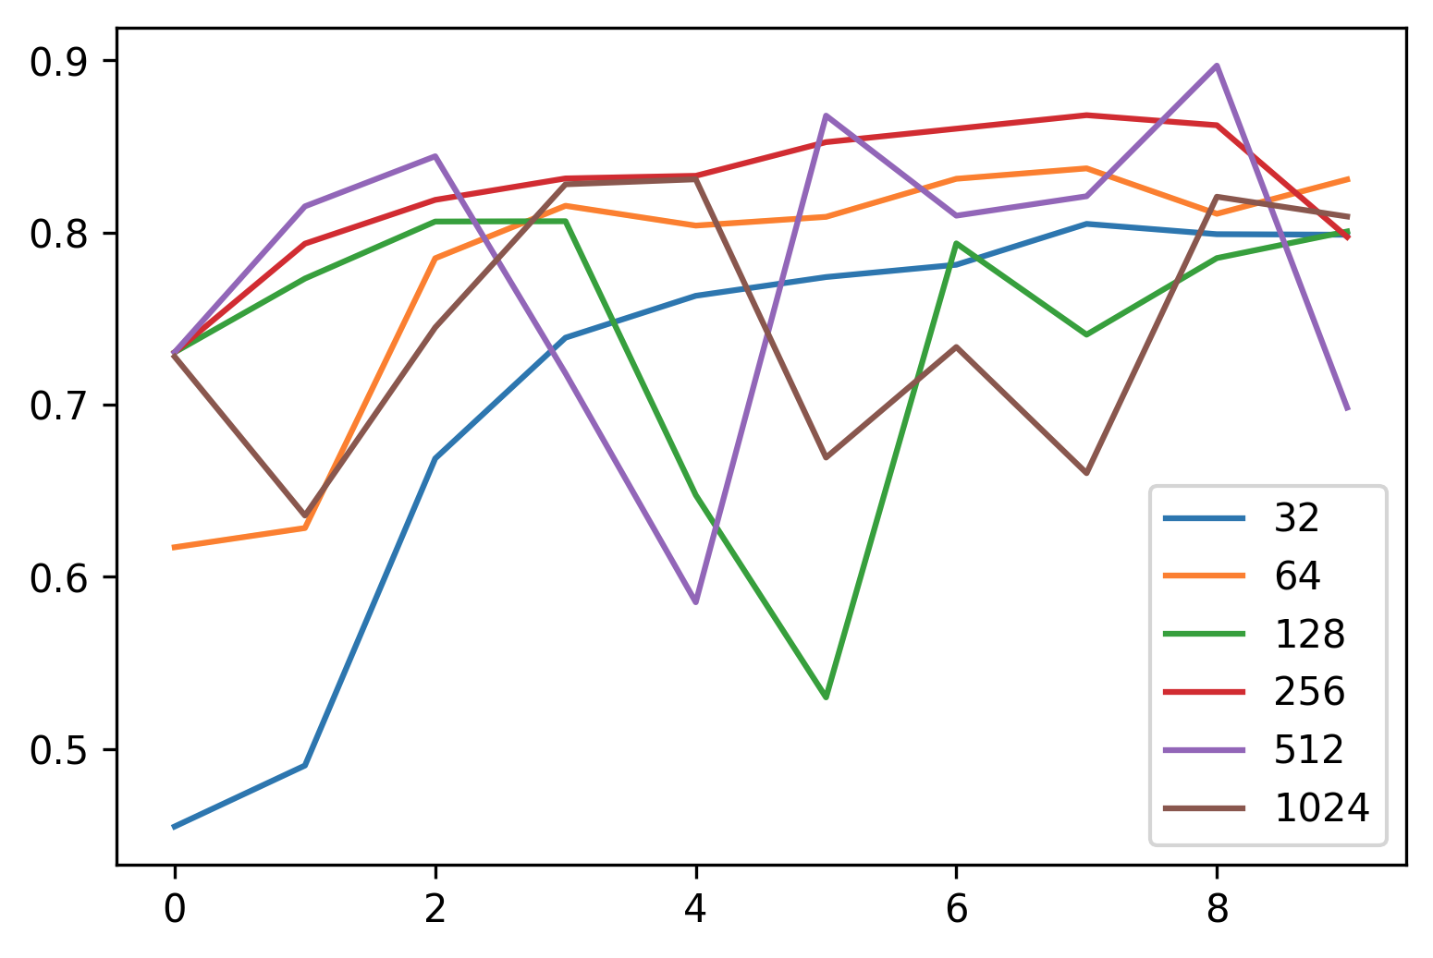
LR=.0025
Epochs

Slide 20
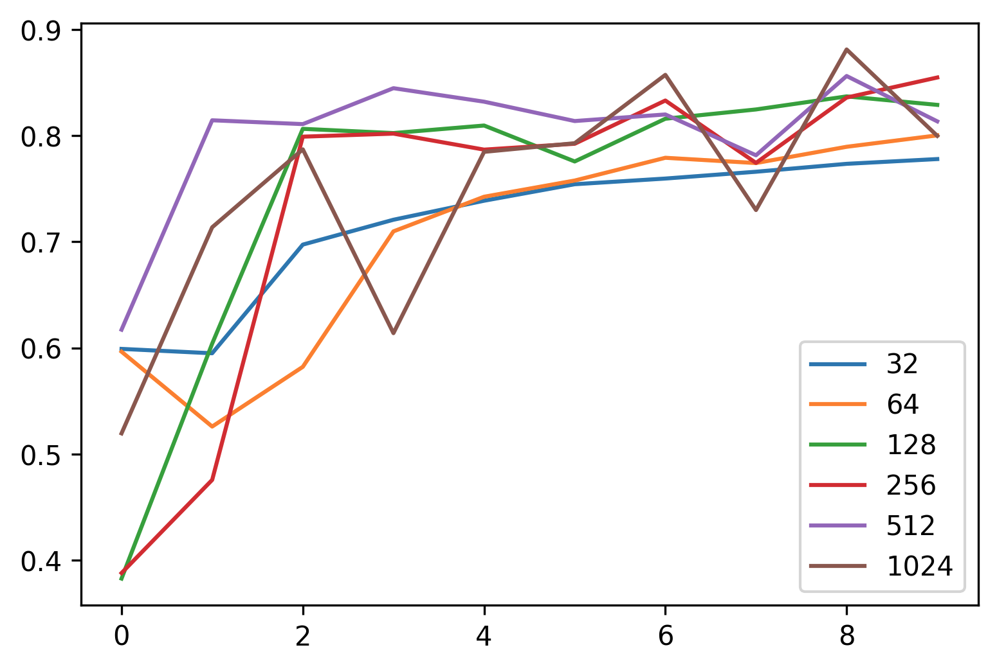
LR=.0001
Epochs

Slide 21
LR=.001
LR=.0075
LR=.0025
LR=.0001

Slide 22
Peeking inside the Black Box
The loss landscape of models gets more hilly with a greater number of parameters
Adam helps larger models recover from these variations
Image credit losslandscape.com
Notes:
so this up and down behavior might initially look like out of control thrashing, but the reality is that this is a _feature_ not a bug of Adam, which actually wants to prevent stagnation by taking us out of local minima.

Slide 23
Conclusions
Our findings are consistent with the conventional understanding that models with a greater number of parameters are more prone to overfitting.
Simple Conclusion
Fewer Parameters means less thrashing
Trashing does not stunt peak accuracy (Adam working)
Interpretation
The higher dimensional loss landscape is more hilly, which is less desirable.
Smaller models with similar accuracy are preferable because they have smoother loss landscapes.
Notes:
In particular width alone is enough to reproduce this over-fitting behavior.

Slide 24
Future Work
Optimization of Categorical Model
Train For a greater number of epochs
Discover a principled way to vary depth
Improving Regression Model
Code the variables with a greater distance between them.
Research if there are known complications to how CNN architectures relate to regression outputs.

Slide 25
Sources
McDermott, Matthew B. A., Shirly Wang, Nikki Marinsek, Rajesh Ranganath, Luca Foschini, and Marzyeh Ghassemi. 2021. “Reproducibility in Machine Learning for Health Research: Still a Ways to Go.” Science Translational Medicine 13 (586).
Monya Baker. 1,500 scientists lift the lid on reproducibility.Nature News, 533(7604):452, May 2016.

