Slide 1


RentaNa: An Integrated Web-based Rental Property Management System With Predictive Analytics Using Time Series Analysis
Maravilla, Miguel Anton M.
Moreno, John Lester S.
Munda, Jesie Rose P. (SPED)
Roales, Raniel A.
December 15, 2024

Slide 2
Introduction
Lucena is the fastest growing city in CALABARZON (PSA) (1st) (2023).
Population in Lucena is constantly growing due to migration (City Government of Lucena, 2020)
Increasing number of people renting rental properties
  Urbanization
  Employment opportunities
S&M Products and Rentals, a registered local rental house property business in Lucena
Integrated Website For Rental Property Management for Systematic Approach

Slide 3
Purpose and Description
Web-based system integrates property management, online booking, and business analytics for S&M Products and Rentals.
Rental House Business Owner manages their rental properties effectively and efficiently
Potential Tenants have the means to search and book rental properties easily
Rental House Business Owner made data-driven decision from analytics

Slide 4
Statement of the Objectives
1. Design a user-friendly platform for S&M Products and Rentals to enhance the visibility and accessibility of rental house units for potential tenants by listing different rental house properties with the following essential information::
Availability
Price
Number of rooms and beds
Landmarks near the location

Slide 5
Statement of the Objectives
2. Develop an online booking system to automate rental house unit reservation that would do the following:
  Simplifies the Rental Process for Both Landlords and Tenants
  Reduce Administrative Overhead
  Improve Transaction Efficiency
  Record bookings through transaction history

Slide 6
Statement of the Objectives(cont’d)
3. Integrate predictive analytics tools to provide S&M Products and Rentals to forecast future maintenance costs, monthly and daily bookings with actionable insights to enable informed decision making and strategic plans in terms of the following:
  Bookings Seasonal Trends
  Occupancy Rates
  Financial Performance

Slide 7
Statement of the Objectives(cont’d)
4. Build an integrated website with the following features:
  Chatbot for inquiries
  Virtual Tour
  Payment History
  Maintenance History

Slide 8
Statement of the Objectives(cont’d)
5. Evaluate the system based on ISO 25010 series 2017 in terms of the
following:
a. Functional Suitability
b. Performance Efficiency
c. Compatibility
d. Usability
e. Reliability
f. Security
g. Maintainability
h. Portability

Slide 9
Scope and Limitations
Rental Property Management systems to showcase:
  Houses
  Transient Houses
  Bedspaces
  Apartments
  Rooms
Online Booking
Features
  Chatbot Integration
  Virtual Tour

Slide 10
Scope and Limitations(cont’d)
Limited to One Rental House Business Only
Internet Dependency
Precision of Chatbot
Virtual Tour - Google Streetview, 360-degree Camera
Geolocation - OpenStreetmap
No Third Party API Payment Method
No Automatic Refund feature
Focuses on Predictive Analytics only

Slide 11
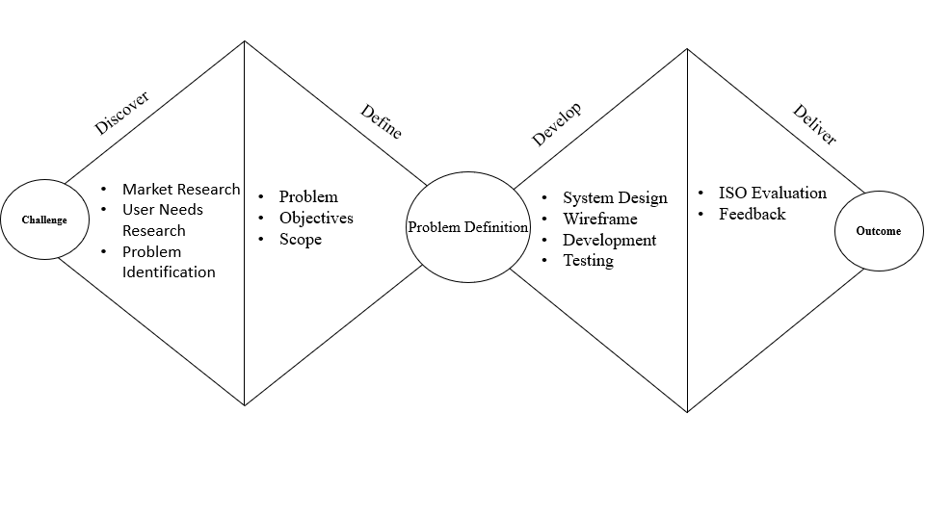
Conceptual Framework
Double Diamond Design Model

Slide 12
Related Literatures/Systems
Property Management System
Castle(2021) - Property Management System was in demand from 1980s until now.
Labis(2023) - property management systems help the owners to save time and money in terms of managing properties since it is mobile and needs only few workers.
Magyar(2021) - Property Management systems reduced carbon emissions

Slide 13
Related Literatures/Systems(cont’d)
Role of Chatbots in Integrated Website
Chatbot Magazine(2023) - Chatbots are rapidly transforming the property management landscape, offering significant advantages for both landlords and tenants
Santos (2022) - chatbots can address frequently asked questions (FAQs) 24/7

Slide 14
Related Literatures/Systems(cont’d)
Predictive Analytics in Business
IBM(2024) - Predictive Analytics is a field that utilizes historical data and statistical techniques to forecast future trends
Lamudi (2023) - Analyzing Historical rental data can predict future rental trends.
Property Guru (2024) - predictive analytics can forecast occupancy rates.

Slide 15
Related Literatures/Systems(cont’d)
Virtual Tour in Rental Applications
National Association of Realtors(2023) - surge in the popularity of virtual tours, offering a convenient and remote way for potential tenants to explore properties
Dot Property Philippines (2024) - virtual tours are rapidly becoming the new standard in the Philippine real estate market.
The Red Marker (2023) - virtual tours can significantly increase the attractiveness of listings, potentially leading to a rise in qualified leads and reduced vacancy periods.

Slide 16
Related Literatures/Systems(cont’d)
Improved Transaction Efficiency through Online Transactions
Tripathi et al. (2021) - highlights how blockchain can enhance transparency by ensuring secure and immutable transaction records, thereby reducing administrative overhead and potential disputes
MDPI (2020) - discusses the sustainability and efficiency gains from integrating mobile payment systems into digital financial services
Taylor & Francis(2023) - Fintech Solutions help automate most of the transactions such as real-time payments, and data analytics.

Slide 17
Related Literatures/Systems(cont’d)
Rental Properties as Business
Samarin and Sharma (2021) - stated that more than a billion tenants live in rental homes around the world
Recodo (2021) - house rental business is a good source of consistent income and is regarded as a type of investment

Slide 18
Related Literatures/Systems(cont’d)
The Need for GPS Proximity in a System
TomTom (2021) - GPS is a navigation technology utilized on land, sea, and air to precisely determine location, time, and velocity, regardless of weather conditions
Chime et al. (2021) - GPS aids in locating positions.
Dhamodaran et al (2023) - GPS is one of several new features and improvements included in the proposed system for the house rental application to make the customer experience better

Slide 19
Related Literatures/Systems(cont’d)
The Use of Rental Trends in Business Success
Dong et al. (2020) - there has been a notable shift from a passive renting culture to actively buying, and then back to actively renting
Rubaszek and Rubio (2020) - assert that reducing the relative cost of renting compared to owning could influence rental prices

Slide 20
Research Design
Quantitative descriptive research design
ISO 25010 Series of 2017
Target population
Convenience Sampling Method

Slide 21
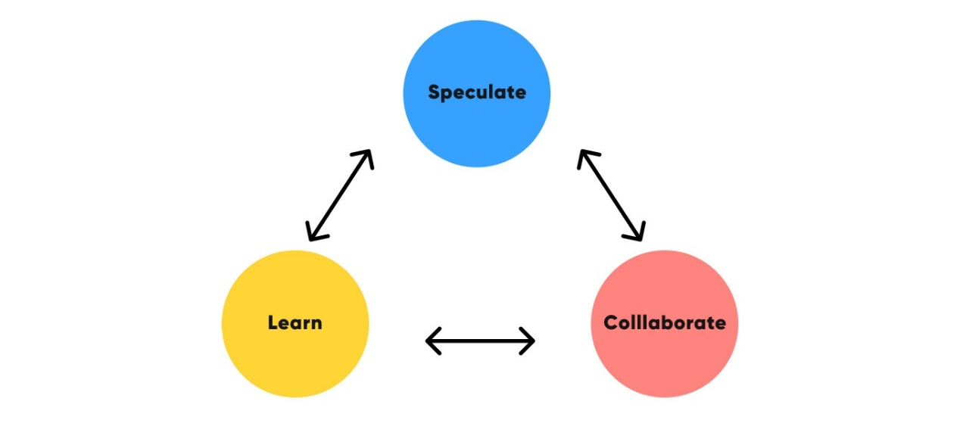
Software Development Lifecycle
Adaptive Agile Development

Slide 22
Requirement Analysis
Functional Requirements
User Registration and Authentication
Admin Dashboard
Property Browsing and Search
Property Listings and Details
User Profile Management
Maintenance Tracking Dashboard
Communication (Chatbot-based)
Ratings and Reviews
Property Management
Booking and Availability Management

Slide 23
Requirement Analysis (cont’d)
Non-Functional Requirements
Performance Efficiency
Reliability
Security
Maintainability
Scalability
Usability
Compatibility

Slide 24
Requirements Documentations
Data Gathering Procedures
Survey questionnaires
Google Forms – Online Survey Platform
To identify the difference between the existing process in booking rental units and the systems that will be developed

Slide 25
Requirements Documentations(cont’d)
Respondents of the Study
convenience sampling method
population size of the chosen groups cannot be determined
Stratton (2021) - it is best to use non-probability sampling such as convenience sampling method

Slide 26

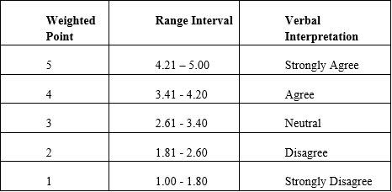
Requirements Documentations(cont’d)
Statistical Treatment
Quantitative data analysis
Tables for presentation
Formula:
  Weighted Mean
  Likert Scale

Slide 27
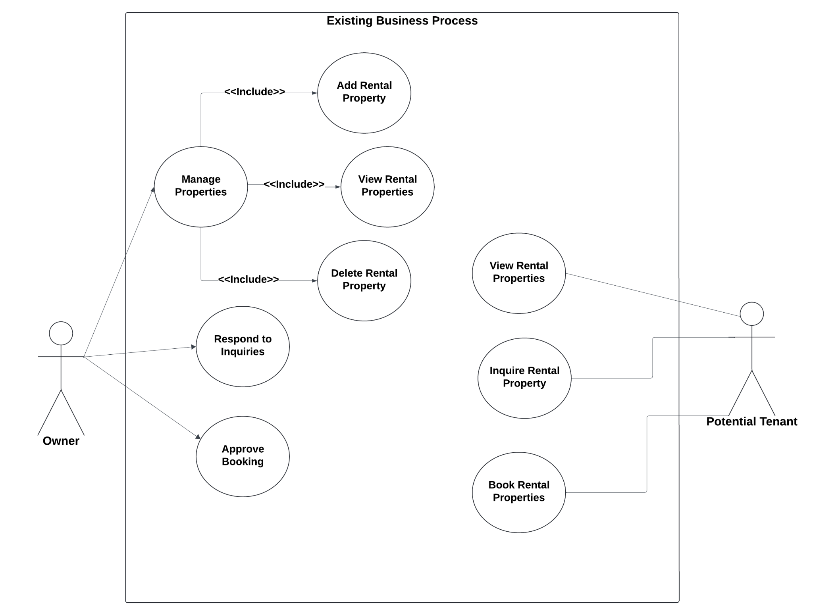
Design of Software, Systems, Product, and/or Processes
Use Case of the Existing Business Process

Slide 28
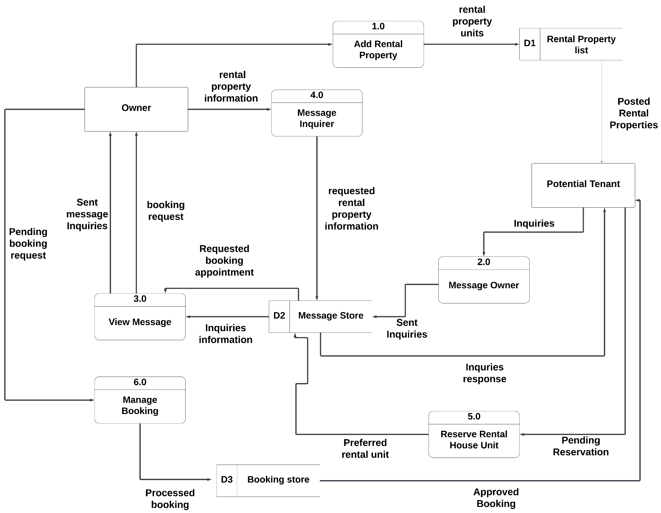
Design of Software, Systems, Product, and/or Processes(cont’d)
Data Flow Diagram of the Existing Business Process

Slide 29
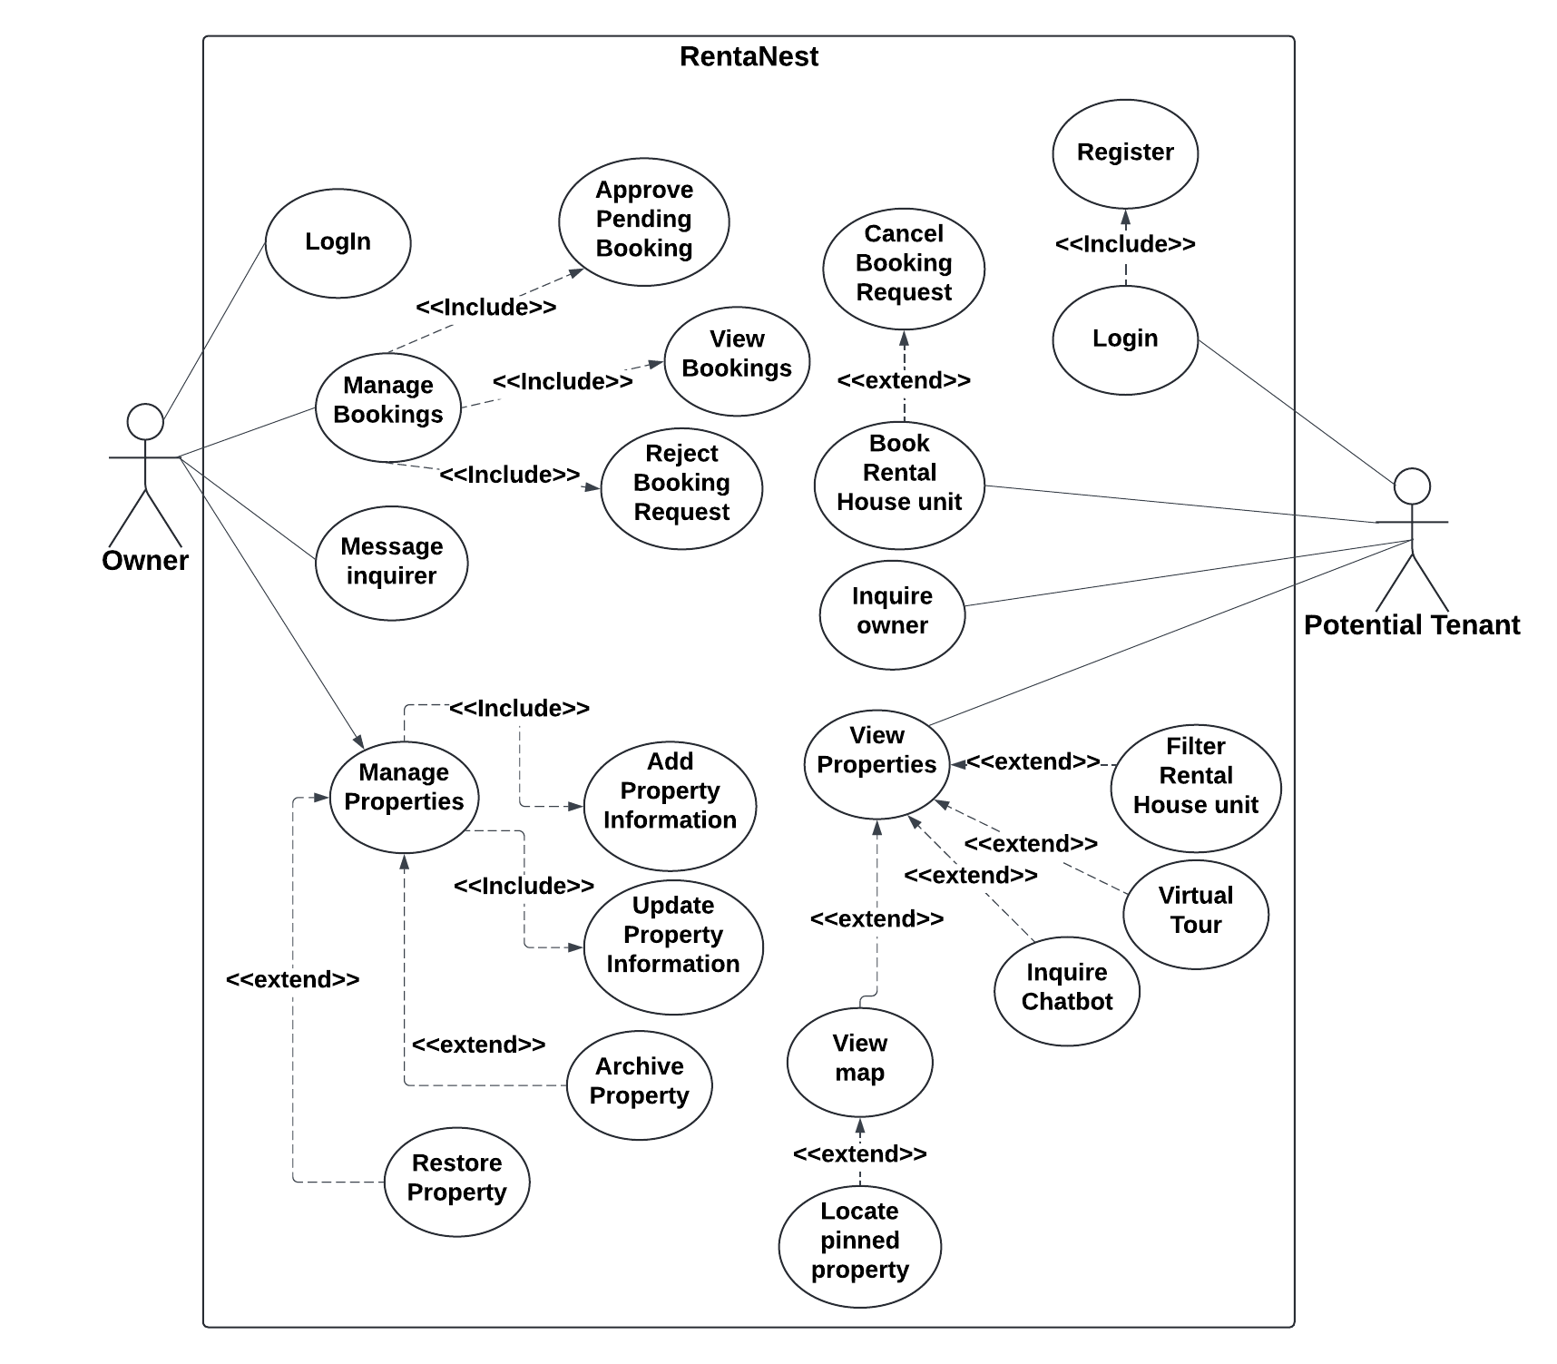
Design of Software, Systems, Product, and/or Processes(cont’d)
Use Case of the Proposed System (RentaNest)

Slide 30
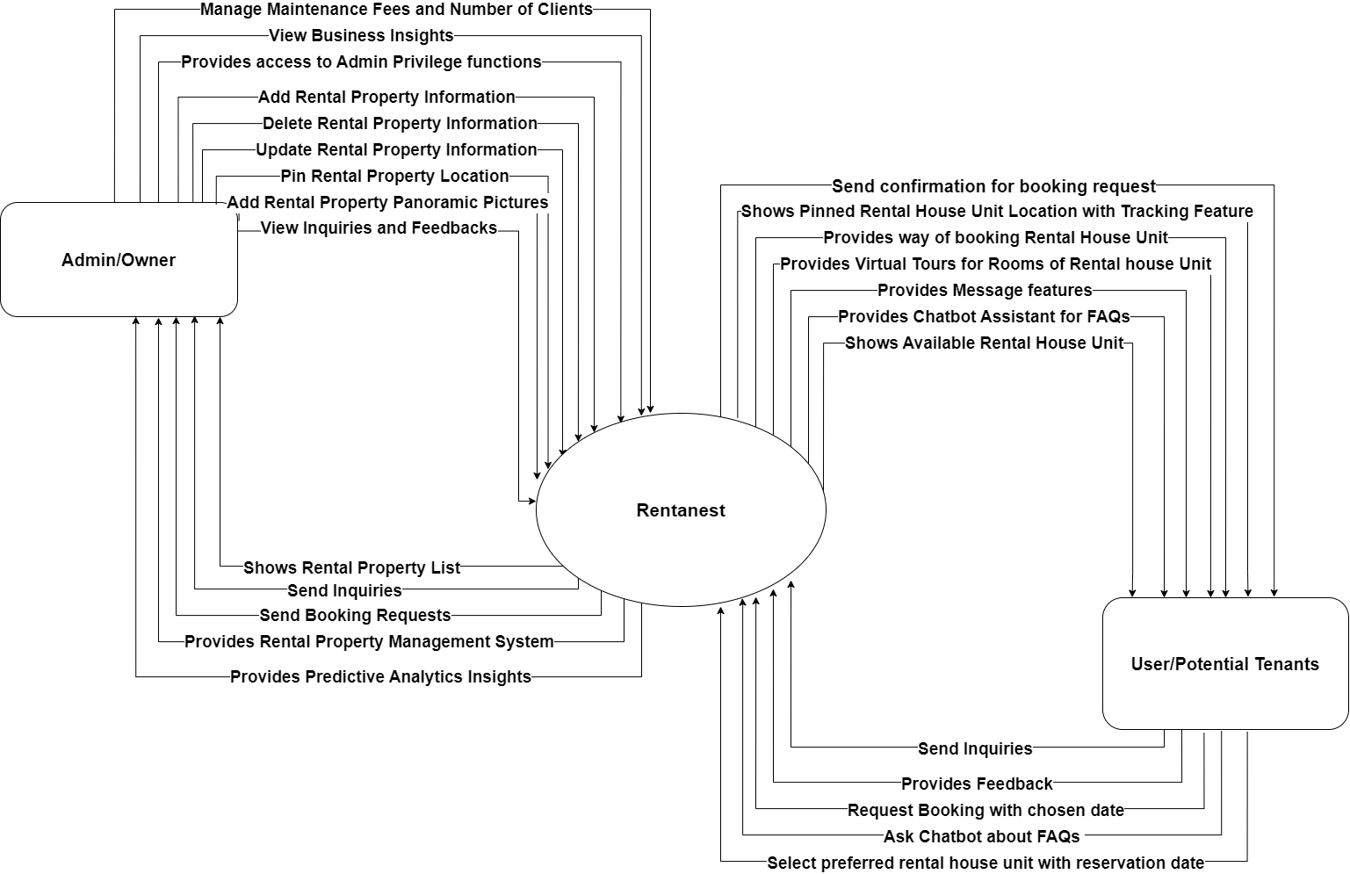
Design of Software, Systems, Product, and/or Processes(cont’d)
Context Diagram of the Proposed System (RentaNest)

Slide 31
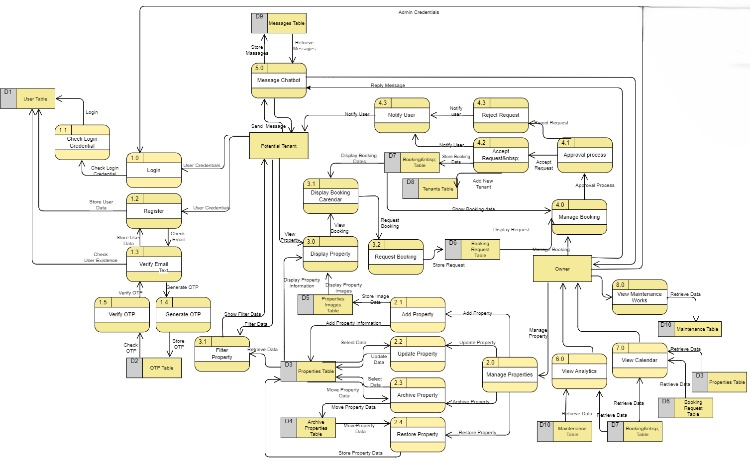
Design of Software, Systems, Product, and/or Processes(cont’d)
Data Flow Diagram of the Proposed System

Slide 32
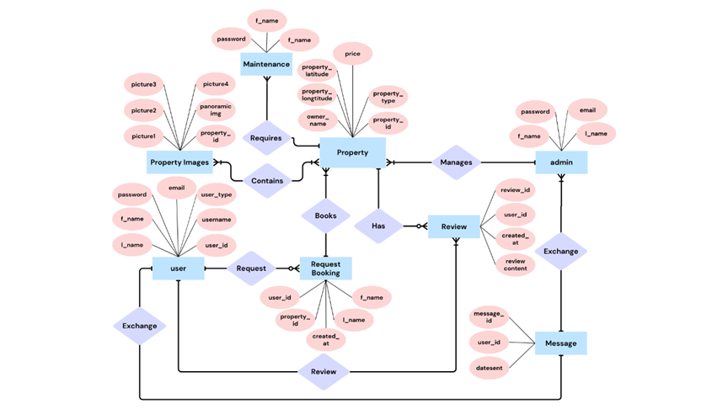
Design of Software, Systems, Product, and/or Processes(cont’d)
Entity Relationship Diagram

Slide 33
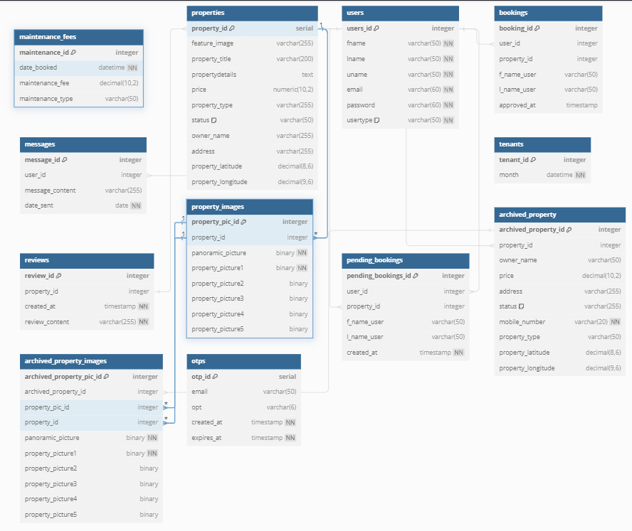
Design of Software, Systems, Product, and/or Processes(cont’d)
Database Schema

Slide 34
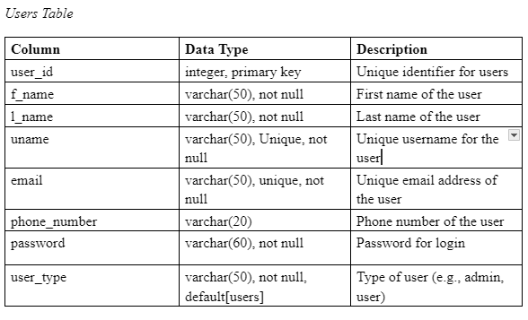
Design of Software, Systems, Product, and/or Processes(cont’d)
Data Dictionary

Slide 35
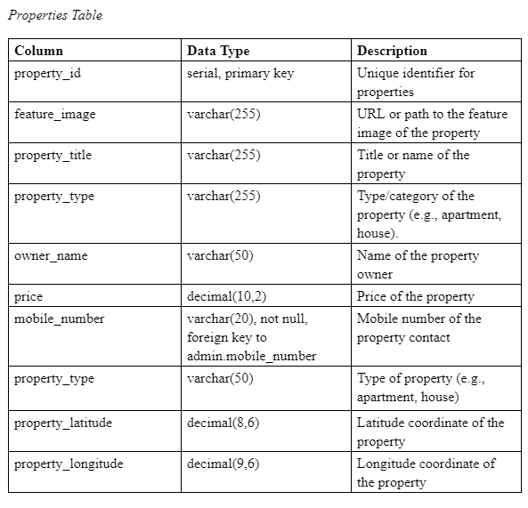
Design of Software, Systems, Product, and/or Processes(cont’d)
Data Dictionary

Slide 36
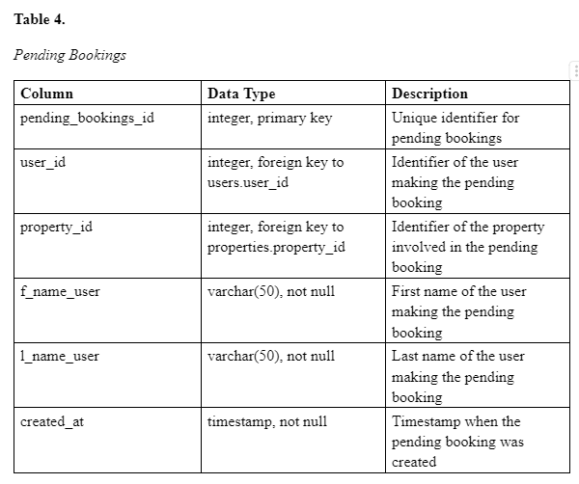
Design of Software, Systems, Product, and/or Processes(cont’d)
Data Dictionary

Slide 37
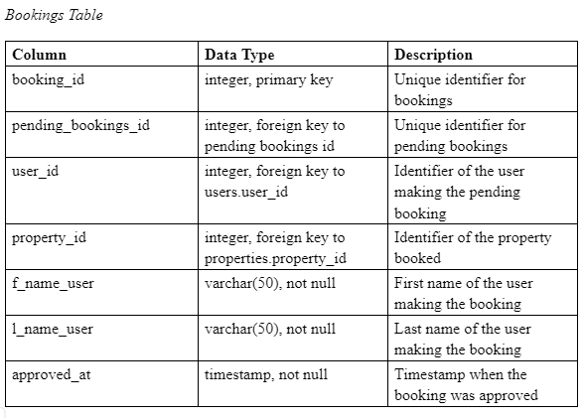
Design of Software, Systems, Product, and/or Processes(cont’d)
Data Dictionary

Slide 38
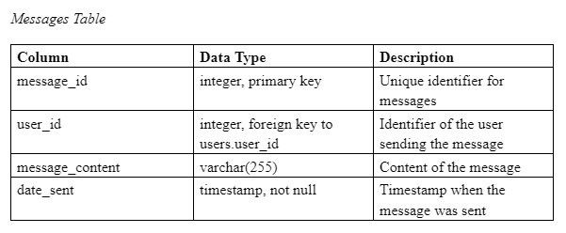
Design of Software, Systems, Product, and/or Processes(cont’d)
Data Dictionary

Slide 39
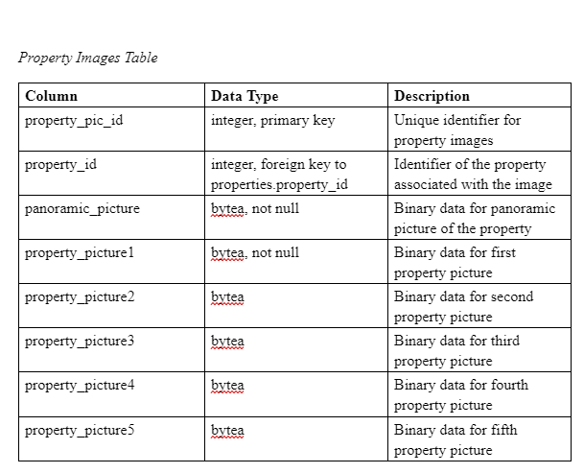
Design of Software, Systems, Product, and/or Processes(cont’d)
Data Dictionary

Slide 40
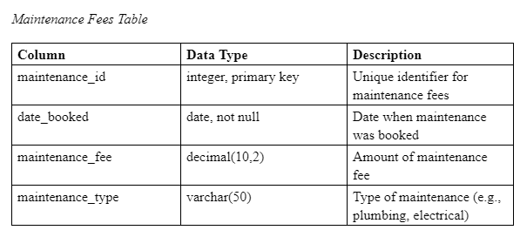
Design of Software, Systems, Product, and/or Processes(cont’d)
Data Dictionary

Slide 41
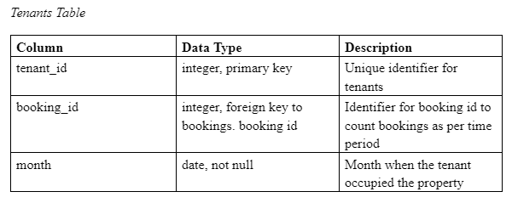
Design of Software, Systems, Product, and/or Processes(cont’d)
Data Dictionary

Slide 42
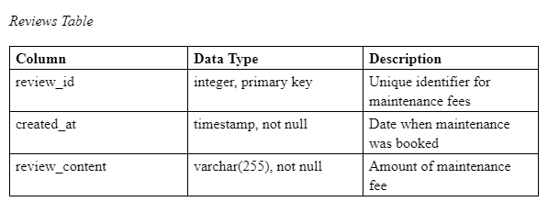
Design of Software, Systems, Product, and/or Processes(cont’d)
Data Dictionary

Slide 43
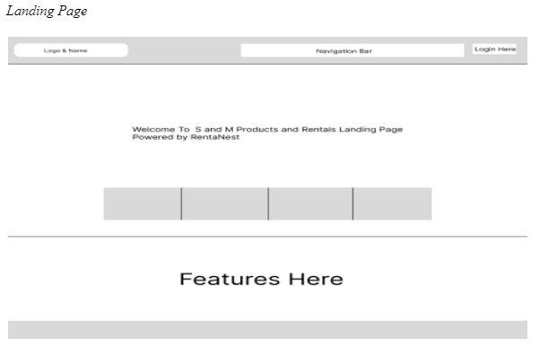
Development and Testing
Prototype

Slide 44
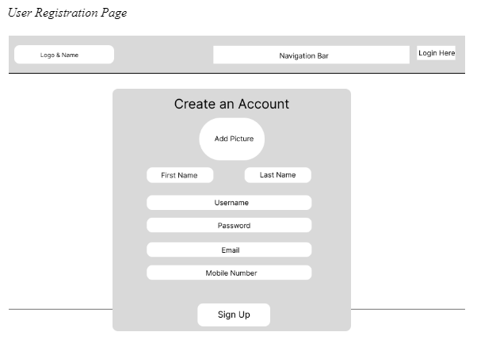
Development and Testing

Slide 45
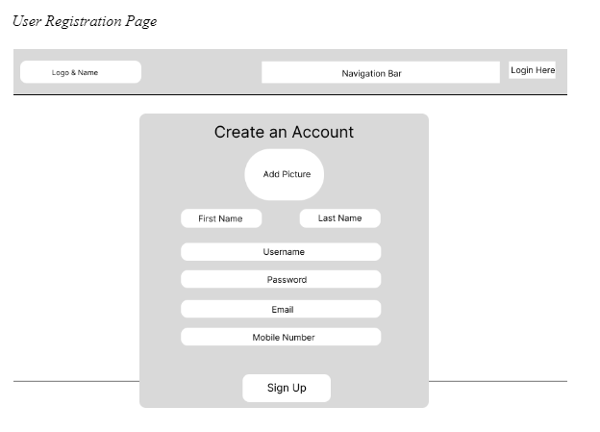
Development and Testing

Slide 46
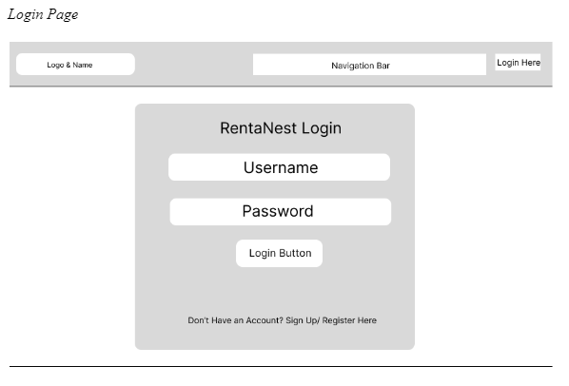
Development and Testing

Slide 47
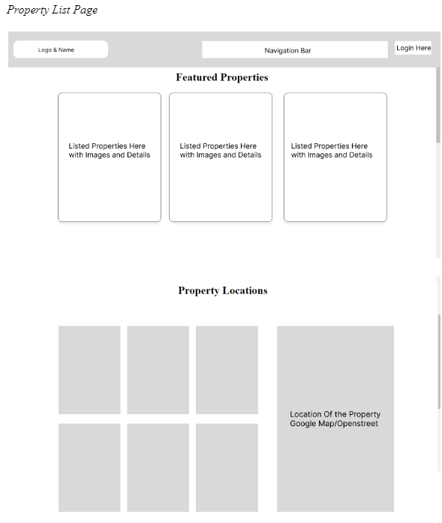
Development and Testing

Slide 48
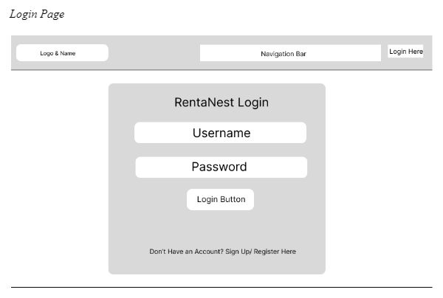
Development and Testing

Slide 49
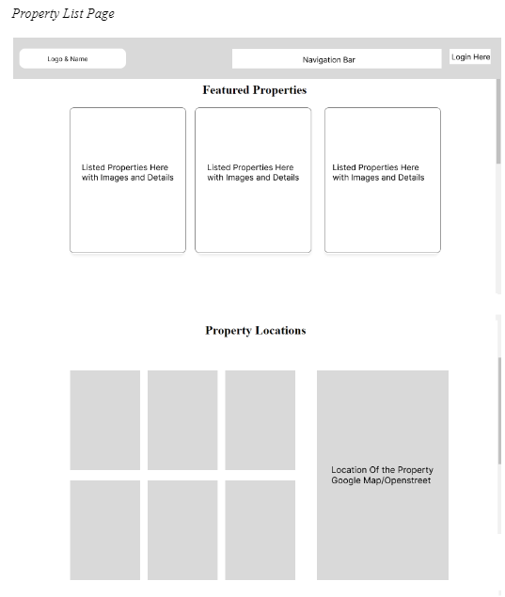
Development and Testing

Slide 50
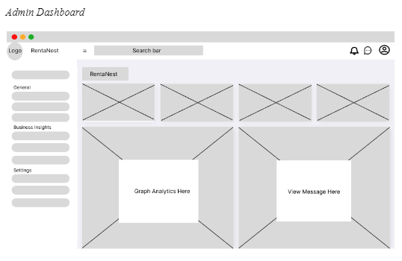
Development and Testing

Slide 51
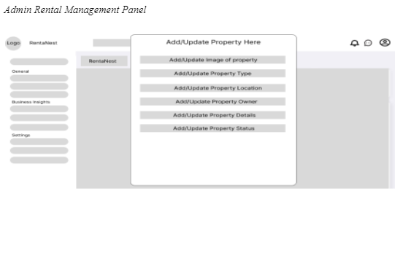
Development and Testing

Slide 52
ISO 25010 series of 2017
Functional Suitability
Functional completeness
Functional correctness
Functional appropriateness

Slide 53
ISO 25010 series of 2017
Performance Efficiency
Time behavior
Resource utilization
Capacity

Slide 54
ISO 25010 series of 2017
Compatibility
Co-existence
Interoperability

Slide 55
ISO 25010 series of 2017
Usability
Appropriateness recognizability
Learnability
Operability
User error protection
User interface aesthetics
Accessibility

Slide 56
ISO 25010 series of 2017
Reliability
Maturity
Availability
Fault tolerance
Recoverability

Slide 57
ISO 25010 series of 2017
Security
Confidentiality
Integrity
Non-repudiation
Accountability
Authenticity

Slide 58
ISO 25010 series of 2017
Maintainability
Modularity
Reusability
Analyzability
Modifiability
Testability

Slide 59
ISO 25010 series of 2017
Portability
Adaptability
Installability
Replaceability

Slide 60
Results and Discussions
100 respondents – Tenants of S&M Products and Rentals
Google Forms
Video Demo of the proposed system
Users can see the availability, price, number of rooms and beds, landmarks near the location, and the ratings of the rental house units.
Users can describe the process of online booking can help them to book easily
Less time managing inquiries and bookings
Transaction/ Booking History ---- Visible to Owner and Users

Slide 61
Results and Discussions
Payment History
Business Insights for the business owner (not Included in the questionnaire)
  Descriptive Analytics
    Monthly Incomes
    Number of Maintenance per month
    Property with the highest Bookings
  Predictive Analytics
    Monthly Bookings
    Daily Bookings
    Maintenance Costs per month
Improved Current Business Processes
  User Experience
  Administrative Efficiency

Slide 62
Results and Discussions – Evaluation Based on ISO 25010
Functional Suitability
The respondents described the system as functional.
Statement 1 has got 3.98 weighted mean
64 out of 100 Respondents
Accuracy and Timeliness
Taplin(2024) – On going process; Key for building trust and credibility
Avoiding Mistakes and Wrong Decisions
Statement 5 – 59 out of 100
Payment history for tracking users’ transactions
Statements | Weighted Mean | Verbal Interpretation
1. The system provides accurate and up-to-date information on available rental properties. | 3.98 | Agree
2. The descriptions and photos in the system are detailed and helpful for choosing rental preferences. | 3.90 | Agree
3. Users can easily filter rental house unit properties based on their preferences. | 3.96 | Agree
4. The system provides needed information to help users produce informed decision. | 3.97 | Agree
5. Users can track their payment history in real-time. | 3.70 | Agree
Average Weighted Mean | 3.90 | Agree

Slide 63
Results and Discussions – Evaluation Based on ISO 25010
Performance Efficiency
Statement 5 -3.99 weighted mean
Grigoropolous(2023) – page load is related to user retention
Google –Load time 1 to 3 seconds increases bounce off
Statement 3 -3.79 weighted means
Average weighted mean – 3.88
Respondents agreed about the responsiveness and page load speed
Statements | Weighted Mean | Verbal Interpretation
1. Users experience responsive processes such as giving fast results (e. g. Filtering House units with low prices). | 3.87 | Agree
2. The systems process rental bookings efficiently. | 3.85 | Agree
3. The images of virtual tour features load quickly without interruptions. | 3.79 | Agree
4. Users do not experience lag while navigating through property listings. | 3.89 | Agree
5. The images of all the rental house units are responsive and load quickly. | 3.99 | Agree
Average Weighted Mean | 3.88 | Agree

Slide 64
Results and Discussions – Evaluation Based on ISO 25010
Compatibility
3.85 average weighted mean
Statement 4 – 3.97 weighted mean ;
Statement 1 – 3.96 weighted mean ; 55 out of 100
Shira(2023) – mobile devices reshaped how the users browse the internet (ex.Smartphones)
Responsiveness of website is essential for platform to be accessible in different devices
Users have their own preferences on device they will use – responsive web design
Statement 5 - 3.70 weighted mean ; 50 out of 100
See the uniqueness of the website interface
Statements | Weighted Mean | Verbal Interpretation
1. The system works smoothly on smartphones. | 3.96 | Agree
2. The system works well on desktop or laptop browser. | 3.89 | Agree
3. The features of the system can be accessed on different computer devices (e. g. Smartphones, Desktop, Laptop, Tablet). | 3.75 | Agree
4. The system works well on different kinds of operating systems. | 3.97 | Agree
5. The system has unique interface for different computer devices. | 3.70 | Agree
Average Weighted Mean | 3.85 | Agree

Slide 65
Results and Discussions – Evaluation Based on ISO 25010
Usability
3.93 average weighted mean
Smooth and good quality of experience while using its features
Statements 3(64) and 5(53) - 3.96 weighted mean
Users observed the clarity of the user interface
Feedback section is also noticeable which makes it easier for the users to put their concerns and comments on their experience while using the platform
Malewicz(2024) – UI should be enjoyable, satisfying and frustration-free. Do not care about the design but their goal of getting their tasks done
Statement 2(57) – 3.87 WM
Statements | Weighted Mean | Verbal Interpretation
1. The system is easy to use, even for someone unfamiliar with it. | 3.92 | Agree
2. Users can easily find rental house units without putting much effort. | 3.87 | Agree
3. The User Interface is clear and easy to understand. | 3.96 | Agree
4. The booking feature is straightforward and quick. | 3.95 | Agree
5. The users can easily contact admin or owner when they encounter problems. | 3.96 | Agree
Average Weighted Mean | 3.93 | Agree

Slide 66
Results and Discussions – Evaluation Based on ISO 25010
Reliability
Average 3.84 weighted mean – Agree
Availability and credibility of the system that can withstand different situations like having errors
Statement 3(65) – 3.99 WM – Agree
Crudu(2024) - error messages are important to the interaction of users and the website
Informative messages can help the users quickly understand their situation when errors happened
Statement 2(54) – 3.71 WM
Majority of the users can effectively observe the availability of the payment history inside the platform
Statements | Weighted Mean | Verbal Interpretation
1. The system is stable to use, providing reliable platform for finding rental house units and booking processes. | 3.73 | Agree
2. The payment history is always available when the users need proofs that they have legitimate transactions. | 3.71 | Agree
3. The system handles errors effectively, minimizing disruption in rental booking processes. | 3.99 | Agree
4. Users feel confident that their booking and transaction processes are real-time and accurate. | 3.95 | Agree
5. The system is always available when the users need it without downtime. | 3.76 | Agree
Average Weighted Mean | 3.84 | Agree

Slide 67
Results and Discussions – Evaluation Based on ISO 25010
Statements | Weighted Mean | Verbal Interpretation
1. The system ensures that the platform is available to authorized and authenticated users only | 3.94 | Agree
2. The login process is secured by using authentication process such as email verification. | 3.86 | Agree
3. Users feel safe and confident when placing their bookings, ensuring that their transaction is accurate and real. | 3.79 | Agree
4. Transactions have detailed information, ensuring users their bookings can be traced back to them. | 3.83 | Agree
5. The system first confirms the users of their booking processes, avoiding wrong bookings, ensuring accountability | 3.82 | Agree
Average Weighted Mean | 3.85 | Agree
Security
Average 3.85 weighted mean – Agree
Website to make the users feel secure when they are using the platform to book rental house units.
Statement 1 (63) – 3.84 WM
Focuses in the process of account verification and user authentication
Waite (2024) – Access information for cybercrime purposes
Build Trust as Business show security measurement
Statement 3 (53) -3.79 weighted mean
Majority of the users observed the credibility of the proposed system to present real-time information about the booking transactions

Slide 68
Results and Discussions – Evaluation Based on ISO 25010
Statements | Weighted Mean | Verbal Interpretation
1. The system runs correctly when users use it, proving maintainability. | 4.12 | Agree
2. The users can see changes and improvements in the system without experiencing negative effects on quality of service. | 3.64 | Agree
3. The system provides technical support such as feedback forms to address any issues or concerns the users may encounter. | 3.98 | Agree
4. The users do not experience bugs and issues while accessing the features of the system. | 3.51 | Agree
5. The system provides real-time house unit information such as the availability and prices of the rental properties, ensuring the system is well-maintained. | 3.98 | Agree
Average Weighted Mean | 3.85 | Agree
Maintainability(For Users)
Average 3.85 weighted mean – Agree
Statement 1 (59) – 4.12 WM
Baig(2023) - website is a tool for business just like any other business assets
Security at risk
Affect performance and functionalities
Statement 4 (44) – 3.51 WM
the functions inside the platform are working without having any issues

Slide 69
Results and Discussions – Evaluation Based on ISO 25010
Portability
Average 3.90 weighted mean – Agree
Offer services to the users in a portable manner
Statement 3 (64) – 4.00 WM
Dragan (2023) -website needs to cater the needs of mobile users
Responsive Web design – user retention
Statement 2 (65) (x32) – 3.71 WM
Users described the proposed system as a website that can offer services and cater their needs based on their preferences of computer devices, time and place
Statements | Weighted Mean | Verbal Interpretation
1. Users can access the system from different locations without issues. | 3.98 | Agree
2. Users can book rental house units anytime and anywhere. | 3.71 | Agree
3. Users do not need heavy devices such as desktop to access the system, they can use their smartphones. | 4.00 | Agree
4. The system is accessible to users without the need of installation, promoting easy access for booking processes. | 3.99 | Agree
5. The features and functions of the system are consistent across different types of computer devices. | 3.82 | Agree
Average Weighted Mean | 3.90 | Agree

Slide 70
Results and Discussions – Evaluation Based on ISO 25010
Summary
The proposed system has got favorable ratings across different categories of Software Quality Standard
Usability – 3.93 WM
As mentioned from the usability category, users do not care about the design of the website
Reliability – 3.84 WM
As mentioned from the usability category, users do not care about the design of the website
Category | Weighted Mean | Verbal Interpretation
Functional Suitability | 3.90 | Agree
Performance Efficiency | 3.88 | Agree
Compatibility | 3.85 | Agree
Usability | 3.93 | Agree
Reliability | 3.84 | Agree
Security | 3.85 | Agree
Maintainability | 3.85 | Agree
Portability | 3.90 | Agree
Average Weighted Mean | 3.87 | Agree

Slide 71
Summary of the Findings
The proposed system effectively provides accurate and up-to-date information on rental properties, and the users can easily use the filter feature of the system to help them gather details they need to decide properly.
The platform also effectively offers users a way to track their payment using payment history.
Easy for the page contents to load
Navigating through property listing is smooth
Majority of the users agreed that the virtual tour features can load quickly without interruptions. Some still experiences interruptions
The users agreed that the system works well in different platforms
The users agreed that the system works well in different kinds of operating system, especially OS for smartphones and desktops such as iOS, Windows, Android, and macOS
Ease of use
Easy to Understand website

Slide 72
Summary of the Findings
The system handles errors effectively which might affect the processes inside the business
Confident that their booking and payment transactions information are accurate.
Identify the reliability of the system to be able to offer services without worrying about it not functional very well.
Stable as it provides reliable ways to find rental house units and bookings.
Users feel confident in the system’s security measures since the initial steps for accessing the website are user authorization and authentication
Booking and transaction history make them feel more secured
They can easily track the transactions
Action Confirmation

Slide 73
Summary of the Findings
Well-maintained
System works efficiently since the features are functional really well
System provides support such as feedback forms to address the concerns
Real-time information is also visible to the system such as the real-time update of the availability
User interface cannot affect their transactions with the system
Some users encounter bugs while using the system but still the majority of them agreed that these bugs are present in the process.
Access the system just by using their smartphones
Access through web without any installation required
Features are also consistent despite being used in different devices

Slide 74
Conclusion
Users can easily see the transparency of the details they need to choose rental properties based on their personal preferences
Users can decide on the rental house units they want to choose without any hesitations since they have enough details about the rental propert
Users can easily filter the property listing with this information
The system achieved a quick load of page contents. Users can immediately see the property listings.
For interactivity, the proposed system successfully integrated a virtual tour feature which purpose is for the users to view each room with 360-degree view angle.
Real-time data being offered by the tools used in the system, it is clear that the platform can send accurate and up-to-date information which can help the users and the admin.

Slide 75
Conclusion
Users using similar system uses mobile phones (Smartphones)
Users also described how easy it is to navigate things inside the website
booking process is too straightforward for the users
The transaction is easy and fast as it does not require to put more effort
The system is also prepared for interactions that the users can make while using the website such as accessing some sections with functionalities that are still in the development stage
The system successfully created a platform for users to use easily in finding and booking rental house units being offered by S&M Products and Rentals
It also has the tools to improve the business processes of the rental property business such as management system and analytics tools.

Slide 76
Recommendations
Third Party Payment API
Use of Mobile development design
Transition to Mobile Development
Machine Learning Implementation
Actual AI

Slide 77
Questions

Slide 78
https://www.investopedia.com/terms/s/sma.asp

Slide 79
Sana Pasado Kami

Slide 80
Thesis Defended

