Slide 1

Introduction to R through a case study
Hong Qin
Notes:
Part of materials are based on Ken Rice and Thomas Lumley’s lecture on R

Slide 2
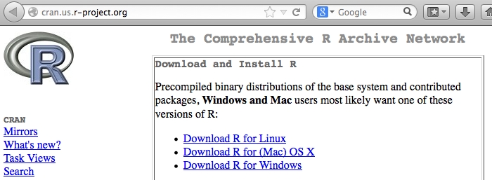
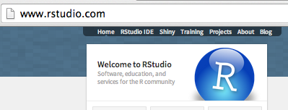
Install R and RStudio
R
  www.r-project.org
Rstudio (a nice GUI IDE for R)
  www.rstudio.com
  Free Desktop version.
YouTube
  How to download and install R and Rstudio .

Slide 3
GitHub
Register for an account.
Download a desktop client of GitHub.

Slide 4
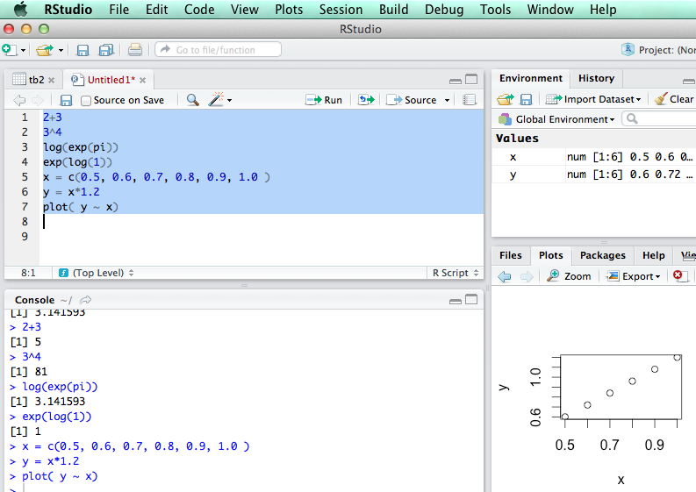
R is an interpretive language

Slide 5
R markdown file
Code chunk (blocks)
Comment blocks.
Run selected lines
Run chunks (next chunks).

Slide 6
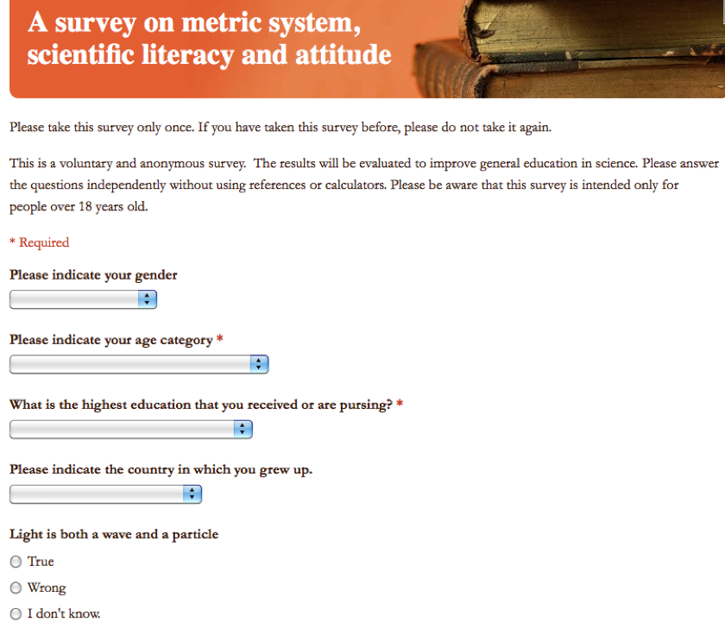
Learning R using an example
R Code: ‘metric.R’
Link to the online Survey

Slide 7
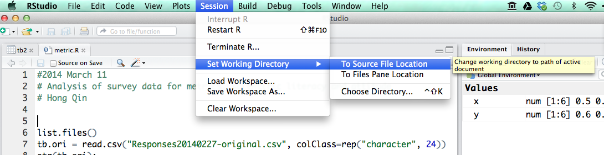
Load data into R
First, change working directory
Then, read.csv()

Slide 8
Explore the data
str()
head()
View()
Change long names to short names.

Slide 9
Table is a dataframe
A dataframe is like a spreadsheet in Excel.
tb[ 1:4, 2:7] #1-4 rows, 2-7 columns
tb$age #pick a column of a dataframe.

Slide 10
Brackets and parentheses
# barackets are often for variable-access
x[i,j]
y[1];
z[[1]];
# parentheses are often for functions
t.test(x,y)
If (x <0 ) { x = -x; }
#curly parentheses are for other things

Slide 11
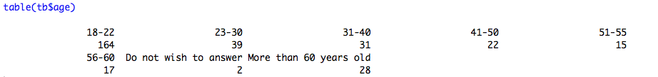


Explore the data

Slide 12
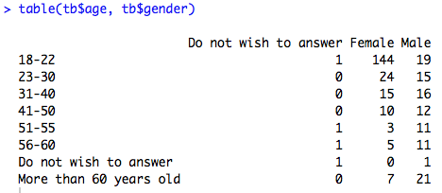
Explore the data

Slide 13
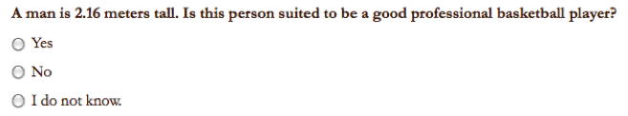
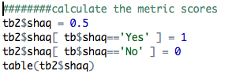

Convert answers to numerical scores

Slide 14
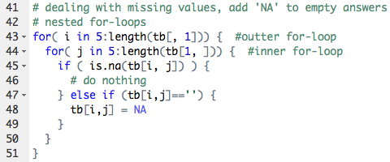
Loops in R

Slide 15
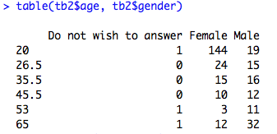
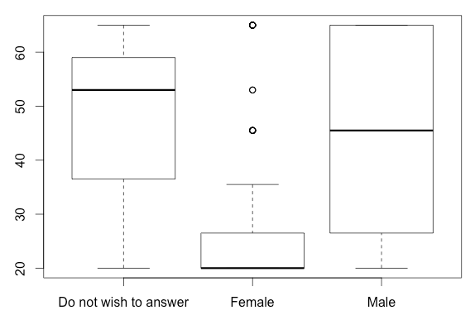

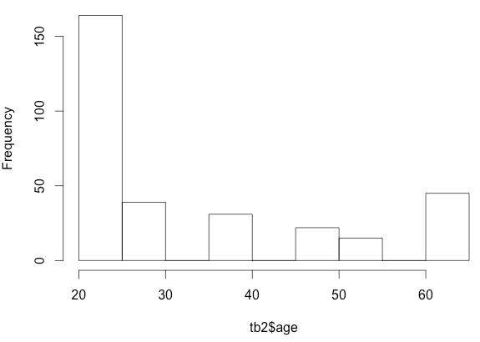
Plotting the data

Slide 16
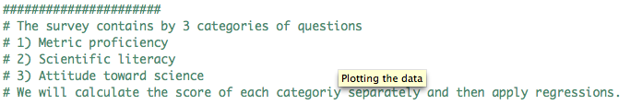
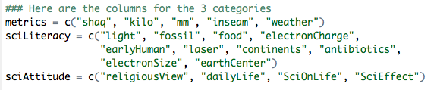
Three categories of questions

Slide 17
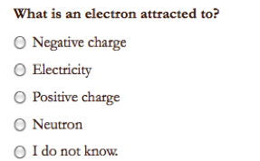
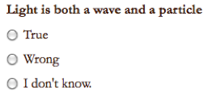
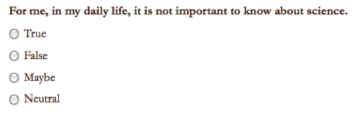
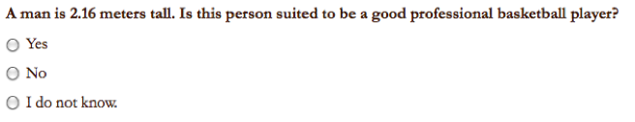
Sample Questions

Slide 18

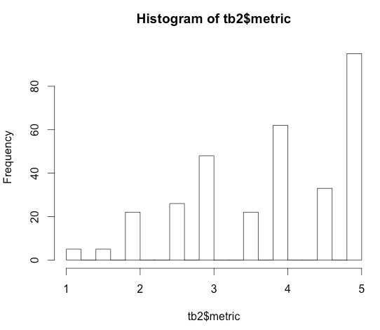

Score for Metric Proficiency

Slide 19
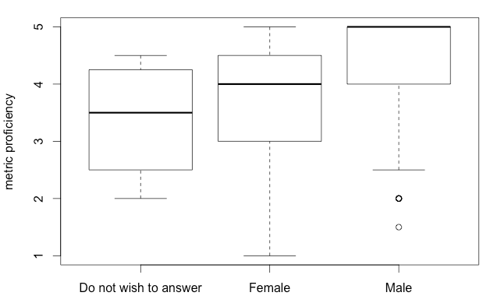
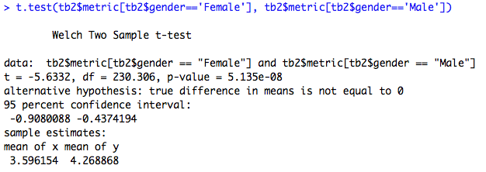
Do females tend to be less proficient in metric usage?

Slide 20
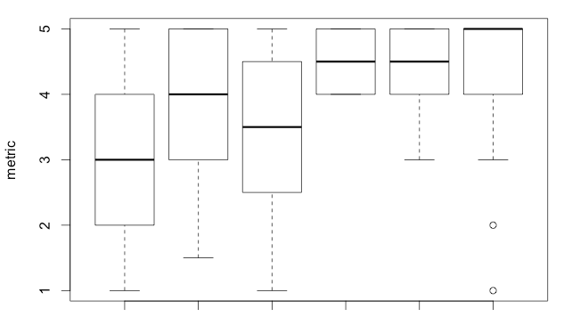
Education is a confounding factor.
BA BS HS MD MS PhD

Slide 21
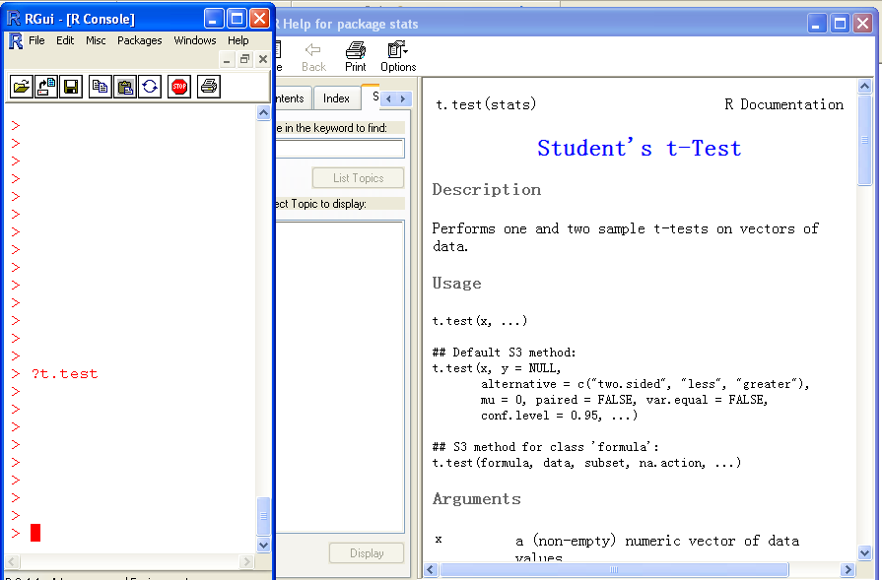
Help!

Slide 22
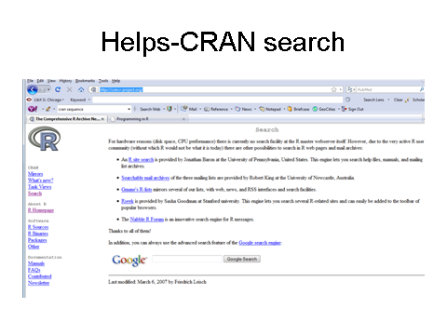
The R card

Slide 23
Assignment
Use the 2014 survey data for student assignment.

Slide 24
Todo
Add linear regression demo.

