Slide 1
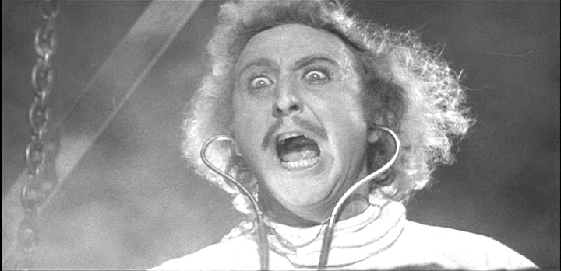
Data Creation

Slide 2
Chain of Data Creation
Preparation
Creation of Metadata
Acquisition
Building a Permanent Record
Data Management
Storage
Data Sharing

Slide 3
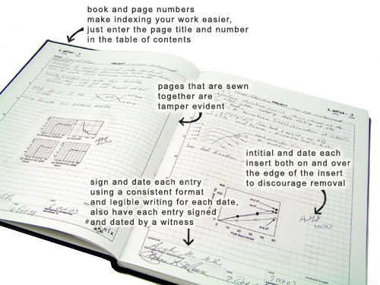
Lab Notebook
Record of hypotheses
Record of Protocols
Second brain

Slide 4
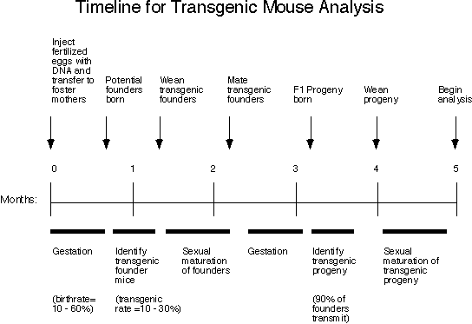
Plan Your Experiment, Experiment With your Plan
medicine.umich.edu

Slide 5
Question to Ask About your Data Collection Activity
What am I measuring?
When am I measuring it?
How am I measuring it?
What are the tools I am using?
What about the lab/field environment do I need to know?
Is my protocol reproducible?

Slide 6
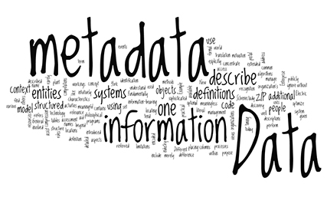
Meta-Data

Slide 7
What is Metadata?
Collection of data objects
Description of whole collection
Descriptors of each
data object

Slide 8
What Meta-Data Do You Need?
Descriptive metadata describes a resource for purposes such as discovery and identification
Administrative metadata provides information to help manage a resource, such as when and how it was created
Rights management metadata, which deals with intellectual property rights
Preservation metadata, which contains information needed to archive and preserve a resource
Understanding Metadata: niso.org

Slide 9
Structured Metadata
Dublin Core Example
Title=”Metadata Demystified”
Creator=”Brand, Amy”
Creator=”Daly, Frank”
Creator=”Meyers, Barbara”
Subject=”metadata”
Description=”Presents an overview of
metadata conventions in
publishing.”
Publisher=”NISO Press”
Publisher=”The Sheridan Press”
Date=”2003-07"
Type=”Text”
Format=”application/pdf”
Identifier=”http://www.niso.org/
standards/resources/
Metadata_Demystified.pdf”
Language=”en”
Understanding Metadata: niso.org

Slide 10
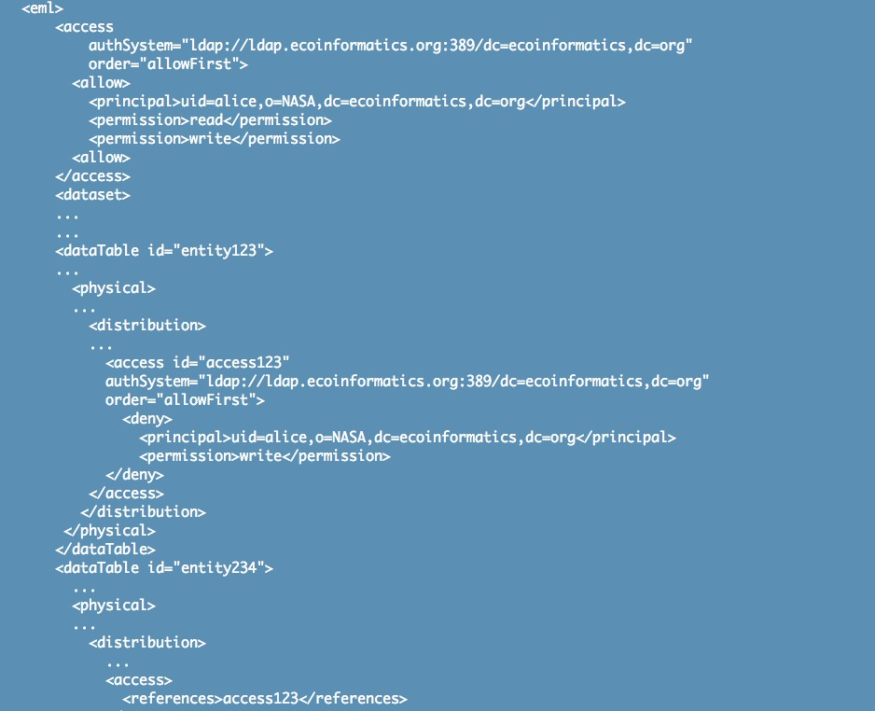
Structured Metadata
TAGS
KNB

Slide 11
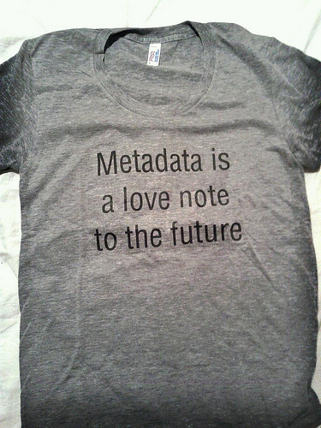
Britishlibrary.co.uk

Slide 12
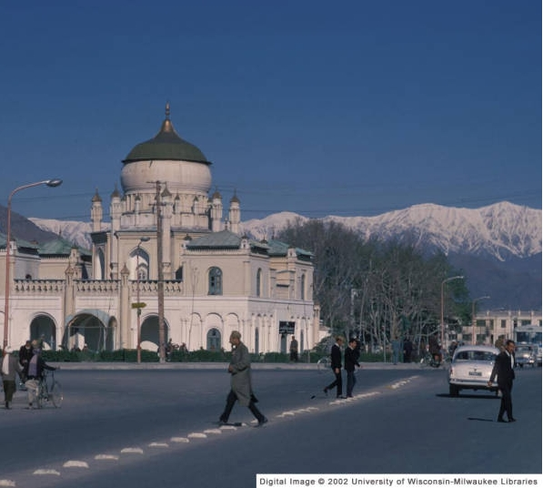
Case Study 1

Slide 13
Case Study 2

Slide 14
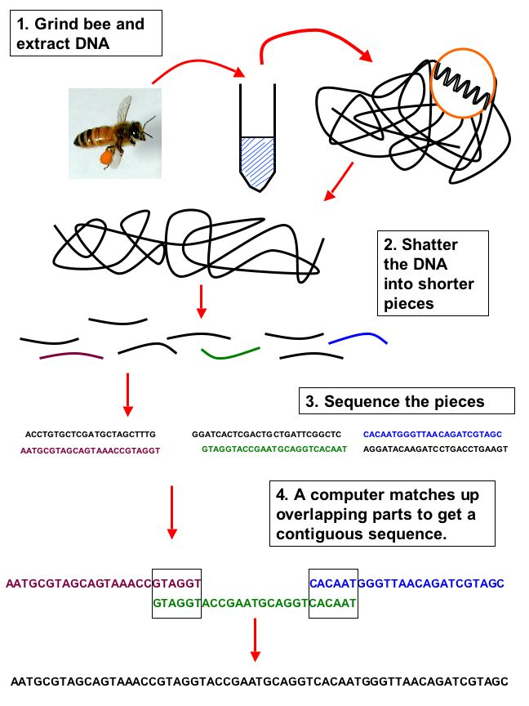
Case Study 3
beespotter.org

Slide 15
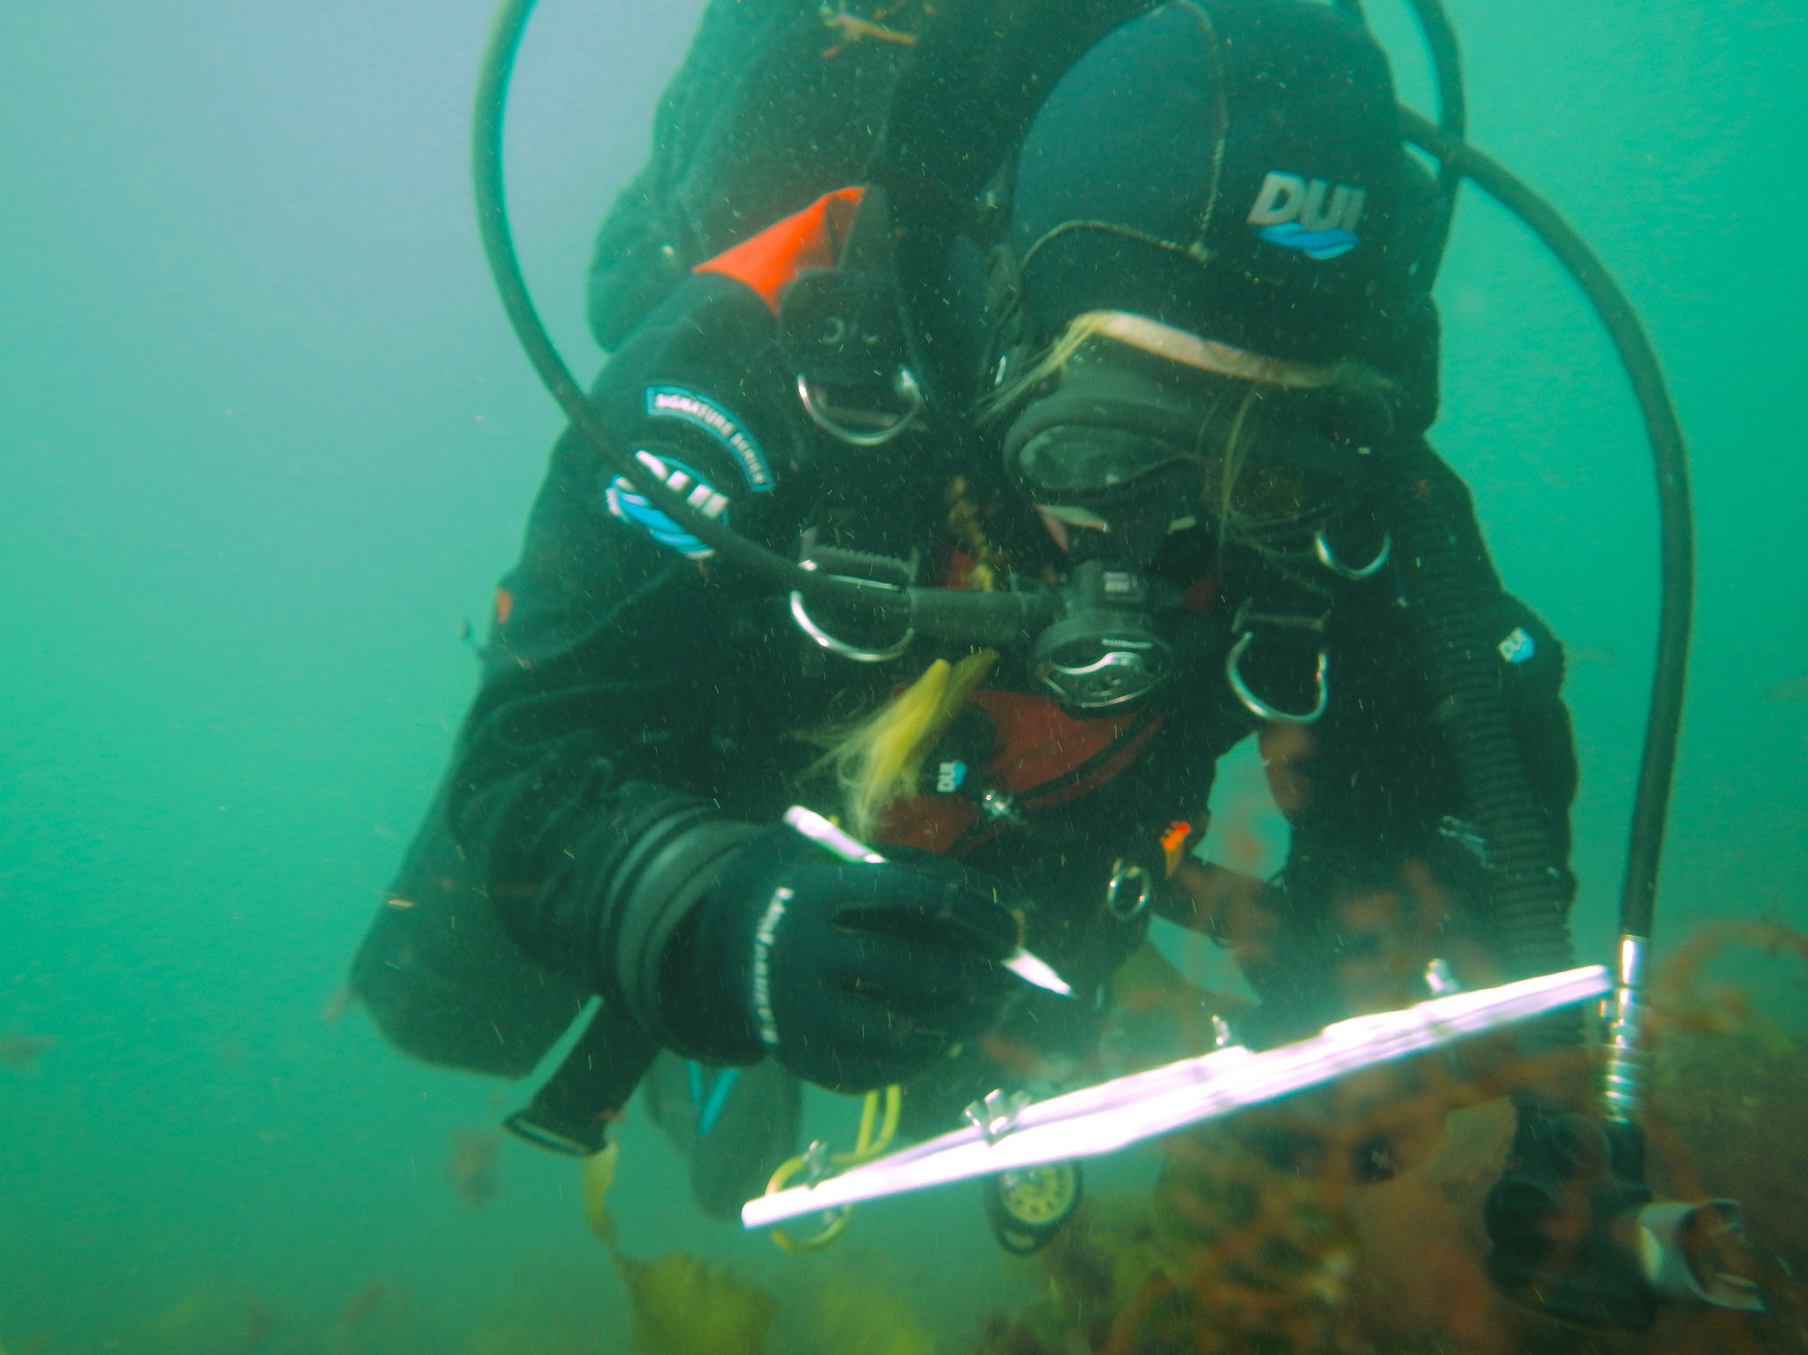
Data Collection

Slide 16
Creating a Good Data Gathering Sheet
How easy is it to read?
Are column and row definitions clear?
Is there metadata?
How similar is it to your digital data entry form?
Can you use it at 4am?

Slide 17
After the Collection…
Preserve original data
Created digital archive of raw data
Implement robust storage strategy
Quality Control (next time)

Slide 18
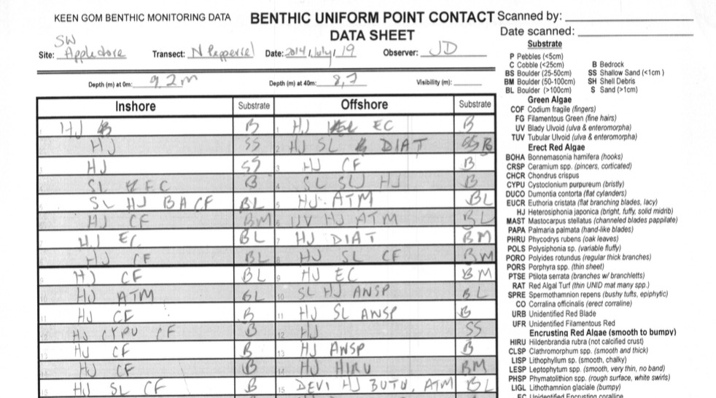
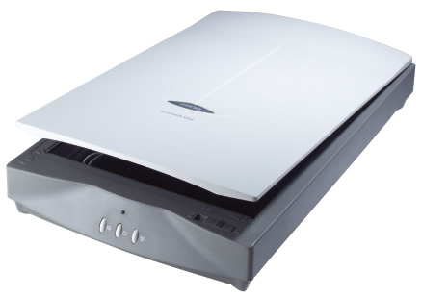
Scanning

Slide 19
EXCEL TIME!
Entry
Fills
Basic Functions
Functions for Error Checking
Controlled Vocabularies

Slide 20
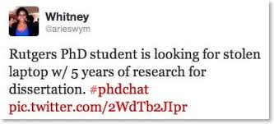
Storage: Physical
DO NOT LET THIS BE YOU

Slide 21
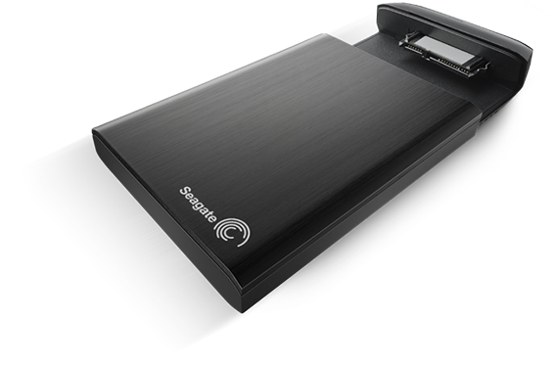
Storage: Physical

Slide 22


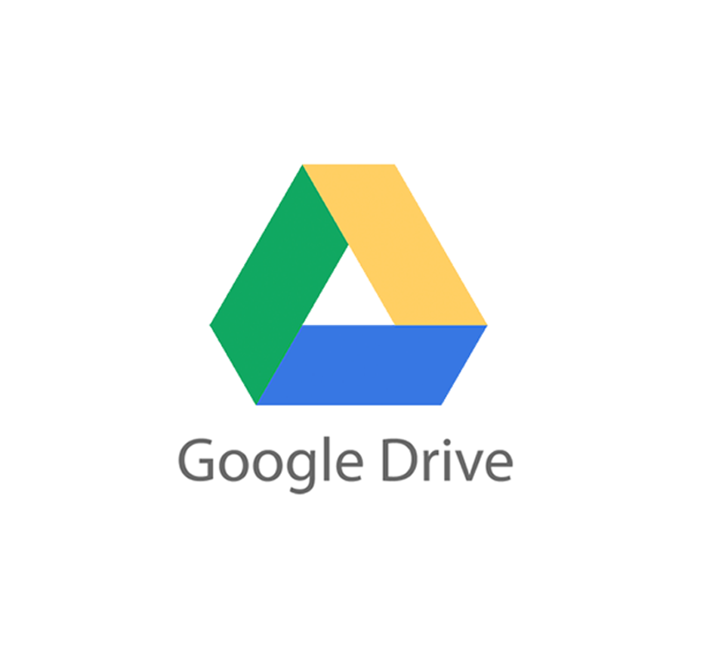
Storage: The Cloud

Slide 23
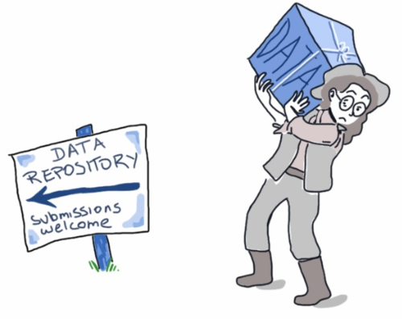
Data Sharing
blog.veritythink.com

Slide 24
Things to Consider when Data Sharing
Is what you did understandable?
How do you want your work credited?
Will your data sharing service be around in 50 years?

Slide 25
Why Share Data?
One scientist can only do so much
More data = more Power
Science must be reproducible
Who paid for this data collection?

Slide 26
Examples
https://www.dataone.org/
http://blast.ncbi.nlm.nih.gov/Blast.cgi
http://datadryad.org/
http://www.oceandataportal.org/

Slide 27
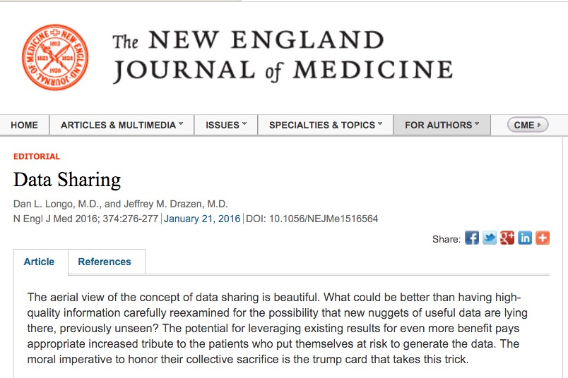
Backlash?
“A second concern held by some is that a new class of research person will emerge — people who had nothing to do with the design and execution of the study but use another group’s data for their own ends, possibly stealing from the research productivity planned by the data gatherers, or even use the data to try to disprove what the original investigators had posited. There is concern among some front-line researchers that the system will be taken over by what some researchers have characterized as ‘research parasites.’

Slide 28
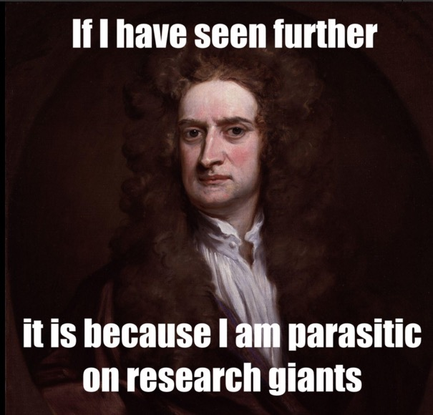

Slide 29
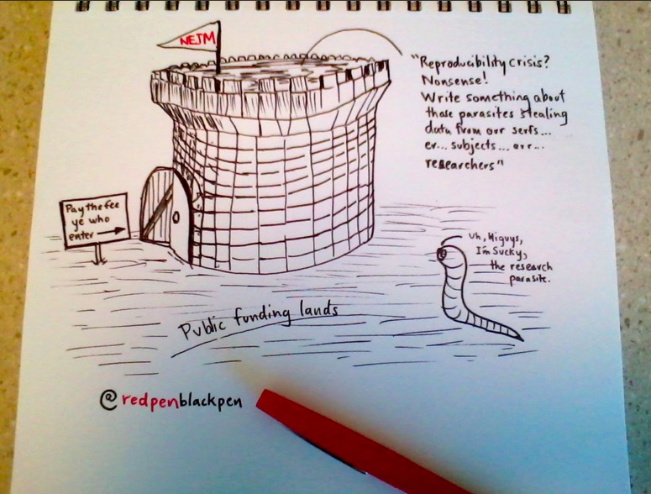

Slide 30
Should all Data be Open?

Slide 31
