Slide 1

Data Collection & Entry

Slide 2
Creating a Good Data Gathering Sheet
How easy is it to read?
Are column and row definitions clear?
Is there metadata?
How similar is it to your digital data entry form?
Can you use it at 4am?

Slide 3
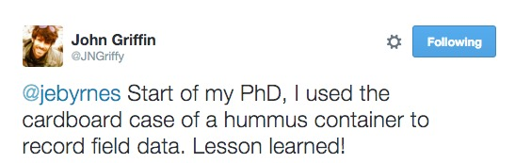

Slide 4
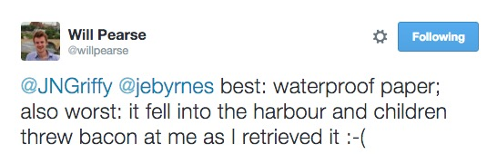

Slide 5
The Dimensions of Data
Number of complete observations
Number of things measured per observation

Slide 6
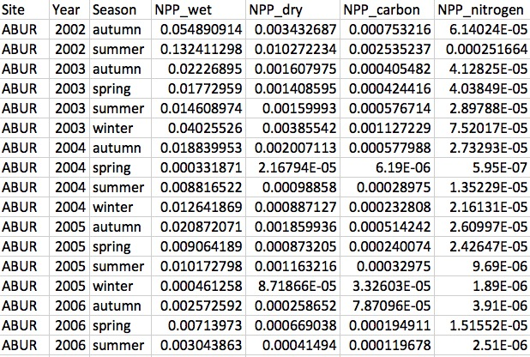
Wide Data
One Observation per row
All data fields are columns

Slide 7
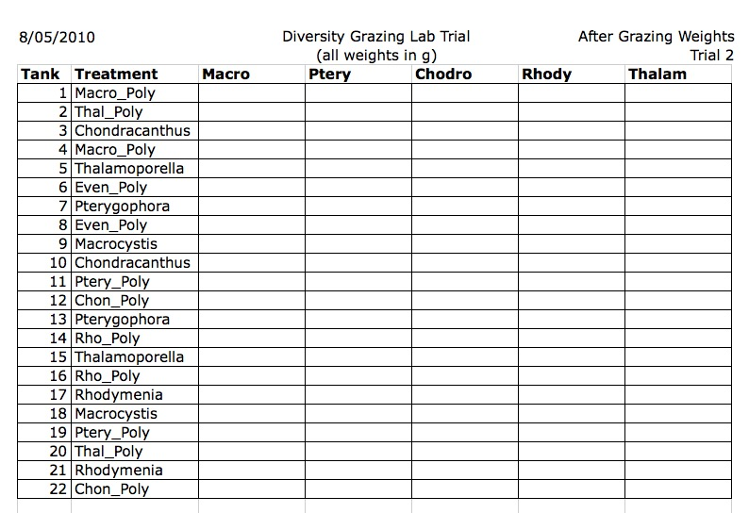

Slide 8
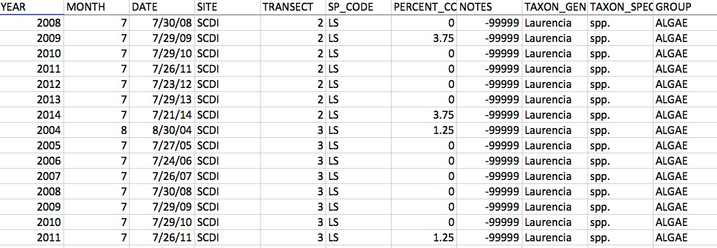
Long Data
Each measurement 1 row
All information about measurement in row

Slide 9
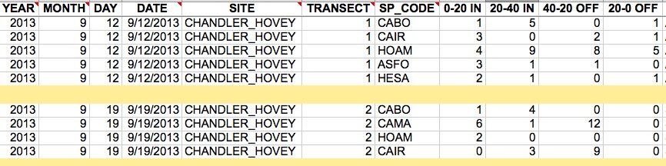
Hybrid Data
Neither long nor wide
Each row has multiple measurements…but also some unique qualities
Each row is not a complete observation

Slide 10
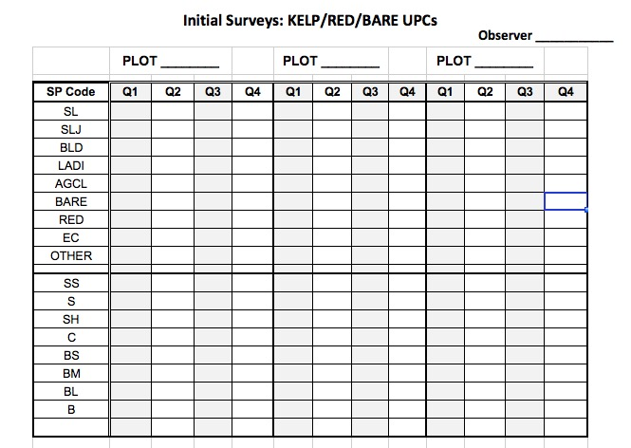
Efficiency May Drive Data Sheet Design

Slide 11
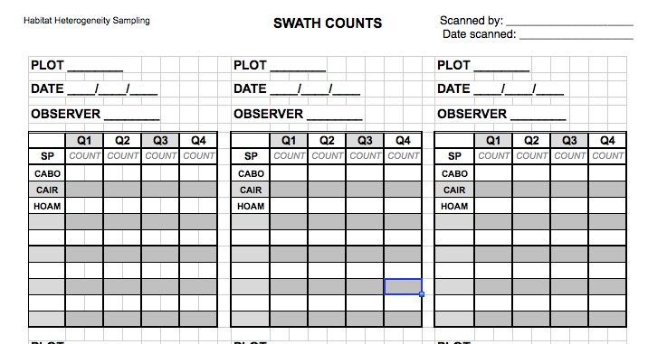
Efficiency May Drive Data Sheet Design

Slide 12
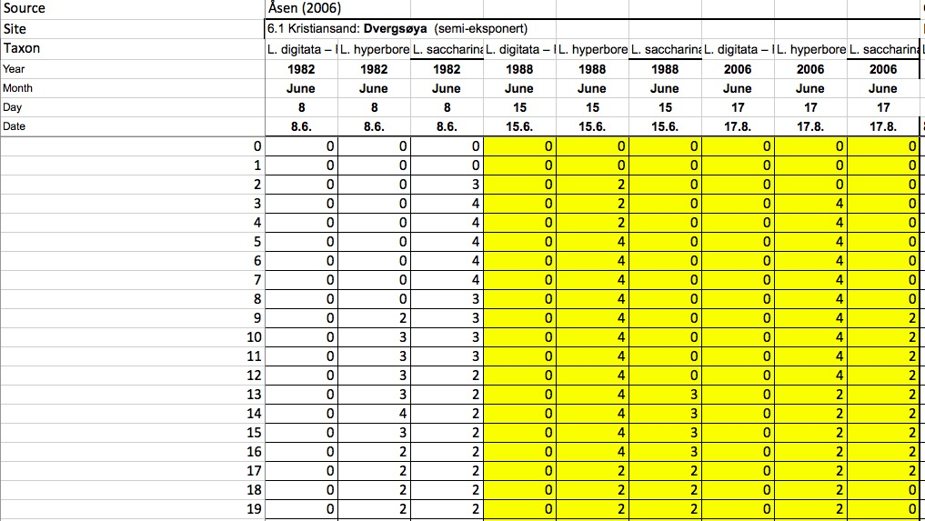
Is this wide, long, other, or bad?

Slide 13
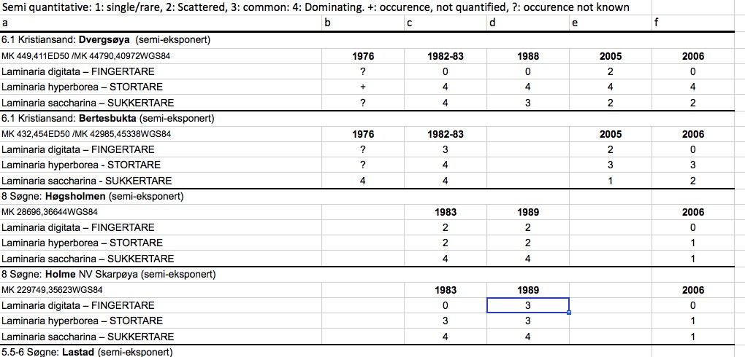
What is bad practice here?

Slide 14
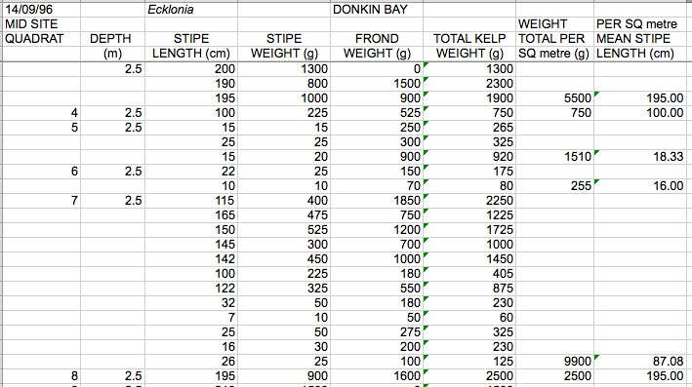
What is wrong here?

Slide 15
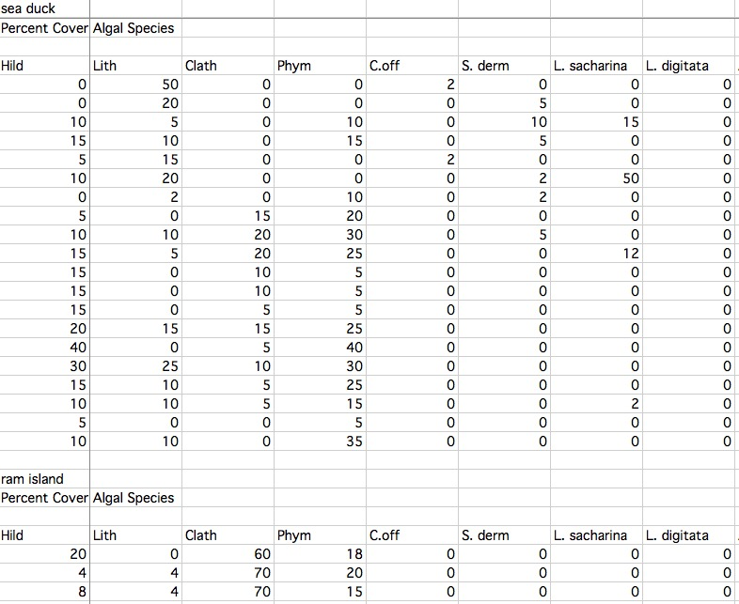
What is bad practice here?

Slide 16
General Rules for Good Data Creation
Columns should have only 1 type of data
Keep metadata separate or repeated
No bare space
Consistent NA character
Others?

Slide 17
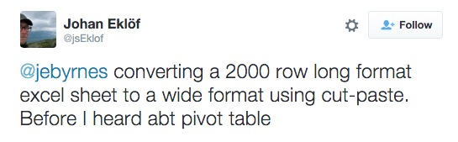
EXCEL TIME!

Slide 18
EXCEL TIME!
Entry
Fills
Basic Functions
Functions for Error Checking
Pivot tables
Controlled Vocabularies

