Slide 1
Sampling distributions
ggplot2 + dplyr

Slide 2
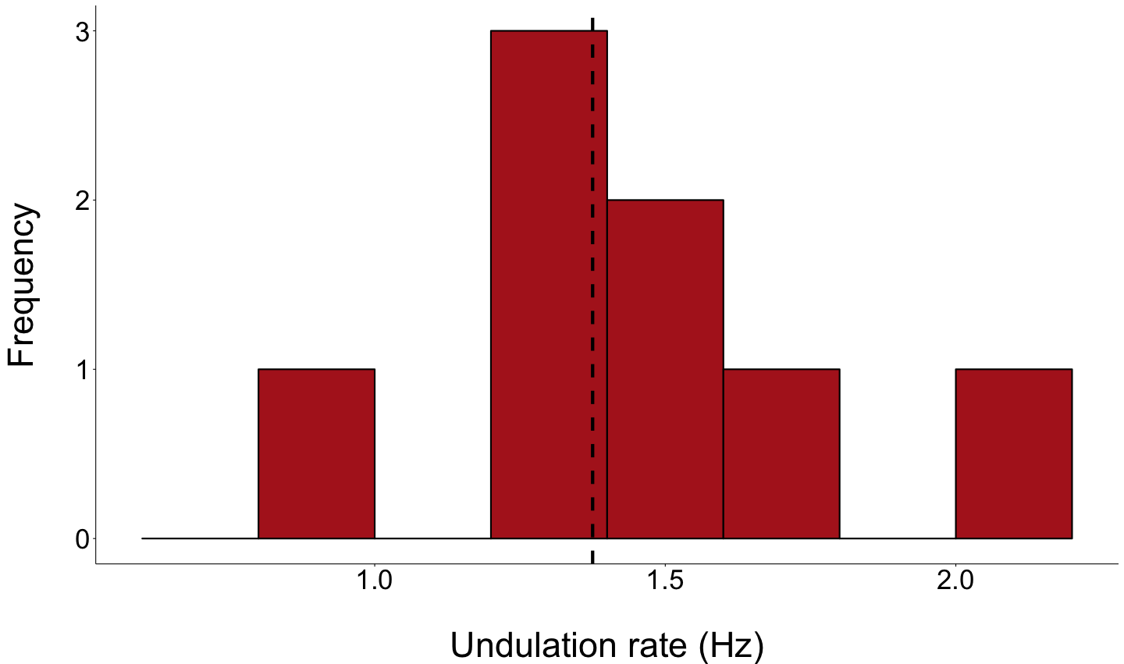
Sample Data
Notes:
Sample.

Slide 3
Sample Data
Estimates
Notes:
Sample.

Slide 4
Sample Data
Estimates
Mean = 1.375 Hz
Std Dev = 0.324
Notes:
Sample.

Slide 5
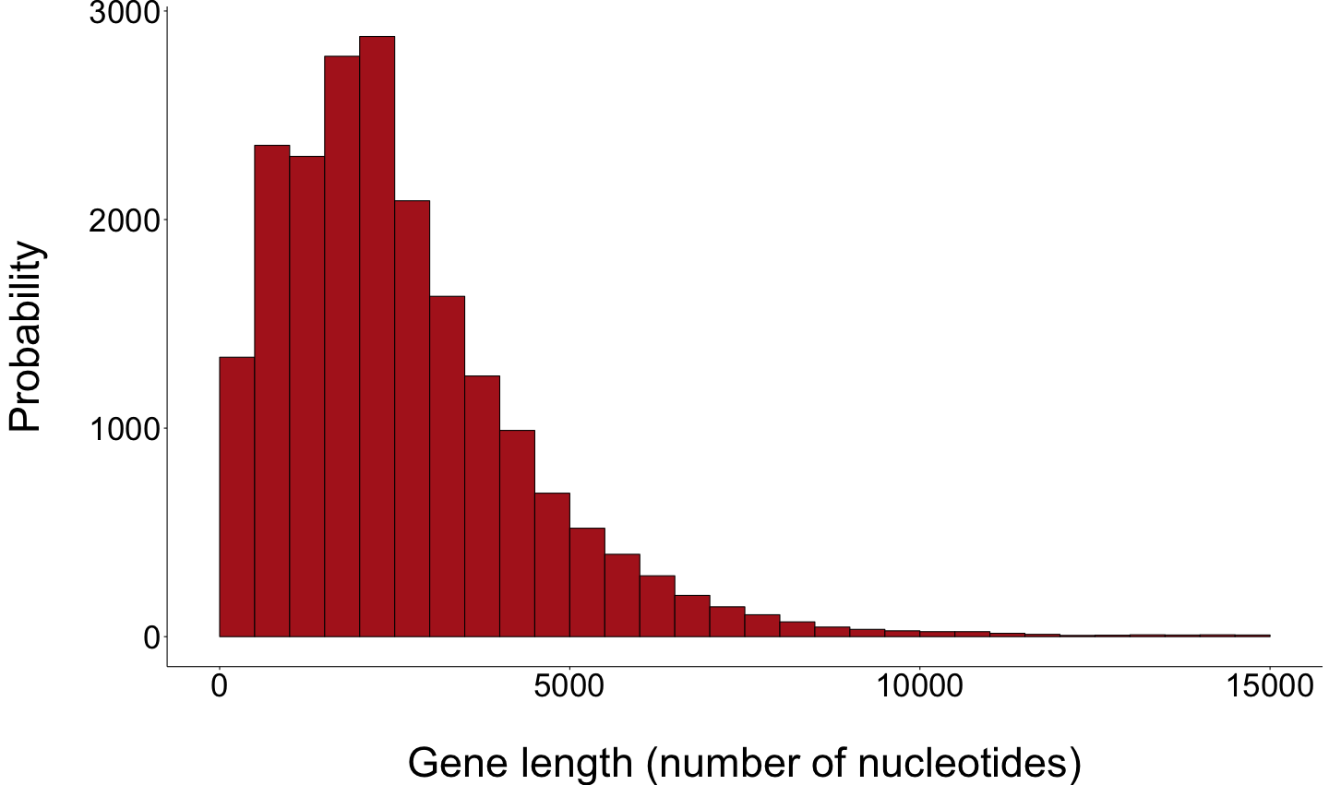
Population Data

Slide 6

Population Data
Parameters
Mean = 2622.0
Std Dev = 2036.9

