Slide 1

Modular Iterative Code

Slide 2
Modularity
Many of you wrote two functions
read_buoy()
format_buoy()
buoy_1986 <- format_buoy(read_buoy(1986))
This is the beginning of MODULAR CODE

Slide 3
Why write in Modules?
Each function should do one thing, and do it well
Easier to debug
Modular code means that individual functions can be used in many places
Flexible
Modular code allows you to organize your thought process

Slide 4
Think Before You Code: Modularity Edition
Ask yourself, what do I want to do
Start at the highest level
This is your ‘wrapper function’
Then break it down into sub-functions

Slide 5
Think Through Your Plan
Read in a file based on year
Standardize file format
for between year differences
Take that data frame and format it
Return formatted data frame

Slide 6
Turn Your Plan Into a Function
make_buoy_data <- function(a_year){
Read in a file based on year
Standardize file format
for between year differences
Take that data frame and format it
Return formatted data frame
return(buoy_data)
}

Slide 7
Write Functions for Each Step
make_buoy_data <- function(a_year){
Read in a file based on year
buoy_data <- read_buoy(a_year)
Standardize file format
for between year differences
buoy_data <- standardize_buoy(buoy_data )
Take that data frame and format it
buoy_data <- format_buoy(buoy_data )
Return formatted data frame
return(buoy_data)
}

Slide 8
read_buoy
read_buoy <- function(a_year){
#make a filename
filename <- paste0("./buoydata/44013_",
a_year, ".csv")
#read in the file with that name
a_buoy <- read.csv(filename,
na.strings = c("99", "999"))
#return the resulting data frame
return(a_buoy)
}

Slide 9
standardize_buoy
If year < 1999
Column name changes from YYYY or X.YY to YY
need to add 1900 to year
If year > 2005, we need to eliminate row 2, and make sure our columns of interest are numeric

Slide 10
standardize_buoy <- function(buoydata){
#make sure the year column is called YY
names(buoydata) <- gsub("X.YY", "YY", names(buoydata))
names(buoydata) <- gsub("YYYY", "YY", names(buoydata))
#If the year > 2005, remove the second row
if(as.numeric(buoydata$YY[1])>2005) buoydata <- buoydata[-1,]
#Make sure our columns of interest are numeric
buoydata <- buoydata %>%
mutate(YY = as.numeric(YY),
MM = as.numeric(MM),
DD = as.numeric(DD),
WTMP = as.numeric(WTMP),
WVHT = as.numeric(WVHT))
#make sure the years all are in the thousands
if(buoydata$YY[1]<1999) buoydata$YY <- buoydata$YY + 1900
return(buoydata)
}

Slide 11
format_buoy
You’ve done this…
format_buoy <- function(buoydata){
buoydata <- buoydata %>%
select(YY, MM, DD, WVHT, WTMP) %>%
rename(Year = YY,
Month = MM,
Day = DD,
Wave_Height = WVHT,
Temperature_c = WTMP) %>%
group_by(Year, Month, Day) %>%
summarise(Wave_Height = mean(Wave_Height, na.rm=T),
Temperature_c = mean(Temperature_c, na.rm=T)) %>%
ungroup()
return(buoydata)
}

Slide 12
Your Wrapper Function!
make_buoy_data <- function(a_year){
Read in a file based on year
buoy_data <- read_buoy(a_year)
Standardize file format
for between year differences
buoy_data <- standardize_buoy(buoy_data )
Take that data frame and format it
buoy_data <- format_buoy(buoy_data )
Return formatted data frame
return(buoy_data)
}

Slide 13
Putting it All together
OK, now I have a set of functions
But I have a LOT of years!
What now?

Slide 14
The for loop
for(i in 1:100){
print(i)
}

Slide 15
The for loop
a_vec <- 201:500
for(i in 1:100){
print(a_vec[i])
}

Slide 16
The for loop
a_vec <- rnorm(100)
for(i in 1:100){
print(a_vec[i])
}

Slide 17
The for loop
a_vec <- 201:500
i_vec <- round(runif(50, min = 1, max = 300))
for(i in i_vec){
print(a_vec[i])
}

Slide 18
Fibonacci
fib_vec <- c(1,1)
for(i in 3:20){
fib_vec[i] <- fib_vec[i-1] + fib_vec[i-2]
}
fib_vec

Slide 19
The For Loop
For loops let us iterate
We have flexibility in values we use by creating a vector to iterate over

Slide 20
For Loops and Creating Data
Create a basic data frame from the first file
Use a loop to iterate over all other files
For each file, read it in and rbind it to the growing data frame

Slide 21
Example
my_data <- read.csv(“100.csv”)
for(a_num in 101:200){
my_data <- rbind(my_data,
read.csv(paste0(a_num, “.csv”))
}

Slide 22
Try it with the buoy data!

Slide 23
buoys <- make_buoy_data(1986)
for(one_year in 1987:2013){
buoys <- rbind(buoys,
make_buoy_data(one_year))
}

Slide 24
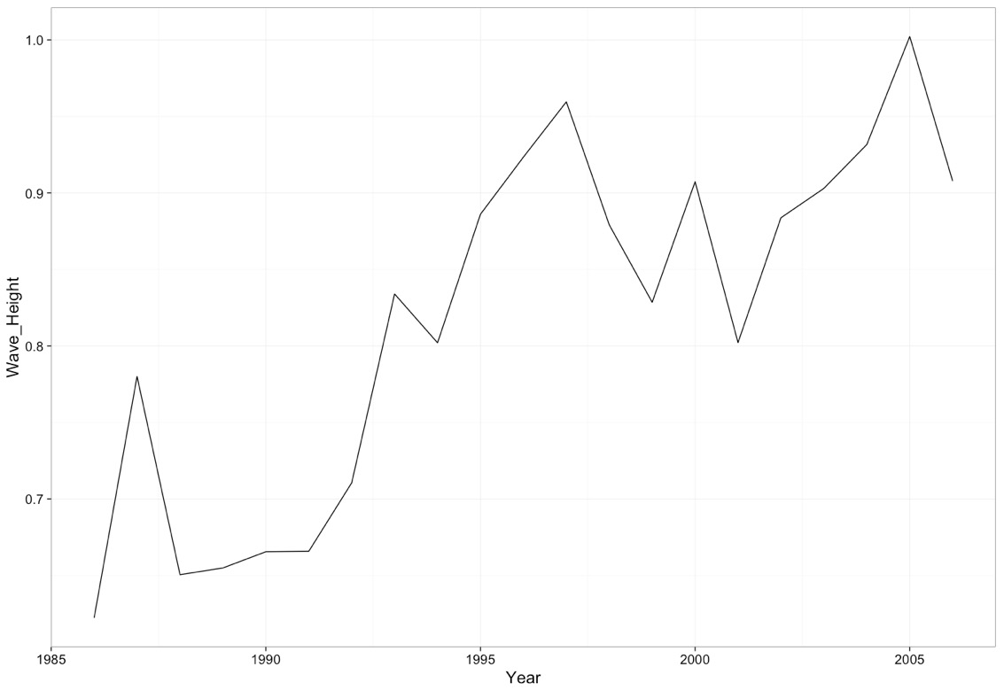
Now plot change over time!

