Slide 1
Joining Disparate Data Sets

Slide 2
Merging Data
Problem: I have two data sets
One is biological information
One is physical information
They have a common key – e.g., Lat/Long

Slide 3
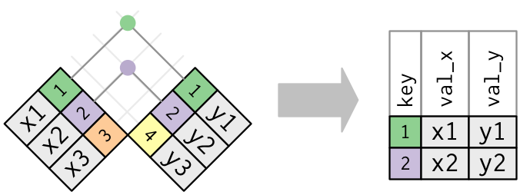
JOIN

Slide 4
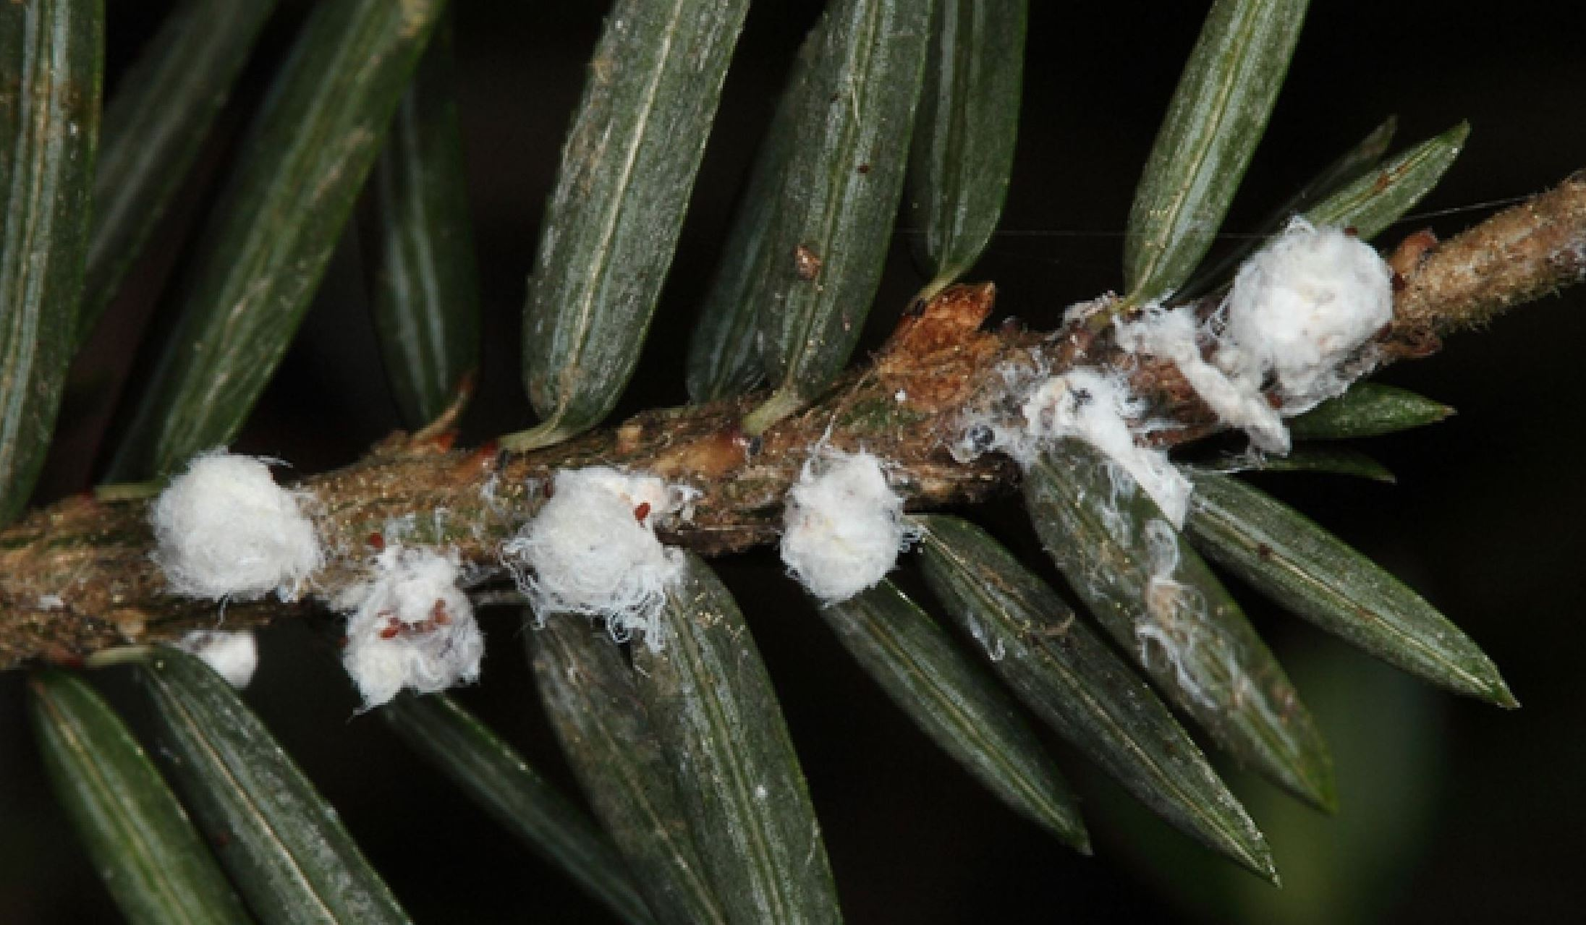

Slide 5
The data
> hemlock_data <- read_excel("./hemlock.xlsx")
> Source: local data frame [98 x 11]
> str(hemlock_data)
Classes ‘tbl_df’, ‘tbl’ and 'data.frame': 98 obs. of 11 variables:
$ Stand : chr "Athol 1" "Athol 2" "Athol 4" "Athol 6" ...
$ Year : num 2003 2003 2003 2003 2004 ...
$ Latitude : num -72.2 -72.2 -72.2 -72.2 -72.1 ...
$ Longitude : num 42.5 42.5 42.5 42.6 42.6 ...
$ Live BA : num 36.3 31.2 35.9 32.6 23 ...
$ Dead Hem BA : num 0.46 0.46 0 0 0 2.87 0 0 0 1.15 ...
$ Hem Vigor : num 1.6 1.18 1.47 1.86 1.25 1.9 1.91 1.56 1 1.81 ...
$ Hem Den : num 1450 1250 900 725 600 725 825 450 400 925 ...
$ Dead Hem Den : num 50 50 0 50 0 150 50 50 0 100 ...
$ Tree Den : num 2125 1725 1700 1100 1075 ...
$ Borer Density: num 0 0 0 0 0 0 0 0 0 0 ...-72.42921 42.32916 36.16 1.15 1.81 925 100 1225 0

Slide 6
Environmental Information
> hemlock_sites <- read_excel("./hemlock.xlsx", sheet=2)
> str(hemlock_sites)
Classes ‘tbl_df’, ‘tbl’ and 'data.frame': 111 obs. of 12 variables:
$ Stand : chr "Athol 1" "Athol 2" "Athol 3" "Athol 4" ...
$ Year : num 2003 2003 2003 2003 2003 ...
$ Mapped Code: chr "A" "A" "A" "B" ...
$ Aspect : num 213.2 357 292.5 80.5 227.5 ...
$ Slope : num 3.8 27.83 23.83 8.78 12.17 ...
$ Latitude : num -72.2 -72.2 -72.2 -72.2 -72.2 ...
$ Longitude : num 42.5 42.5 42.6 42.5 42.6 ...
$ Elevation : num 269 220 231 247 233 ...
$ Area : num 35.8 36.6 33.7 94.7 40.7 ...
$ Humus : num 9.9 5.92 5.58 6.89 3.71 5.25 7.33 12.4 6.75 8.85 ...
$ Logged : num 1 1 1 1 1 1 1 0 1 1 ...
$ Rand : num NA NA NA NA NA NA NA NA NA NA ...

Slide 7
The problem
> nrow(hemlock_data)
[1] 98
> nrow(hemlock_sites)
[1] 111

Slide 8
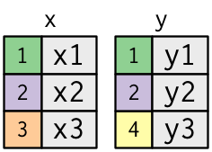
Mismatched Data Sets with Common Keys

Slide 9
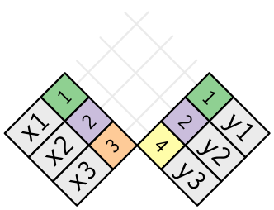
Mismatched Data Sets with Common Keys

Slide 10
Inner Join
Creates new Data with rows that exist in both data sets

Slide 11
Reducing Data in Inner Joins
> hem_inner <- inner_join(hemlock_data,
hemlock_sites)
Joining by: c("Stand", "Year", "Latitude", "Longitude")
> nrow(hemlock_data)
[1] 98
> nrow(hemlock_sites)
[1] 111
> nrow(hem_inner)
[1] 87

Slide 12
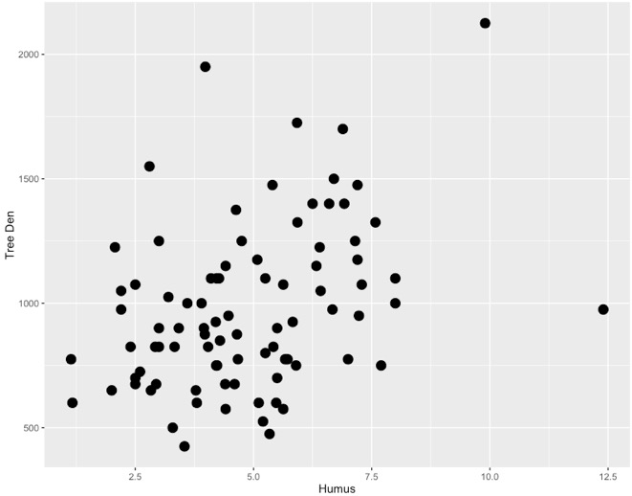
Plotting Paired Data

Slide 13
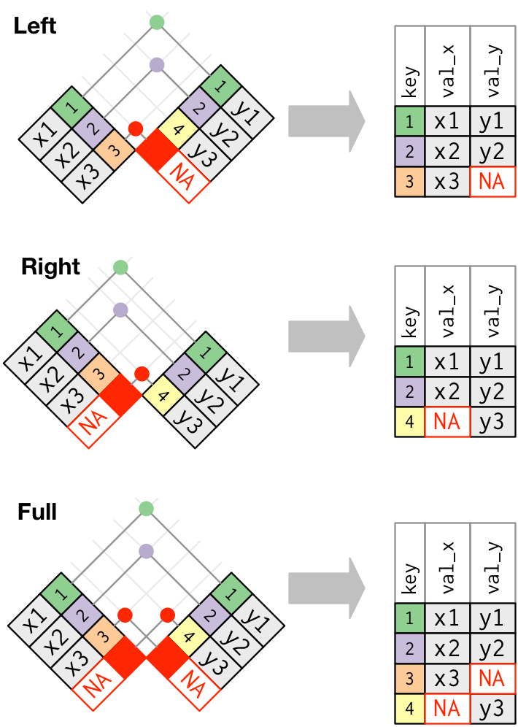
Outer Joins

Slide 14
Left Join: Retain Rows with NAs in First Dataset
Good when too much descriptive information available
> hem_left <- left_join(hemlock_data, hemlock_sites)
Joining by: c("Stand", "Year", "Latitude", "Longitude")
> nrow(hem_left)
[1] 98

Slide 15
Right Join: Retain Rows with NAs in Second Dataset
Good when you second dataset contains key information, and first is ancillary
> hem_right <- right_join(hemlock_data, hemlock_sites)
Joining by: c("Stand", "Year", "Latitude", "Longitude")
> nrow(hem_right)
[1] 111

Slide 16
Full Join: Bring it All Together
Good when you want to see the full dataset
> hem_full <- full_join(hemlock_data, hemlock_sites)
Joining by: c("Stand", "Year", "Latitude", "Longitude")
> nrow(hem_full)
[1] 122

Slide 17
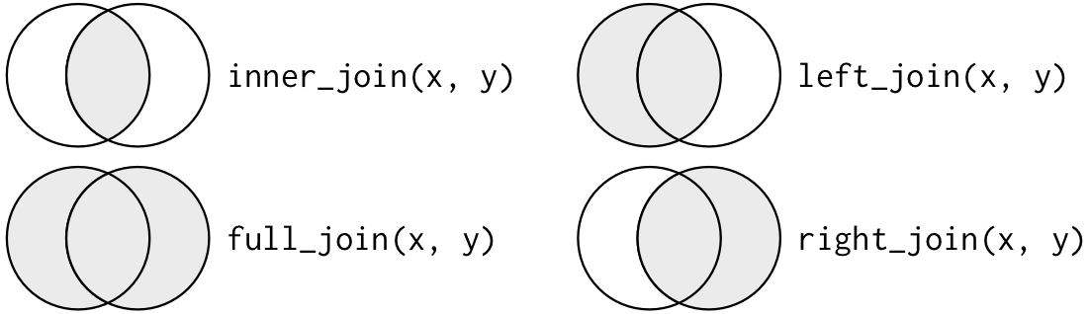
The Joins

Slide 18
Filtering Joins
I only want data that matches a set of criteria
Like outer joins with a second na.omit step

Slide 19
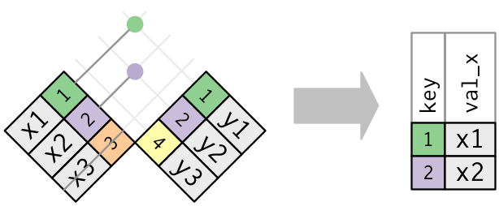
Semi Join: X %in% Y
Good before data pre-processing
> hem_semi <- semi_join(hemlock_data, hemlock_sites)
Joining by: c("Stand", "Year", "Latitude", "Longitude")
> nrow(hem_semi)
[1] 87

Slide 20
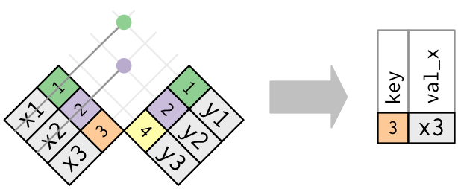
Anti Join: X NOT %in% Y
Good for diagnosing data mismatch
> hem_anti <- anti_join(hemlock_data, hemlock_sites)
Joining by: c("Stand", "Year", "Latitude", "Longitude")
> nrow(hem_anti)
[1] 11

Slide 21
Exercise 1
You want to plot a map of the sites
You want size of points to be area
You want color of points to be dead Hemlock area

Slide 22
Exercise 2
You want to plot a map of the sites
BUT – you want to show which sites are missing environmental data
AND – you want to show which sites are missing biological data
(this might be more than one plot and more than one data join!)

