Slide 1

Differences Between Two Groups

Slide 2

Statistical Golems (sensu Richard McElreath)
ravenscar45

Slide 3
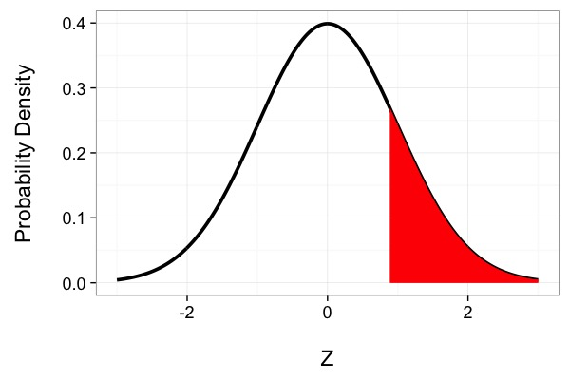
This is a Golem
What is my data generating process?
What is my error generating process?

Slide 4
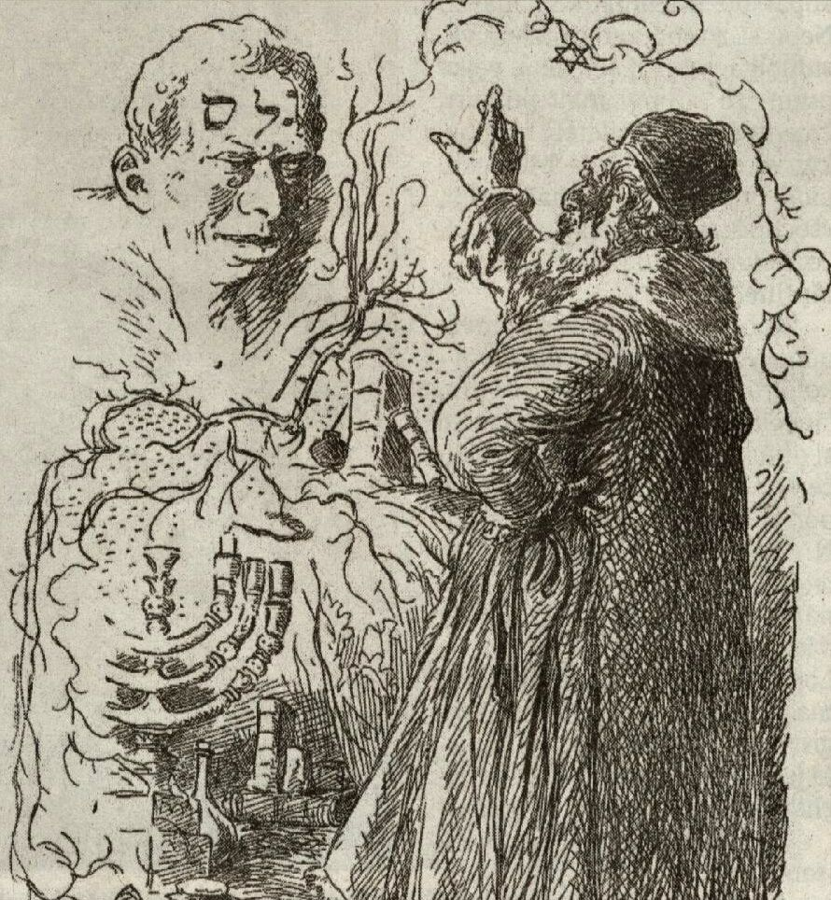
What Drives My Golem?
Assumption about Population
Drawn from Data
Assumption about Population
Drawn from Data

Slide 5
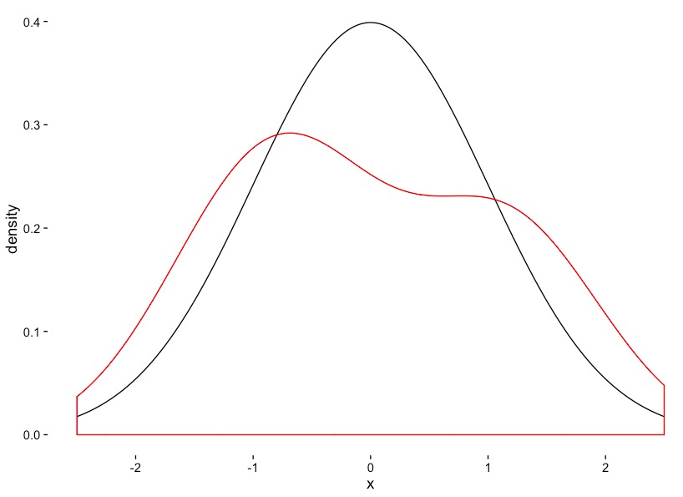
Is this a Good Golem for Realistic Sample Sizes?
Golem
N=5
Data

Slide 7
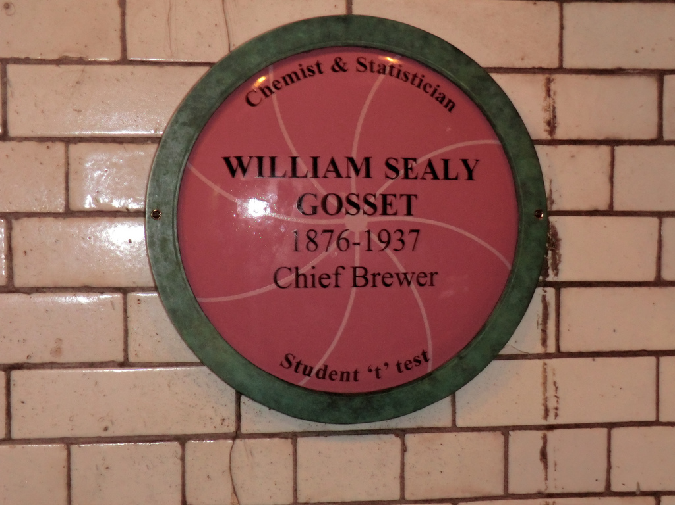

Slide 8
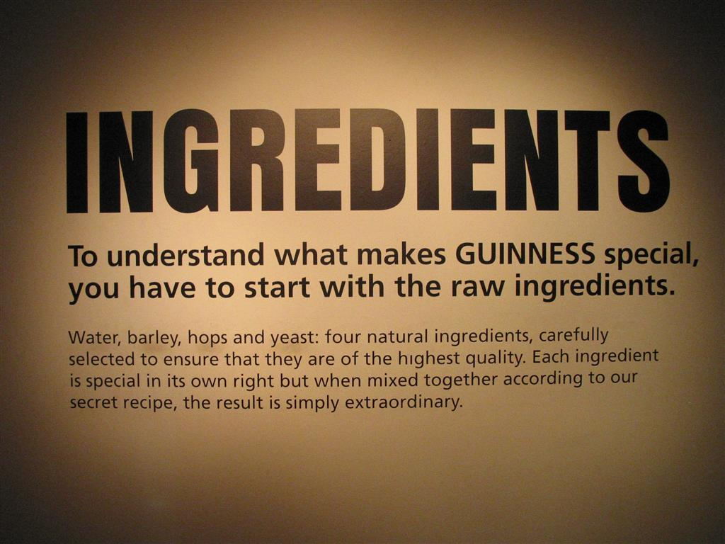

Slide 9
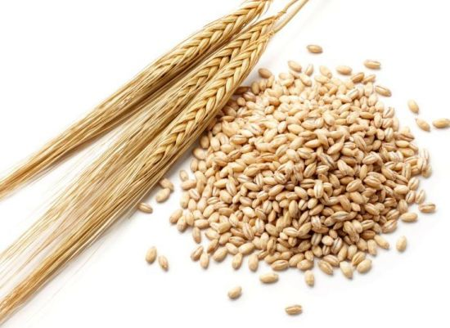
Does This Farm Produce Barley at the Right Moisture?
The Standard
N=5
Barley

Slide 10
What Does My Golem Know?
Assumption about Population
Drawn from Data
Drawn from Data
Drawn from Data
Evaluate against T Distribution with n-1 Degrees of Freedom

Slide 11
T Versus N
A Normal Distribution is defined by a mean and a SD
A T-Distribution assumes a mean of 0, a SD of 1, but changes shape based on its Degrees of Freedom

Slide 12
Degrees of What?
Let’s say you estimate a mean
Mean = (x1 + x2 + x3)/3
If you know the mean, x1, and x2, you can calculate x3
How much unique information is there in calculating a parameter?

Slide 13
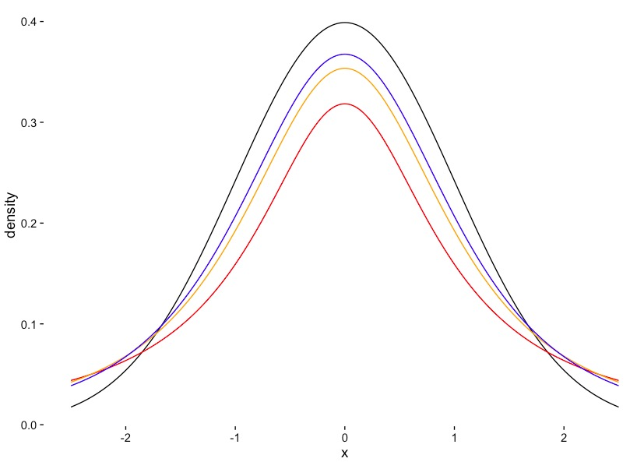
T Distribution Versus Normal
Normal
3DF
2DF
1DF

Slide 14
Comparing Paired Groups H₀: Difference = 0
Drawn from Data
Drawn from Data
Drawn from Data
Evaluate against T Distribution with n-1 Degrees of Freedom
N is the sample size per group

Slide 15

Testosterone and Birds

Slide 16
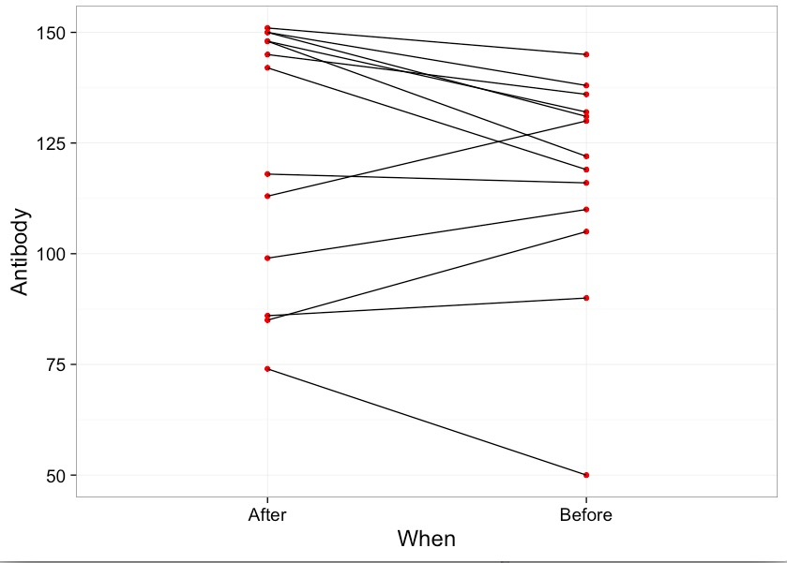
Differences in Antibody Performance

Slide 17
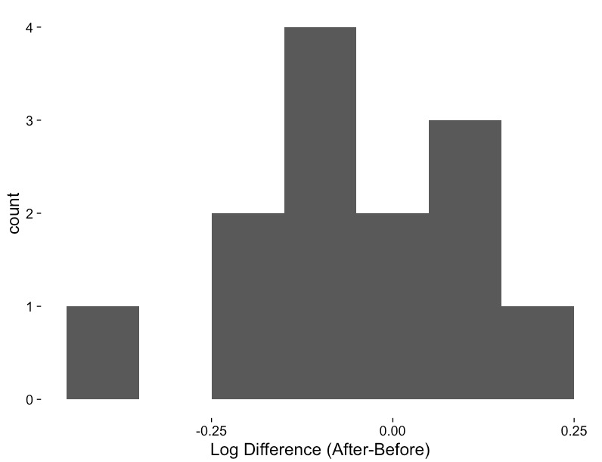
Is the Log Difference Different from 0?

Slide 18
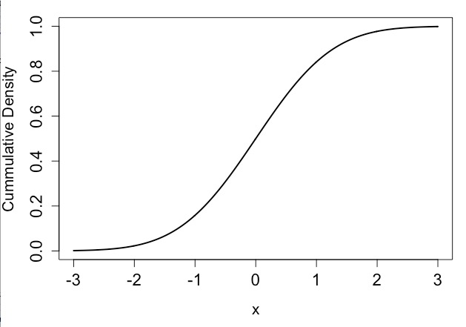
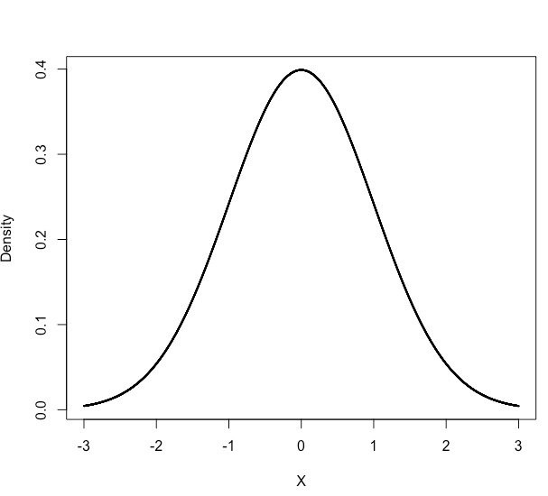
One Way to Evaluate If Your Golem is Good: Quantiles

Slide 19
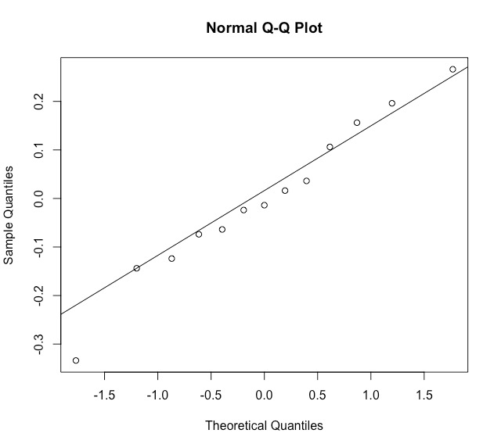
QQ Plot to Evaluate If Residuals are Normal
From Residuals
Line
From a Normal Distribution

Slide 20


QQ Plot to Evaluate If Residuals are Normal

Slide 21
General Testing Workflow
Build a Test
Evaluate Assumptions of Test
Evaluate Results
Visualize Results

Slide 22
Comparing Groups H₀: Difference = 0
Pooled Sample SD = √(s₁ + s₂)
Evaluate against T Distribution with n-1 Degrees of Freedom
N is the sample size per group
Assumes equal sample size and equal variance of populaitons

Slide 23
Troubleshooting Your Golem
Unequal Sample Sizes
Alternate Formula for Denominator
Unequal Population Variances
Welch’s T-Test (different denominator and DF)
Residuals Not Normal
Transform
Non-Parametric Test
Golem with a different error structure

