Slide 1
Document quality is the first pipeline gate
Task 4 · Context and objective
Image capture
Quality gate
Further processing
document photo
→
GOOD / BAD
→
OCR / extraction
Dataset and evaluation protocol
1,260
270
270
Training · 70%
Validation · 15%
Test · 15%
1,800 synthetic variants from 300 source documents · defects: blur, glare, skew, occlusion, exposure
Lab 06 · Document quality classification | Experiment: 25 Oct 2026 | Seed 2473986
1/4
Notes:
We classify images as good or bad before downstream processing. The dataset has 1,800 synthetic images from only 300 source documents, partitioned by source to avoid variants leaking across train, validation and test. The positive class is bad.

Slide 2
Comparison: accuracy, cost and training
Original results · same held-out test set (270 images)
Model
Test accuracy
Macro F1
CPU latency
Size (MiB)
MobileNetV2
99.63%
0.9963
37.69 ms
11.06
EfficientNetB0
98.89%
0.9889
56.69 ms
18.14
YOLOv8n-cls
98.89%
0.9889
26.97 ms
2.83
YOLOv8s-cls
99.26%
0.9926
51.07 ms
9.78
Actual epochs run: MobileNetV2 15 · EfficientNetB0 15 · YOLOv8n 11 · YOLOv8s 7
CPU latency — lower is better
MobileNetV2
37.69 ms
EfficientNetB0
56.69 ms
YOLOv8n
26.97 ms
YOLOv8s
51.07 ms
Lab 06 · Document quality classification | Experiment: 25 Oct 2026 | Seed 2473986
2/4
Notes:
All models were measured on the same held-out test split. MobileNetV2 had the highest observed accuracy, but YOLOv8n was the fastest passing the predeclared validation and cost criteria. We recorded the actual epochs: 15, 15, 11 and 7. CPU latency excludes file loading.

Slide 3
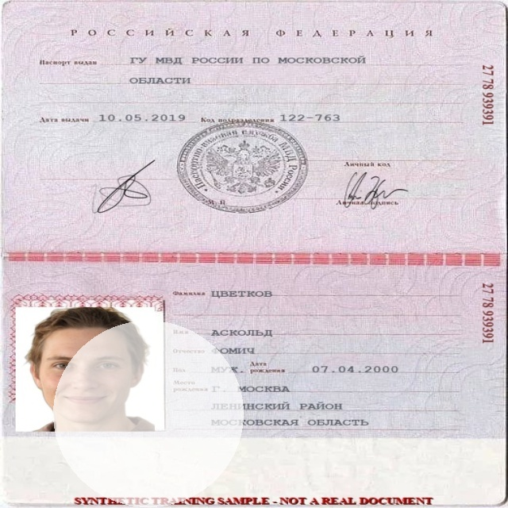
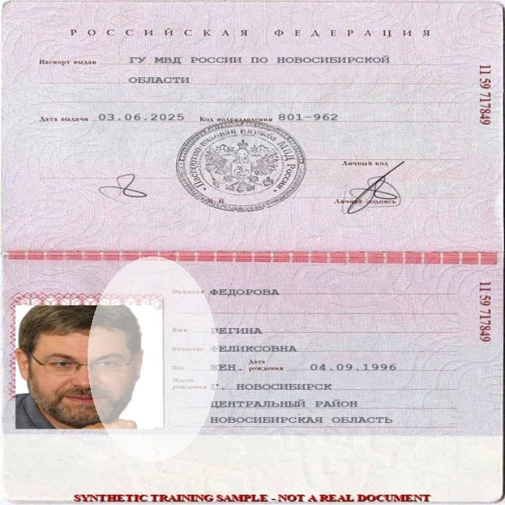
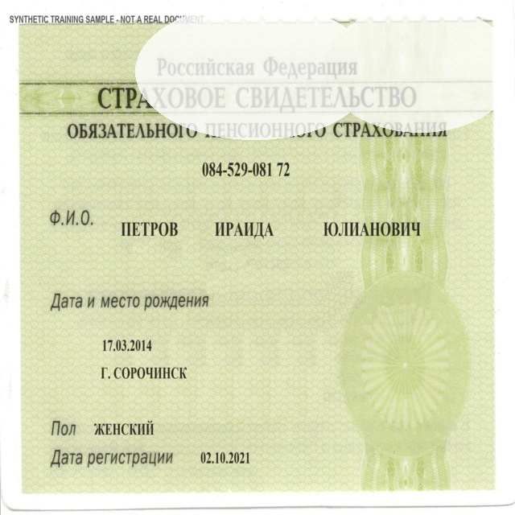
Failure analysis: glare is the hardest defect
True observed test mistakes · YOLOv8n-cls
Passport · glare
Passport · glare
SNILS · glare
P(bad) = 0.003
P(bad) = 0.029
P(bad) = 0.201
True BAD → Predicted GOOD
True BAD → Predicted GOOD
True BAD → Predicted GOOD
3 false accepts · Glare recall 25/28 = 89.29% · Train-only glare augmentation is a possible next experiment
Lab 06 · Document quality classification | Experiment: 25 Oct 2026 | Seed 2473986
3/4
Notes:
The three pictures are authentic misclassified test examples. All errors across our four classifiers involved glare. YOLOv8n missed three of 28 bad glare cases, while correctly detecting other defect types in this small synthetic test set. We must not fabricate two additional errors just to reach five examples.

Slide 4
Decision: YOLOv8n-cls, with documented risks
Provisional recommendation under the recorded validation/cost policy
98.89%
26.97 ms
2.83 MiB
Test accuracy
CPU / image
Checkpoint size
Why this model?
Risks & mitigation
Lowest measured CPU latency among candidates that passed the predeclared validation and artifact-size gates. MobileNetV2 is the stronger accuracy alternative.
Glare false accepts; only 300 source documents; synthetic-to-real gap unmeasured. Collect real captures, improve glare training, validate on fresh holdout.
Transparent setup disclosure
Teacher: 50 epochs / batch 32 / patience 5 / YOLO 640. Actual run: 15 / 16 / 4 / 224.
Lab 06 · Document quality classification | Experiment: 25 Oct 2026 | Seed 2473986
4/4
Notes:
We selected YOLOv8n as a provisional quality gate because it was the fastest candidate satisfying our validation and cost targets, although MobileNetV2 scored higher on this test set. Glare and synthetic-to-real transfer are key risks. Our actual run settings differed from the later detailed instructor specification; we disclose that instead of changing recorded results. We can follow the instructor settings in a new run if required.

