Slide 1
Document quality classification
Lab 06
Model selection on a small synthetic dataset
Seed 2473986
25 October 2026
01
Notes:
Suggested time: 20 seconds.
This lab compares four pretrained image classifiers for a document-quality gate. The task is to accept usable images and catch defective captures before further processing. I use a grouped holdout and a validation-based selection rule, then characterize the chosen model on the test set.

Slide 2
Dataset and source-level split
1,800 images from 300 source documents
Partition | Images | Sources | Good / bad
Training | 1,260 | 210 | 630 / 630
Validation | 270 | 45 | 135 / 135
Test | 270 | 45 | 135 / 135
INN, passport and SNILS
All variants of each source stay in one partition
02
Notes:
Suggested time: 40 seconds.
The dataset contains eighteen hundred synthetic images from three hundred source documents. Each source produces three good and three bad variants. The source document is the split unit, so variants of the same document cannot appear in training and test. The exact split is seventy, fifteen and fifteen percent, stratified by document family. The held-out test contains only forty-five independent source documents, so its two hundred and seventy images are correlated.
Sources: results/manifest.json and results/protocol.json. The review checked source IDs and recorded SHA256 values across partitions.

Slide 3
Training and input conventions
Candidate | Training regime | Base learning rate
MobileNetV2 | Frozen base, train head | 0.001
EfficientNetB0 | Frozen base, train head | 0.001
YOLOv8n / v8s | Full fine-tuning | 0.0001
Whole RGB image, 224 × 224, batch 16
Maximum 15 epochs, patience 4, dropout 0.3
Fixed threshold 0.5, positive class bad
03
Notes:
Suggested time: 40 seconds.
MobileNetV2 and EfficientNetB0 keep their ImageNet feature extractors frozen and train the same binary head. The two YOLO classification variants fine-tune the full model. All candidates receive the whole document at two hundred and twenty-four pixels square. Model-specific scaling stays explicit. I avoid extra cropping or erasing because it can hide or change quality defects. These are practical pipeline comparisons, with different optimization regimes, rather than a controlled architecture-only experiment.
Sources: lab06.py, config.json and model training.json files. Keras head: GAP, Dense 128 ReLU, dropout, sigmoid. MobileNet scaling −1 to 1, EfficientNet built-in rescaling from 0 to 255, YOLO tensor scaling 0 to 1. YOLO uses its recorded warm-up schedule. Architecture references are in docs/Model_Selection_Memo.md.

Slide 4
Final test results
Model | Accuracy | Precision | Recall bad | F1 bad | Misses
MobileNetV2 | 99.63% | 1.0000 | 0.9926 | 0.9963 | 1
EfficientNetB0 | 98.89% | 1.0000 | 0.9778 | 0.9888 | 3
YOLOv8n-cls | 98.89% | 1.0000 | 0.9778 | 0.9888 | 3
YOLOv8s-cls | 99.26% | 1.0000 | 0.9852 | 0.9925 | 2
270 test images: 135 good and 135 bad
All errors are false accepts of defective captures
04
Notes:
Suggested time: 40 seconds.
All four models classify every good test image correctly. Their errors are defective images accepted as good. MobileNetV2 has the highest measured test accuracy, with one error, followed by YOLO small with two. Nano and EfficientNet each miss three bad images. One image changes accuracy by about zero point three seven percentage points. These small differences on forty-five test sources do not establish a reliable general ranking. I do not select a model from this test table.
Sources: all four results/*/evaluation.json files. Precision, recall and F1 use bad as the positive class. All table values have been recomputed from saved predictions.

Slide 5
Accuracy and CPU inference cost
CPU, batch one. Resize + conversion + inference. Disk I/O and decode excluded.
05
Notes:
Suggested time: 35 seconds.
This chart combines final test accuracy with the separately measured CPU cost. Nano takes about twenty-seven milliseconds per image, MobileNet about thirty-eight, and the other two exceed the declared fifty-millisecond mean budget. Every timing uses batch one, four configured threads, twenty warm-up calls and one hundred measured calls. The scope includes preprocessing and inference on an already decoded image. The much lower GPU timings in the training logs measure a different device and scope.
Sources: results/*/evaluation.json, including the 100 raw latency samples per model. Host load and different frameworks remain limitations. Selection uses validation metrics and cost, despite the test characterization on this plot.

Slide 6
Learning curves and checkpoint choice
MobileNetV2: lowest validation loss at epoch 15
YOLOv8n: best validation fitness first at epoch 7
06
Notes:
Suggested time: 40 seconds.
MobileNet training and validation loss decrease overall, although validation fluctuates. Its best validation loss occurs at epoch fifteen. Nano also shows decreasing losses and reaches its best validation top-one accuracy first at epoch seven. Patience stops the run after eleven epochs. YOLO chooses by validation fitness, so a later improvement in loss does not necessarily replace its checkpoint. EfficientNet shows unstable late validation loss and uses its best epoch-eleven checkpoint. Top-five accuracy is uninformative for two classes.
Sources: results/mobilenetv2/history.json and results/yolov8n/results.csv. EfficientNet and YOLO small curves appear in the appendix. Loss scales and regimes differ, so compare trends within each pipeline.

Slide 7
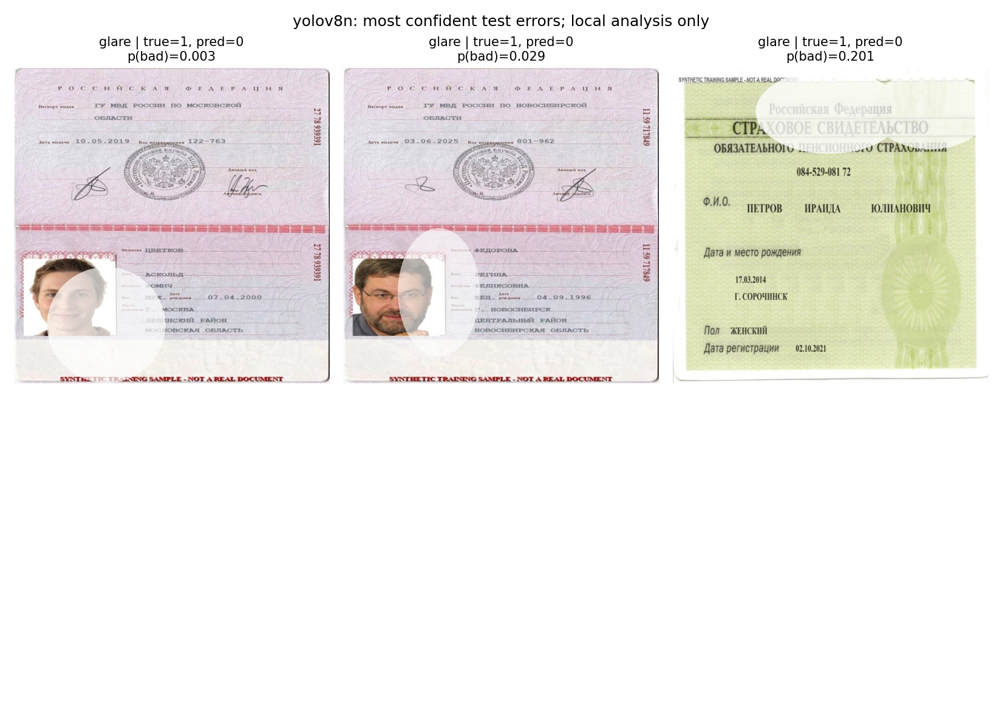
Glare causes every observed test error
YOLOv8n glare recall: 25 / 28 = 89.29%
Other measured defects: no misses in this test set
07
Notes:
Suggested time: 45 seconds.
The selected nano model misses three of the twenty-eight glare examples, so glare recall is about eighty-nine percent. It detects every measured example of the other four defects, but those subsets contain only twenty-five to twenty-nine images each. In these false accepts, glare covers part of the portrait or printed fields. One defective image receives a bad probability of only zero point zero zero three. High aggregate accuracy therefore does not guarantee a safe quality gate. This result motivates a future glare-focused experiment on fresh held-out data.
Sources: results/yolov8n/failure_gallery.png, predictions.json and results/defect_analysis.csv. The examples are synthetic training documents, as marked in their image text. The gallery is supplied evidence and remains unchanged.

Slide 8
Validation-based decision and limits
Selected candidate: YOLOv8n-cls
Validation recall bad 98.52%
Mean CPU latency 26.97 ms
Saved checkpoint 2.83 MiB
Predeclared gates
Accuracy ≥ 0.90
F1 bad ≥ 0.90
Recall bad ≥ 0.95
Mean CPU ≤ 50 ms
Checkpoint ≤ 100 MiB
300 synthetic source documents limit the conclusion.
Real-camera validation remains necessary.
08
Notes:
Suggested time: 40 seconds.
The predeclared rule selects the fastest candidate meeting all validation and cost gates. Nano passes, with validation bad recall of ninety-eight point five two percent and mean CPU latency of twenty-six point nine seven milliseconds. Its checkpoint is two point eight three mebibytes. MobileNet also passes and remains the measured alternative when accuracy matters more than the lowest latency. The other candidates exceed the mean CPU budget in this run. The numerical gates are provisional project targets. Before deployment, real captures and unfamiliar documents need separate validation. I keep the test set fixed and do not tune against these results.
Sources: results/protocol.json, decision.json and evaluation.json files. Both MobileNetV2 and YOLOv8n pass. The gates are engineering assumptions, not teacher-specified deployment requirements. The test set does not trigger reselection.

Slide 9
Appendix: size and training cost
Model | Mean CPU ms | MiB | Parameters | Train s
MobileNetV2 | 37.69 | 11.06 | 2,422,081 | 247.9
EfficientNetB0 | 56.69 | 18.14 | 4,213,668 | 272.4
YOLOv8n-cls | 26.97 | 2.83 | 1,440,850 | 232.3
YOLOv8s-cls | 51.07 | 9.78 | 5,083,298 | 176.0
Training: Tesla T4. Inference benchmark: CPU.
YOLOv8n runs 11 epochs, YOLOv8s runs 7.
09
Notes:
Suggested time: 0 seconds.
Use this table if asked about artifact size, parameter counts or total training time. Keras files can include optimizer state while YOLO strips it. Parameters describe saved unfused models. Early stopping makes total training times unequal budgets.
Sources: results/*/evaluation.json and run.log. File sizes measure practical serialized checkpoints, not identical weight formats.

Slide 10
Appendix: test confusion matrices
MobileNetV2
EfficientNetB0
True / predicted | Good | Bad
Good | 135 | 0
Bad | 1 | 134
True / predicted | Good | Bad
Good | 135 | 0
Bad | 3 | 132
YOLOv8n-cls
YOLOv8s-cls
True / predicted | Good | Bad
Good | 135 | 0
Bad | 3 | 132
True / predicted | Good | Bad
Good | 135 | 0
Bad | 2 | 133
10
Notes:
Suggested time: 0 seconds.
Rows are true labels and columns are predicted labels. Good is zero and bad is one. Every off-diagonal count is a bad image classified as good, so every observed error is a false accept.
Sources: results/*/evaluation.json. Counts independently recomputed from each saved predictions.json.

Slide 11
Appendix: additional learning curves
EfficientNetB0 best checkpoint: epoch 11
YOLOv8s best validation fitness first at epoch 3
11
Notes:
Suggested time: 0 seconds.
EfficientNet reaches its lowest validation loss at epoch eleven. Its later spikes indicate instability and possible overfitting, rather than a proven cause. YOLO small reaches its best top-one level at epoch three and stops at epoch seven. Its later loss decrease does not override the validation-fitness checkpoint rule.
Sources: results/efficientnetb0/history.json, results/yolov8s/results.csv and run.log.

