Slide 1
Industrial Surface Defect Classification
ResNet18 · Cross-Entropy versus Poly-1 · KolektorSDD2
Two complementary experimental protocols
Fixed 216-update study + 30 true full-epoch follow-up
YASSER IDBOUZKRI · иикб-24
AI Implementation Technologies · Final scope: 8 new full-epoch runs · 12 Nov 2026
1

Slide 2
Research objective and the design correction
• Binary classification: normal versus defective industrial surfaces.
• Compare two loss functions on the same pretrained ResNet18 model.
• Initial design kept optimizer updates fixed (216), not full dataset passes.
• Follow-up resolves the low-epoch concern with 30 genuine passes per model.
• The two evaluation datasets differ: results must remain separate.
AI Implementation Technologies · Final scope: 8 new full-epoch runs · 12 Nov 2026
2

Slide 3
Dataset, reproducibility and splits
• Official training pool: 2,331 images (2,085 normal; 246 defective).
• Official test pool: 1,004 images — previously inspected in older work.
• Training cohorts: 70 / 140 / 280 / 420, balanced and nested.
• Follow-up validation: same 180 unused official TRAIN images for every run.
• All source hashes checked; part-level independence remains unverified.
AI Implementation Technologies · Final scope: 8 new full-epoch runs · 12 Nov 2026
3

Slide 4
Study A: fixed optimizer updates
24 evaluation records = 4 sizes × 2 losses × 3 seeds; 70-image source archived
Training images | Optimizer updates | Equivalent full passes
70 | 216 | 12
140 | 216 | 6
280 | 216 | 3
420 | 216 | 2
Original 12 training rounds were not 12 complete epochs at sizes > 70.
AI Implementation Technologies · Final scope: 8 new full-epoch runs · 12 Nov 2026
4

Slide 5
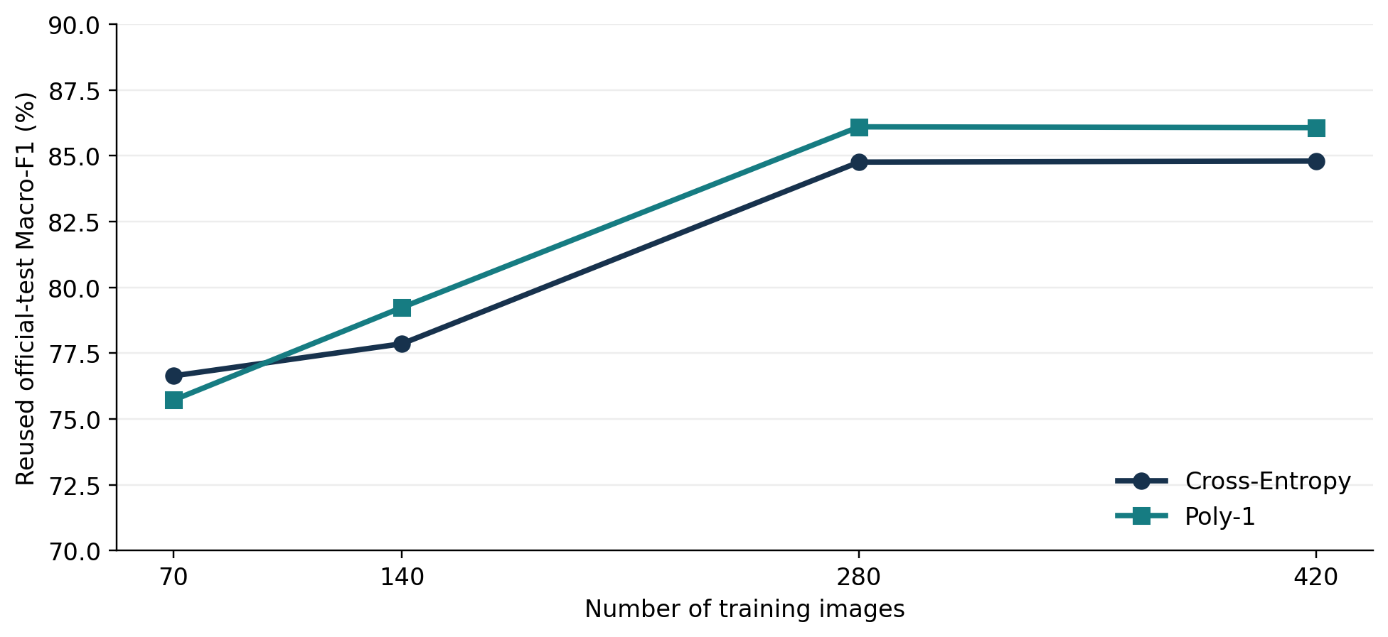
Study A: exploratory reused-test findings
Three-seed mean Macro-F1; previously inspected official test set (n = 1,004)
AI Implementation Technologies · Final scope: 8 new full-epoch runs · 12 Nov 2026
5

Slide 6
Study B: 30 complete full epochs
Eight new real trainings = 4 sizes × 2 losses × one seed (20261028)
Training images | Full epochs | Optimizer updates | Validation images
70 | 30 | 540 | 180 (same set)
140 | 30 | 1,050 | 180 (same set)
280 | 30 | 2,100 | 180 (same set)
420 | 30 | 3,150 | 180 (same set)
Checkpoint selected by best internal validation Macro-F1 — not by the official test.
AI Implementation Technologies · Final scope: 8 new full-epoch runs · 12 Nov 2026
6

Slide 7
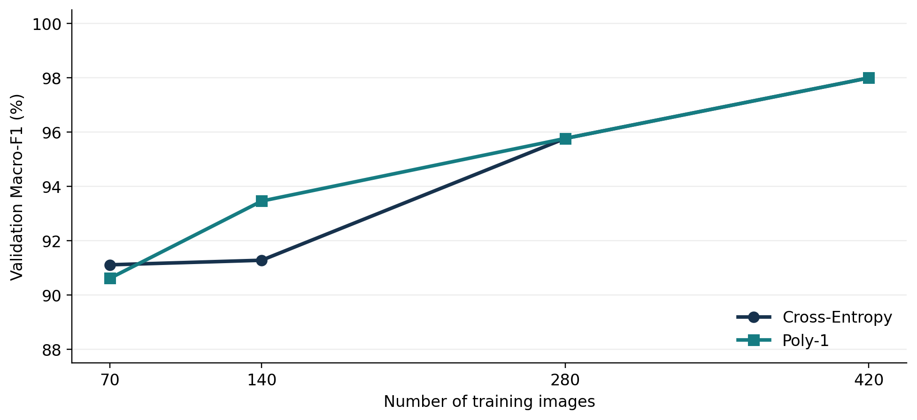
Study B: best internal validation Macro-F1
Single seed; best of 30 epochs selected per model; not blind test accuracy
AI Implementation Technologies · Final scope: 8 new full-epoch runs · 12 Nov 2026
7

Slide 8
Study B: exact eight-run results
Images | CE best epoch | CE Macro-F1 | Poly-1 best epoch | Poly-1 Macro-F1
70 | 23 | 91.12% | 19 | 90.62%
140 | 12 | 91.29% | 30 | 93.46%
280 | 7 | 95.77% | 19 | 95.77%
420 | 30 | 98.00% | 22 | 98.00%
Poly-1 wins at 140; CE wins slightly at 70; ties at 280 and 420.
AI Implementation Technologies · Final scope: 8 new full-epoch runs · 12 Nov 2026
8

Slide 9
420-image case: validation confusion matrix
True label | Predicted normal | Predicted defective
Normal | 149 | 1
Defective | 1 | 29
• Both CE and Poly-1: Macro-F1 98.00%; accuracy 178/180 = 98.89%.
• Defect recall 29/30 = 96.67%; false-positive rate 1/150 = 0.67%.
• Identical aggregate errors do not prove identical mistakes per image.
AI Implementation Technologies · Final scope: 8 new full-epoch runs · 12 Nov 2026
9

Slide 10
Interpretation and statistical limits
• Thirty full epochs were completed: the original epoch-count concern is addressed.
• More images also mean more total optimizer updates in Study B.
• Validation uses only 30 defective images; one error moves recall 3.33 pp.
• Best-of-30 selection and one seed may overstate expected performance.
• Previously inspected test data cannot serve as fresh blind validation.
AI Implementation Technologies · Final scope: 8 new full-epoch runs · 12 Nov 2026
10

Slide 11
Final conclusion
• The original 216-update study and the new 30-full-epoch study are preserved.
• Eight paired full-epoch runs are complete; no further training is required for this scope.
• At 420 images, CE and Poly-1 both achieve 98.00% best validation Macro-F1.
• Neither loss consistently outperforms the other across all four sizes.
• Independent specimen-separated testing and replicated seeds remain future work.
AI Implementation Technologies · Final scope: 8 new full-epoch runs · 12 Nov 2026
11

Slide 12
References and evidence
• He et al. (2016): Deep Residual Learning for Image Recognition.
• Leng et al. (2022): PolyLoss, ICLR.
• ViCoS: KolektorSDD2 industrial surface-defect dataset.
• Code/protocol: GitHub branch nazih-training-set-size-20261109.
• Saved checks: Google Drive Nazih_Coursework/06_Full_Epoch_Pilot.
AI Implementation Technologies · Final scope: 8 new full-epoch runs · 12 Nov 2026
12

