Slide 1
IDA Embedded Workshop
Tobias Ottsen
Nikolaj Gliese Pedersen

Slide 2
Agenda
Introduction to IoT at Dansac
ESP32 Environment
  Install Environment
  Try out http program
  Upload Image to rpi-server
Python image analysis
  Download notebook template
  Try out the offline example
BREAK
Put it all together
  Reprogram 1 esp32cam to post to a specific API
  Watch RPI perform image analysis live

Slide 3
Motivation behind the workshop

Slide 4

What are we going to see?

Slide 5
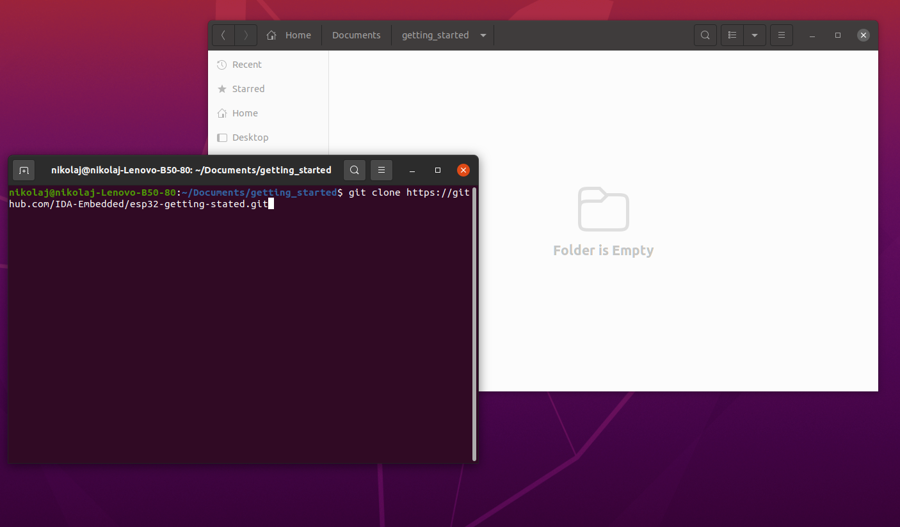
Getting started ESP32 Env
Open folder, open
terminal in folder
Write
git clone https://github.com/IDA-Embedded/esp32-getting-stated.git

Slide 6
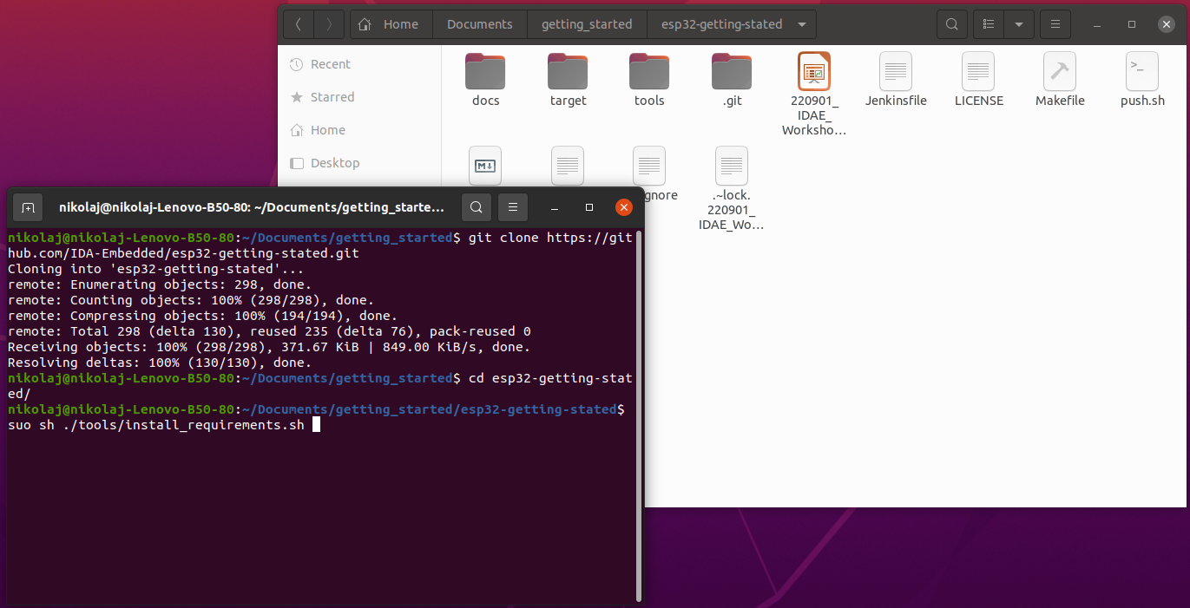
Install linux requirements
Cd into the folder
Sudo sh ./tools/install_requirements.sh

Slide 7
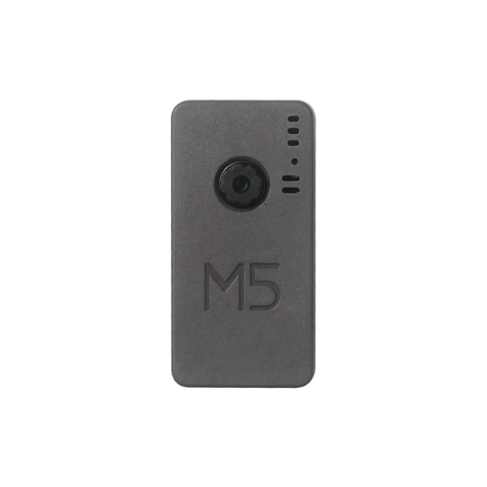
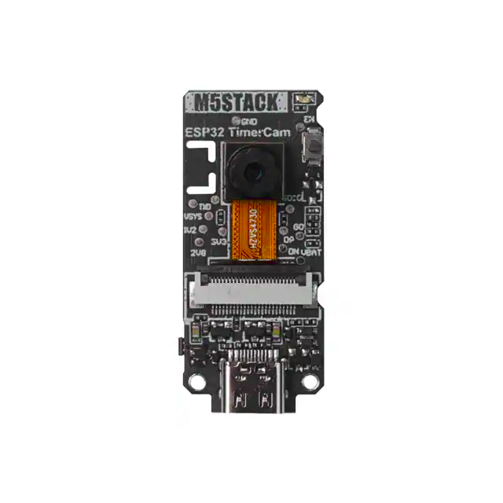
ESP32 Hardware
https://www.digikey.dk/da/products/detail/m5stack-technology-co-ltd/U082-X/13545179

Slide 8
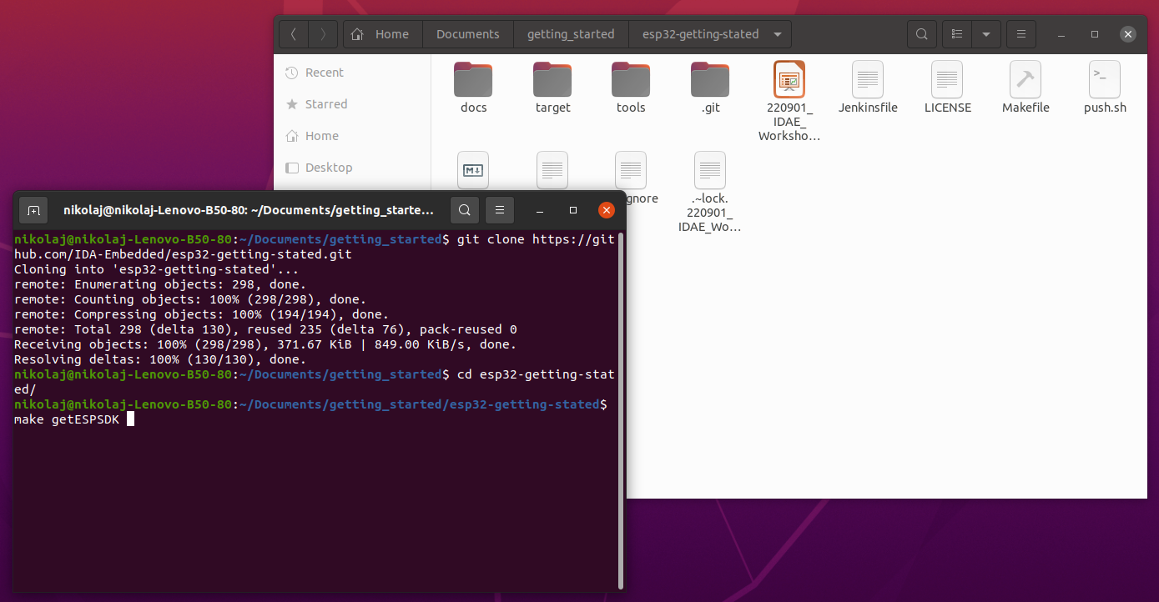
Install ESP-IDF
Write make command:
make getESPSDK

Slide 9
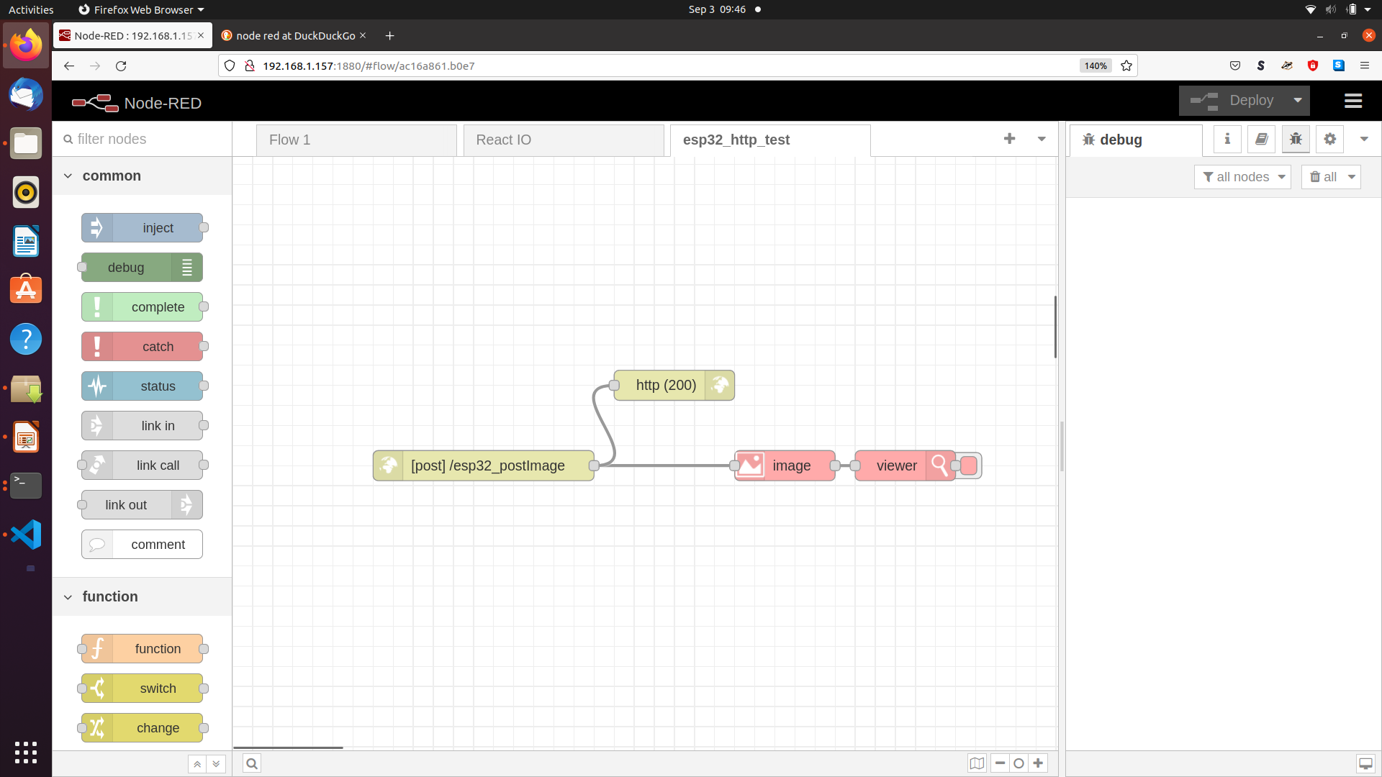
https://nodered.org/

Slide 10

Compile the project
make
BUGFIX: . /home/$USER/esp/esp-idf/export.sh

Slide 11
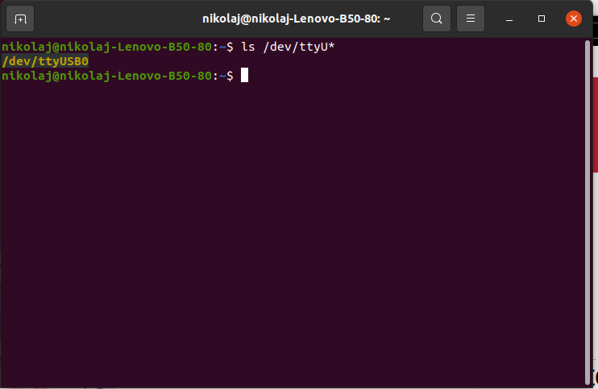
Connect esp32Cam to your computer
ls /dev/ttyU*

Slide 12
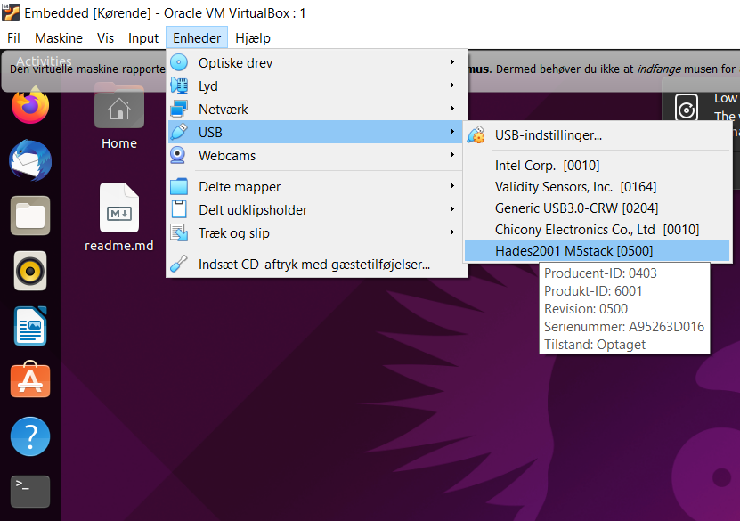
** ON VIRTUEL BOX ONLY **
Make sure to connect the esp32Cam to the virtual box’s USB

Slide 13
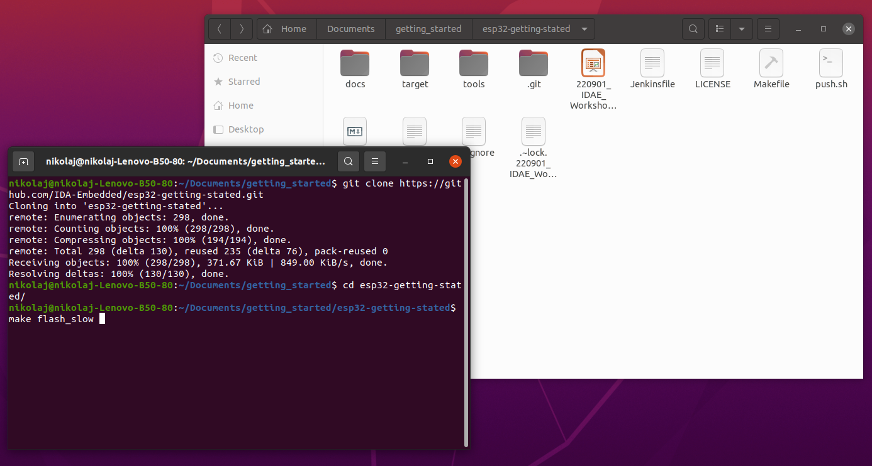
Flash to target
make flash_slow
Permission issues :
sudo usermod -a -G dialout $USER
BUGFIX: . /home/$USER/esp/esp-idf/export.sh

Slide 14
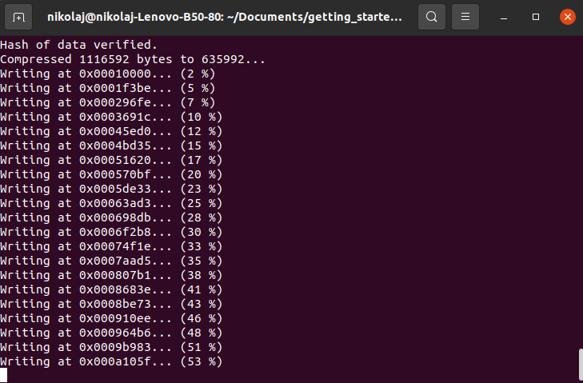
Congrats!
You should have compiled and flashed the code to the esp32camera by now

Slide 15
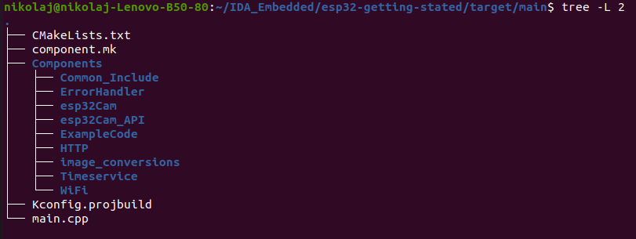
Open your code editor and lets have a look at the code

Slide 16
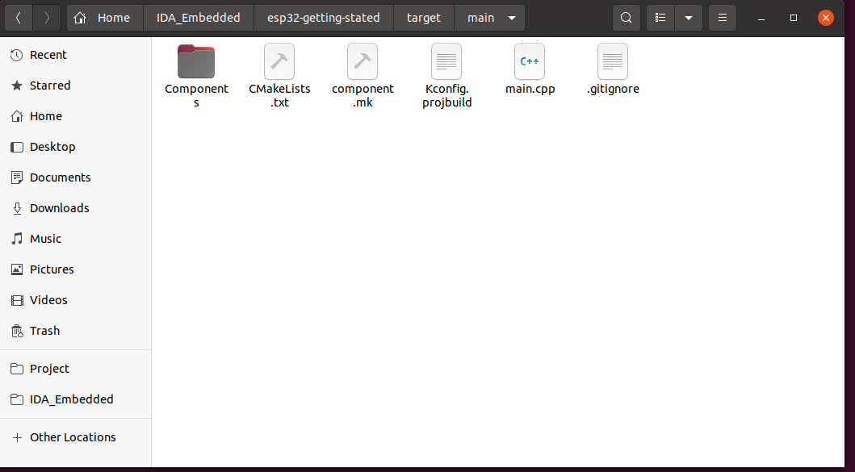
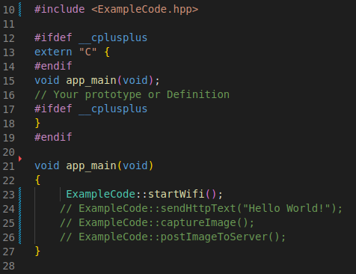
Folder structure

Slide 17
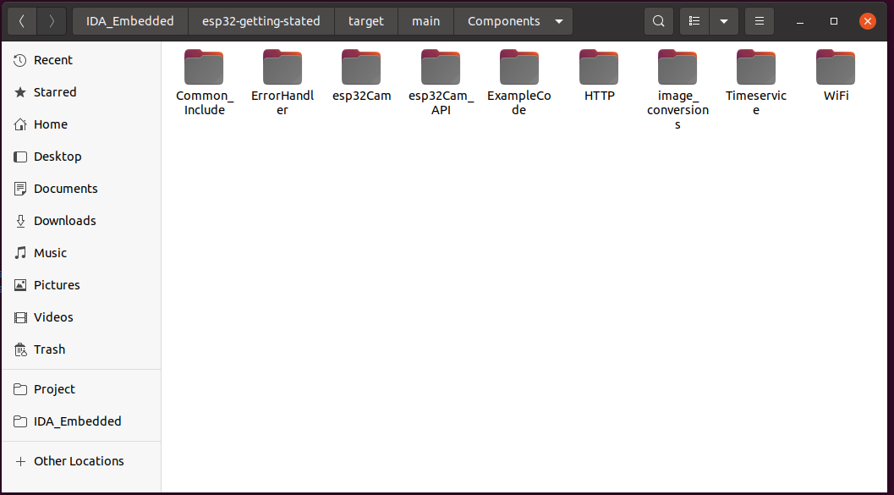
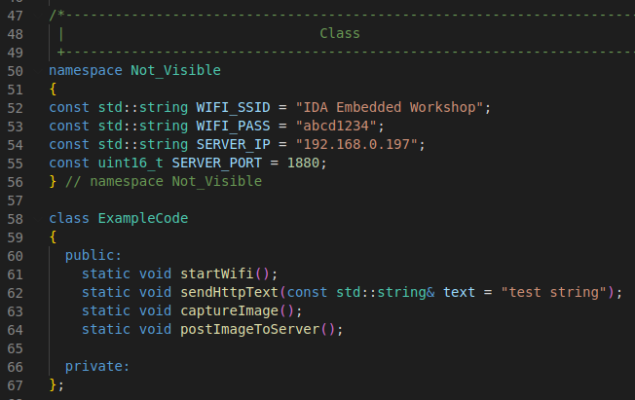
Folder structure

Slide 18
