Slide 1

Shattering the monolith: automatic detection of inlined functions
Ali Rahbar, Elias Bachaalany, Ali Pezeshk

Slide 2
Agenda
Who we are
Function inlining
Forced inlining and reverse engineering
Detecting inlined functions(high level)
Detecting inlined function in binary
Visualization
Refactoring (Binary rewriting)
Notes:
What is f inlining
The effect of inlining on RE

Slide 3
Who
Ali Rahbar : Microsoft TWC
Elias Bachaalany: Microsoft TWC
Ali Pezeshk: Microsoft TWC

Slide 4
Background

Slide 5
Function Inlining
Embedding the function body in place of a function call
Used as an optimization by compilers
In C and C++ users can request inlining
inline int max(int a, int b)
{
return (a > b) ? a : b;
}
Could be forced in various compilers:
Gcc :__attribute__((always_inline))
MSVC :__forceinline
Notes:
inserting the function code at the address of each function call thereby saving the overhead of function invocation and return (register saving and restore) by avoiding a jump to a sub-routine.
It is faster, there is no register saving or restoring. It is a waste of memory if the function is called from 100 places.
In C++ the inline keyword can be used to request inlining from the compiler. There is no guarantee that the compiler will respect that request.
GCC : __attribute__((always_inline))
VC: __forceinline

Slide 6
Forced inlining and reverse engineering
Simple control flow obfuscation
Increases code size
Increases complexity of analysis
Identification of equivalent code is not trivial
Notes:
Forced inlining is used as a simple form of control flow obfuscation.
It increases the complexity of analysis, it is much easier to reverse a set of small functions with a simple logic than a huge function that does a lot.
While reversing, we get accustomed to the patterns that we see in that binary and tend to recognize them later. But it is still time consuming to reanalyzed the same pattern.

Slide 7
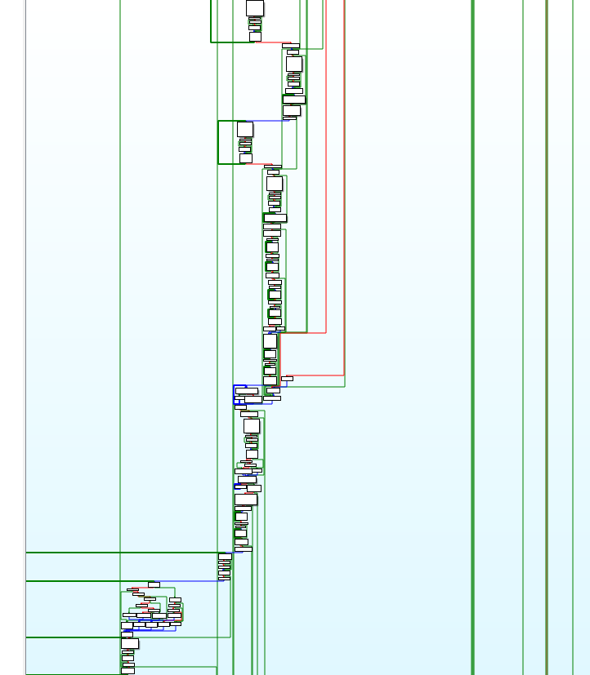
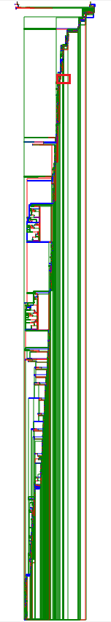

Slide 8
Algorithm

Slide 9
Problem
We don’t want to re-analyze a code snippet only to find out that we had already seen that before
Recognizing similar code by hand can become difficult when looking at a large number of inlined functions
Complex navigation and visualization
Dirty after decompilation

Slide 10
Solution
A tool that can
Automatically detect inlined functions
Match equivalent inlined functions
Simplify visualization and interaction
Rewrite the binary to outline inlined functions
Notes:
If there are three instance of the same function inlined, we should know that they are the same
Interaction with a CFG that has inlined function is very difficult if not impossible. Visualization should be simplified by regrouping nodes of an inline function as a single node.
We would like to rewrite the binary and outline the functions. This will help for easier decompilation and visualization.

Slide 11
How to detect inlined functions
Simplifying the problem:
Only multiple instance of an inlined function are important to detect
Multiple equivalent code sequence could be potentially an inlined function
We need a way to detect multiple equivalent code sequences
Notes:
As we are looking for a solution to detect inlined functions that have been created to thwart reverse engineering.
If a function has been inlined a single time, it does not add to the complexity of our analysis.
It has to be inlined at least twice to be considered as waste of analysis time for us.
If there are MACRO’s which produces the same equivalent code multiple time, we still want to match them.
Now we need a way to detect multiple equivalent code sequence
The first problem to overcome is to find a way to detect inline functions.
As we are looking for a solution to detect inlined functions that have been created to thwart reverse engineering.
If a function has been inlined a single time, it does not add to the complexity of our analysis.

Slide 12
High level algorithm
Build the CFG and break the program into blocks
Compare all blocks to construct a list of equivalence
For each pair of equivalent blocks, try to construct/find the biggest equivalent subgraphs
Notes:
At a high level independent from the program’s format either binary or source/
We can detect inlined function like this:

Slide 13
Example
[(2,7,26),(5,13,33),(4,14,34),(9,22,42)]
1
2
3
4
5
6
7
8
9
10
11
12
13
14
15
16
17
18
19
20
21
22
subgraph₁{(2,5),(2,4),(4,9)} == subgraph₂{(7,13),(7,14),(14,22)}

Slide 14
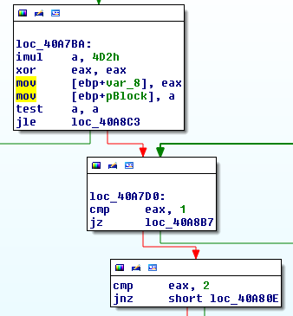
What are blocks
Blocks are “basic block” created from the control flow
A sequence of instruction that do not modify the control flow are in the same block
Any change in the control flow, starts a new block

Slide 15
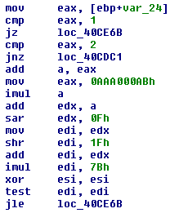
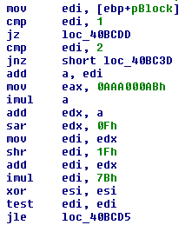
Block comparison (1)
Can’t simply compare the bytes in two blocks
Registers change(register allocation):
VS
Notes:
Extract some feature from a block and calculate a digest
Simply compare the digest

Slide 16
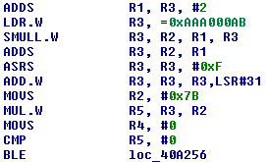
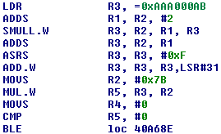
Block comparison (2)
Instructions are reordered(instruction scheduling):
VS

Slide 17
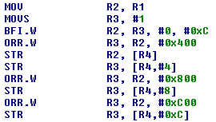
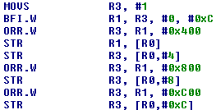
Block comparison (3)
Small variations:
VS

Slide 18
Features
Digest of sequence of instruction types in the block:
An ordered representation of instruction types
Digest of the set of instructions and operand types in the block:
An order agnostic combination of instruction types and operand types
(Small Prime Product)
Digest of frequency of instruction types and operands types
Notes:
http://static.googleusercontent.com/media/www.zynamics.com/en/us/downloads/bindiffsstic05-1.pdf
SPP(Small Prime Product)

Slide 19
Algorithm
Build a CFG
Use digest2 to calculate block equivalence of all blocks
Take each pair of equivalent blocks as head nodes
Try to construct the longest equivalent subgraphs with the strictest digest
Switch to fuzzier digest if no match is found

Slide 20

DEMO

Slide 21
IDA Plugin Details

Slide 22
BBGrouper
Python library that contains a set of algorithms
Basic Block abstraction layer (BB_types.py)
A set of utility functions (BB_util.py)
An IDA support library (BB_ida.py)

Slide 23
GraphSlick (1)
GraphSlick is an IDA Pro plugin
Analyze and visualize
Result can be interactively modified by the user
The algorithm is processor agnostic

Slide 24
GraphSlick (2)
The UI represents the results using:
A chooser window (aka “GS Panel”): displays the BB Analyze() function call results in a list
A user graph window (aka “GS View”):
displays a user graph containing the matching results
Allows interactivity to manipulate the grouping results
Allows coloring and navigating through the results

Slide 25
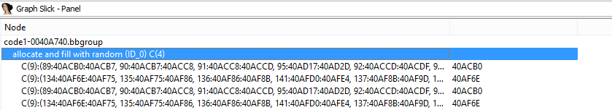
GraphSlick – Panel (1)
The GS panel shows all the nodes and under which parent group they fall
Each parent group contains various group each containing a set of nodes that make up similar code pattern in various program location
“allocate and fill with random” parent group has four groups
Each group is composed of 9 basic blocks

Slide 26
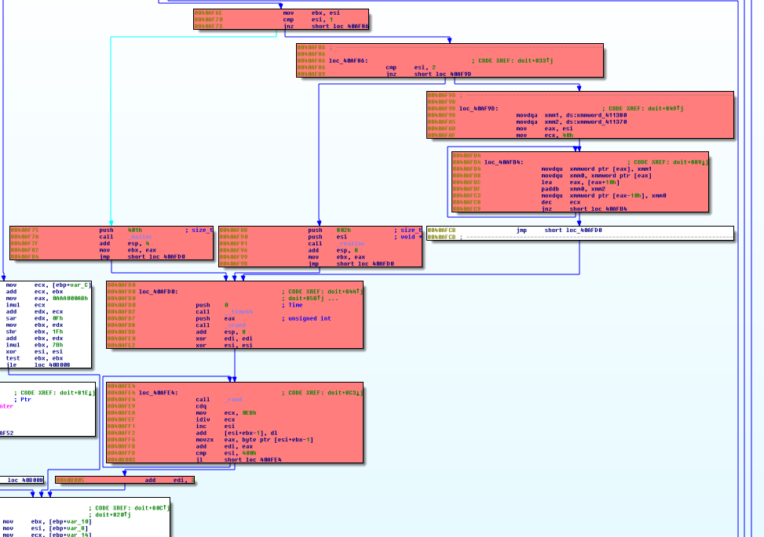
GraphSlick – Panel (2)
These are the 9 nodes that make up “allocate and fill with random” code logic
It is composed of 9 basic blocks
These 9 blocks could have been an inlined function
Or code that has been copied and pasted

Slide 27
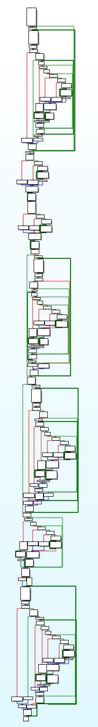
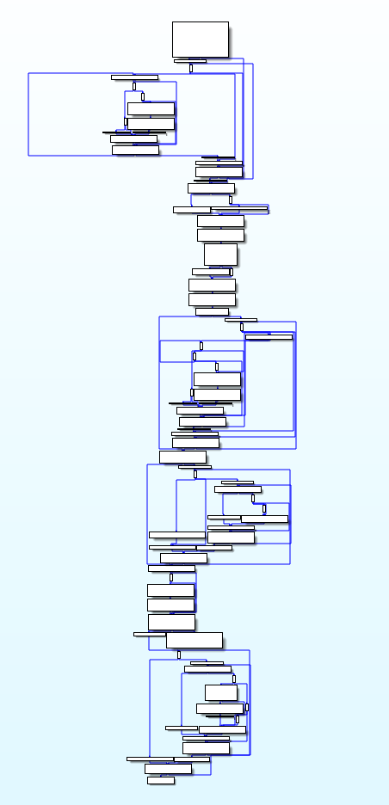
GraphSlick – Before and after
Before
After
In this example, we automatically identified similar subgraphs and grouped them under a single parent group
Note how the graph is much more simpler

Slide 28
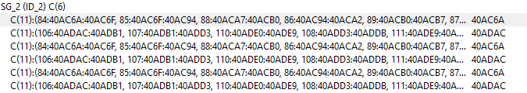
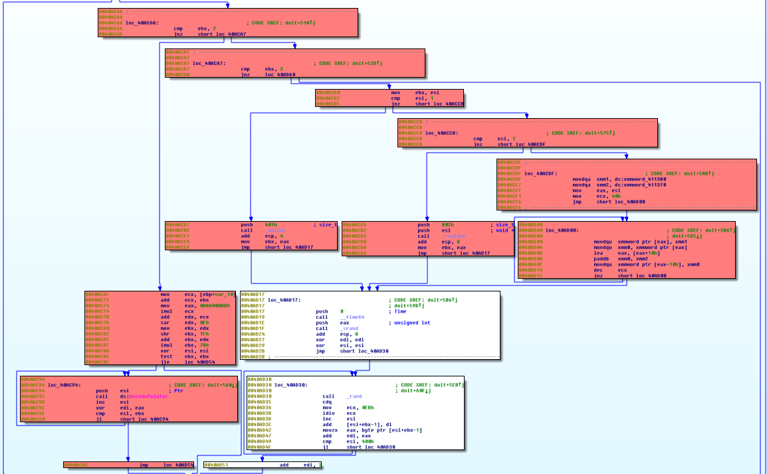
GraphSlick – Automatic grouping on x86
In this example, we can see how the GraphSlick panel:
Created one parent group with 6 sub groups
Each sub-group is composed of 11 basic blocks

Slide 29
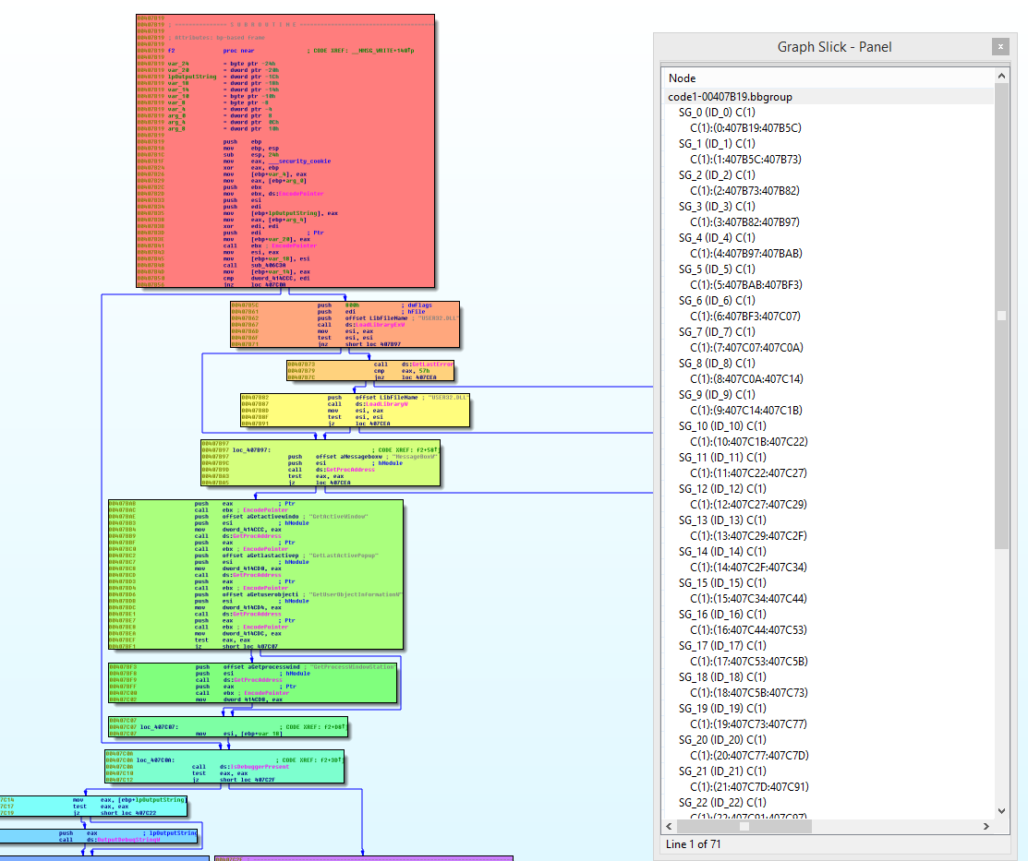
GraphSlick – Automatic coloring
Here we see a function with no similar basic blocks
Each basic block is its own parent block
Each parent block is automatically assigned a distinct color

Slide 30
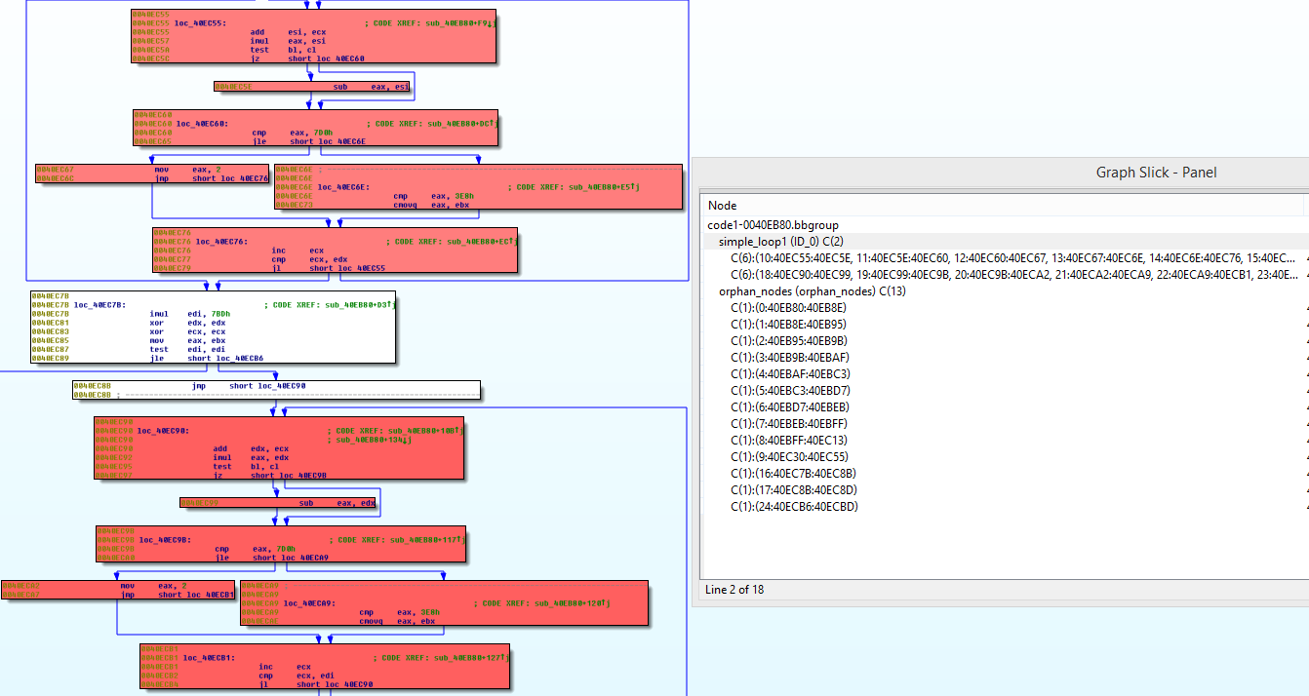
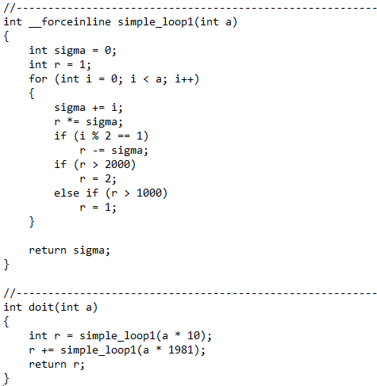
GraphSlick – Automatic color shades
The “doit” function has the body of “simple_loop1” inserted twice
The GS panel detected 6 basic blocks per inlined function call
All the groups belonging to the same parent group have the same color but with different shade
The other “Orphan nodes” are just regular blocks

Slide 31
Refactoring

Slide 32
Refactoring overview
Add a sufficiently large section to the binary
Script will
Move snippets of code for inlined function instances found to the new section
Fix up the moved code for calls, jumps/branches, and returns
Patch the original location to do a call in place of the inlined function instance
Patch after the call to handle return value to stitch back the original code flow
Note that the following description is for ARM

Slide 33
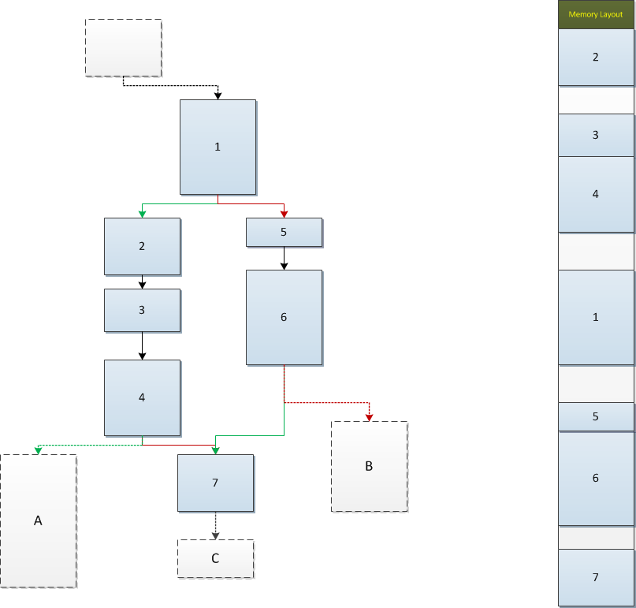
Glance at an inlined function instance
Single entry
Exit 2
Exit 1
Exit 3

Slide 34
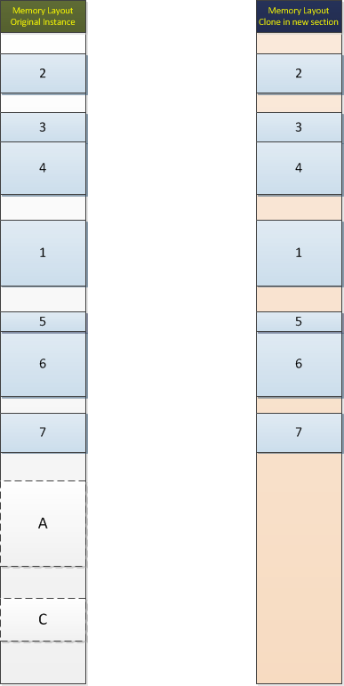

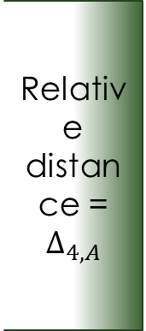



Moving an inlined function instance (1)
Relative distance = $Δ_{1,2}$
Relative distance = $Δ_{1,2}$
Relative distance = $Δ_{4,A}$
$$Δ_{1,5}$$
$$Δ_{1,5}$$
Block A is not part of the instance

Slide 35
Fixing branches/jumps
Gaps are preserved when creating the clone
Relative branches/jumps that fall back into the instance are good to go
Calls outside the instance are good to go as well (absolute address)
Any absolute jumps/branches into the instance need to be patched
Relative jumps may need to be patched as well

Slide 36
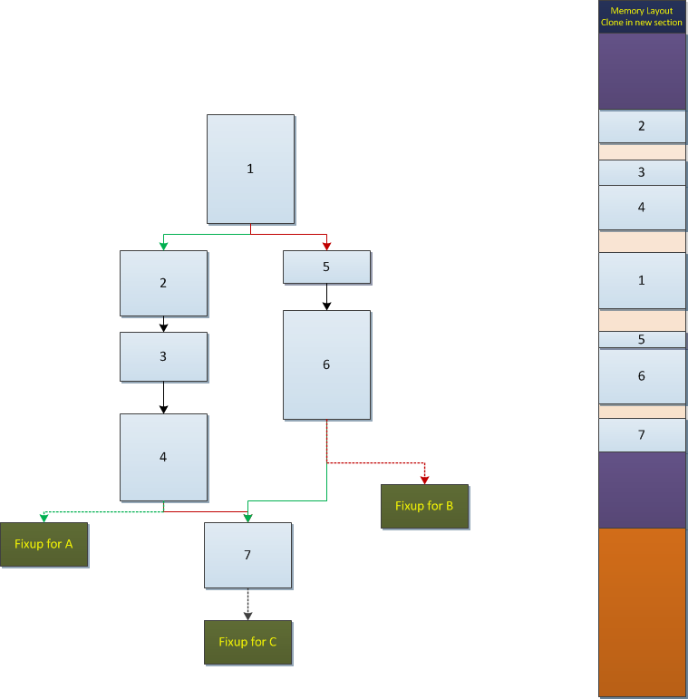
Moving an inlined function instance (2): Envelope
270 byte pre-landing pad
270 byte post-landing pad
Fixup pad

Slide 37
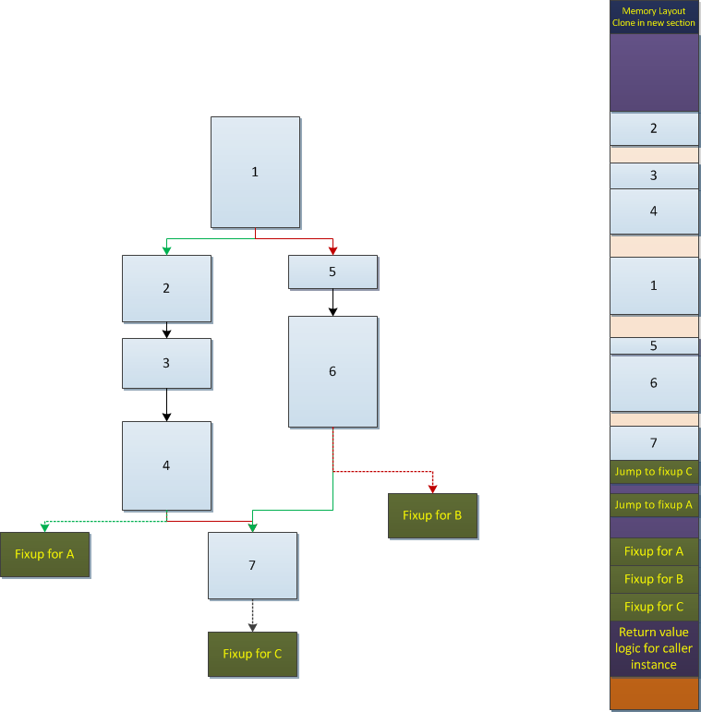
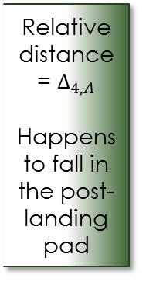
Relative address fixups (1)
If jump/branch destination falls in a gap or the pre/post landing pads we just add a jump to the fix up at that location
This helps handling thumb mode 2-byte relative jumps/branches, since the fixup pad can be farther than 258 bytes away and the instruction size won’t allow larger distance specified otherwise
Relative distance = $Δ_{4,A}$
Happens to fall in the post-landing pad
Notes:
Fixup is the code needed to help recreate the original code flow for the particular instance.

Slide 38

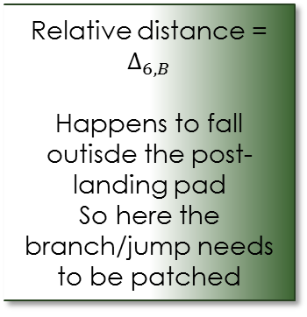
Relative address fixups (2)
Depending on $Δ_{6,B}$ we need to patch the branch/jump instruction to go to the fixup location in the fixup pad
Relative distance = $Δ_{6,B}$
Happens to fall outisde the post-landing pad
So here the branch/jump needs to be patched

Slide 39
Fixing the fall through to outside of instance
Fall through location is the instruction address right after end of block 7, which happens to fall outside the instance
We put a jump to the fixup for C at this location (there’s either a gap here or we’re in the post-landing pad)
Jump to fixup C is added immediately after fall through

Slide 40
Fixing up flow to outside of instance
The fixup block for each branch/jump to outside the instance sets a constructed unique return value and returns
For instance fixup for A looks like this
MOV.W R0, #1; return value for fixup A
MOV PC, LR
Then at call location we can use the return value and stich back the flow to the original form with a decision tree

Slide 41
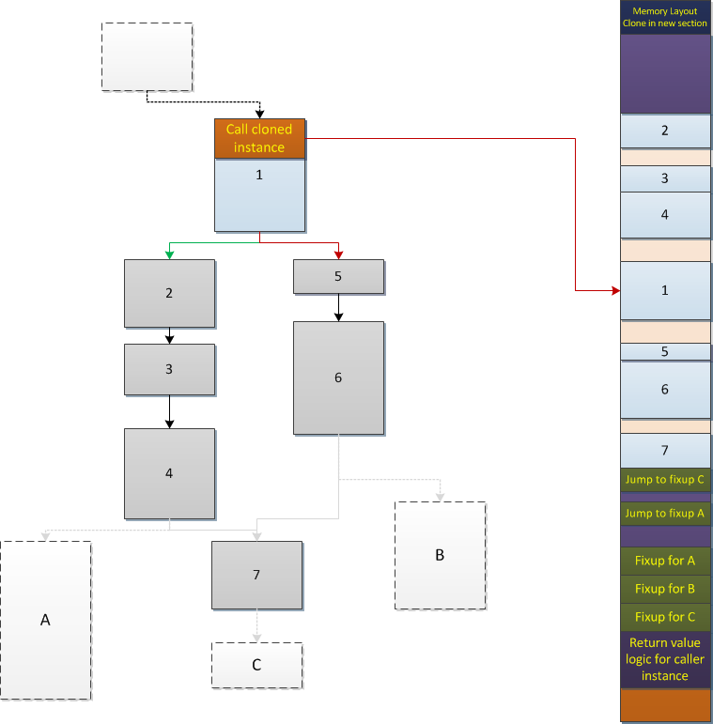
Patching the call site
We need at least 4 bytes for the call, so we put restrictions on the size of the first block of the instance

Slide 42
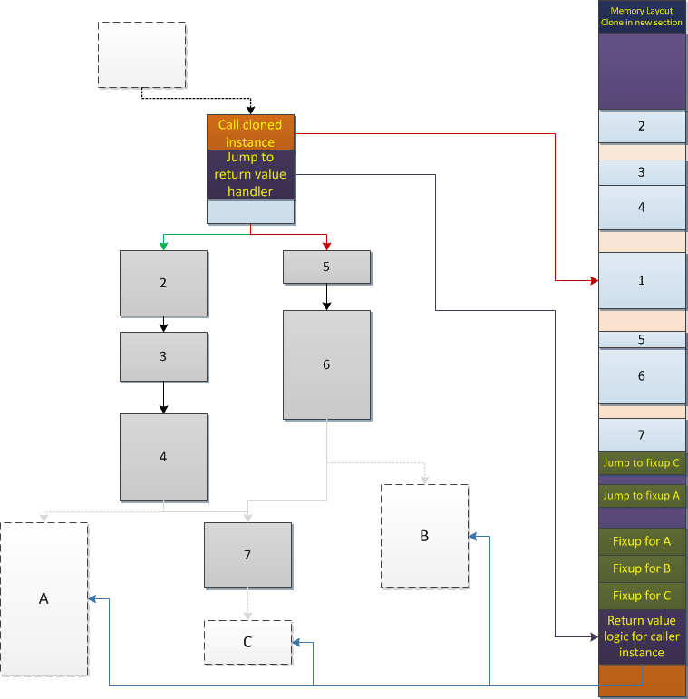
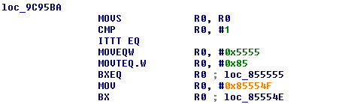
Adding return value handling
We need another 4 bytes for the jump to the return value handler logic which we place in the fixup pad after the fixup blocks
Sample code for the patch
Sample code for return value logic

Slide 43
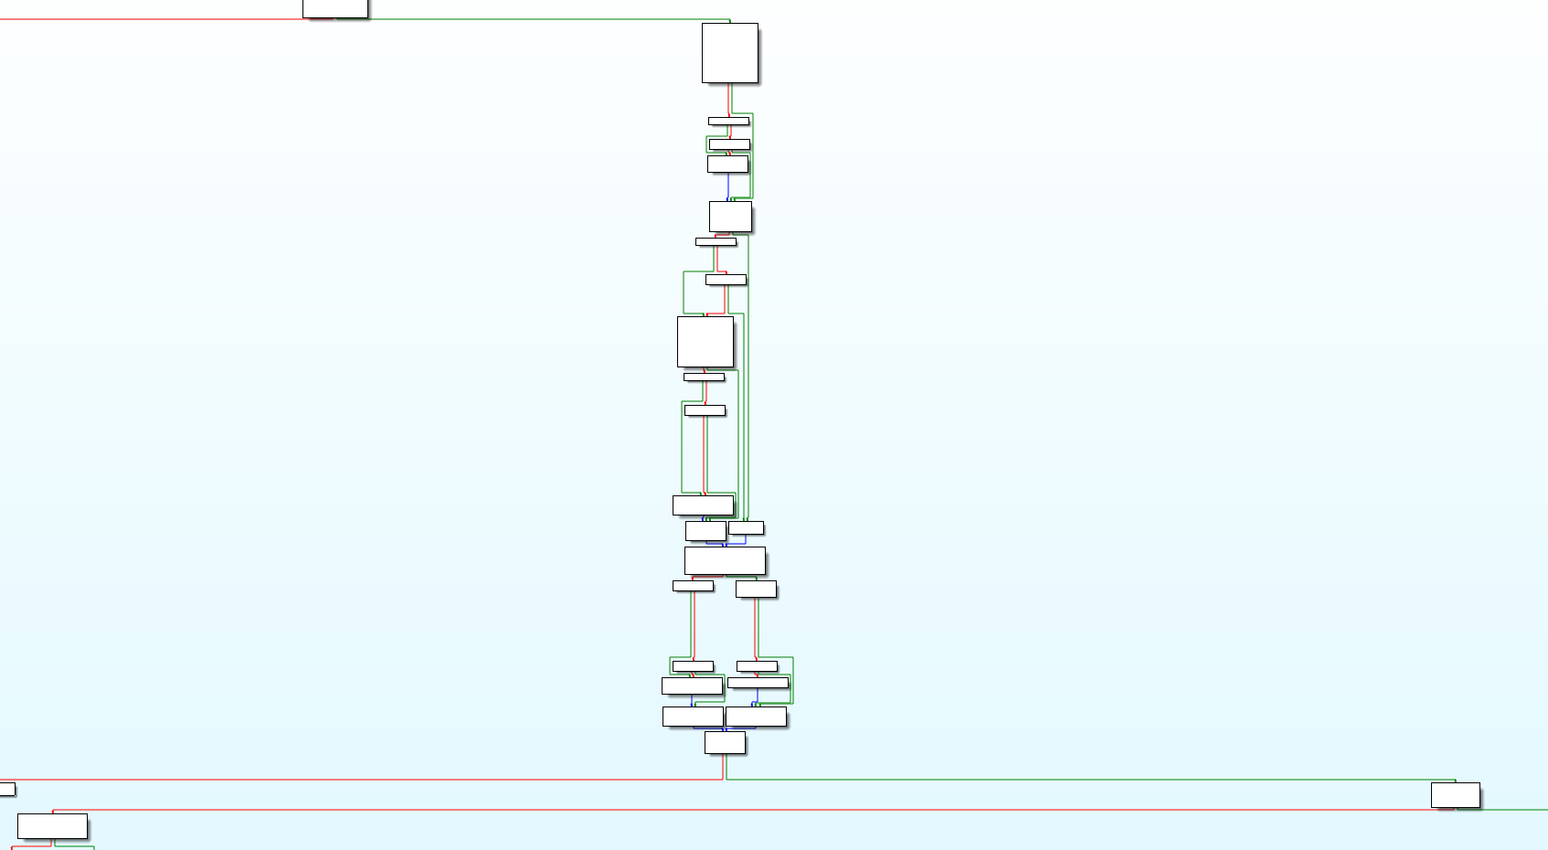
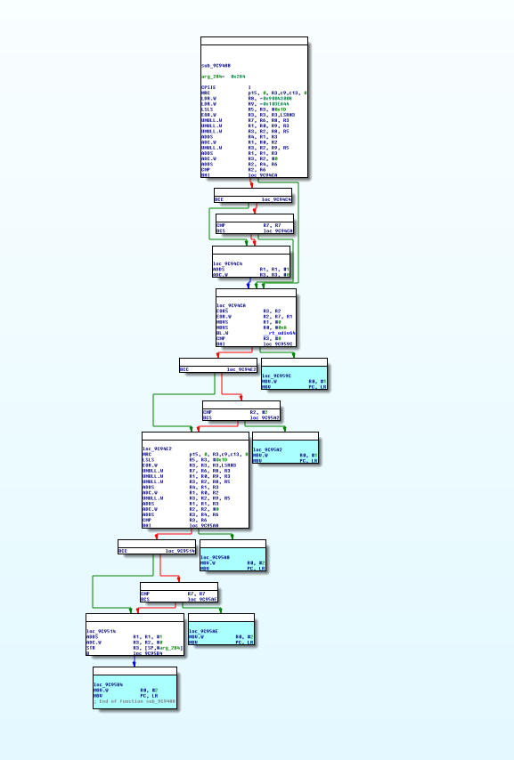
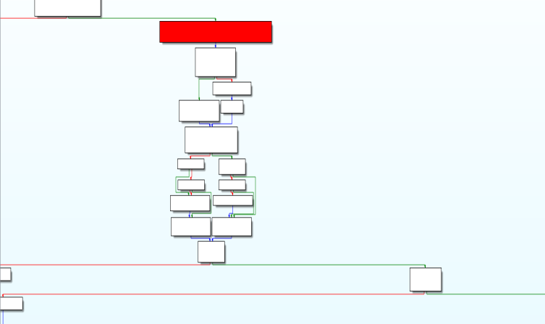
Sample
Original binary
Inlined function instance
Refactored binary
Notes:
Fixups are highlighted
Red highlighted block is the patched binary

Slide 44
What about different register usages
Different instances of an inlined function may use different registers and parameters may be passed to them through different registers through optimization
We can clone each instance as described and then in decompilation have the different instances be renamed to the same function

Slide 45
Current implementation limitations
ARM only
We currently don’t handle jump tables
Some corner cases still problematic ☺

Slide 46
Questions
?

