Slide 1
ShieldPay

Slide 2
01
TABLE OF CONTENTS
02
03
04
$
Team members
Topic
Stages of realization
Used technologies

Slide 3
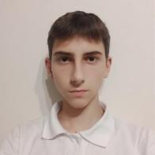
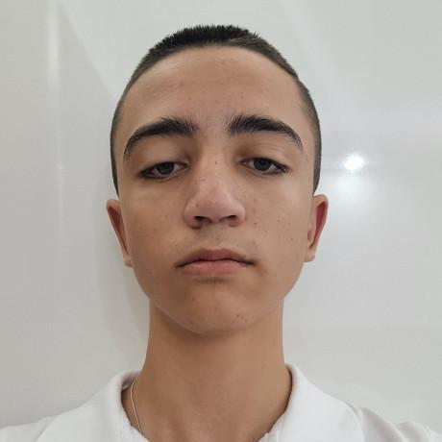
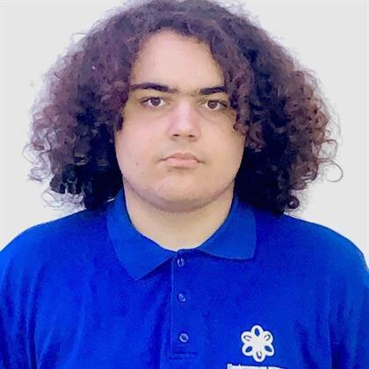
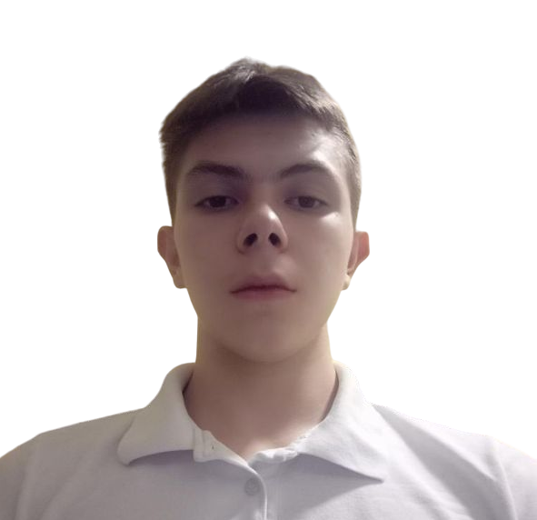
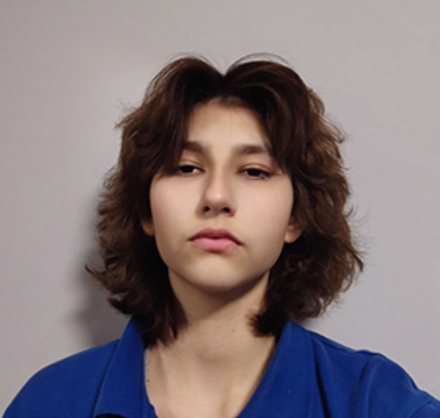
OUR TEAM
Ivan Dimov
Kevin Rusev
Svilen Todorov
Dimitar Georgiev
Teodora Lozeva
Backend Developer
Backend Developer
Scrum Trainer
Scrum Trainer
Designer

Slide 4
Topic
This app is used for banking transactions and to bequeath something as it’s made easy to understand app for people to use.

Slide 5

Stages of realization
01
02
03
04
Form the team
The idea
Realizing it
Present

Slide 6







USED TECHNOLOGIES

Slide 7
Let’s move to our project..

