Slide 1
Masquarade

Slide 2
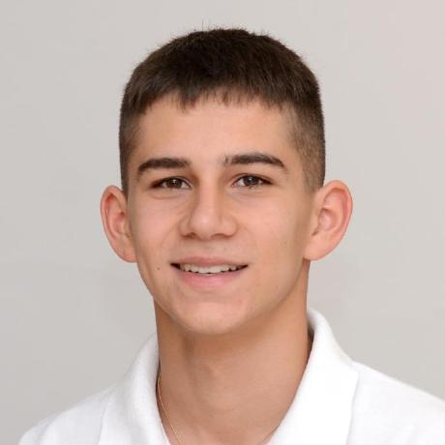
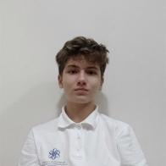
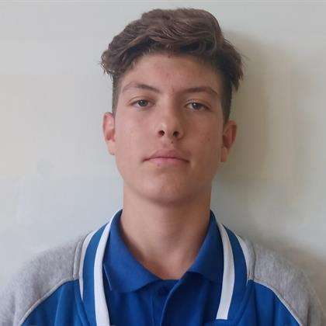

Our Team
Alex Kazakov
[Back-end developer]
Yavor Penkov
[Back-end developer]
Ivan Dochev
[Scrum trainer]
Ivan Tsvyatkov
[Designer]

Slide 3
About the project
We have made a web and console application that allows our customers to register themselves to our bank using whichever method they are most comfortable with.

Slide 4













Used Technologies

Slide 5
Now let's jump to the project!

