Slide 1
Open-Source Solutions for Data Capture at Syringe Services Programs
Lessons from Florida
Britt DeVries & Daniel Maya | Thursday, January 29, 2025 | 4th Annual FLHRC

Slide 2
Quick Introductions

Slide 3
Today’s Roadmap
Open-Source & Common Data Elements
  Practical Examples
Data Collection Platforms
  Pros & Cons
Hands-On Workshop
  Using a Platform of Choice
  Accessing GitHub Repository
Questions & Discussion
Notes:
Danny

Slide 4
Open-Source Principles
Open-source principles center on transparency,
collaboration, and freedom, ensuring software's
source code is publicly accessible, modifiable,
and redistributable, fostering innovation through
community participation, meritocracy, and
iterative development.
Notes:
Britt
Open source principles: transparency, collaboration, and freedom. Source code is publicly accessible, modifiable, redistributable.
fosters innovation through community participation and iterative development. Iterative development means that files or code shared are constantly being worked on

Slide 5
Common Data Elements
A common data element (CDE) is a standardized, precisely defined question that is paired with a set of specific allowable responses.
Common data elements are developed so that data can be collected in the same way across multiple research studies or sites.
Notes:
Danny
CDE) is a standardized precisely defined question paired with specific allowable responses
Why? So data can be collected the same way across multiple research studies or sites

Slide 6
Practical Example #1
SCENARIO
  New bill is proposed that aims to limit or rollback SSPs in Florida because of the claim that "access to syringes encourages people to start injecting drugs."
APPROACH
  Pull data from all SSPs to refute this claim and present findings to policymakers.
WHAT VARIABLES/INDICATORS DO WE NEED?
  What do we actually have?
Notes:
Britt
Ask the audience. Age of first injection and Age at enrollment (first access). Checking the age gap (over time)
These data can be collected in different ways based on site needs

Slide 7
Practical Example #1
Age of First Injection
  Year you first injected?
  How old were you when you first injected?
Current Age
  DOB
  Year of birth
  Self-reported age
Date
Notes:
Britt
Ask the audience. Age of first injection and Age at enrollment (first access). Checking the age gap (over time)
These data can be collected in different ways based on site needs

Slide 8
Practical Example #2
SCENARIO
  SSP participants in Miami-Dade are reporting stronger and/or new effects from Fentanyl. SSPs in other areas are concerned this may soon impact their participants and want to begin spreading the word.
APPROACH
  Pull drug checking data across SSPs to determine if and when new adulterants were first detected by region.
WHAT VARIABLES/INDICATORS DO WE NEED?
  What do we actually have?
Notes:
Danny
Ask the audience. Date of drug checking. Adulterants detected. Location.
Highlight: these data can also be collected in different ways that can make life easier or harder depending on the methods

Slide 9
Practical Example #2
Date
Adulterants Detected
  Open text?
    Tranq, tranq, Xylazine, zylazine, XYL, Xyl...
Location
  ZIP code?
  Open text?
    Miami, MIA, Mimi, miami...
  Neighborhood or street address?
Notes:
Danny
Ask the audience. Date of drug checking. Adulterants detected. Location.
Highlight: these data can also be collected in different ways that can make life easier or harder depending on the methods

Slide 10

Pros & Cons of Data Platforms
Excel/Google Sheets Pros
  + Probably Most Common
  + Accommodates Many Data Types
  + Can Create Summary Tables
  + Easy Startup & Use
  + Multiple Tabs for Data Organization

Slide 11
Pros & Cons of Data Platforms
Excel/Google Sheets Cons
  - Not a Survey
  - Can Get Messy Quickly
  - Learning Curve to Use Well
  - Not HIPAA Compliant
Notes:
What are some different options for data collection?

Slide 12
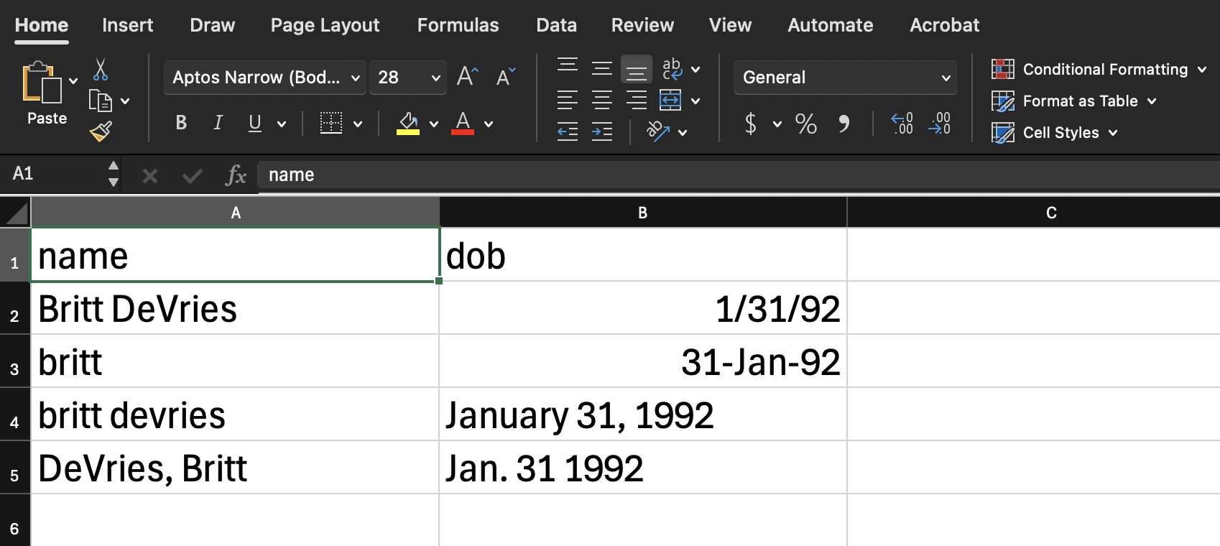
da_id_code
id_code
en_id_code
idcode
id
record_id
Notes:
Britt
This is where Common Data Elements can help standardize the variable/column/item names

Slide 13

Pros & Cons of Data Platforms
Google Forms Pros
  + Free or Low Cost
  + Low-Barrier Survey Builder
  + Provides Response Summaries
  + Easily Export to Excel or Sheets

Slide 14
Pros & Cons of Data Platforms
Google Forms Cons
  - Survey Flow Difficult to Customize
  - Cross-Platform Migration Difficult
  - One Survey per Project
  - Limited Data/Field Types
  - HIPAA Compliance Costs Extra
  - Data Exports Not Customizable
  - Does Not Support Variable Naming

Slide 15
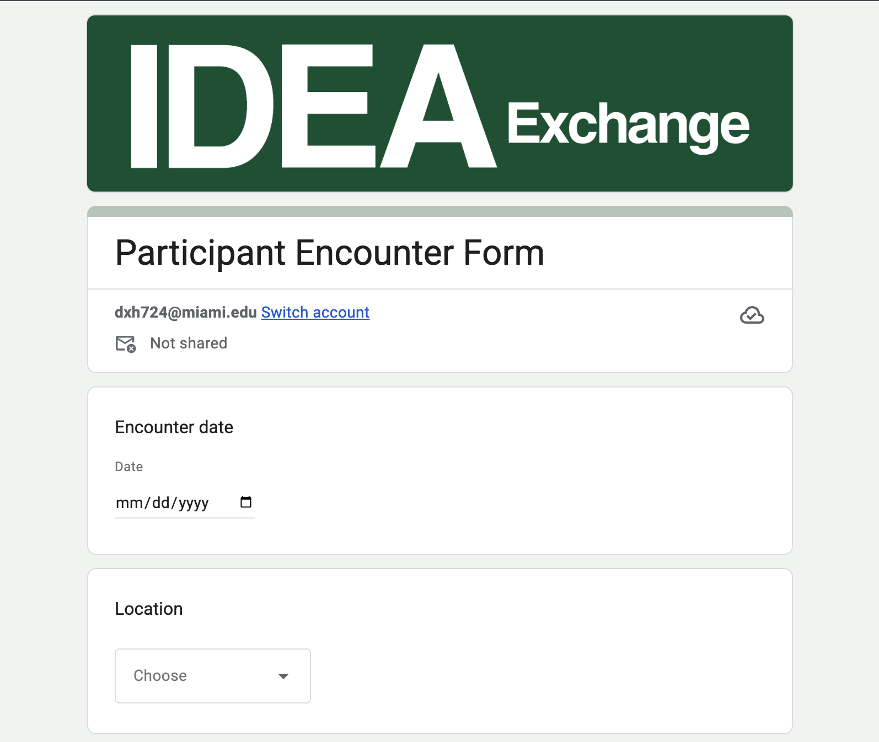

Slide 16

Pros & Cons of Data Platforms
Qualtrics Pros
  + Survey Forms Shareable (Within Qualtrics)
  + Response Analytics Available
  + Customizable Survey Flows
  + Data Exports Nicely
  + Custom Variable Labels
  + Very Mobile Friendly

Slide 17
Pros & Cons of Data Platforms
Qualtrics Cons
  Extremely Expensive
  One Survey per Project
  Survey Flow & Question Types Limited
  One Survey per Project
  Limited Customization to Look/Feel
  Cross-platform Migration Difficult
  Limited Report Building Options

Slide 18
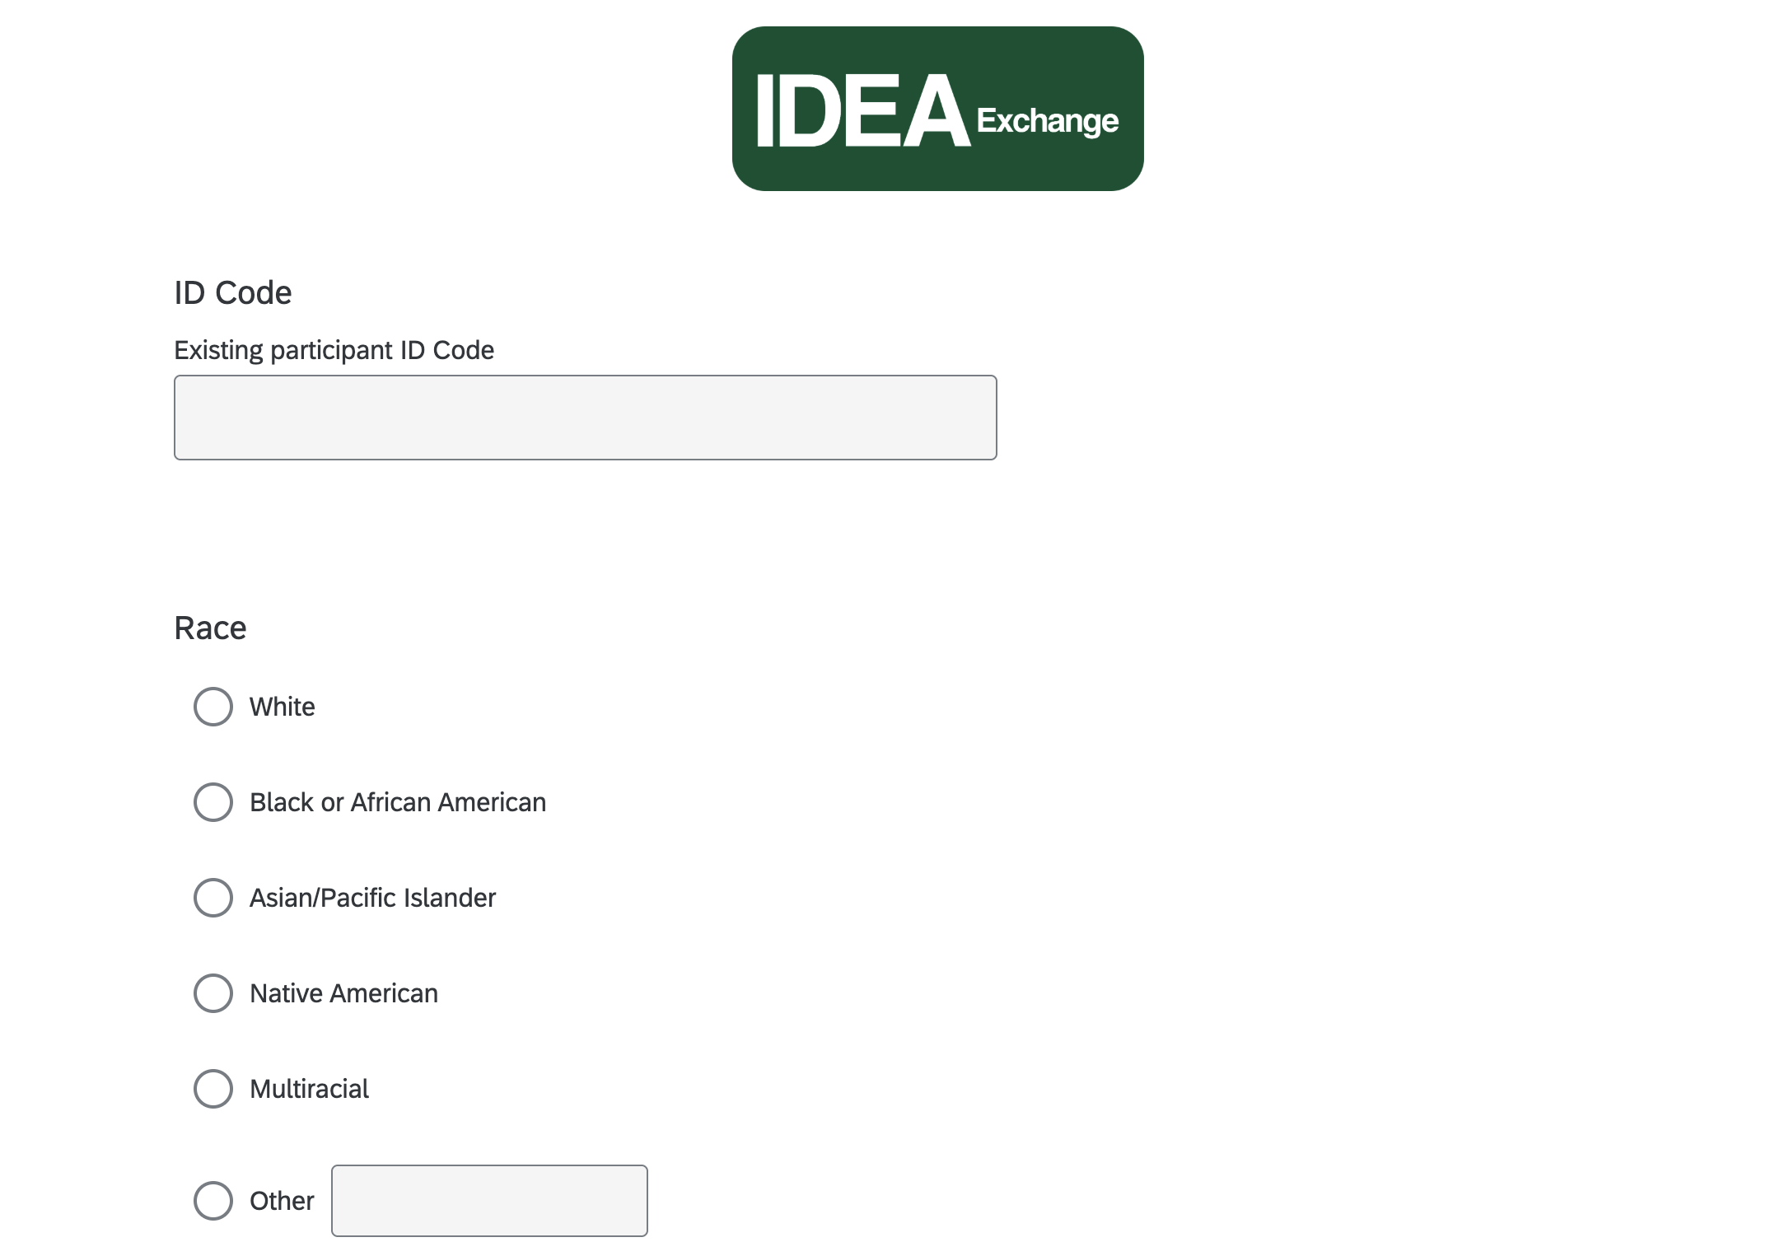

Slide 19

Pros & Cons of Data Platforms
Microsoft Forms Pros
  + Free with Microsoft Account
  + Low-Barrier Access & Use
  + Does Allow for Some Branching

Slide 20
Pros & Cons of Data Platforms
Microsoft Forms Cons
  - Survey Flow Difficult to Customize
  - Cross-Platform Migration Difficult
  - Data Output Less Usable
  - One Survey per Project
  - HIPAA Compliance Costs Extra
  - Does Not Support Variable Naming

Slide 21
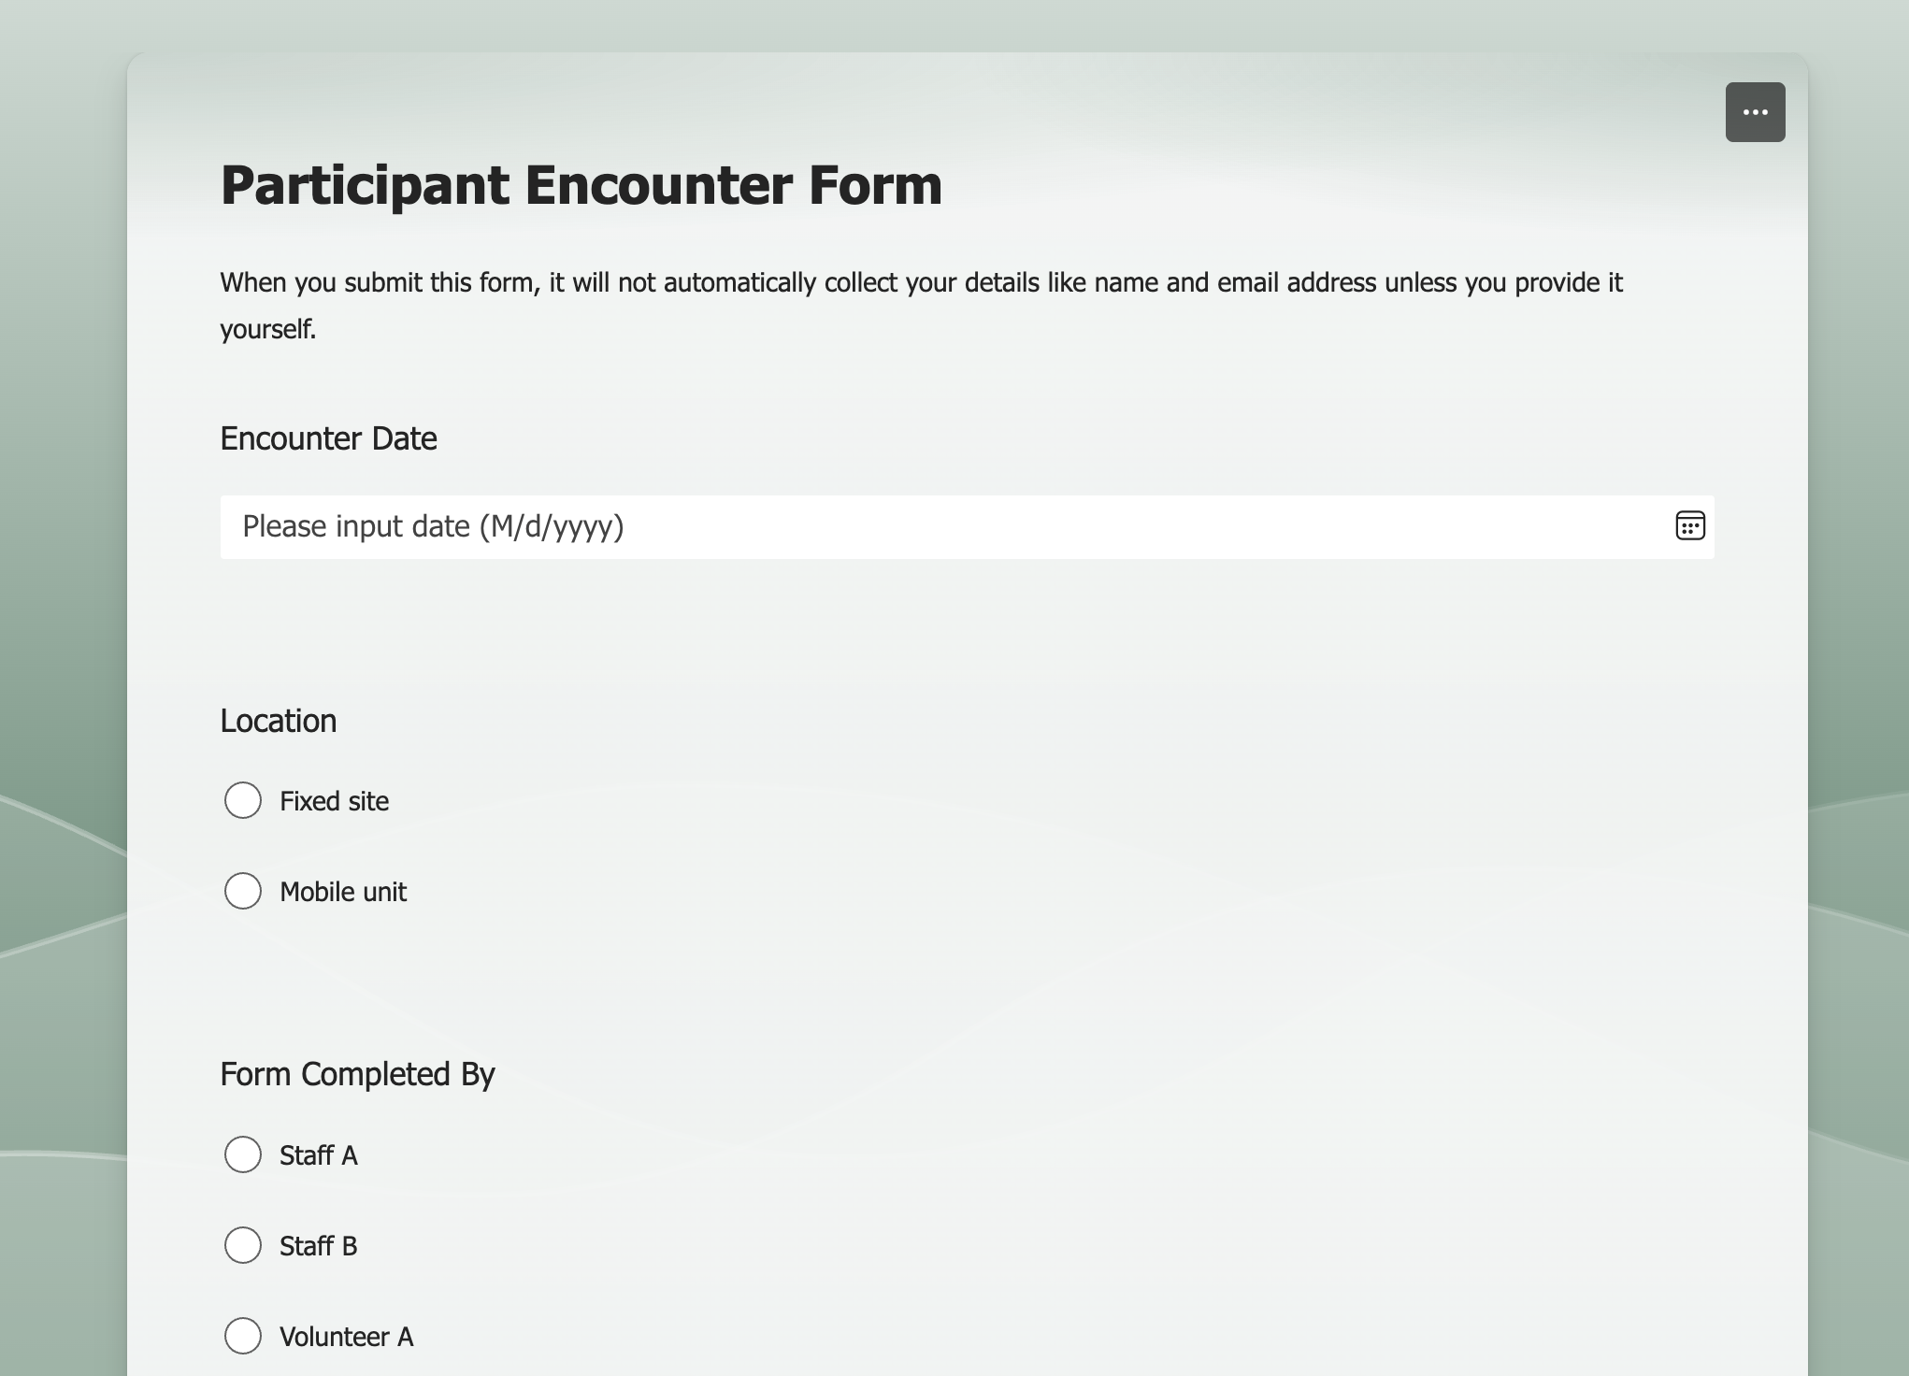

Slide 22

Pros & Cons of Data Platforms
Bisque Pros (New!)
  + Low Cost (Use-Based)
  + Designed by Researchers
  + Intuitive Survey Builder
  + Shareable Survey Templates
  + Data Summaries Available
  + Data Exports Are Smooth
  + (Coming Soon!) HIPAA Compliance

Slide 23
Pros & Cons of Data Platforms
Bisque Cons
  - Under Development
  - One Survey per Project
  - Does Not Currently Support Variable Naming

Slide 24
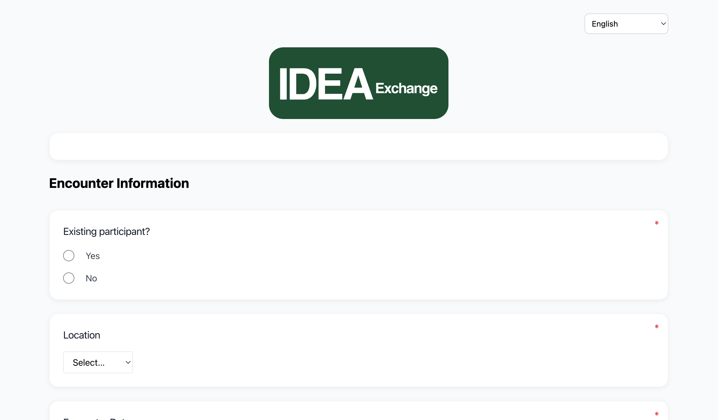

Slide 25

Pros & Cons of Data Platforms
REDCap Pros
  + Projects/Data Import/Upload Easily
  + HIPAA Compliant & Backed-up
  + Easily Customizable Survey Flows
  + Customizable Data Exports
  + User Rights to Control Access
  + Improvements/Upgrades Ongoing
  + Survey Mode for Links & QR Codes
  + Mobile App for Offline Collection
  + Clinical Data Pull for EHR Data

Slide 26
Pros & Cons of Data Platforms (cont.)
REDCap Cons
  - Costly for Non-501(c)(3) Organizations
  - Requires IT (Servers & Maintenance)
  - Learning Curve for Use
  - May Need External Data Processing

Slide 27
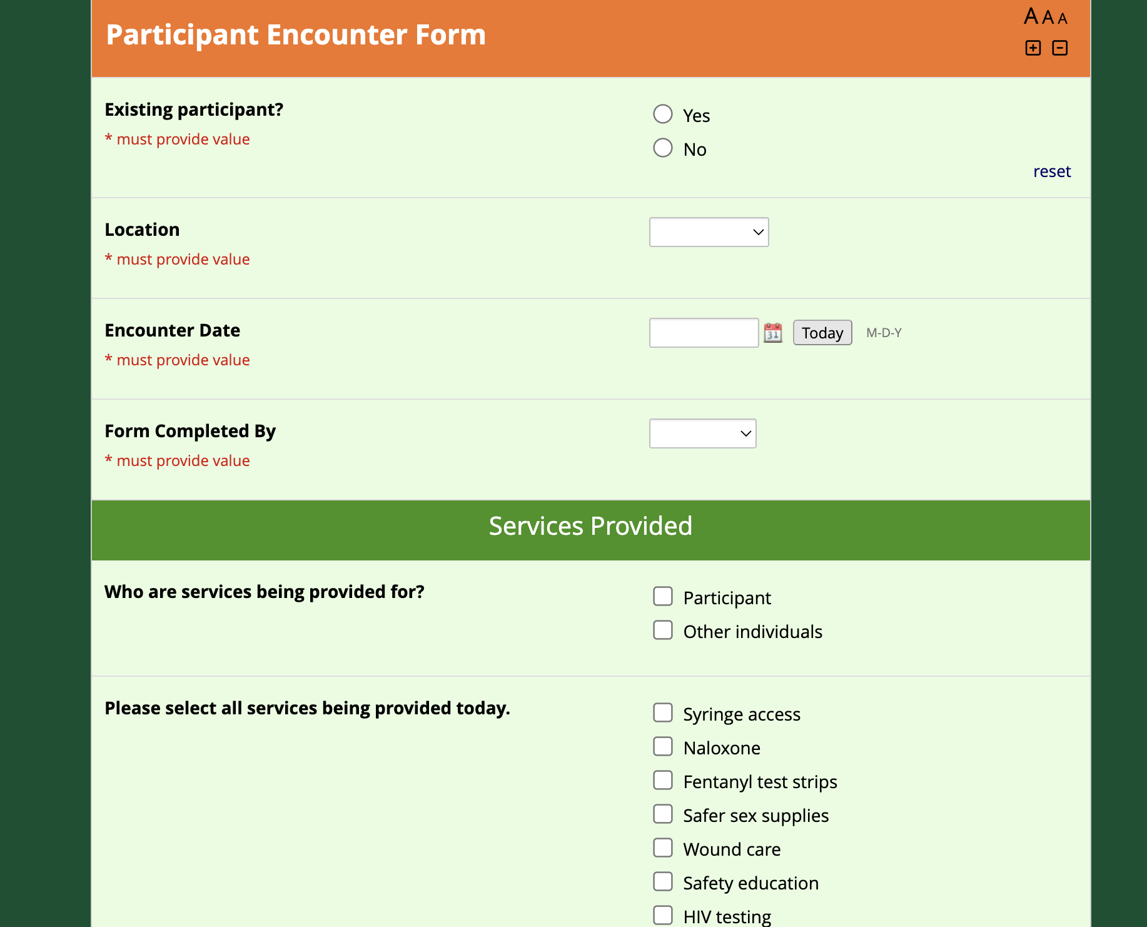

Slide 28
Hands-On Exploration is Next!
Questions?

Slide 29
Before We Start
This is a workshop – please don’t be afraid to participate.
All responses are anonymous!
No wrong answers!

Slide 30
What platform might be best for us?
How is our data collected?
What do we do with data?

Slide 31
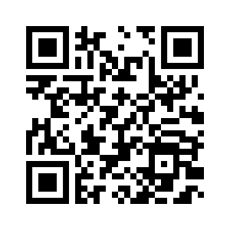
Google Forms
https://forms.gle/5RNU7Fy9FBrmAjCZ8

Slide 32

Microsoft Forms
https://forms.office.com/r/SCbqyM8FnU

Slide 33
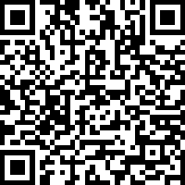
Qualtrics
https://umiami.qualtrics.com/jfe/form/SV_0DoeFz4it03sB1Q

Slide 34
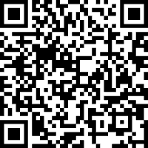
Bisque
https://surveys.hellobisque.com/survey/2cad3bb4-ebbf-4acf-a205-7b73818ae145

Slide 35

REDCap
https://redcap.link/ga6qyj93

Slide 36


Accessing The Templates
https://github.com/IDEA-Miami/Data-Collection-Instruments.git

Slide 37
Overarching Goal
Open-Source SSP Start-Up Package
  Customizable for Specific Needs
  Different Platforms Available Based on Needs and Program Budgets
Provide Technical Assistance
  Support for Data Requests & Publications

Slide 38
What's Next?
Provide Code (R, Python, etc.) to Generate Reports and Data Visualizations
Add Templates for New Platforms

Slide 39
Lower Barriers for SSP Implementation.
Lower Barriers to Access.

Slide 40
Thank you for participating!
Questions? Thoughts?
Britt DeVries & Daniel Maya | Thursday, January 29, 2026 | 4th Annual FLHRC

Slide 41

Technical Assistance Request Form
https://redcap.link/idea-ta

Slide 42
References & Resources
Common Data Elements – Learning Resources: https://www.nlm.nih.gov/oet/ed/cde/tutorial/index.html
Open-Source Principles – Definition & Resources: https://opensource.org/osd
Wilkinson, M., Dumontier, M., Aalbersberg, I. et al. The FAIR Guiding Principles for scientific data management and stewardship. Sci Data 3, 160018 (2016). https://doi.org/10.1038/sdata.2016.18

