Slide 1
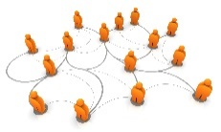

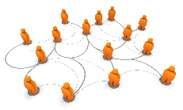
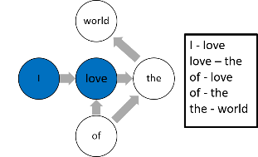
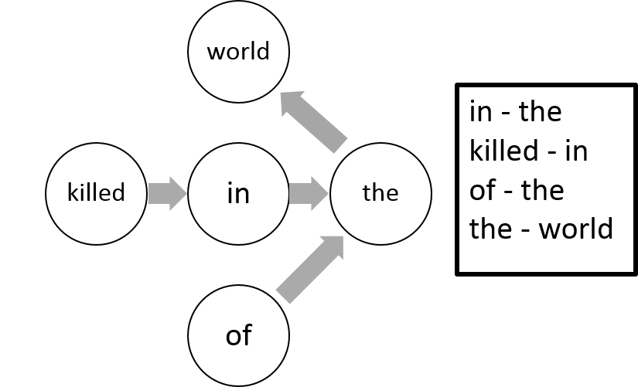
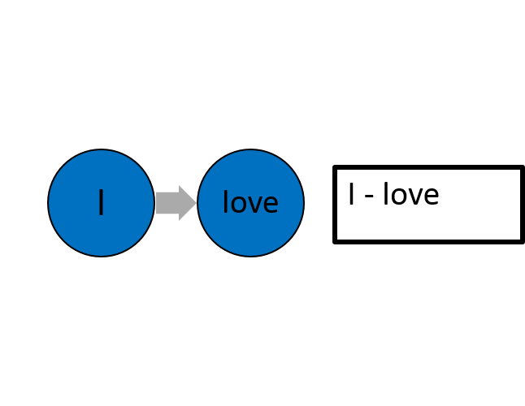

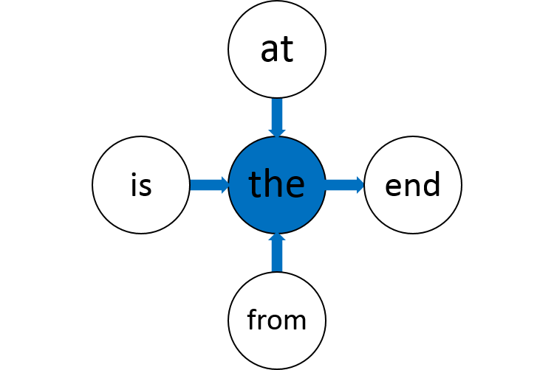
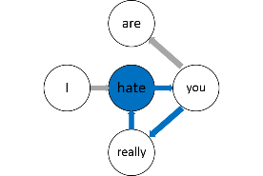

Tweets
News
Tweets
emotion1
Tweets
emotion2
Tweets
Emotion n
Preprocessing
…
Processed
tweets
Processed
news
Processed emotion sets
Graph-Based
Connector and
Emotion Words
Extraction
…
Graph Construction
Tweets graph
News graph
Models
Construction
Emotion 1
Vector Model
Emotion 2
Vector Model
Emotion n
Vector Model
…
Graph Reduction
Emotion graph
Classifier
Node Centrality Analysis
Node Clustering
Analysis
Connector words
Emotion words
List of patterns
Emotion Patterns Extraction

Slide 2
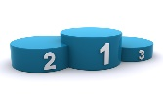
Tweets
News
Preprocessing
Segmented
tweets
Segmented
news
Graph Construction
Graph-Based
Connector and
Emotion Words
Extraction
Tweets graph
News graph
Ranked list
of patterns
Graph Reduction
Patterns Scoring
and Filtering
Emotion graph
Node Centrality Analysis
Node Clustering
Analysis
Connector words
Emotion words
List of pattern
candidates
Emotion Patterns Extraction

Slide 3
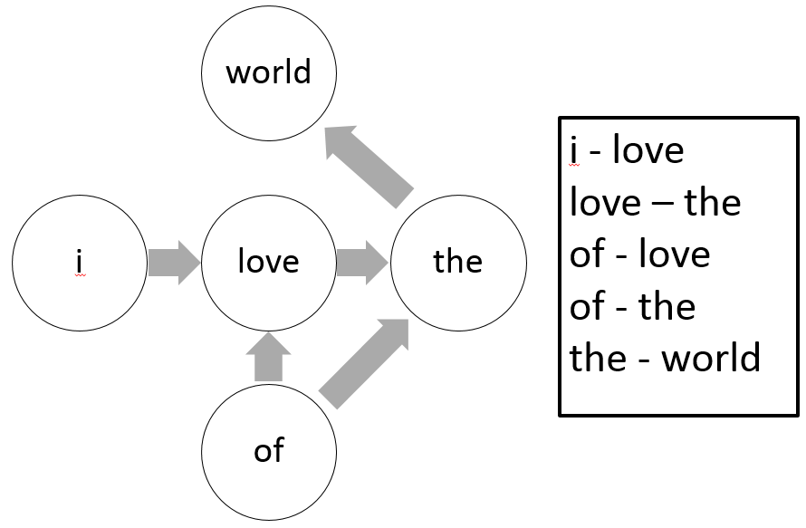
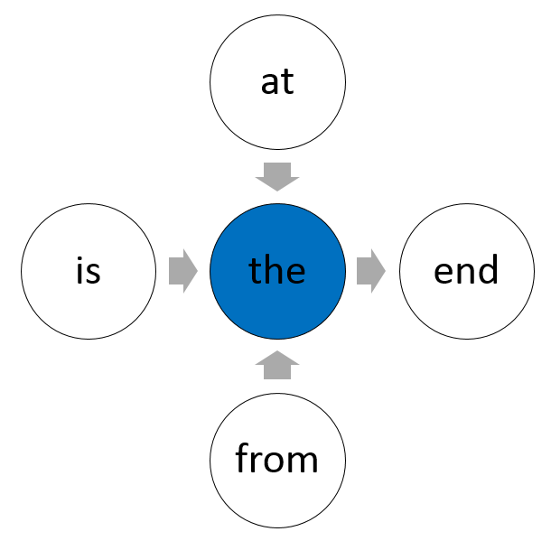
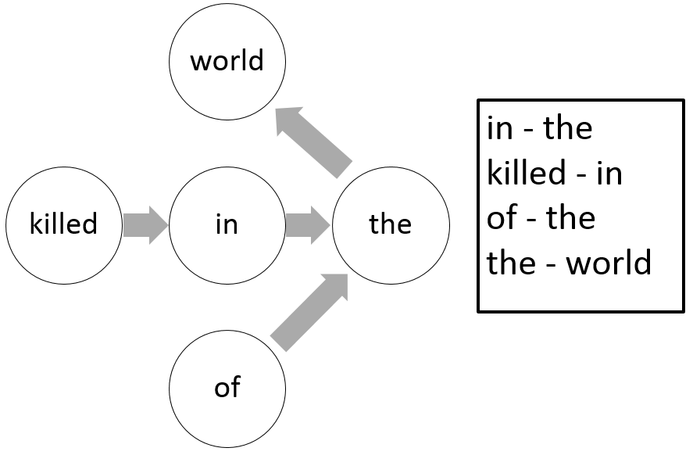
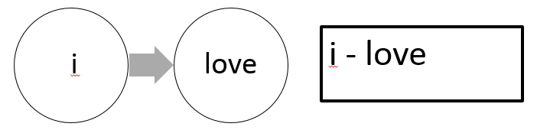
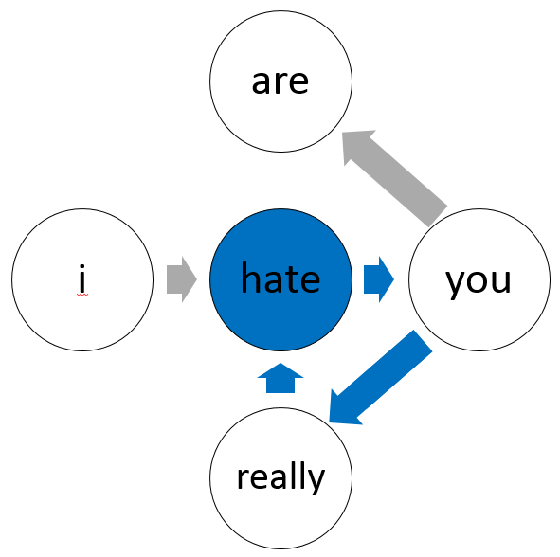
Tweets
News
Segmented
tweets
Segmented
news
Tweets graph
Preprocessing
Graph Construction
Connector words
News graph
Node Centrality Analysis
Emotion graph
Graph Reduction
Emotion words
Node Clustering
Analysis
List of pattern
candidates
Ranked list
of patterns
Patterns Extraction
Patterns Scoring
and Filtering

Slide 4
love
world
the
of
I
I - love
love – the
of - love
of - the
the - world

Slide 5
love
world
the
of
I
I - love
love – the
of - love
of - the
the - world

Slide 6
love
the
of
I
I - love
love – the
of - love

Slide 7
in
world
the
of
killed
in - the
killed - in
of - the
the - world

Slide 8
love
I
I - love

Slide 9
the
at
end
from
is

Slide 10
hate
are
you
really
I

